Slide 1
Introduction to Operating Systems
THrough tracing, analysis and experimentation
George Neville-Neil

Slide 2
Review of Processes

Slide 3
Review of Locking

Slide 4
Types of Memory
Stack
Automatic variables
Function call frames
Heap
Pretty much everything else
Caches
L1, L2, L3, etc.

Slide 5
The Illusion of Memory
How much memory can one process have?
Early UNIX VM systems built on 32 bit hardware
4,294,967,296 bytes
Modern systems based on 64 bits.
18,446,744,073,709,551,615 bytes
How does the OS manage this illusion?

Slide 6
A Brief History of Memory
Delay Line
Core
Dynamic RAM

Slide 7
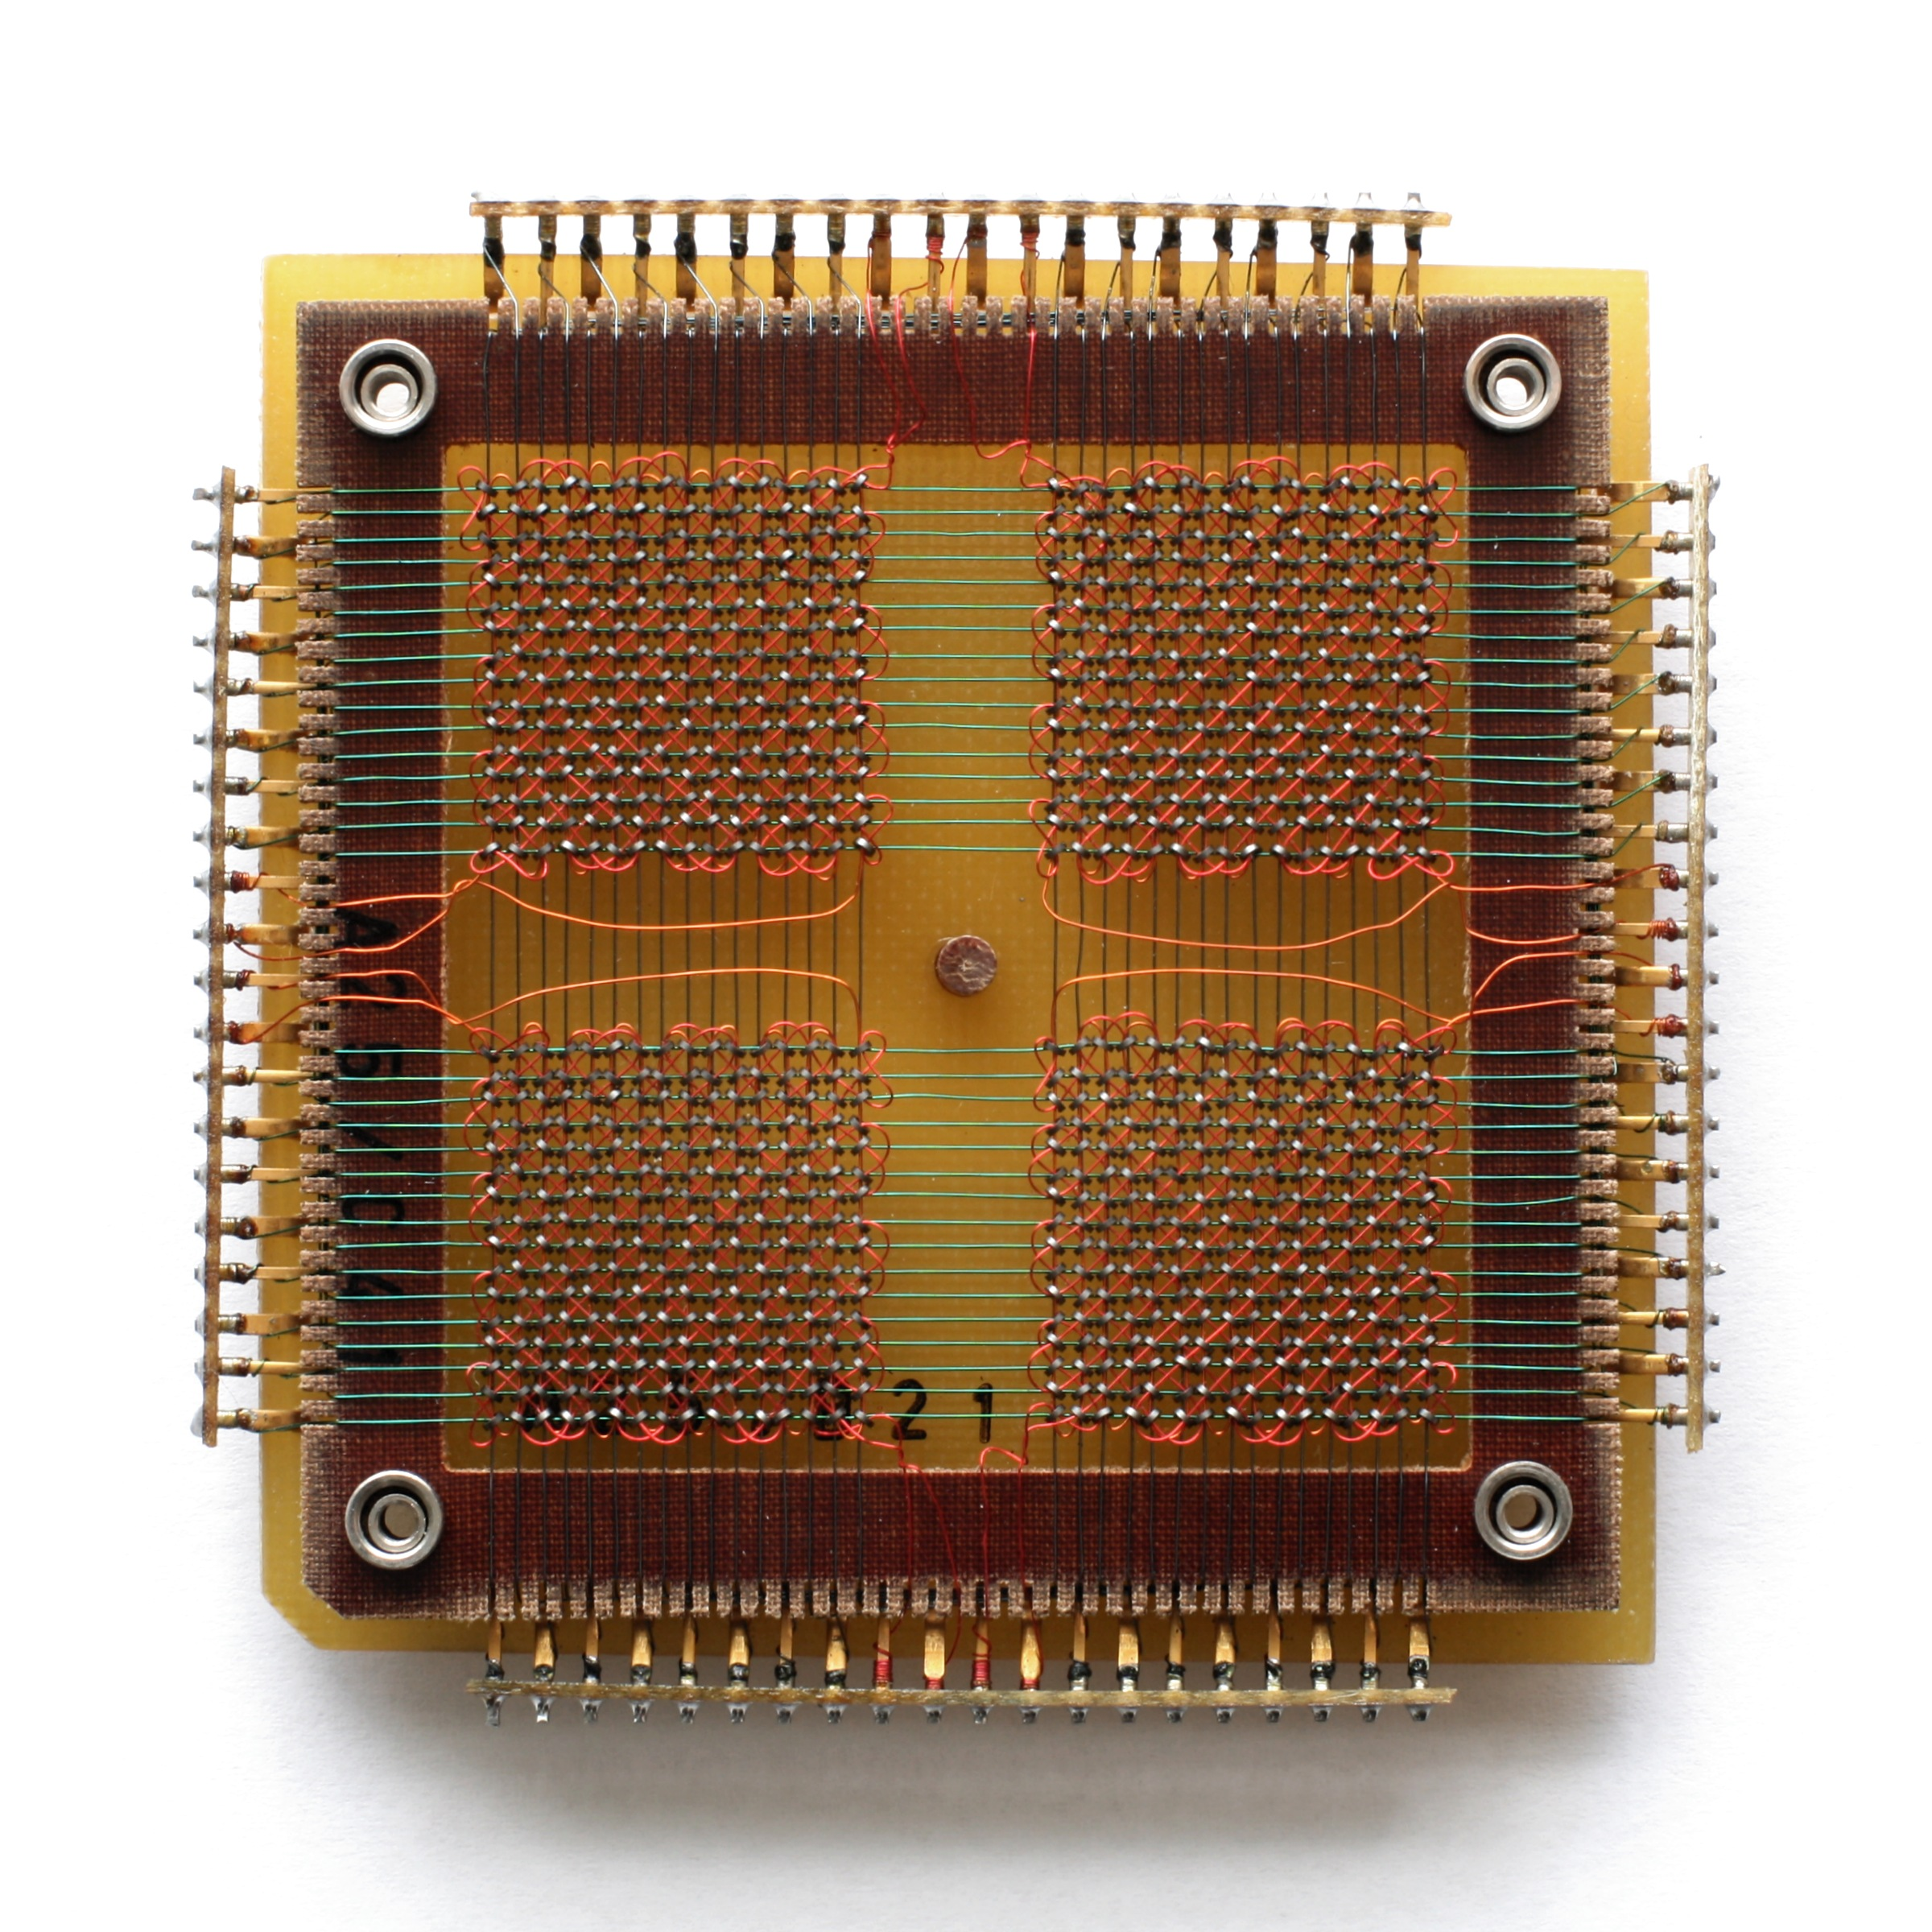
Core Memory

Slide 8
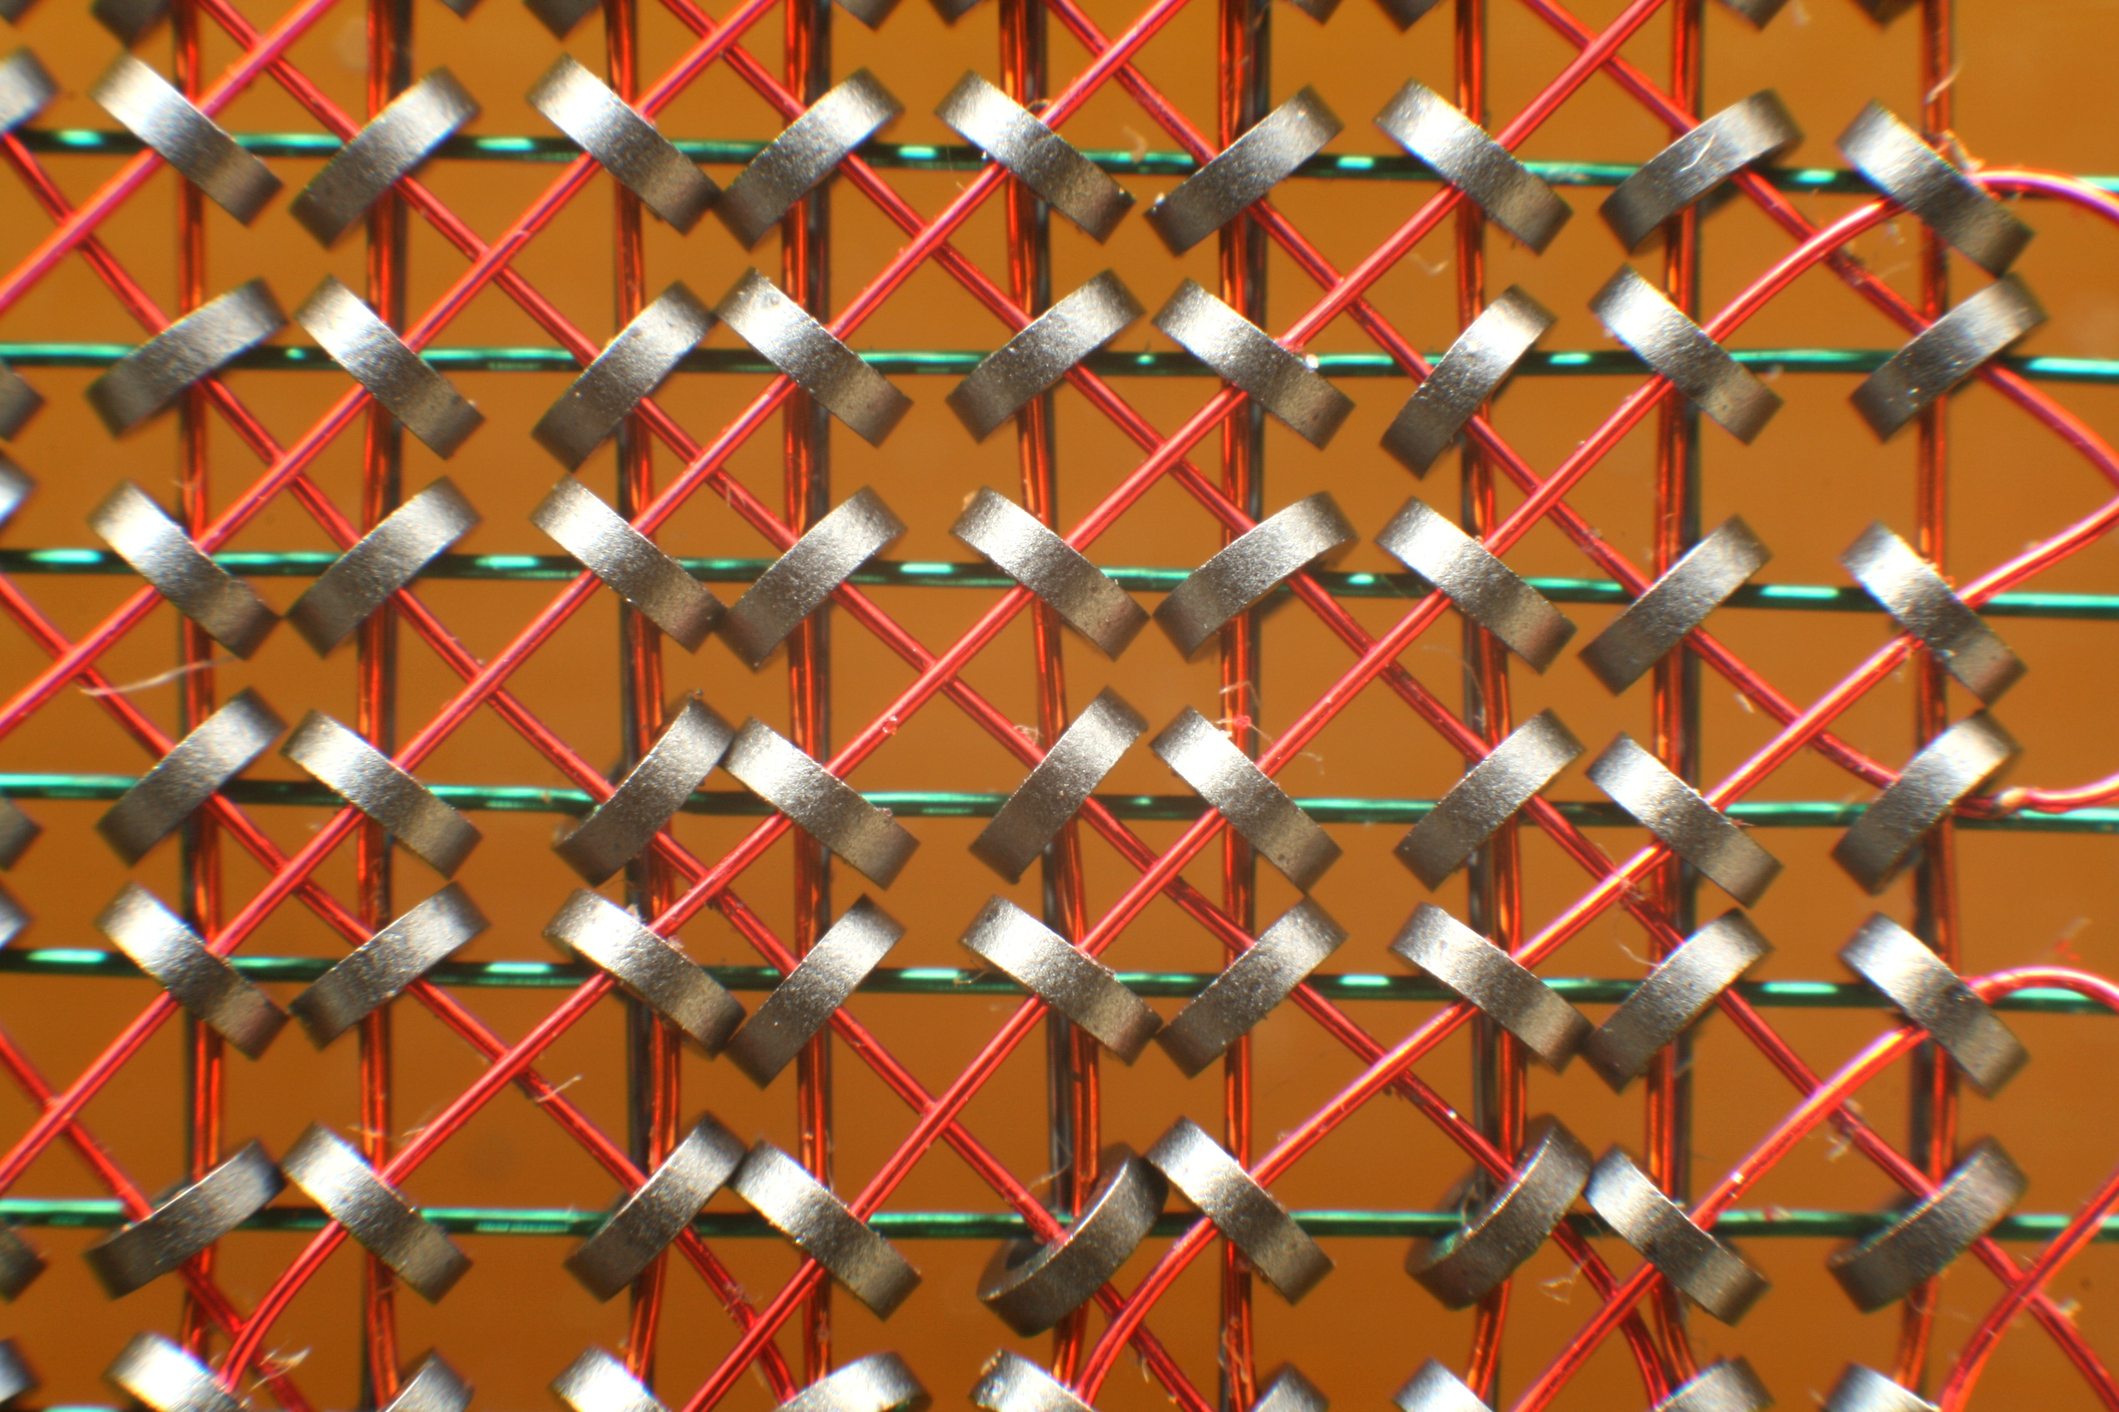
Cores Close Up

Slide 9
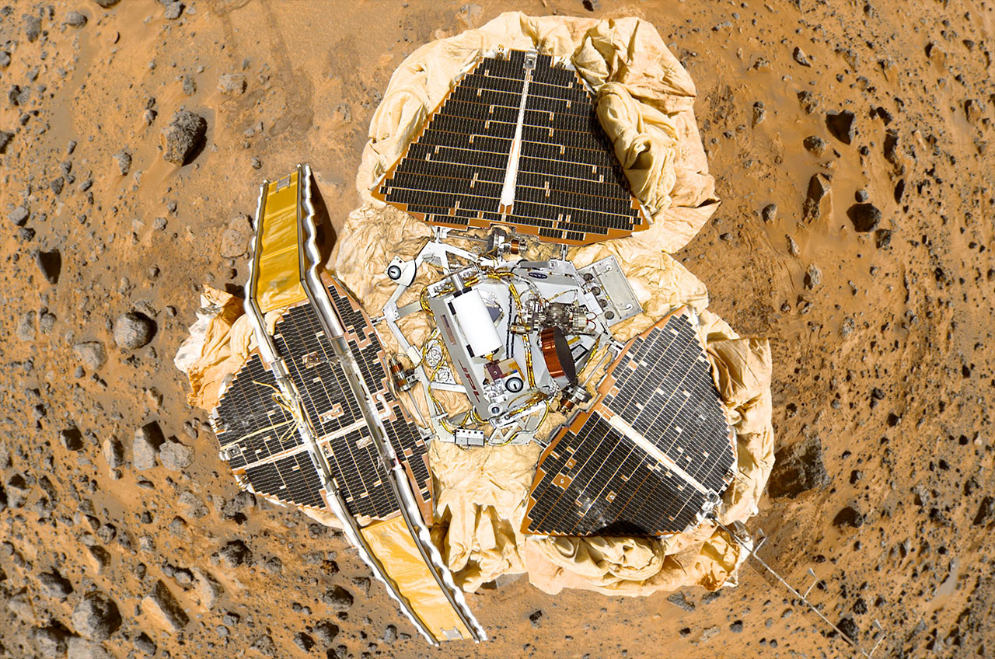
A World Without Virtual Memory
Single Address Space Systems
Embedded and Real Time Operating Systems (RTOS)
These still exist
There are several on Mars
There are even more in automotive braking systems

Slide 10
Advantages of Virtual Memory
Simplification Programs (mostly) don’t care about addresses.
Portability No memory location is more special than any other.
Protection All memory accesses go via the kernel.

Slide 11
High Level
Memory Management Unit (MMU)
Transforms virtual addresses into physical addresses
Memory is laid out in pages (4K, 2M, 1G…)
Control available only in supervisor mode
Software handles failures (e.g., permissions) via traps

Slide 12
Translating Addresses
The Translation Look-aside Buffer (TLB)
Hardware cache of entries -- avoid walking pagetables
Content Addressable Memory (CAM);
48? 1024? entries
TLB tags: entries are either global or for a specific process
Software- vs. hardware-managed TLBs

Slide 13
Virtual memory (quick but painful primer)

Slide 14
Virtual memory (quick but painful primer)
Memory Management Unit (MMU)
Transforms virtual addresses into physical addresses
Memory is laid out in virtual pages (4K, 2M, 1G, …)
Control available only to the supervisor (historically)
Software handles failures (e.g., permissions) via traps
Page tables
SW-managed page tables provide virtual-physical mappings
Access permissions, page attributes (e.g., caching), dirty bit
Various configurations + traps implement BSS, COW, sharing, ...
Translation Look-aside Buffer (TLB)
Hardware cache of entries – avoid walking pagetables
Content Addressable Memory (CAM); 48? 1024? entries
TLB tags: entries global or for a specific address-space ID (ASID)
Software- vs. hardware-managed TLBs

Slide 15
So: back to Virtual Memory (VM)
The process model’s isolation guarantees incur real expense
The VM subsystem works quite hard to avoid expense
Shared memory, copy-on-write, page flipping
Background page zeroing
Superpages to improve TLB efficiency
VM avoids work, but also manages memory footprint
Memory as a cache of secondary storage (files, swap)
Demand paging vs. I/O clustering
LRU / preemptive swapping to maintain free-page pool
Recently: memory compression and deduplication

Slide 16
Kernel programmer view of VM

Slide 17
Observing Virtual Memory

