Slide 1
Introduction to Operating Systems
THrough tracing, analysis and experimentation
gnn@freebsd.org

Slide 2
Review
History
UNIX Like Systems
Debugging and Tracing

Slide 3
Review: What is an Operating System?
Provider of useful abstractions
Generic interface to varied hardware resources
Controller of resources
Provider of basic security

Slide 4
The process model
The process model and its evolution
Where do programs come from?
Traps and system calls
An introduction to virtual memory

Slide 5
Before Processes and Virtual Memory
All code in a single address space
No memory protection
Each program must cooperate with all others
Core wars

Slide 6
What is a process?
Container for code
Protective shell between competing programs
The defining abstraction on which all modern computing rests

Slide 7
Process Contents
Open Files
Process Statistics
Resource Limits
Signal Actions
Process Identifier (PID)
Lists of related processes
Many Locks and Mutexes
Address Space
Alarms and Timers
Resource Usage
Threads
Debugging
Security
112 total fields

Slide 8
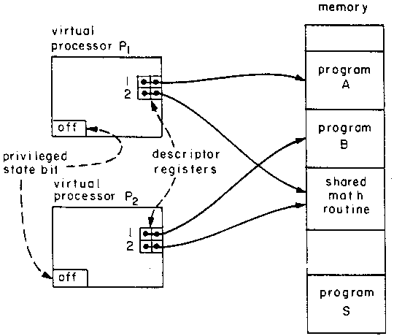
The Process Model: 1970s foundations
Saltzer and Schroeder, The Protection of Information in Computer Systems, SOSP’73, October 1973. (CACM 1974)
Multics process model
‘Program in execution’
Process isolation bridged by controlled communication via supervisor (kernel)
Hardware foundations
Supervisor mode
Memory segmentation
Trap mechanism
Hardware protection rings (Schroeder and Saltzer, 1972)

Slide 9
The process model: today
‘Program in execution’
Process ≈ address space
Threads execute code
Unit of resource accounting
Open files, memory, …
Kernel interaction via traps: system calls, page faults, ...
Hardware foundations
Rings control MMU, I/O, etc.
Virtual addressing (MMU) to construct virtual address spaces
Trap mechanism
Details vary little across {BSD, OS X, Linux, Windows, ...}
Recently: OS-Application trust model inverted due to untrustworthy operating systems: Trustzone, SGX

Slide 10
The UNIX process life cycle
fork()
Child inherits address space and other properties
Program prepares process for new binary (e.g., stdio)
Copy-on-Write (COW)
execve()
Kernel replaces address space, loads new binary, starts execution
exit()
Process can terminate self (or be terminated)
wait4() (et al)
Parent can await exit status

Slide 11
Evolution of the process model
1980s: Code, heap, and stack
1990s: Dynamic linking, threading
2000s: Scalable memory allocators implement multiple arenas (e.g., as in jemalloc)
Co-evolution with virtual memory research
Acetta, et al: Mach microkernel (1986)
Nararro, et al Superpages (2002)

Slide 12
Observing the Process Lifecycle
DTrace can follow all system calls
Tracing the fork() system call
dtrace −n ’syscall::∗fork:entry { @forks[execname] = count();} ’
dtrace : description ’ syscall ::∗ fork : entry ’ matched 8 probes
^C
csh 7031
Notes:
Why o we use a wild card?

Slide 13
Tracing with the proc Provider
exec | Program execution attempt
exec-failure | Program start failed
exec-success | Program successfully started
exit | Program terminated
signal-send | Send a signal
signal-clear | Cleared a signal
signal-discard | Signal ignored

Slide 14
Scheduling
Control over CPU resources
Which process or thread can run now?

Slide 15
The Scheduler
Decides which thread gets to run
The thread is the scheduable entity
Chooses a processor/core
Can be overridden by cpuset

Slide 16
Process States
NEW | Being created
RUNNABLE | Can run
SLEEPING | Awaiting some event
STOPPED | Debugging
ZOMBIE | In the process of dying

Slide 17
Scheduling Classes
Priority Range | Class Name | Usage
0-47 | ITHD | interrupt thread
48-79 | REALTIME | real-time user
88-119 | KERN | kernel threads
120-223 | TIMESHARE | normal user programs
224-255 | IDLE | run when nothing else does

Slide 18
Sched Provider
on-cpu | Thread moves onto a core
off-cpu | Thread moves off of a core
remain-cpu | Thread remains on core
change-pri | Priority changed
fbt:kernel:cpu_idle:entry | Thread went idle

Slide 19
Context Switching
Processes all believe they own the computer
Context switching maintains this fiction
Requires saving and restoring state
Common measure of operating system performance
cswstat.d measures overall context switching

Slide 20
What is Locking, and why do we need it?
Protection of shared resources
Prevent incorrect updates
Required in OS kernels before multi-core systems
Devices are a source of asynchronous events

Slide 21
A Sample Locking Protocol
All subway trains must be separated by one block
When a train is in a block the two signals following must be red.
No subway train may pass a red signal

Slide 22

Locking and Safety
Block 1
Block 2
Block 3

Slide 23
CPUs, Cores, Threads and Locking
Past the end of frequency scaling
One CPU die has many cores
The number of cores increases year on year
ARMv8 has 48 cores per die, 96 cores per system
The kernel may now be the largest multi-threaded program in history.

Slide 24
Locking Overview
Multiple hardware threads
Protection for kernel shared state
The kernel’s lists and hash tables
Locking required for multi-core systems

Slide 25
What is locked in the kernel?
Processes
File Systems
Name Cache
Network Sockets
Routing Tables
Interface Lists
Firewall Rules
Virtual Memory System
All Device Drivers
Timers and Callouts
Terminals and Console
Network Protocol Lists
Any shared resource

Slide 26
The Problems of Locking
Deadlock | System unable to make forward progress
Starvation | One part of the system always gets the lock

Slide 27
DEADLOCK
Thread A
Thread B
Thread A takes a lock
on Shared Data A
Thread B takes a lock
on Shared Data A
Thread A tries to lock
Shared Data B
Shared
Data A
Shared
Data B
Thread B tries to lock
Shared Data A

Slide 28
Code Locking Strategies
Giant Lock One big lock around the kernel
List Locks Lock every list in the kernel
Structure Locks Lock individual structures
Poorly chosen locking strategies impact performance

Slide 29
Lock Types
spin Check a value in a tight loop
mutex Mutual exclusion lock
Spin to acquire
None shall pass
r/w lock Reader/writer lock
Supports multiple, simultaneous readers or a single writer
r/m lock Read mostly lock
Reader writer lock tuned for very few writers
sx lock Shared/exclusive lock
Can be held while sleeping

Slide 30
The lockstat provider
All lock types have similar probes, 29 total probes in all
acquire Code grabbed the lock
block Another thread was blocked
spin Thread is spinning on the lock
release Lock is released
Arguments:
arg0 Address of the lock object
arg1 Lock or spin count

Slide 31
Visualizing Locks with DTrace

Slide 32
Who is using locks?
dtrace -n 'lockstat::: { @locks[execname] = count();} '

Slide 33
Locking Review
Protection of shared resources
Prevent incorrect updates
Types of locks in FreeBSD
spin Spin the CPU
mutex Most basic lock
r/w lock Reader/writer lock
sx lock Shared/exclusive lock
The lockstat provider

