Slide 1
Introduction to Operating Systems
THrough tracing, analysis and experimentation
george neville-neil

Slide 2
Objectives
A grounding in systems principles
A grand tour of the Operating System
Practical insights into how the OS works

Slide 3
Course Outline
Day 1
Day 2
High Level Definitions
History
Introduction to Tracing
Lab 1: System Setup and First Traces
Quiz
Processes
Locking
Scheduling
Virtual Memory
Lab 2: Tracking Processes

Slide 4
Course Outline
Day 3: Communication
Day 4: storing data
I/O
Inter Process Communication
Sockets and Network Communication
Lab 3: TCP Connection Setup
Storage Overview
Naming and Location
Virtual Filesystem Layer
Storing and Retrieving Data
Lab 4: Reading a file from disk

Slide 5
Course Outline
day 5: Whole system view
Serving Web Content
NGINX
Review
Final Exam

Slide 6
Lab Work
Tracing Systems Setup, Begin using DTrace
Processes Tracing the Process Life Cycle
Communication Networking and TCP
Storage Storing and Retrieving Data

Slide 7
What do computers do?
Processing Converting information from one form to another.
Communication Moving information between one or more systems.
Storage Maintaining information over time.

Slide 8
What is an Operating System?

Slide 9
What is an Operating System?
[An OS is] the low-level software that supports a computer’s basic functions, such as scheduling tasks and controlling peripherals. - Google hive mind

Slide 10
General purpose operating systems
... are for general-purpose computers
• Servers, workstations, mobile devices
• Run ‘applications’ – i.e., software unknown at design time
• Abstract the hardware, provide ‘class libraries’
• E.g., Windows, Mac OS X, Android, iOS, Linux, FreeBSD,
...

Slide 11
General-purpose operating systems
User space
Kernel
Local and remote shells
management tools
daemons
Run-time linker
system libraries
tracing facilities
System calls
hypercalls
remote procedure call (RPC)
Processes
filesystems
IPC
sockets
System Call Interface

Slide 12
What does an operating system do?
Key hardware-software surface (cf. compilers)
System management: bootstrap, shutdown, watchdogs
Low-level abstractions and services
Programming: processes, threads, IPC, program model
Resource sharing: scheduling, multiplexing, virtualisation
I/O: device drivers, local/distributed filesystems, network stack
Security: authentication, encryption, permissions, labels, audit
Local or remote access: console, window system, SSH
Libraries: math, protocols, RPC, cryptography, UI, multimedia
Other stuff: system log, debugging, profiling, tracing

Slide 13
Key Functions of an Operating System
Provides the Programming Model
Protects Programs from each other
Controls access to hardware
Ensures fair sharing of resources
Does all these things efficiently

Slide 14
What an Operating System is
A single large program
Written in the C language
Built with make
More than 20, 000 files
12, 000, 000 lines of code

Slide 15
Why study operating systems?
Key interface between hardware and software
Strong influence on whole-system performance
Critical foundation for computer security
Exciting programming techniques, algorithms, problems
Virtual memory; network stacks; filesystems; runtime linkers; ...
Co-evolves with platforms, applications, users
Multiple active research communities
Reusable techniques for building complex systems
Boatloads of fun (best text adventure ever)

Slide 16
FreeBSD
Open Source
Unix
Posix
Complete System
20 years of history
Used in real systems around the world

Slide 17
Computer History from the Operating System Perspective
The Hardware Environment
Defines what is possible.
Requirements
What are we asking the system to do?
Services
What can the OS provide.

Slide 18
In the beginning: early computers
Wired programs
Highly specialized to only one problem
Armies of programmers tend a single machine

Slide 19
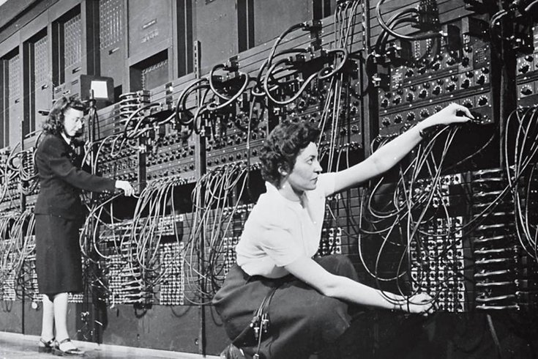
The First Programmers

Slide 20
Early Computers
Processing measured in hundres of Hz
Tiny memories
Limited to no input/output devices
Not much for an Operating System to do or provide

Slide 21
Mainframes and Batch Processing
Standardized input/output with cards
One program at a time (batch processing) • No interactive programming
Early disks and printers
What is a byte?
The rise of computer languages.
Earliest operating systems (monitors)

Slide 22
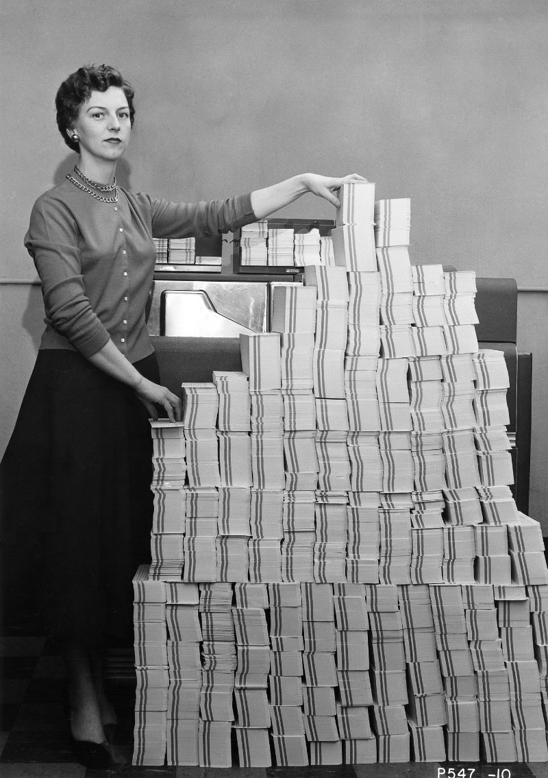
5Mb of Source Code

Slide 23
Mini-computers and Time Sharing Systems
Shrinking hardware and affordable computing resources
CTSS
MULTICS
C, the portable assembler
UNIX
(D)ARPANet

Slide 24
The Unix Kernel
Everything Else
System Calls
Kernel

Slide 25
The Rise of the Microcomputer
LSI shrinks hardware onto the first chip based processors • Moore’s Law
Less powerful than mini-computers
8-bitting
Single user
No networking
Operating System is a monitor and convience routines

Slide 26
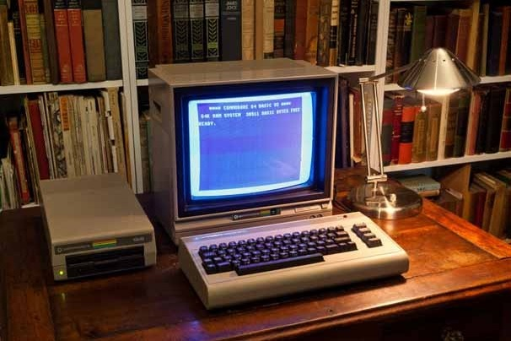
A typical microcomputer 1982

Slide 27
Workstations and Networking
VLSI provides faster and more powerful CPUs
Graphical Displays (X10 and X11)
Ethernet
TCP/IP
UNIX is the de-facto standard, sort of

Slide 28
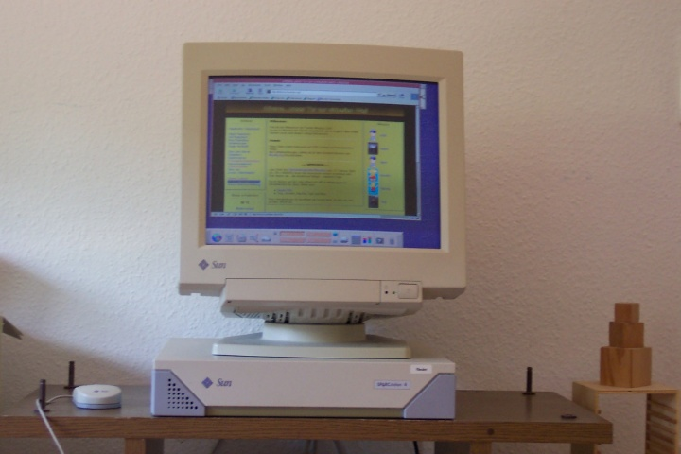
Workstation from the 1990s

Slide 29
Embedded and Real Time Systems
Applied kernel programming
Tasks have deadlines
Failure is not an option
Often forgo more expensive UNIX like features

Slide 30
Mobile Devices and the Ubiquitous Internet
Sensors
Always connected
A return to single user, but with a multi-user OS
Programming for power rather than speed

Slide 31
Today
Multi-user Unix like systems everywhere
Continued use of C for OS development
Heterogeneous environments

Slide 32
Our Challenge
How does data move in a real world system?
Serving Data from Storage to Clients
Program Web Server
Stored Data Filesystem
Communication Network Stack

Slide 33
UNIX Philosophies
Everything is a byte stream
Do a small number of things well
Build complex systems out of simple building blocks
Swiss Army Knife vs. Toolbox

Slide 34
Some Special Considerations
An OS kernel is one, large program.
More than 50, 000 functions.
5677 files
5, 131, 552 lines of C code just for the kernel
A unique programming environment

Slide 35
Design and Implementation Requirements
Fast Low overhead, high performaance
Safe Secure, tractable
Flexible Can be used by many applications

Slide 36
User vs. Kernel Space
User space
Kernel
Local and remote shells
management tools
daemons
Run-time linker
system libraries
tracing facilities
System calls
hypercalls
remote procedure call (RPC)
Processes
filesystems
IPC
sockets
System Call Interface

Slide 37
System Calls: The Operating System’s API
Border between User and Kernel Space
Everything that can be done with the OS
open(), read(), write(), close()
Over 1000 separate interfaces
Section 2 of the manual set
> man 2 open

Slide 38
OS Programming
C is the programming language
Simple data structures
Lists
Hash Tables
Hand crafted classes and objects
Programming without a net

Slide 39
Competing Kernel Architectures
Micro-Kernel
Monolithic
Kernel is Only a Scheduler
Services Model
in-kernel IPC
POSIX as a service
Mach, Barrelfish, L4
One big program
Function Calls
System Call API
FreeBSD, Linux, Windows

Slide 40
Review: What an Operating System Does

