Slide 1
Grammar Correction

Slide 2
Table of contents
01
02
03
04
05
Problem Statement
Proposed solution
Methodology
Results & Comparison
Conclusion & Q&A

Slide 3
01
Problem Statement

Slide 4
Problem statement
Key Issues
Grammatical errors degrade communication quality in emails, documents, and apps.
Rule-based systems fail to handle complex or contextual errors.
State-of-the-art models (like Khan et al.’s T5 ensemble) require heavy computation.
Our Goal
Develop an accurate yet efficient grammar correction system using transformers.

Slide 5
02
Proposed Solution

Slide 6
Proposed solution
Approach
Model Selection: Compared T5 (text-to-text) vs. BART (denoising).
Efficient Fine-Tuning: Achieved 96.4% accuracy with only 10K samples and 1 epoch.
Deployment: Flask API for real-time corrections.
Why BART?
96.4% accuracy vs. T5’s 66.3%
Stable training (no NaN issues)
Natural-sounding outputs

Slide 7
03
Methodology

Slide 8
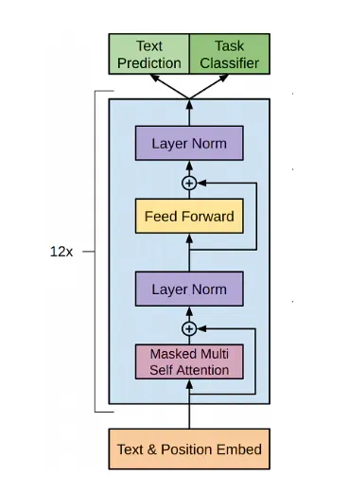
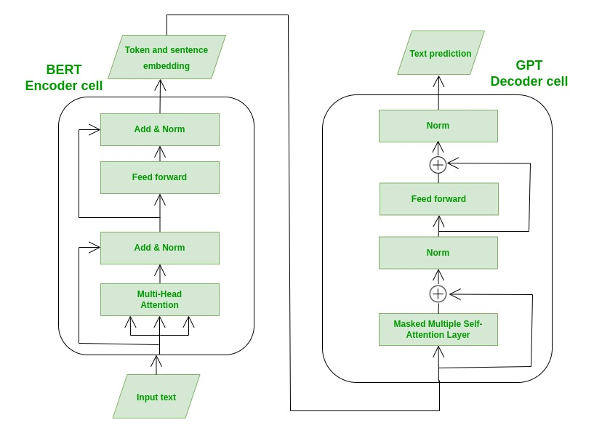
Model Architecture
BART
BERT

Slide 9
Data Flow
Visual
Input: User sends text via API (e.g., "She go to school").
Preprocessing: Prefix added ("fix grammar: She go to school").
Inference: BART generates correction ("She goes to school.").
Output: JSON response returned.
User → Flask API → BART Model → Corrected Text

Slide 10
Deployment
Code Showcase
Downloaded model after training for deployment
Input data taken as JSON
Data is formatted properly then input to model
Output is reformatted and returned as JSON

Slide 11
04
Results & Comparison

Slide 12
Our BART vs. Khan et al. (2023)
Metric | Our BART | Khan et al. (T5)
Accuracy | 96.4% | 98.2%
Training Data | 10K | 500K
Epochs | 1 | 5
Deployment | Flask API | Research-only
Takeaway: Near-state-of-the-art performance with 10× less data.

Slide 13
05
Conclusion & Q&A

Slide 14
Summary
Q&A Open floor for questions
BART outperforms T5 in accuracy and stability.
Our API makes grammar correction accessible.
Achieved SOTA-competitive results efficiently.

