Slide 1
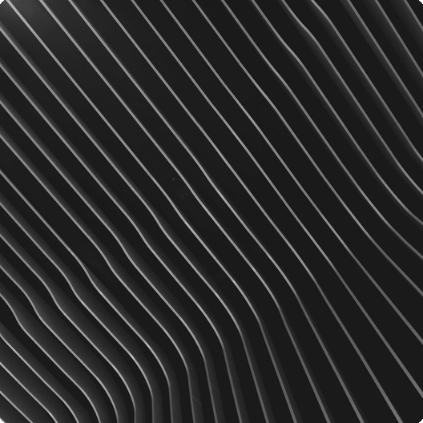
Everything is Made of Particles
Everything is made of tiny, moving particles, even solids! In solids, particles are close and vibrate. In liquids and gases, they move more freely, causing diffusion. This movement is key to understanding matter.

Slide 2
01
Random Movement
Diffusion occurs due to the random movement of particles, spreading them out over time. This movement creates equilibrium.
Diffusion: Mixing of Particles
Diffusion is the mixing of particles from high to low concentration areas until evenly spread.
02
Concentration Gradient
Particles move from high to low concentration until evenly spread. Perfume spreading in a room is a great example.

Slide 3

Types of Particles
Atoms
Molecules
Atoms are the smallest particles that cannot be broken down chemically; they are the fundamental building blocks.
Molecules are two or more atoms joined together, such as water (H2O) or oxygen (O2).

Slide 4


States of Matter: Solids
Definite Shape/Volume
Incompressible
Solids maintain their shape and volume because their particles are tightly packed and vibrate in fixed positions.
Solids are incompressible due to tightly packed particles, making it difficult to squeeze them.

Slide 5


Fluidity
Liquids flow easily because their particles are close but can move around, adapting to the container shape.
States of Matter: Liquids
Liquids have definite volume but no definite shape. They flow easily as their particles can move around.
Volume Constancy
Liquids maintain a constant volume, regardless of the container shape. They are relatively incompressible.

Slide 6
States of Matter: Gases
01
02
03
No Definite Form
Compressible
Rapid Movement
Gases have no definite shape or volume, filling any container completely and expanding to fit.
Gases are easily compressed because their particles are far apart and move rapidly.
Particles in gases are far apart and move rapidly, filling their container completely.

Slide 7


Changes of State
Melting
Freezing
Boiling
Melting is the change from solid to liquid due to increased temperature.
Freezing is the change from liquid to solid due to decreased temperature.
Boiling is the change from liquid to gas due to increased temperature.

Slide 8
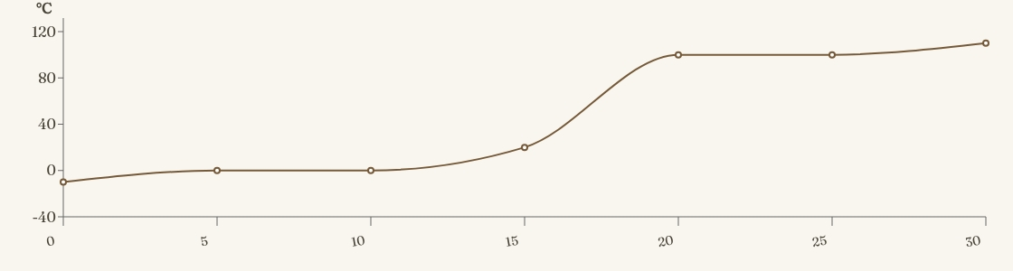
Heating Curve
A heating curve shows temperature changes as a substance is heated. Plateaus indicate state changes (melting/boiling) where temperature remains constant as energy is used to change state.

