Slide 1
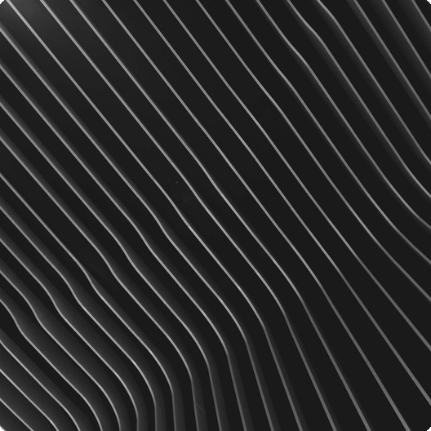
Everything is Made of Particles
Everything around us consists of tiny, constantly moving particles. In solids, they're close and vibrate; in liquids/gases, they move more freely, causing `diffusion`. This motion defines matter's properties.

Slide 2
01
Concentration Gradient
Particles move from areas of high concentration to areas of low concentration. This process continues until particles are evenly distributed.
Diffusion: Mixing of Particles
`Diffusion` mixes particles via random movement from high to low concentration until evenly spread. It's faster in gases due to quicker particle movement.
02
Gas vs Liquid
Diffusion occurs more rapidly in gases compared to liquids due to the higher kinetic energy and greater freedom of movement of gas particles.

Slide 3


Atoms
The smallest particles that cannot be chemically broken down, like argon. They are the fundamental building blocks of matter, retaining the element's properties.
Types of Particles
Matter comprises atoms, molecules, and ions. Atoms are the smallest units; molecules are atom combinations; ions are charged atoms or atom groups.
Molecules
Two or more atoms joined together, such as water or oxygen. They form through chemical bonds and exhibit distinct properties based on their composition.

Slide 4


States of Matter: Solids
Definite Shape
Incompressible
Solids maintain a fixed shape and volume. Their strong inter-particle forces restrict movement, allowing only vibration in fixed positions.
Solids resist compression due to the close proximity of their particles. Applying pressure has minimal effect on their volume.

Slide 5


States of Matter: Liquids
Definite Volume
Incompressible
Liquids maintain a fixed volume but adapt to the shape of their container. Particles are close but can move, enabling flow.
Liquids resist compression due to the close proximity of their particles. Applying pressure has minimal effect on their volume.

Slide 6

States of Matter: Gases
No Definite Volume
Compressible
Gases lack a fixed shape or volume, expanding to fill their container. Particles are far apart and move rapidly and randomly.
Gases are easily compressed due to the large spaces between their particles. Volume decreases significantly under pressure.

Slide 7
Changes of State
01
02
03
Melting
Boiling
Condensation
The transition from a solid to a liquid state. Heat energy increases particle motion, overcoming inter-particle forces.
The transition from a liquid to a gaseous state. Heat energy provides particles with enough kinetic energy to escape the liquid's surface.
The transition from a gaseous to a liquid state. Cooling reduces particle motion, allowing inter-particle forces to draw them closer together.

Slide 8
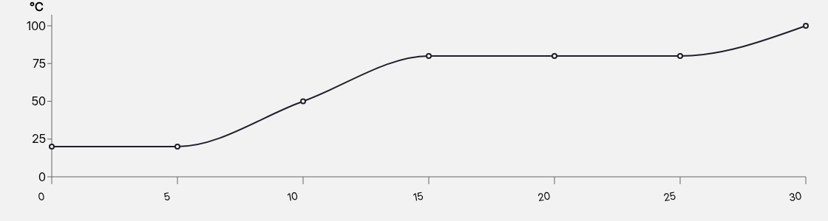
Heating Curve
Heating curves illustrate temperature changes as a substance heats. Plateaus signify state changes (melting/boiling), with constant temperature and plateau length indicating energy needed.

Slide 9
01
Solids
Particles are closely packed in a regular arrangement. This arrangement gives solids their definite shape and volume.
Particle Arrangement
Particle arrangement differs across states: solids have regular, close packing; liquids have close, random arrangement; gases have far apart, random arrangement.
02
Liquids
Particles are close together but randomly arranged. This allows liquids to flow and take the shape of their container.

Slide 10


Gas Pressure
Caused by gas particles colliding with the walls of their container. More collisions result in higher pressure within the container.
A Closer Look at Gases
Gas pressure arises from particle collisions with container walls. More collisions raise pressure, increased by temperature or decreased volume, measured in Pascals or atmospheres.
Pressure Measurement
Pressure is measured in Pascals (Pa) or atmospheres (atm). These units quantify the force exerted by gas particles per unit area.

