Slide 1
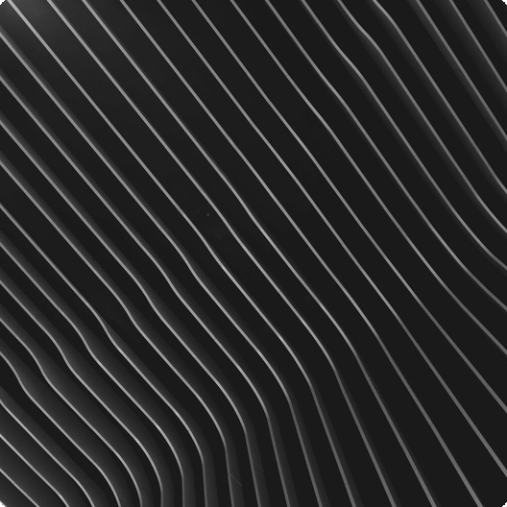
Unlocking the Secrets of Matter
Explore the fundamental building blocks of our universe. From the smallest particles to the largest structures, discover the secrets that govern matter's behavior and transformations. Understand the essence of everything around us.

Slide 2


Concentration Gradient
Particles move from areas of high concentration to areas of low concentration until evenly spread, driven by the concentration gradient.
Diffusion: Mixing of Particles
Diffusion is crucial for various natural processes. It's the net movement of anything from a region of higher concentration to a region of lower concentration.
Faster in Gases
Diffusion happens faster in gases than in liquids because gas particles move more rapidly due to higher kinetic energy.

Slide 3
01
Atoms
Atoms are the smallest particles of an element that retain its chemical properties and cannot be broken down chemically by ordinary means.
Types of Particles
02
Molecules
Molecules are formed when two or more atoms are chemically bonded together, representing the smallest unit of a compound.
Matter is composed of various types of particles, each with unique characteristics. Understanding these differences is fundamental to chemistry.
03
Ions
Ions are atoms or molecules that have gained or lost electrons, resulting in a net electrical charge, either positive or negative.

Slide 4



States of Matter: Solids
Definite Shape
Fixed Positions
Incompressible
Solids maintain a definite shape and volume because their particles are tightly packed and strongly bound in fixed positions.
Particles in solids vibrate in fixed positions and cannot move freely, contributing to their rigidity and resistance to deformation.
Solids are nearly incompressible due to the close proximity of their particles, making it difficult to reduce their volume significantly.

Slide 5
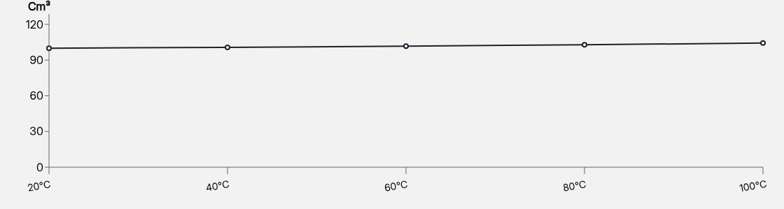
States of Matter: Liquids
Liquids exhibit unique properties due to the arrangement and movement of their particles, which are close but can slide past each other. Understand the characteristics.

Slide 6
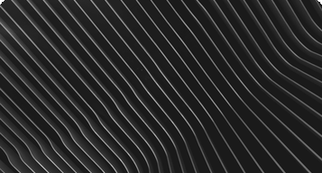
States of Matter: Gases
No Definite Volume
Rapid Movement
Easily Compressed
Gases lack a definite shape or volume, expanding to fill any available space due to the weak intermolecular forces between particles.
Gas particles move rapidly and randomly, with high kinetic energy, leading to frequent collisions and contributing to gas pressure.
Gases are easily compressed because their particles are far apart, allowing them to be pushed closer together with applied pressure.

Slide 7
Changes of State
01
Melting
02
Boiling
Melting is the phase transition from solid to liquid, occurring when a substance absorbs enough heat to overcome intermolecular forces.
Boiling is the phase transition from liquid to gas, characterized by rapid vaporization throughout the liquid at the boiling point.
03
Sublimation
04
Condensation
Sublimation is the direct transition from solid to gas, bypassing the liquid phase, as seen with dry ice at room temperature.
Condensation is the phase transition from gas to liquid, typically occurring when a gas is cooled to its dew point temperature.

Slide 8
01
Gas Pressure
Gas pressure results from gas particles colliding with the walls of their container, with more frequent collisions leading to higher pressure.
A Closer Look at Gases
02
Temperature Impact
Increasing temperature increases gas pressure, as particles move faster and collide more forcefully with the container walls.
Gases exhibit unique properties due to the behavior of their particles. Pressure is influenced by temperature and volume changes.
03
Volume Influence
Decreasing volume increases gas pressure, as particles have less space to move and collide more frequently with the container walls.

