Slide 1
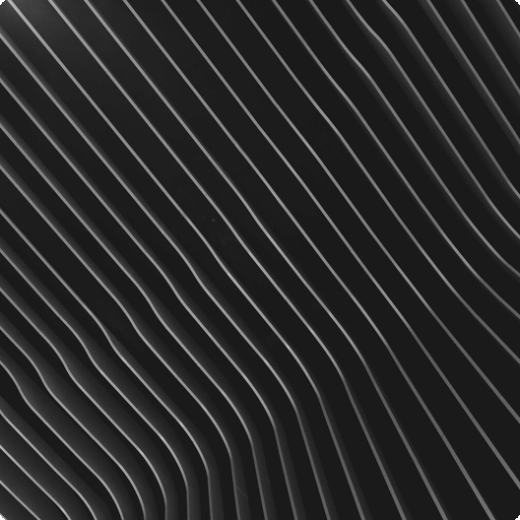
Everything is Made of Particles
The world is composed of minuscule particles, invisible to the naked eye, constantly in motion. Solids feature tightly packed, vibrating particles, while liquids and gases exhibit more freedom. This motion leads to diffusion.

Slide 2
01
Concentration Gradient
Particles move from areas of high concentration to low concentration, seeking equilibrium. This is fundamental to diffusion processes in various media.
Diffusion: Mixing of Particles
Diffusion is the process where particles mix due to their random movement, moving from areas of high to low concentration until evenly spread.
02
Even Distribution
The diffusion process continues until the particles are evenly distributed throughout the available space, creating a uniform mixture.

Slide 3



Types of Particles
Atoms
Molecules
Ions
Atoms are the basic building blocks of matter and cannot be broken down chemically by any means. They determine the properties of elements.
Molecules consist of two or more atoms held together by chemical bonds. They can be made of the same element or different elements.
Ions are atoms or molecules that have gained or lost electrons, giving them an electrical charge. They play a key role in ionic compounds.

Slide 4


Fixed Shape
Solids retain their shape unless acted upon by an external force, due to the strong intermolecular forces between their particles.
States of Matter: Solids
Solids maintain a fixed shape and volume due to their tightly packed particles that vibrate in place, resisting compression and flow.
Incompressibility
The tightly packed nature of particles in solids makes them difficult to compress, as there is little space between the particles.

Slide 5
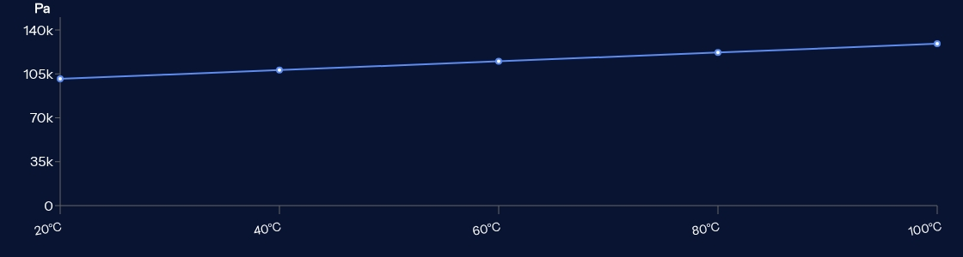
A Closer Look at Gases
Gas pressure arises from the collisions of gas particles against container walls. Increased collisions elevate pressure, which can be influenced by temperature and volume.

