Slide 1
BABY MONITORING SYSTEM
PRESENTER:
FARHA IMTHIYAZ

Slide 2
Roadmap of Presentation
Problem & Solution
Diagram
System Components
Artefact Pictures
Blynk Dashboards
System Functions
Strengths & Weakness
Future Improvements
Conclusion

Slide 3
Problem & Solution
Problem
Now a days every parents are busy with office works and home works. When baby crying Parents can’t do any works. They need to care the baby. So, all the works will be remaining.
Solution
So, I have created Baby Monitoring System to reduce the pressure of parents from a monitoring infant child through their devices and they can also control actuators manually.

Slide 4
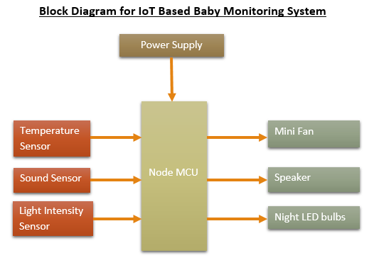
Diagrams

Slide 5
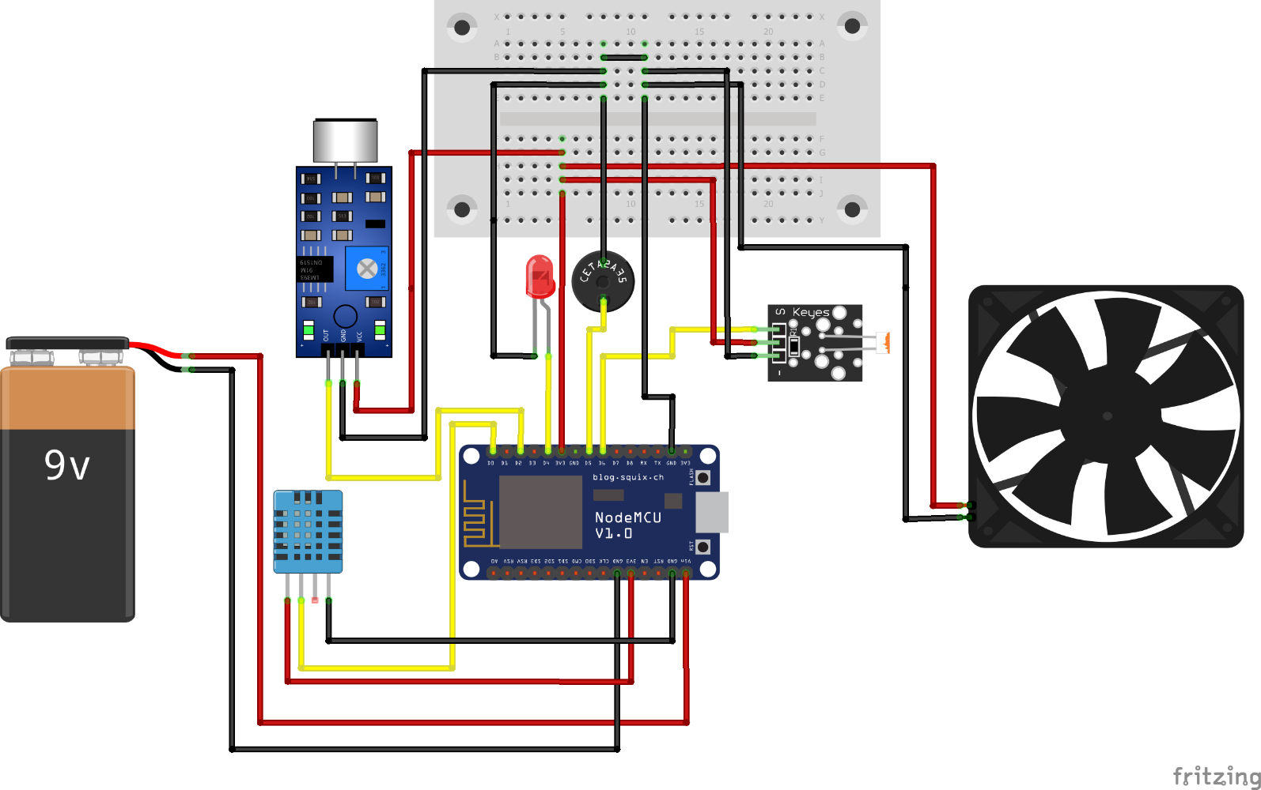
Diagrams (Cont..)
Schematic Diagram for BMS

Slide 6
System Components
Sensors | Actuators
Temperature sensor (DHT21)- to measure the baby’s room Temperature. | Mini Fan- To get the air to the baby living room.
Light Intensity Sensor (Keys Photo Resister Sensor)- to measure the light intensity of baby living room. | Small LED bulbs- To produce light for baby living room.
Sound sensor- To detect strength of sound (Cry detection) of baby. | Speaker- To play music for baby.

Slide 7
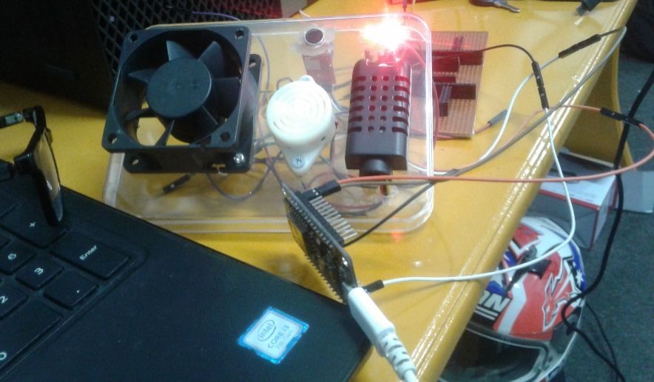
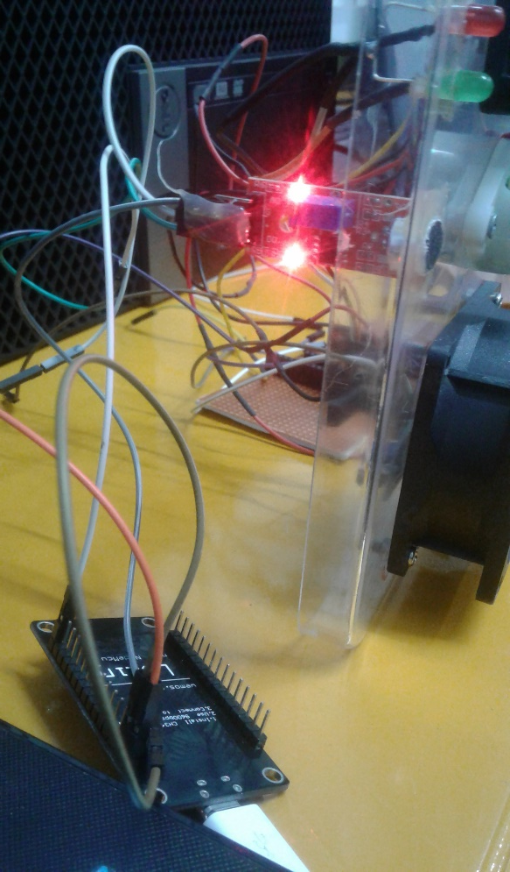
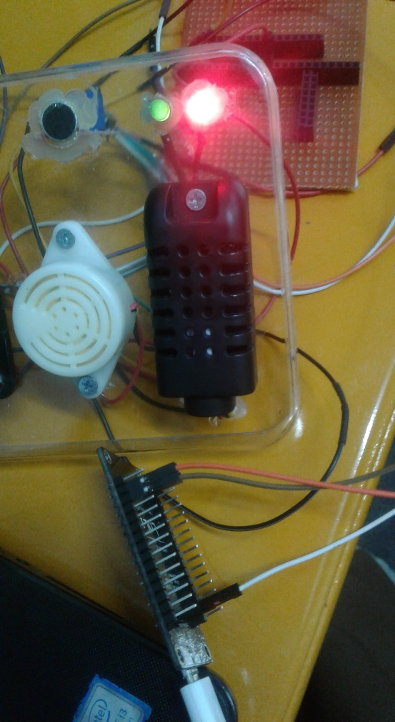
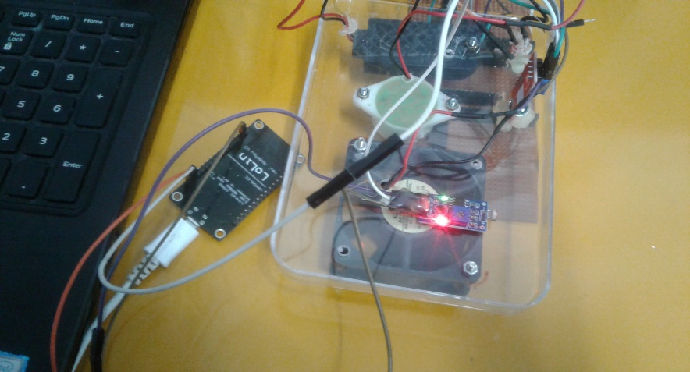
Artefact Pictures

Slide 8
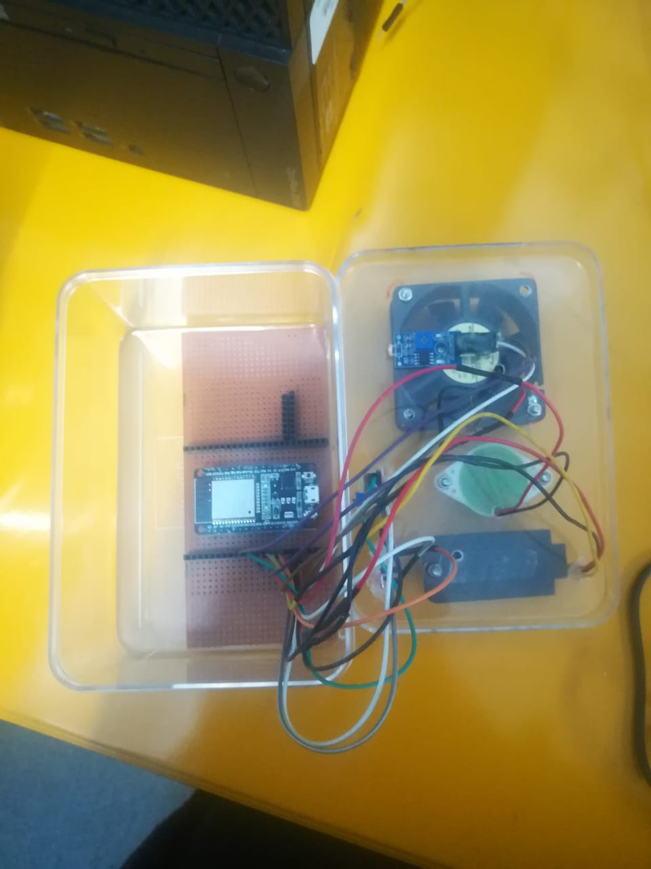
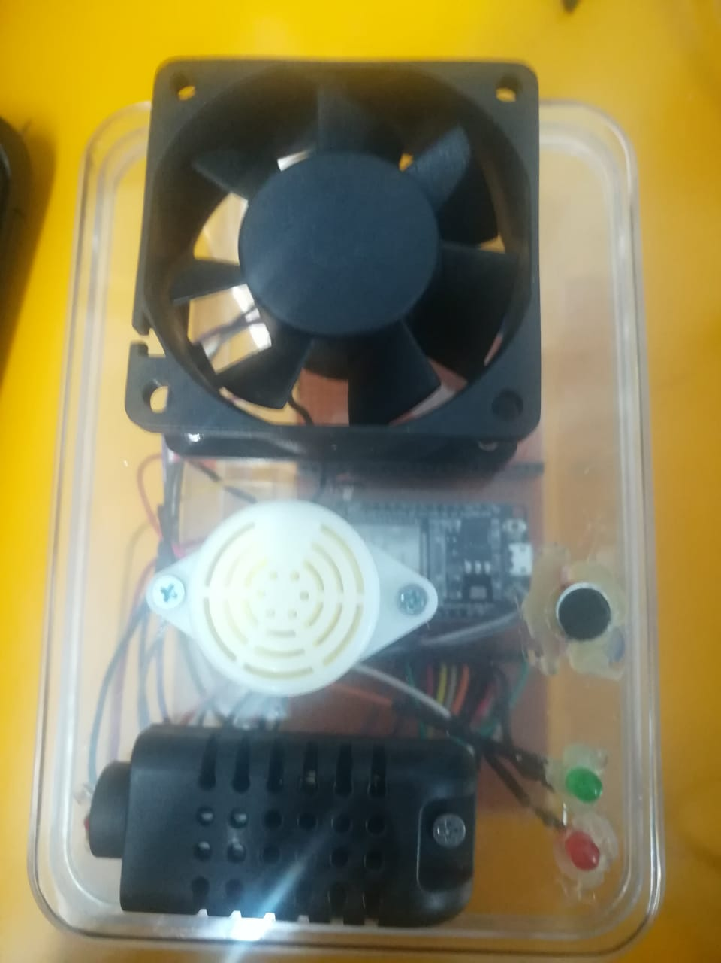
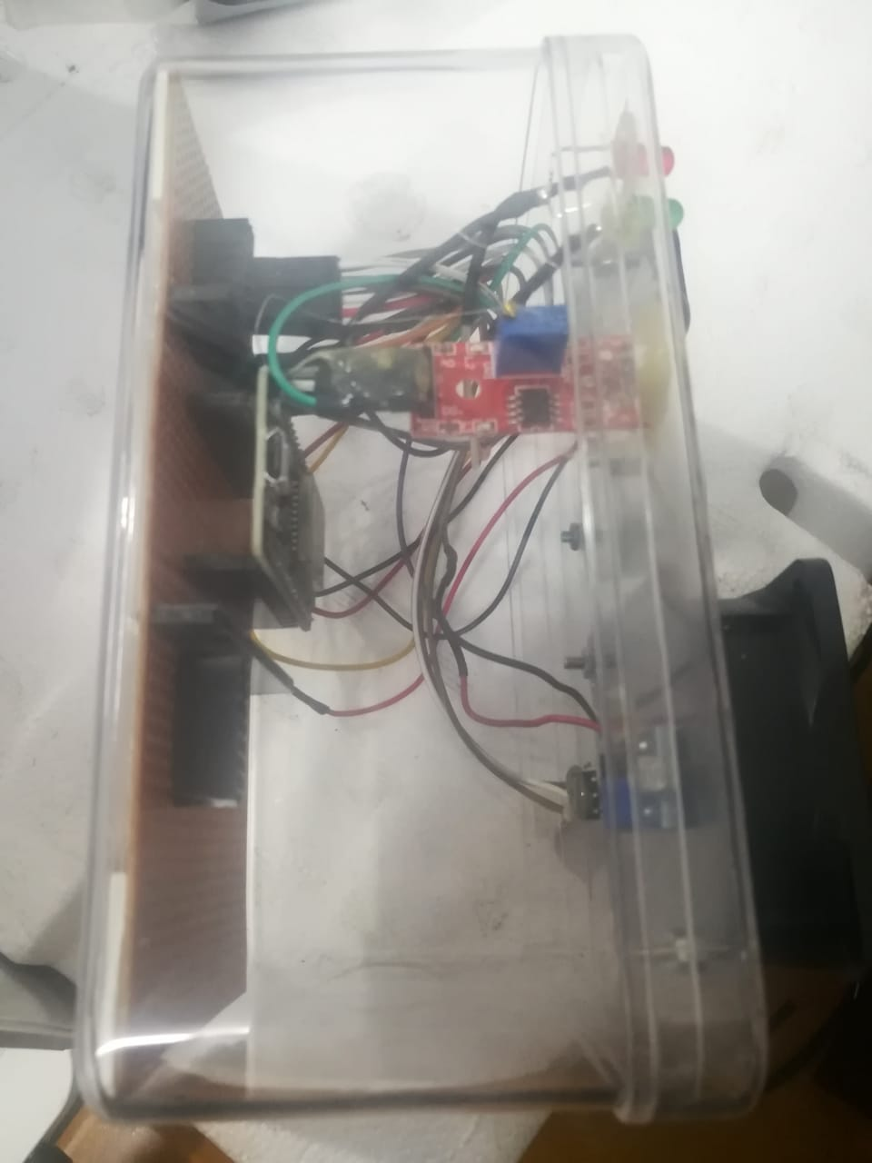
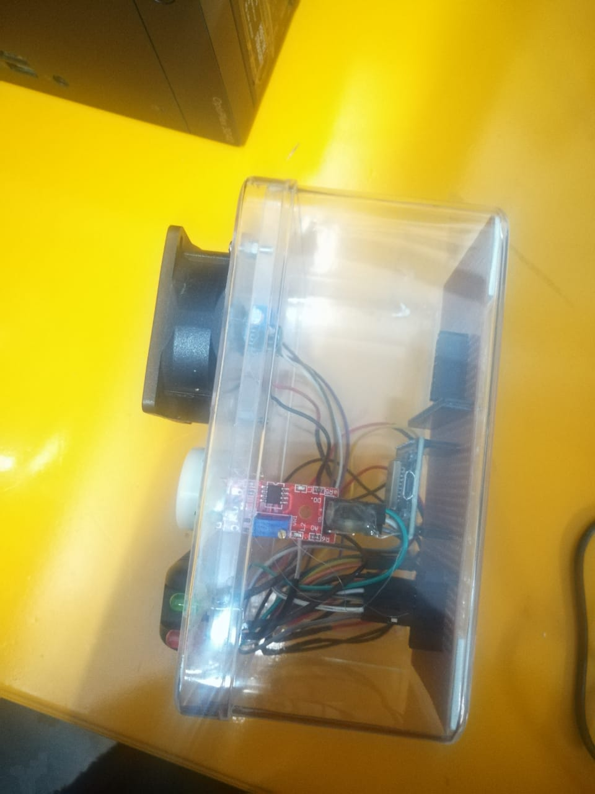
Artefact Pictures (Cont..)

Slide 9
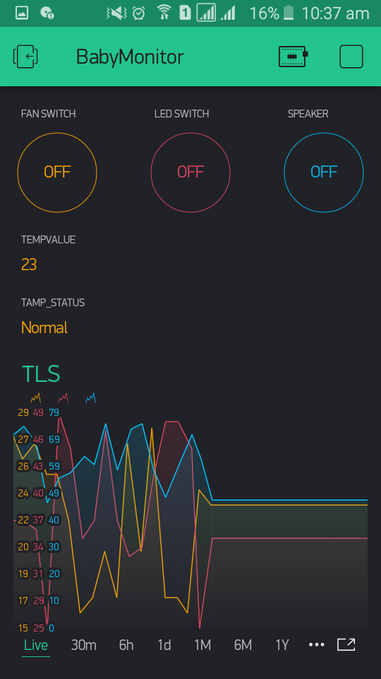
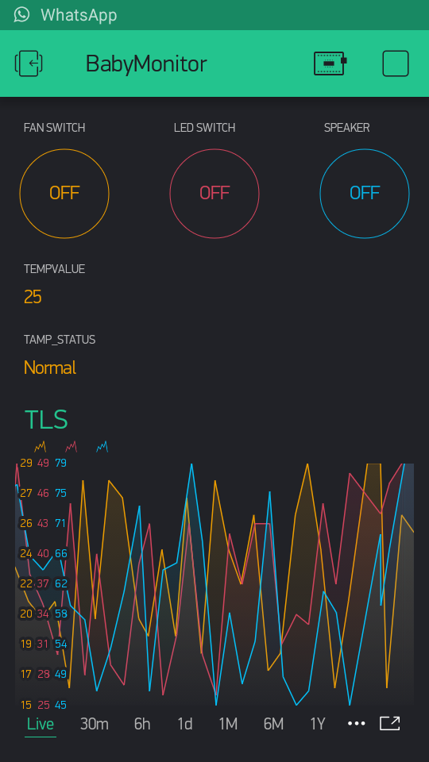
Blynk Dashboards

Slide 10
System Functions
From temperature sensor we get temperature data to our Blynk platform. According to that value we will on/ off the switch of fan by using Blynk platform.
From Light intensity sensor we get Light intensity data to our Blynk platform. According to that value we will on/ off the switch of LEDs by using Blynk platform.
From Sound sensor we get sound data to our Blynk platform. According to that value we will on/ off the switch of Speaker by using Blynk platform.

Slide 11
Strengths & Weakness
Strengths | Weakness
Low cost. Anyone can afford it. | I store our system’s data in third party cloud system. We can’t exactly trust their security.
This system is located in the home. So, it will protect sensors from weather effects. | If there is a power cut meant system not work.
Parents’ workload will reduce. So, they can manage all the works together. | detect only three parameters in my system. From that we can’t take exact decision.
I can analyze data and can get decision about baby. | In Our system we aren’t included Camera. So, we can’t view baby.
System work as automation and we can manually control actuators by our platform. | When Wi-Fi slow down meant our system working will effect.
I am using Wi-Fi. So, we can access our system in any other places. | Sound sensor detect not only baby cry detection but also it detect environment also.
Reduce waste of power and Time | We are focusing in this system mainly baby environment instead of baby.

Slide 12
Future Improvements
I will increase our system with more exact parameters about baby.
I will include camera to capture baby from anywhere.
Now we use mobile to control system. In future I will use wrist watch and many devices.
I have idea to output parents’ direct voice as live instead of playing music.
I will power system by solar panel
I will set cot to swing when baby is crying.
I will set AI. So, According to baby’s behavior and sensing data it will give many solutions.

Slide 13
Conclusion
In Baby Monitoring System (BMS) we used Temperature sensor, Light Intensity sensor and Sound sensor.
As an actuators we used Mini fan, LED and Speaker.
As a IoT platform we used Blynk.
BMS is reducing workload of parents and they can monitor baby living environment through the network.
I deeply understand IoT working pattern. Such as sensors and actuators, Boards, Gateways, Connectivity protocols, Cloud, IoT platforms and Data visualization, analysis and miming tools.

Slide 14
THANK YOU
Any Questions???
Have A Nice Day!!!

