Slide 1

Project Title - Power BI enabled Crop Production Analysis of India
By – Zikre Farha Shakil

Slide 2

PROBLEM STATEMENT
Analyzing crop production data to identify trends, patterns, and key insights across different states, districts, crops, and seasons, enabling stakeholders to make informed decisions regarding agricultural planning, resource allocation, and policy formulation.

Slide 3
Project Description
Crop Production Analysis dataset contains 73827 rows and 7 columns.
This is India’s Crop Production Dataset from year 1997 to 2014.
Columns are State_Name, District_Name, Crop_Year, Season, Crop, Area, Production.
State_Name contains States from India.
District_Name contains particular District form Each State based on crop production.
Crop_Year contains year from 1997 to 2014.
Season contains 6 season – Whole Year, Kharif, Rabi, Winter, Summer and Autumn.
Crop – different names of crop which is produce in India in different season
Area – Area under crop are produced
Production – Production of crop according to different state, district, year and season
So, In this project we are going to Visualize and Analyze above data to gain insights.

Slide 4

WHO ARE THE END USERS?
Farmers and Agriculture Practitioners
Government of India for Agriculture
Agriculture Policy Makers
Non-Governmental Organizations(NGO)
Agribusiness and Traders
Research Institutions and Academics
General Public

Slide 5

Technology Used
Power BI
Power BI Desktop
Power Query Editor

Slide 6
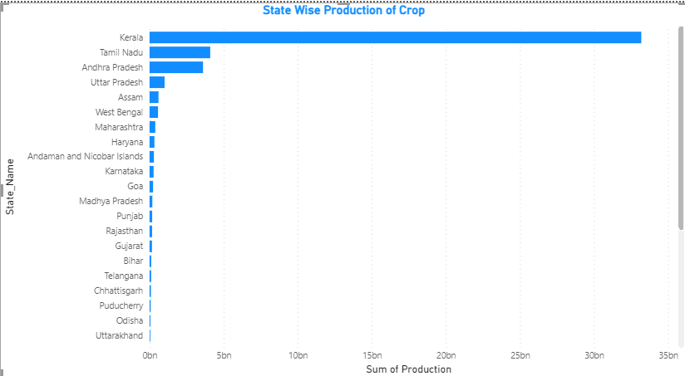
RESULTS
States with overall crop production
Demo Link

Slide 7
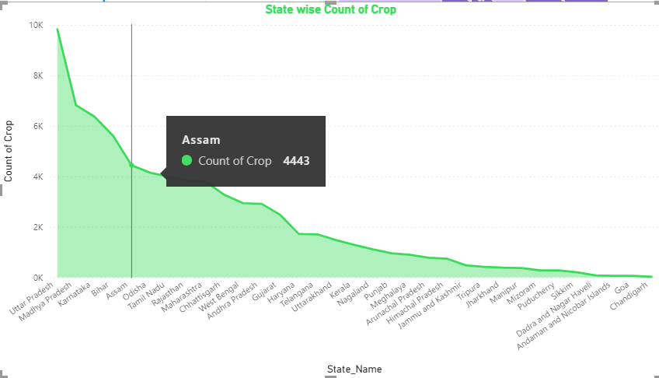
RESULTS
Count of Crop by State
Demo Link

Slide 8
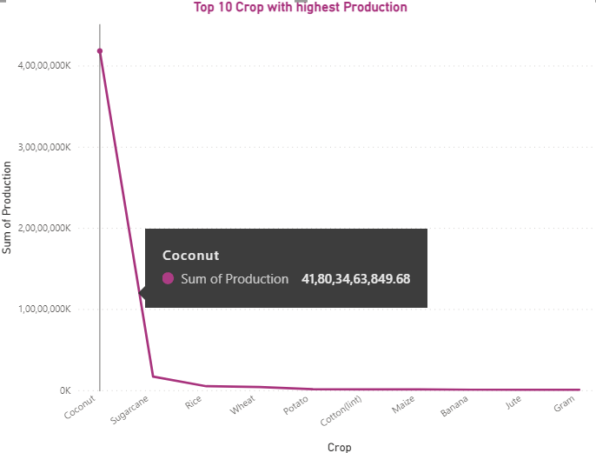
RESULTS
Top 10 Crop with Highest Production
Demo Link

Slide 9
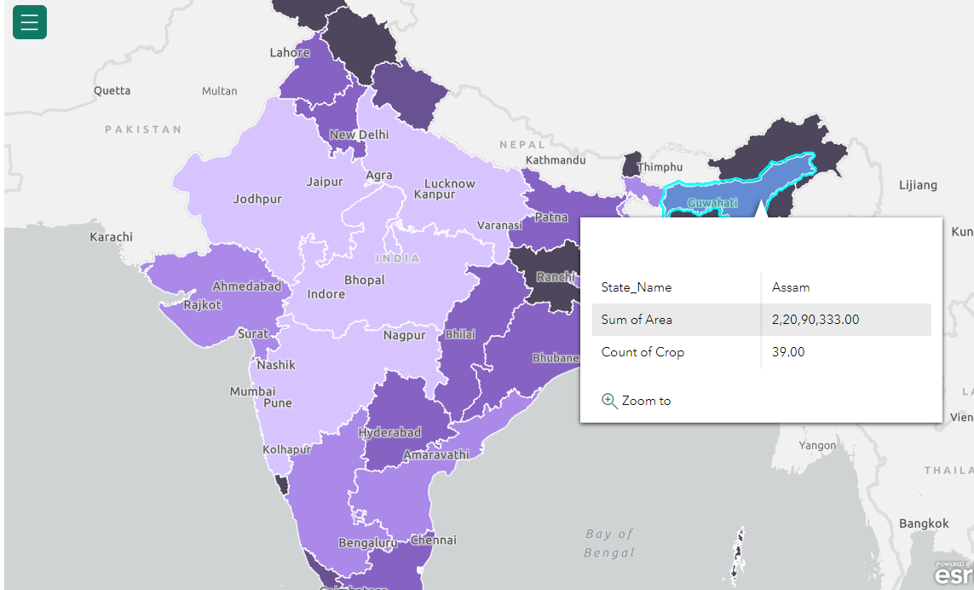
RESULTS
Area Covered by State with total Count of Crop
Demo Link

Slide 10
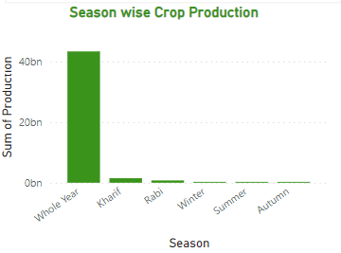
RESULTS
Crop Production by Season
Demo Link

Slide 11
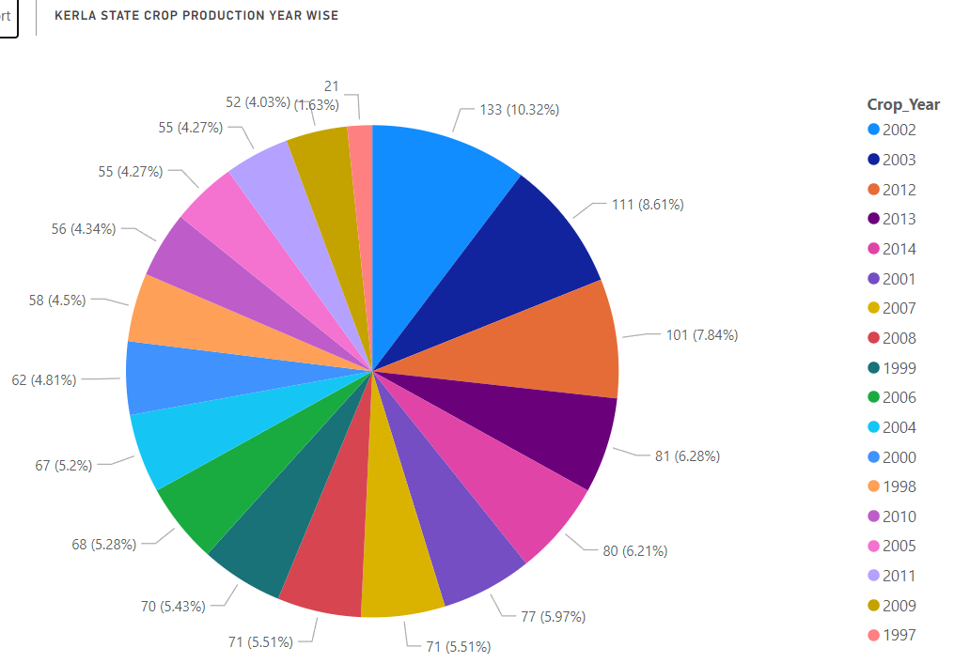
RESULTS
Year wise Crop Production of Kerala State
Demo Link

Slide 12
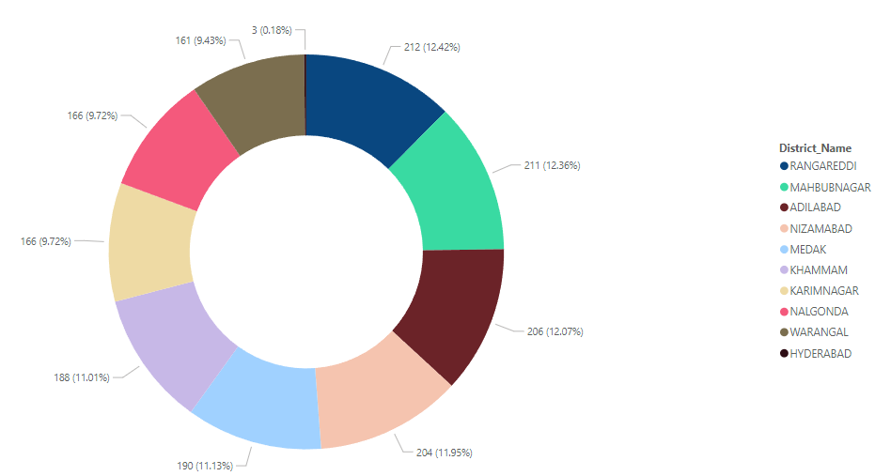
RESULTS
Telangana State Crop Count by District
Demo Link

Slide 13
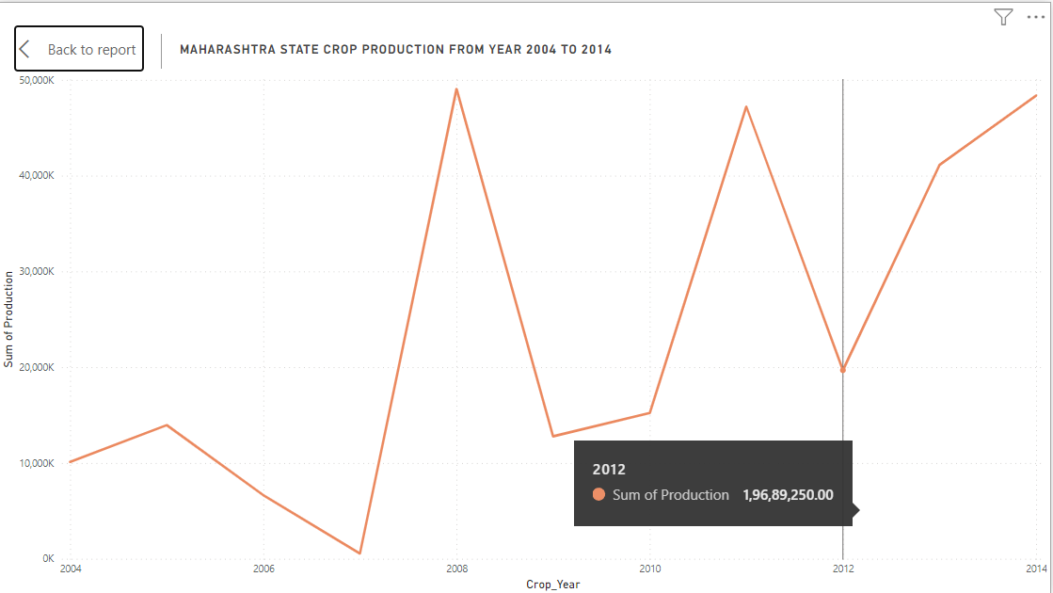
RESULTS
Maharashtra State Crop Production From Year 2004 to 2014
Demo Link

Slide 14
! THANK YOU !
.
.

