Slide 1

Home Safety & Anti-Theft System
17.02.04.116 - Arman Sharker
18.01.04.058 - Maruf Hasan Chisty Fahim
18.01.04.069 - Farhad Uz Zaman
18.01.04.073 - Arif Ishtiaque

Slide 2
Objective
Oftentimes we need to leave our house. Frankly, Our home is special to us, but not to a potential criminal. Thieves can infiltrate our homes, and then again accidents can happen as well.
We want to design a system that would work as an anti theft system and also can protect us from unwanted disasters. Its sole objective will be to scare off burglars and it will also send notification to your local authorities if someone did try to break into your property or some disasters happens.

Slide 3
Social Values
Allows remote access to your home - Modern security systems now allow you to remotely monitor what’s happening in your home from your phone when you’re not there.
Protects valuables - A home security system has an alarm that can scare off many would-be burglars and can notify the local authorities if someone does attempt a break-in.
Prevents accidents - Set up an advanced smoke alarm to respond to a multitude of fire conditions.
Budget friendly – Just the prototype itself doesn’t cost much when you consider your safety and valuables. After a mass production the cost will be much less.
Deters crime - As the number of home security systems increases in an area, the number of residential robberies decreases, even for people who don’t have their own security system.

Slide 4
Required Components
Arduino Mega | Potentiometer
16x2 Lcd Display | PIR Motion Sensor
GPS | Gas Sensor(MQ2)
Speaker | Relay
GSM | Temperature Sensor(LM35)

Slide 5
Working Procedure
The basic components that react to the input are
• Arduino Mega
It controls and connect all the components together.
• PIR Motion Sensor
It is used for detecting any movement from home-invader/thief.
• MQ2 Gas Sensor
It is used for detecting any gas leakage.
• LM35 Temperature Sensor
It is used for detecting any fire breakout.

Slide 6
Working Procedure (Contd.)
• NEO-6M GPS Module
It is used to get GPS location.
• Relay
It is used to turn on/off anti-theft system.
The components that receive commands-
• GSM-SIM900D
It will send messages to the police/fire brigade when theft/fire-breakout occurs.
• Speaker
It is used for alarm.

Slide 7
Working Procedure (Contd.)
• 16*2 LCD
It displays message.
• LED
It lights up when a security situation occurs.
Our system will perform following action:
If there is a gas leakage in the house, the Gas Sensor will pick it up, an alarm will be set; GSM module will send a message to the nearby fire-station along with GPS location.
If there is a fire-breakout in the house, the temperature sensor will detect it, an alarm will be set; GSM module will send a message to the nearby fire-station along with GPS location.
If a home invader or a thief enters a house, PIR sensor will detect his movement, an alarm will be set; GSM module will send a message to the nearby police-station along with GPS location.

Slide 8
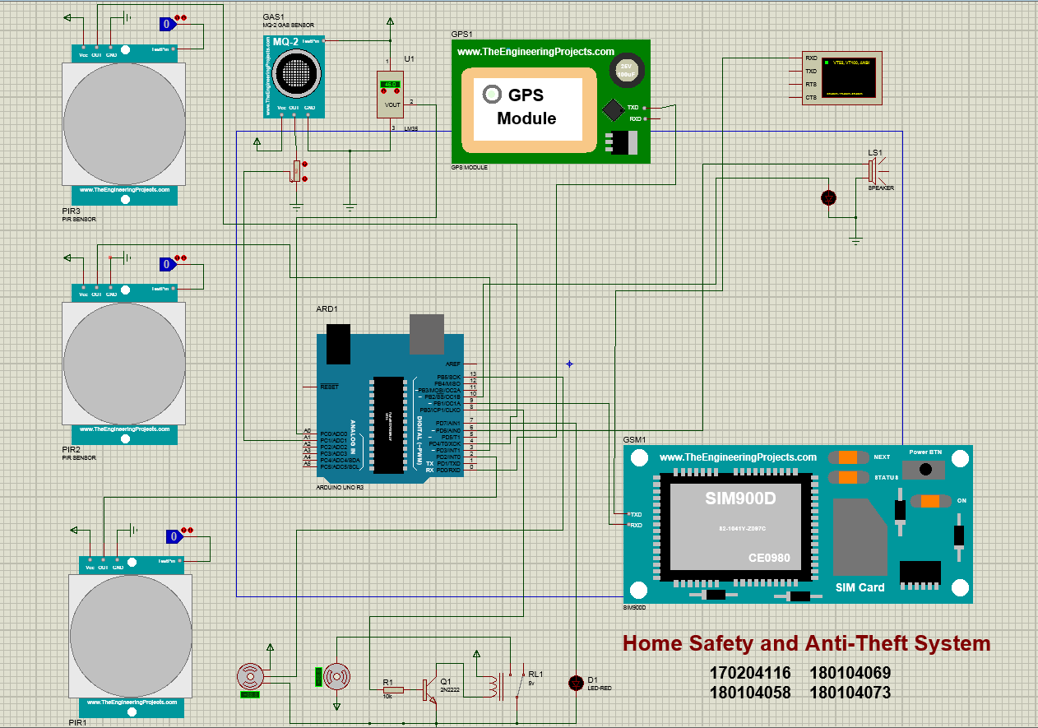
Proteus simulation
Figure:Home-Safety and Anti-Theft System

Slide 9
Budget
Components | Quantity | Budget(TK)
Arduino Mega | 1 | 900/-
16x2 Lcd Display | 1 | 160/-
GPS | 1 | 890/-
GSM | 1 | 1600/-
Speaker | 1 | 130/-

Slide 10
Budget
Components | Quantity | Budget(TK)
Potentiometer | 1 | 50/-
PIR Motion Sensor | 3 | 3*110/-
Gas Sensor (MQ2) | 1 | 150/-
Temperature Sensor (LM35) | 1 | 125/-
Relay | 1 | 210/-
Total |  | 4,545/-

Slide 11
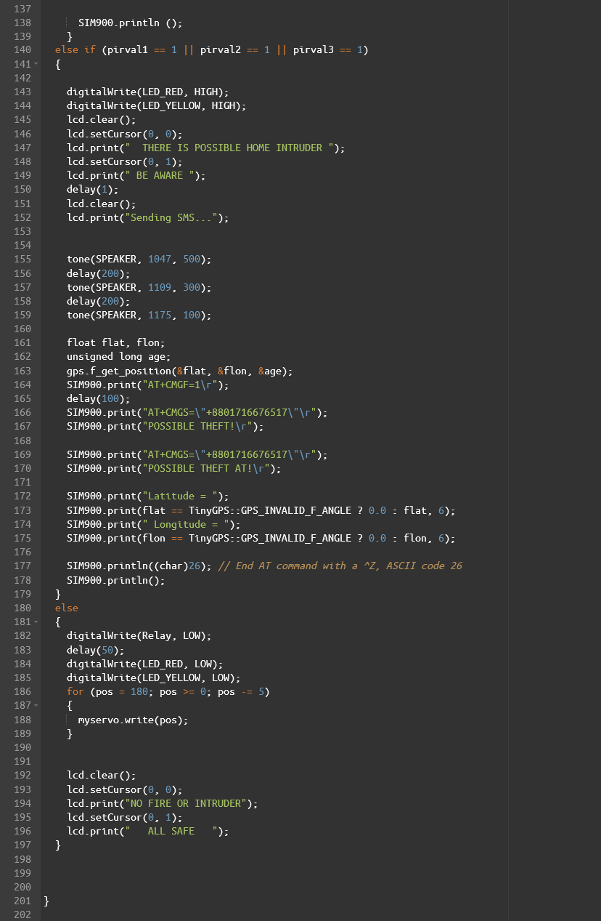
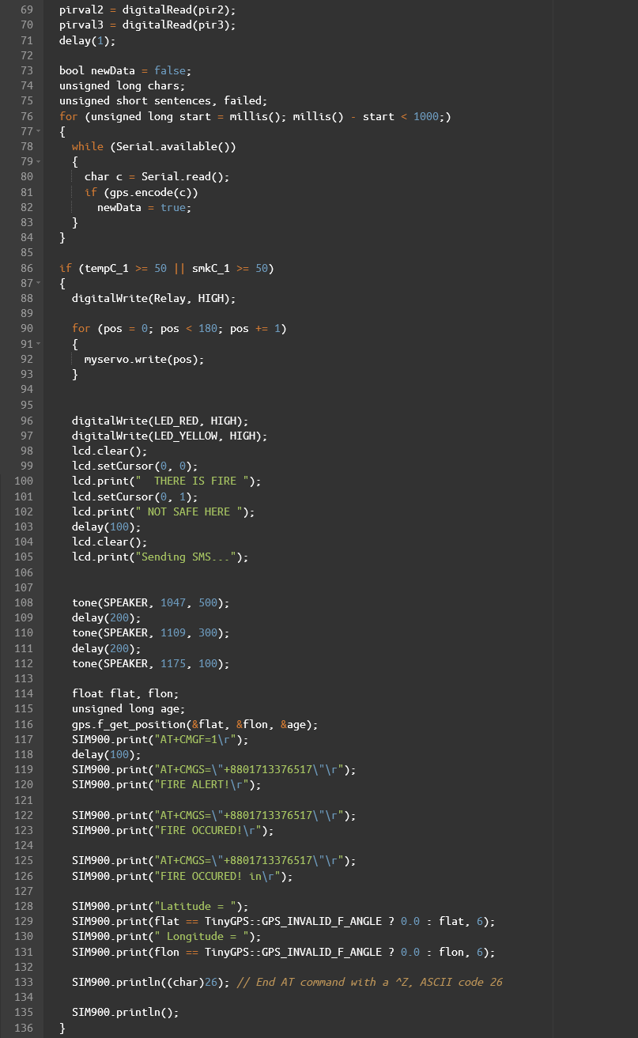
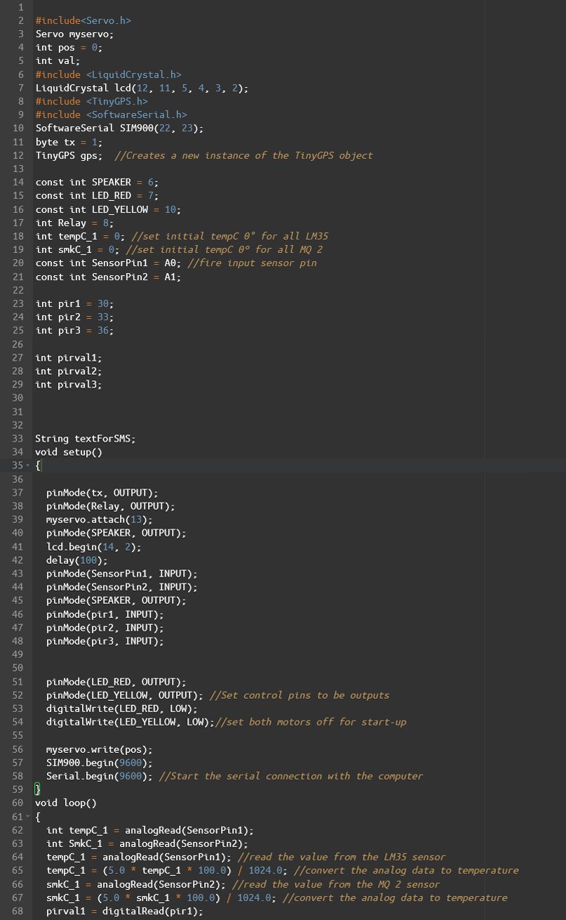
Code

Slide 12
Difficulties
Future Plan
The Arduino Mega turns out to be working a bit slow with proteus and because of that the response time is much higher while simulating.
Finding the proper library files.
We have almost implemented everything that we had thought of in proteus simulation. Even checked performance issues for Arduino Uno and Mega. For future work we wish to make this project in real life.

Slide 13
Conclusion
The Security System we have designed will ensure the safety of our homes both from burglars and other potential threats e.g. fire outburst and gas leakage. This system will cost very little when we consider the amount of safety related to the field. After the mass production it’ll be much cheaper and would be easier to set up. This system would somewhat guarantee the safety of our property as well as relieve us of our worries.

Slide 14
THANK YOU

