Slide 1

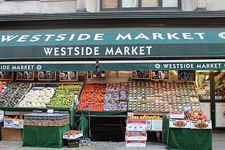
CSE-103 (Structured Programming)
section: 07
Groceries Shop

Slide 2
Present To Mohammad Abu Yousuf, PhD Adjunct faculty Department: CSE East West University
Present By
Name: Md. Farhad Billah
Id: 2020-2-60-213
Name: Md. Saidur Rahaman Shemanto
Id: 2020-1-60-242
Department: CSE
East West Univwersity

Slide 3
Start
Display Menu for choice user
file.txt file
choice=1(Sing Up)
If choice ==2 (Login)
If choice ==3 (Admin)
check id, password
Items.txt file
input id, password
input id, password
Now the admin panel gives 5 option
If choice ==1 (show)
showItems()
If choice ==2 (add)
addItems()
If choice ==3 (edit amount)
EditItems()
If choice ==4 (edit price)
Editprice()
If choice ==5 (Exit)
stop

Slide 4


