Slide 1
Present By Md. Farhad Billah
Pizza Choice: Discover The Ideal Pizza with Machine Learning
Data size (49574,9)
Handle the null value
‘date’ column convert to_datetime
Outlieres Handle

Slide 2
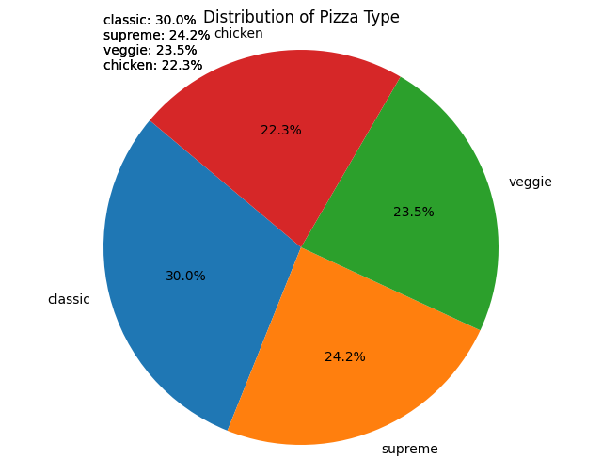
5. The type of prediction percentage

Slide 3
6. checking skewness and handle it 7. only the hour part from the 'time' column 8. Columns to be removed ['id', 'date', 'time', 'day', 'year’] 9. Label Encoder [‘name’,’size’,’type’]

Slide 4
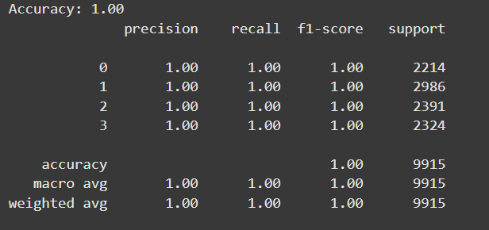
The best model: Decision Tree

Slide 5
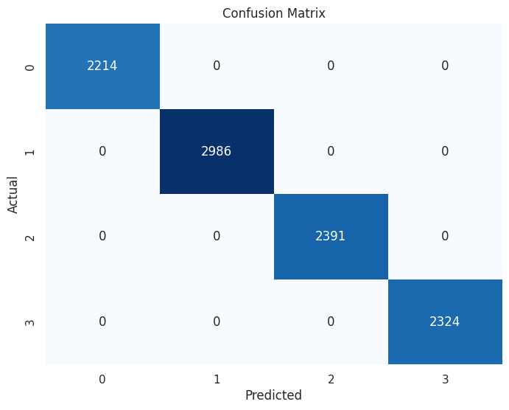
Confusion Matrix

Slide 6
Others models: 1. Random Forest Classification Accuracy (100%) but the confusion matrix is not the best. 2. Gradient Boosting Classification. Accuracy (100%) but the confusion matrix is not the best. 3. Support Vector Machine (SVM). Accuracy (70%) but the confusion matrix is not the best. 4.K-Nearest Neighbors (KNN). Accuracy (99%) but the confusion matrix is not the best. 5. Convolutional Neural Networks (CNN). Not fitted 6. Recurrent Neural Network (RNN). Not fitted.

Slide 7
Web Hosting 1. Model_training.py (train model and collect the DecisionTreeClassifier.pkl→Pickle) 2. app.py (read the .pkl file and connect the .html files using flask)

Slide 8
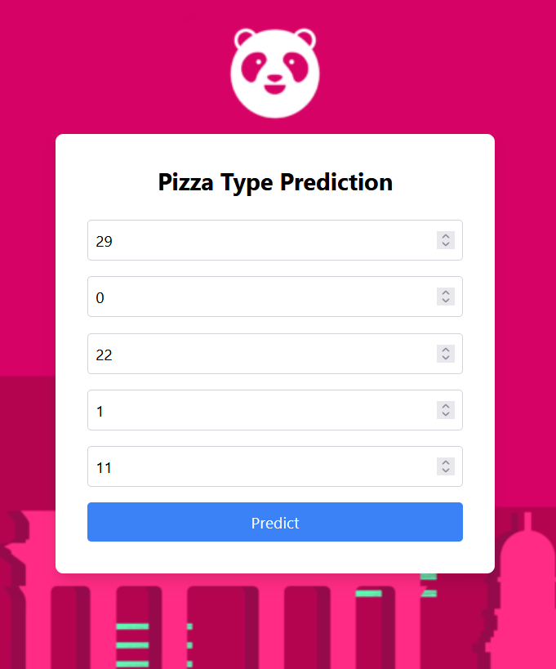
3.templates/form.html The user gives 3.1 name 3.2 size 3.3 price 3.4 month 3.5 hour

Slide 9
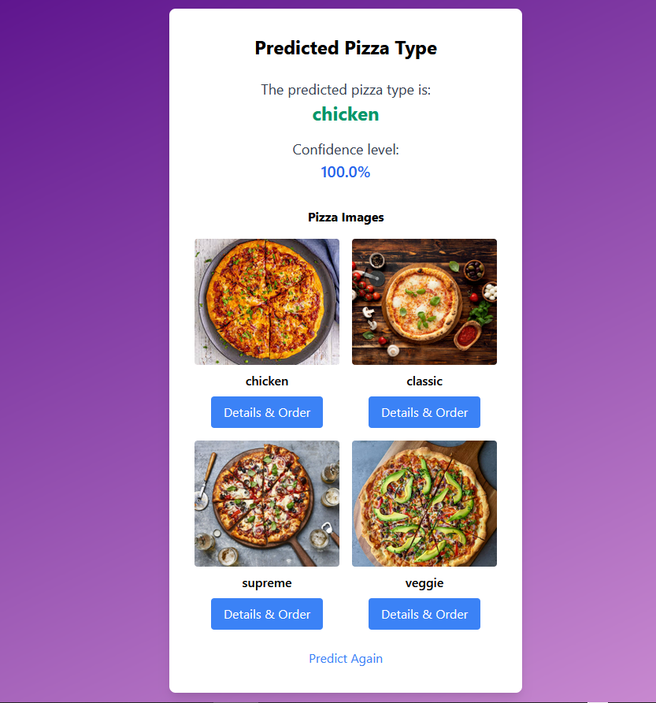
4.templates/ result.html 4.1.use a set for images of pizza 4.2.call the predict() 4.3. predict Again button for go to the templates/form.html

Slide 10
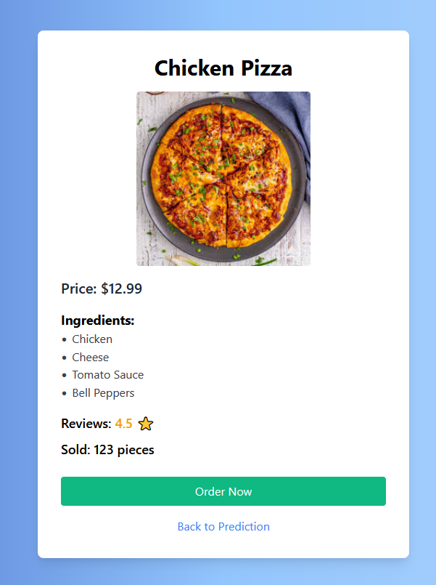
5.templates/details.html when click Details & Order here show the pizza details

Slide 11
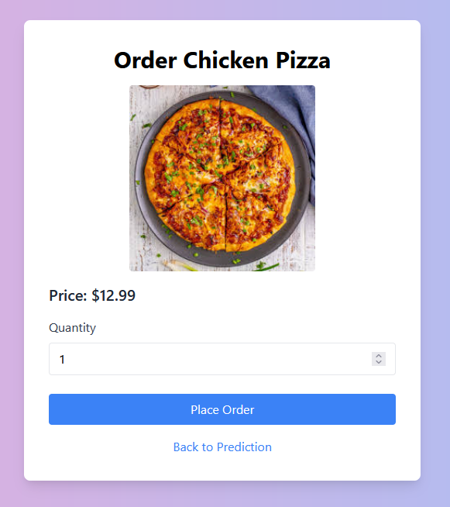
6.templates/order.html after click the Order Now button here show the price and quantity then go the the payment method

Slide 12
Challenge 1. joblib not support solution: pickle 2.there are two types of images files .jpeg and .jpg solution: onerror 3. predication images and other images don’t show. solution: dynamic content in Flask

Slide 13
Projects: 1. https://farhad0111.github.io/Assignment-6/ 2. 41(memorable-water-bottle) 3.40 (react-world-toure) Papers: Deep Learning Models for Classification of Red Blood Cells in Microscopy Images for Anemia Diagnosis (COMPAS 2024 conference).

Slide 14


