Slide 1

Customer Churn Prediction
Farhad Zafari
Data Scientist

Slide 2
Table of Contents
Introduction
Proposed ML solution
Offline experiments
Model performance
Promotion strategy performance
Proposed online experiment
Summary and future work
Notes:
- So first I’ll start with introducing the problem, what customer churn prediction is, and why it is important.
Then I’ll elaborate on the proposed solution - I’ll present the results from two sets of offline evaluation, first model performance using ML performance metrics, and second the real-world performance of the solution when used to guide a couple of promotion strategies
I’ll propose online experiments that we can run as the next step,
And finally I’ll conclude the presentation by summing up the main highlights and giving the future direction

Slide 3
Introduction
Customer churn is one of the most important KPIs (key performance indicators) for companies that have a subscription-based business model
Customer churn is defined as the percentage of customers who stop using the company’s product/service during a certain time frame
Customer churn prediction is a challenging and extremely important business problem particularly in companies with high customer acquisition cost
Technology, telecom, etc.
The companies could potentially gain great revenue from predicting the high risk of a customer churning
If we can successfully identify these customers, we can proactively engage with them (e.g. offer promotions) and make them stay
Notes:
So what is customer churn?
Customer churn is one of the most important KPIs for companies that use a subscription based business model
It is defined as the percentage of customers who give up using our products or services within a specific period of time
This problem is utterly important for business specially in companies that have a high customer acquisition cost. E.g. telecom companies, technologies. etc.
If these companies could predict what customers have higher risk of churning, they can intervene and try to keep those customers and hence get great profit from doing so
For example, we can proactively engage with them, let’s say offer promotions and make them stay with us

Slide 4
Proposed Solution
The proposed solution involves the following steps:
Data Preprocessing
/Cleaning
Feature Encoding
Train/Test Set Splitting
Feature Normalization
Offline
Feature Selection
Model Training
Offline Evaluation (Model)
Offline Evaluation (Promotion Program)
Online
Model Deployment
Model Evaluation A/B testing
Solution Scale up
Notes:
So here is the steps for the proposed MF solution:
The solution involves two sets of steps:
Offline, which includes data pre-processing, feature encoding, … and offline evaluation. It covers all the steps right before deploying the model to production.
Online, which includes model deployment for example using mlflow or a proprietary deployment pipeline, and then configure an AB test to evaluate the new solution online and finally scale up the solution to 100% of the users.

Slide 5
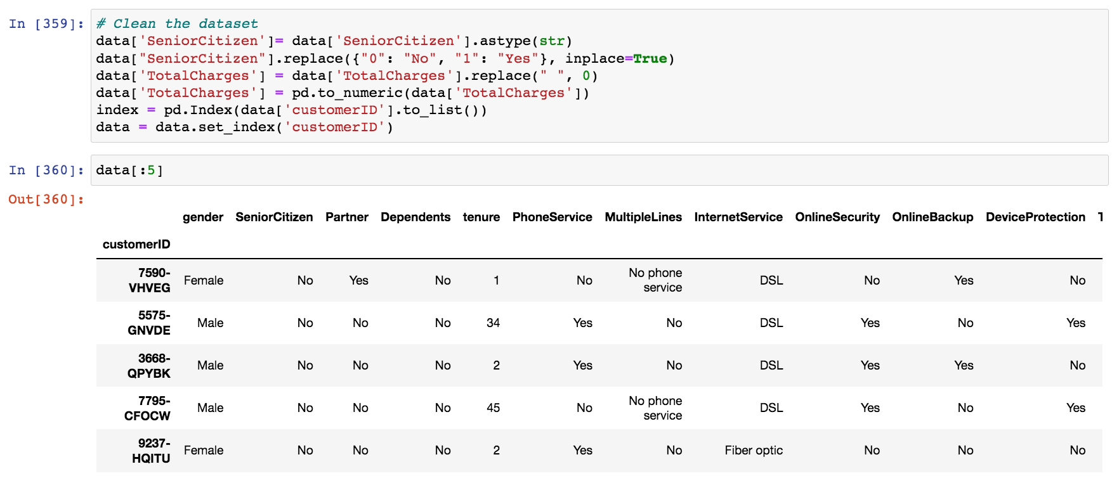
Data Pre-processing
Dataset pre-processing/cleaning:
Inspect the dataset and the fields and replace empty values and normalize types
Notes:
In data pre-processing step we do any cleaning and replacing empty values and normalising types, etc. I noticed for example TotalCharges filed was not numeric and had some empty values so I normalised that, I also changed SeniorCitizen to Yes/No, although this one was not necessary. Only for the dataset to look consistent. Also set the CustomerID as the index of the table.

Slide 6
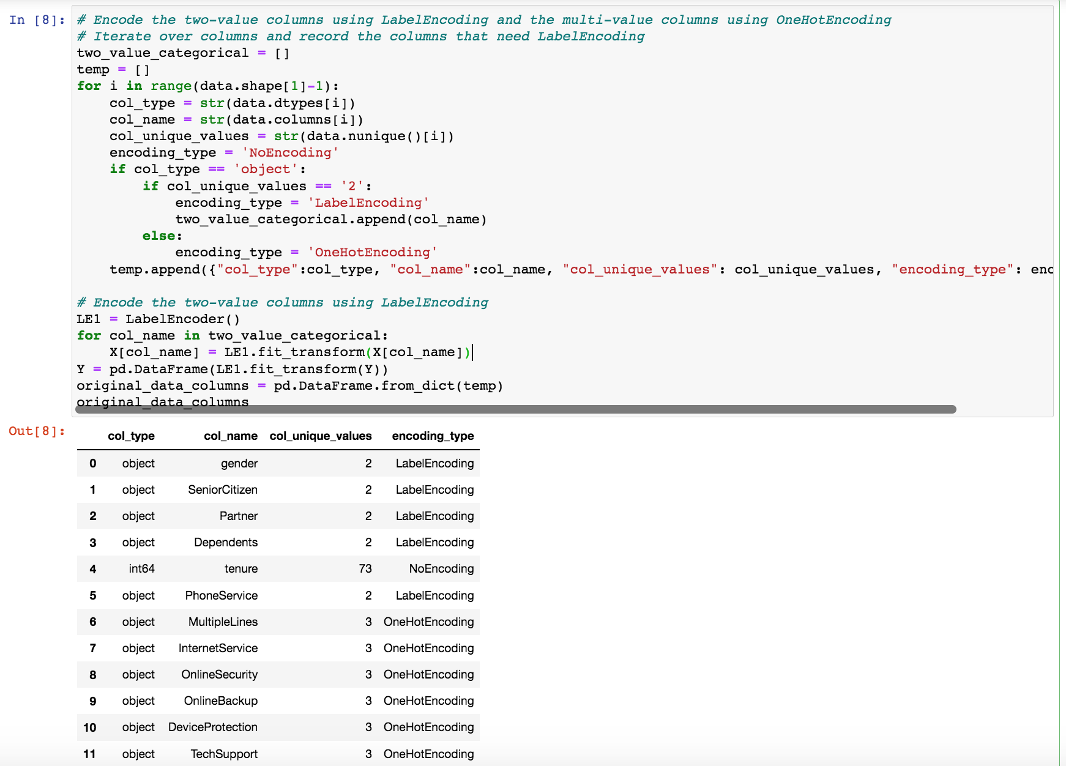
Feature Encoding
Feature encoding: transforming any categorical features into numerical features
Two value features: Label Encoding
Multi value features: One Hot Encoding
Notes:
The next step is feature encoding. This is a critical step in Machine Learning, since most of machine learning models can only work with numerical values, in this step we map all features into numerical features.
Numerical features don’t need encoding, so we leave them as it is. As for the categorical features, we check how many unique values each feature has. For two value features, we use label encoding, which simply assigns 0 for one value and 1 for the other value. For multi value features however if we use label encoding, the natural ordered relationship between integer feature values may be picked up by the model that is not desirable. For example, 2000 for salary is greater than 1000, but we don’t have this relationship between categorical values encoded using label encoding.
So we use one hot encoding that assigns one Boolean value per feature value, and if that value exists gives 1, if not 0.

Slide 7
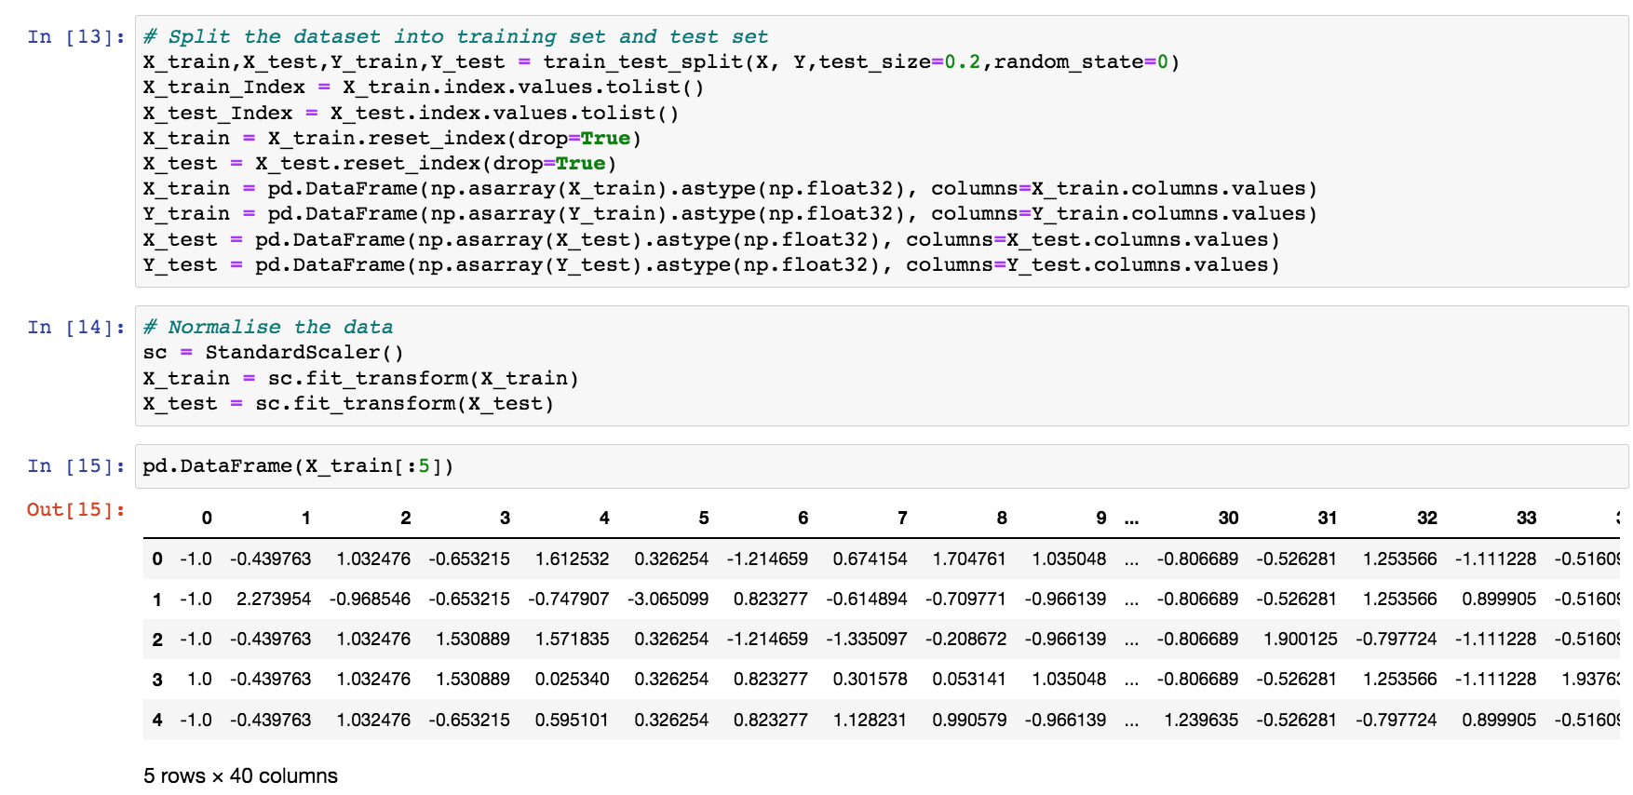
Feature Normalisation/Data Split
Feature scaling: all features are converted to the same scale
To avoid the features with high values dominating when creating the model
Notes:
Takes the mean value in each column and assigns zero to it if present, and then centres the other values around zero with values both positive and negative having variance as 1.
We can see that the mean value in each column is assigned a value of 0.0 if present and the values are cantered around 0.0 with values both positive and negative.

Slide 8
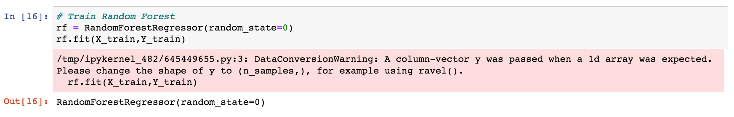
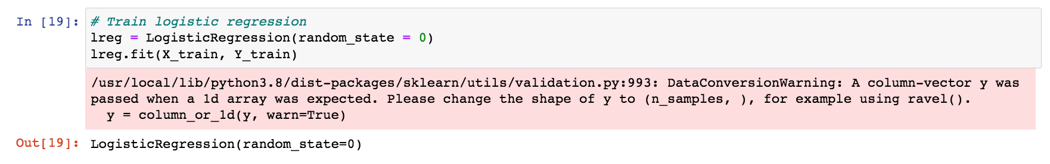
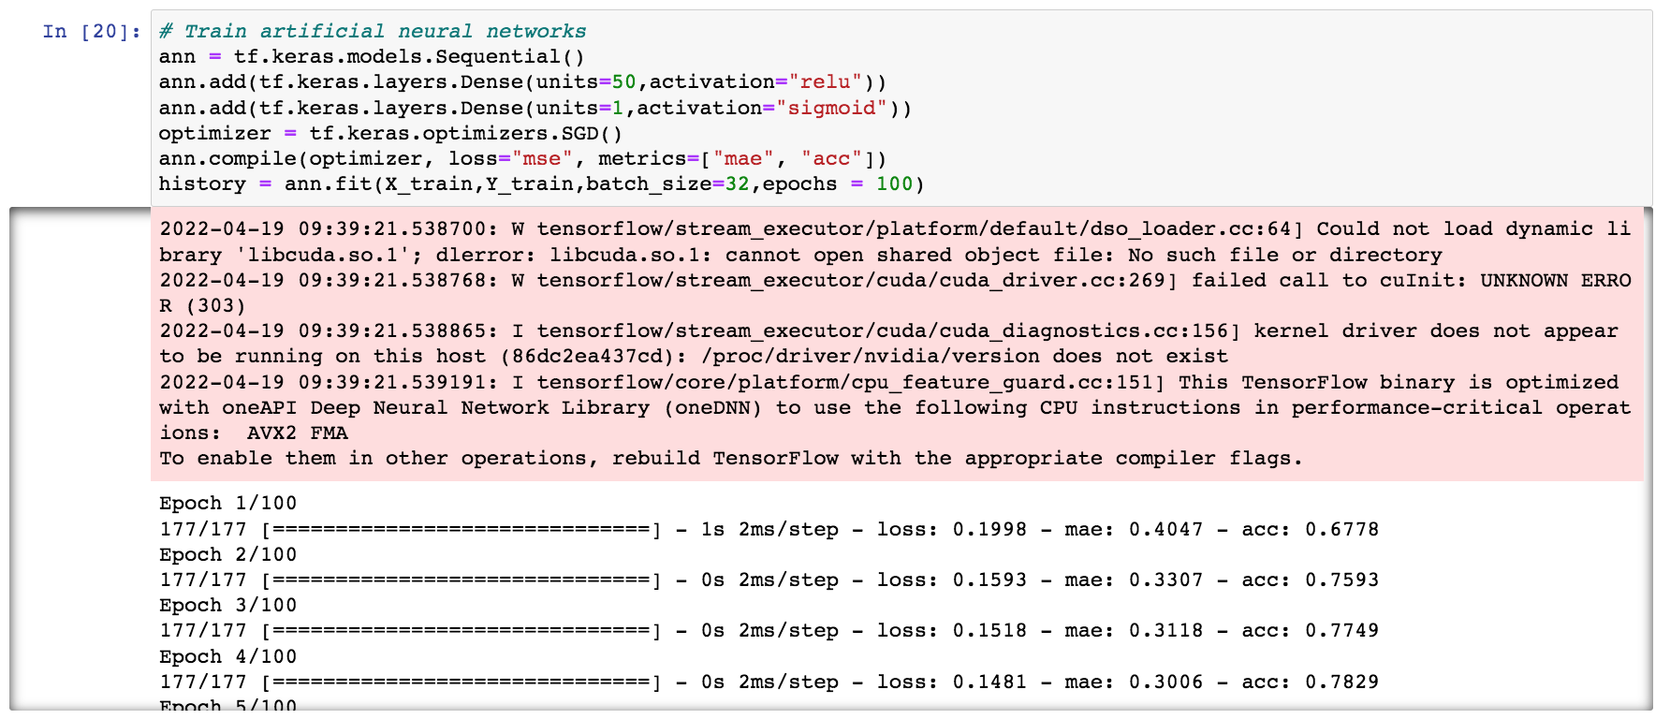
Model Training
Three regression models were tried:
Random Forests
Logistic Regression
ANN
Optimizer: SGD
Epochs: 100
One hidden layer
50 units
Notes:
I trained three models using the features extracted in the previous steps: Random Forests, Logistic Regression, ANN.

Slide 9
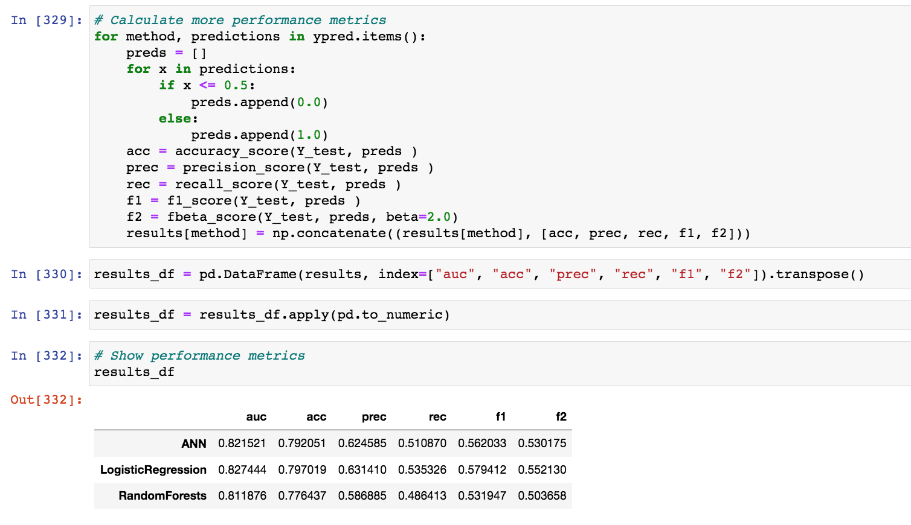
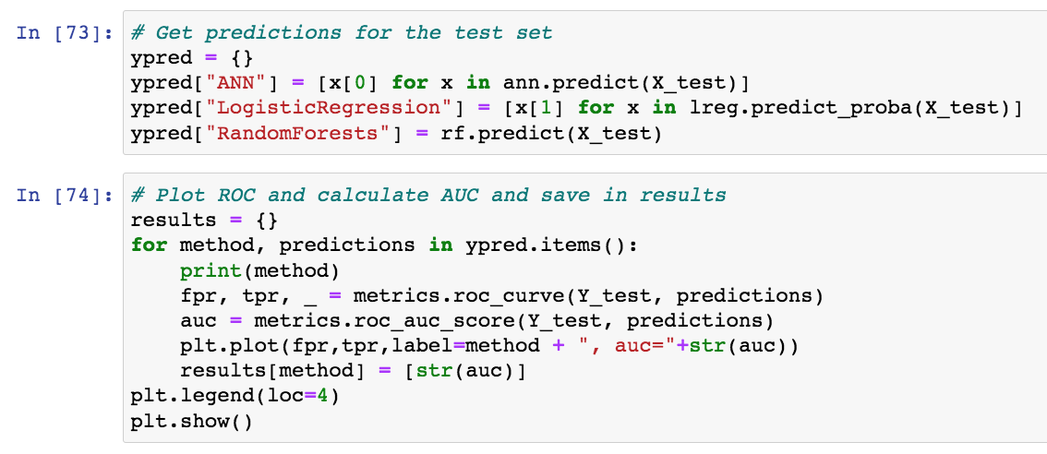
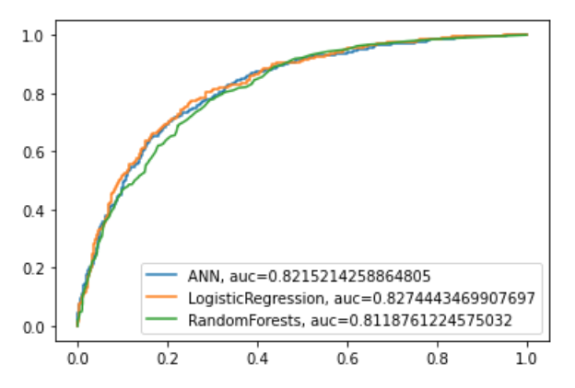
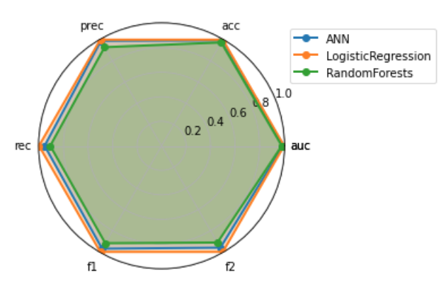
Offline Evaluation (Model Performance)
Notes:
To evaluate the model performance, I chose to plot ROC chart and Area Under ROC, which represents how successfully the model can separate positive samples from negative samples.
I also chose other metrics like accuracy, precision, recall, f1 and f2 measures.
Precision means what percentage of predicted positives are actually positive
Recall means what percentage of actual positives are predicated correctly as positive
F1 measure combines precision and recall into one metric giving same weight for recall and precision
F2 measure is similar to F1 measure, but gives more importance to recall, because missed actual positives are very expensive

Slide 10
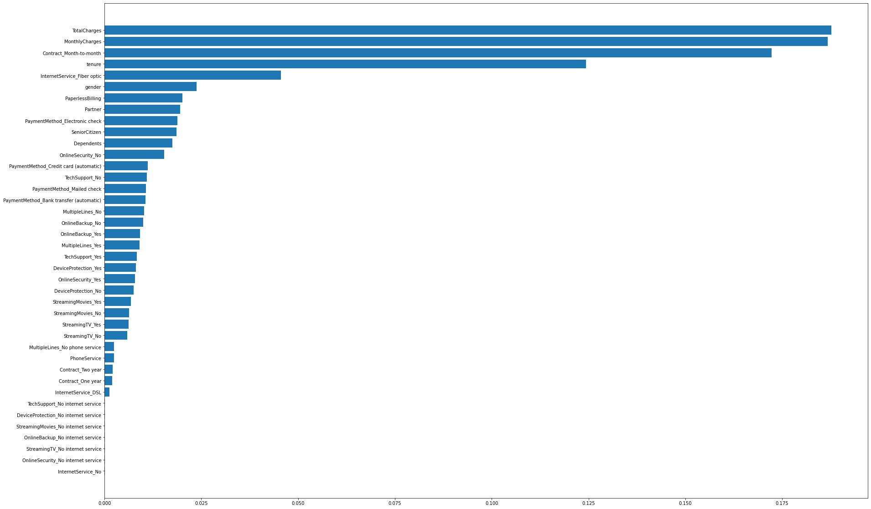
Offline Evaluation (Model Performance)
Important features obtained using Random Forest:
Top features:
Charges
Contract type
We can possibly offer promotions focused on charges and/or contract type to change churn propensity in high-risk customers
Notes:
We also can get important features using random forests. Looks like top features are charges and contract type. This means we can possibly offer promotions focussed on these two features and influence the customer’s churn behaviour.

Slide 11
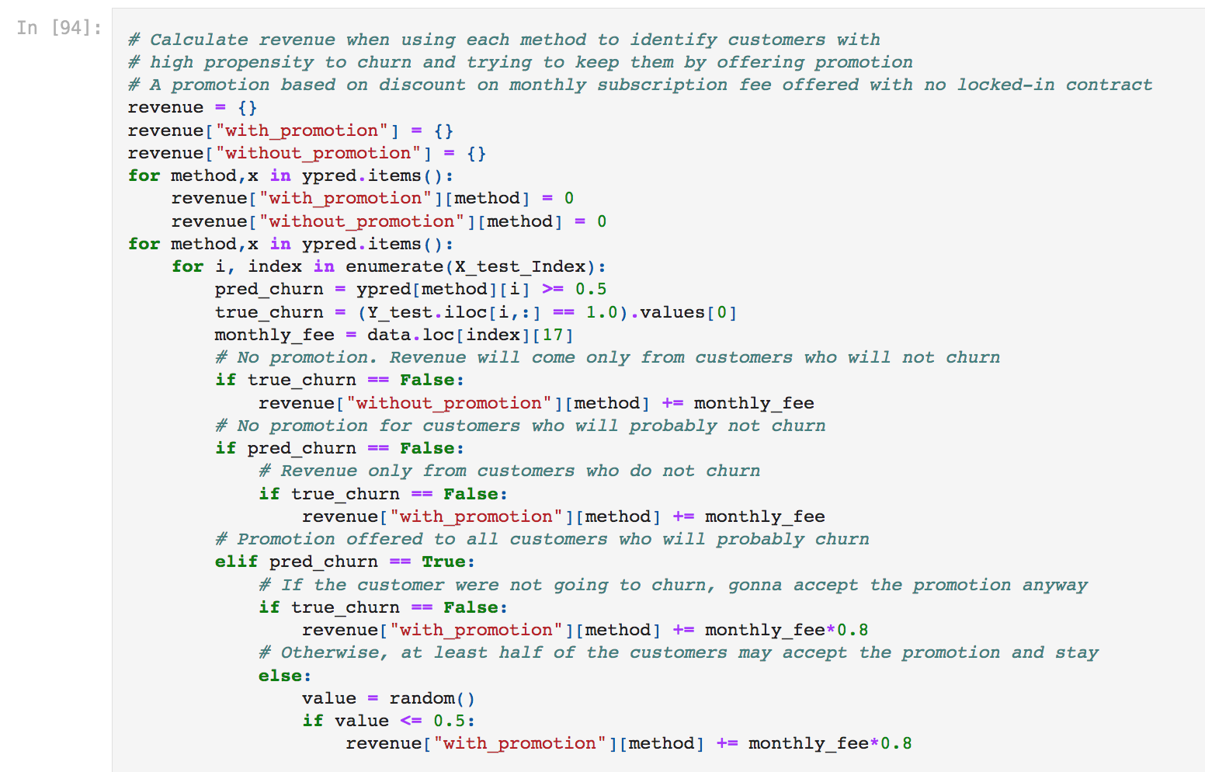
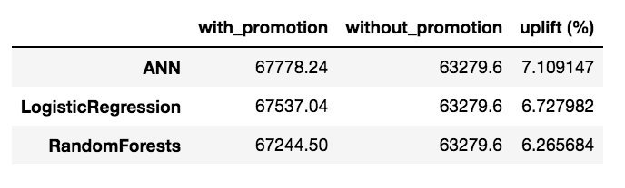
Offline Evaluation (Promotion Performance)
Assumption:
We can retain customers with a high propensity to churn by offering 20% discount on monthly subscription fees
At least half of the customers offered the promotion will take it and stay
Under this assumption, employing machine learning techniques can bring up to around 7.1% uplift in monthly revenues from subscription fees
Notes:
So in this section, I present two promotion strategies.
First strategy, we offer promotions on the monthly subscription fee. We use the model to predict which customers would churn and offer them a 20% discount on monthly fee.
We assume that when offered this promotion, half of the customers would fine it tempting enough to stay.
Under this scenario, we calculate the uplift in monthly revenue against the solution without promotion, and we observe around 7% uplift in monthly revenue.

Slide 12
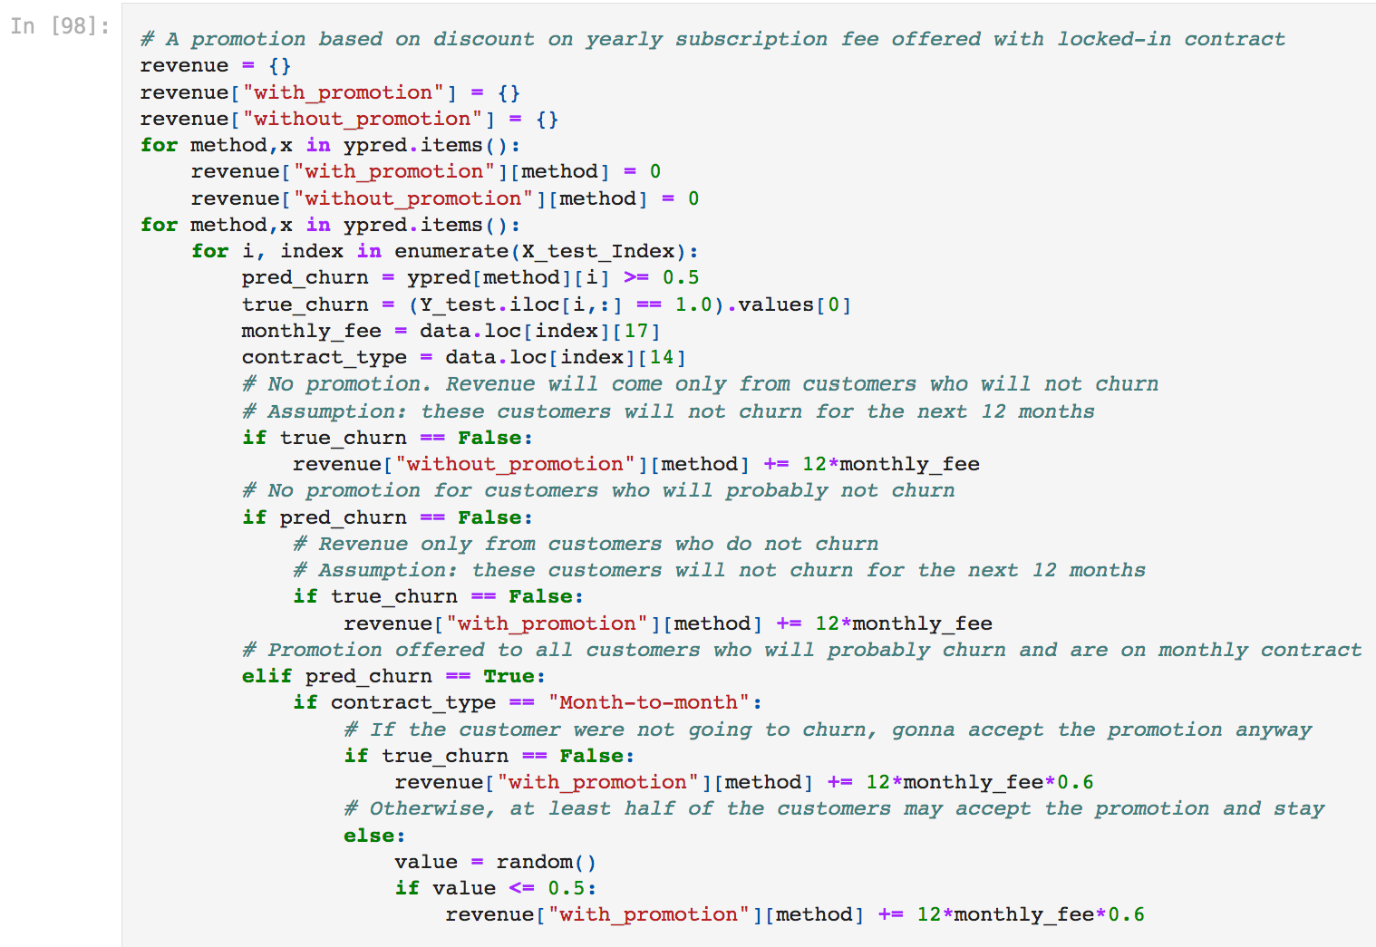
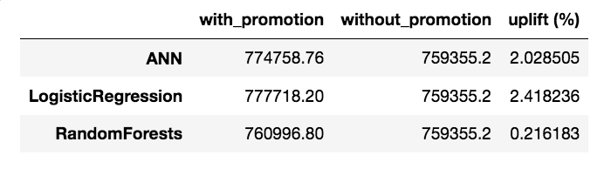
Offline Evaluation (Promotion Performance)
Assumption:
We can retain customers with a high propensity to churn by offering 40% discount on yearly subscription fee and locked-in for whole year
Customers with low churn risk will not churn for the next 12 months
At least half of the customers offered the promotion will take it and stay
Around 2.4% uplift in annual revenue using locked-in contract promotion
RandomForest has worse performance than other solutions using this strategy:
Probably due to poor performance on month-to-month contract types
Notes:
In the second strategy, we offer a bigger promotion of 40% but lock in the customers for one year.
Under this strategy, if we assume that low risk customers who do not churn this month, would not churn for the next 12 months, and at least half of the customers offered this promotion would take it, we would get 2.4% uplift in revenue in the next 12 months.
We also observe that Random Forest doesn’t perform well under this strategy, which emphasises using the right model for the strategy we want to apply.

Slide 13
Model Deployment and AB testing
Evaluation of promotion strategies on test set is restricted by assumptions
AB testing needs to be done to fully evaluate the model
Customers are randomly split into three groups with 33% in each
A: no promotion is offered to customers
B: a monthly promotion offered to customers with high churn predicted propensity
C: a yearly promotion (locked-in contract) offered to high-risk customers
Total revenues from monthly subscriptions are calculated for all groups after several months following the promotions
Do we get more more revenue from group B/C than A?
Are the uplifts statistically significant?
Which strategy results in better customer retention?
Notes:
So as the next step, my suggestion is to run an AB test to see how these strategies and models work in real world. This is necessary because offline evaluation has retractions due to the assumptions and may not be realistic.
I suggest we run three solutions, 33% in each bucket. A no promotion, B monthly promotion with no locked-in contract, and C yearly promotion to high risk customers with lock-in.
Then we can track the revenues from each group for several months and conclude which solution results in higher revenues.

Slide 14
Summary and Future Work
We proposed an ML based solution to predict churn propensity of customers from an internet service provider
Three solutions were implemented and compared offline using model performance metrics
Promotion strategies suggested based on insights obtained from feature importance analysis
Promotion strategy performances were compared offline under assumptions
Promotion strategies can perform very differently when coupled with different models
Future work involves testing the model and promotion strategies under real scenario and deploying the winner solution to production

