Slide 1

Customer Churn Prediction
Farhad Zafari
Data Scientist

Slide 2
Table of Contents
Introduction
Proposed ML solution
Offline experiments
Model performance
Promotion strategy performance
Proposed online experiment
Summary and future work

Slide 3
Introduction
Customer churn is one of the most important KPIs (key performance indicators) for companies that have a subscription-based business model
Customer churn is defined as the percentage of customers who stop using the company’s product/service during a certain time frame
Customer churn prediction is a challenging and extremely important business problem particularly in companies with high customer acquisition cost
Technology, telecom, etc.
The companies could potentially gain great revenue from predicting the high risk of a customer churning
If we can successfully identify these customers, we can proactively engage with them (e.g. offer promotions) and make them stay

Slide 4
Proposed Solution
The proposed solution involves the following steps:
Data Preprocessing
/Cleaning
Feature Encoding
Train/Test Set Splitting
Feature Normalization
Offline
Feature Selection
Model Training
Offline Evaluation (Model)
Offline Evaluation (Promotion Program)
Online
Model Deployment
Model Evaluation A/B testing
Solution Scale up

Slide 5
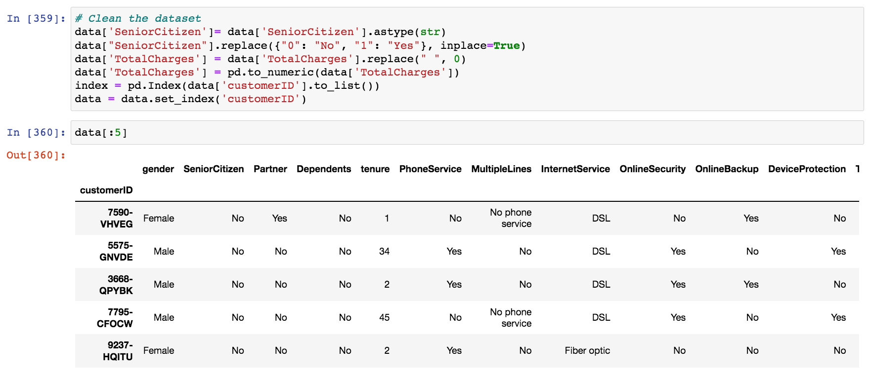
Data Pre-processing
Dataset pre-processing/cleaning:
Inspect the dataset and the fields and replace empty values and normalize types

Slide 6
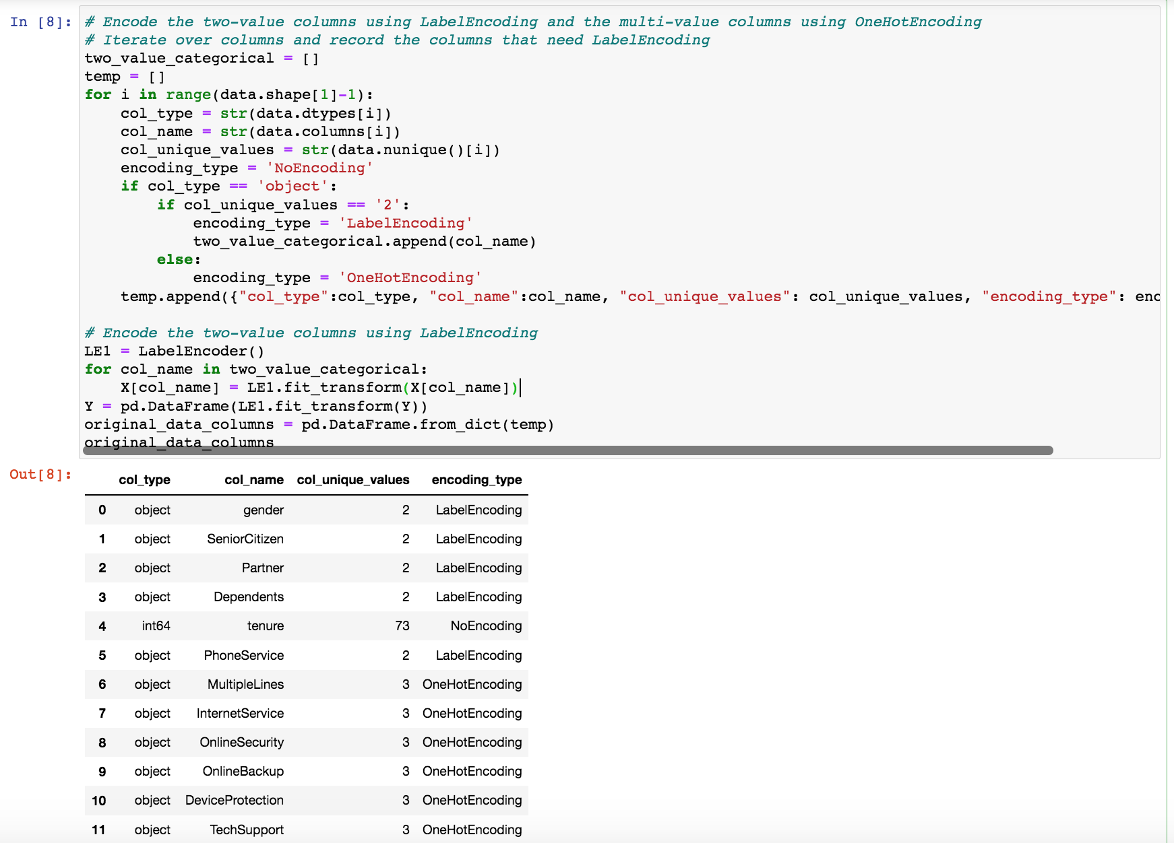
Feature Encoding
Feature encoding: transforming any categorical features into numerical features
Two value features: Label Encoding
Multi value features: One Hot Encoding

Slide 7
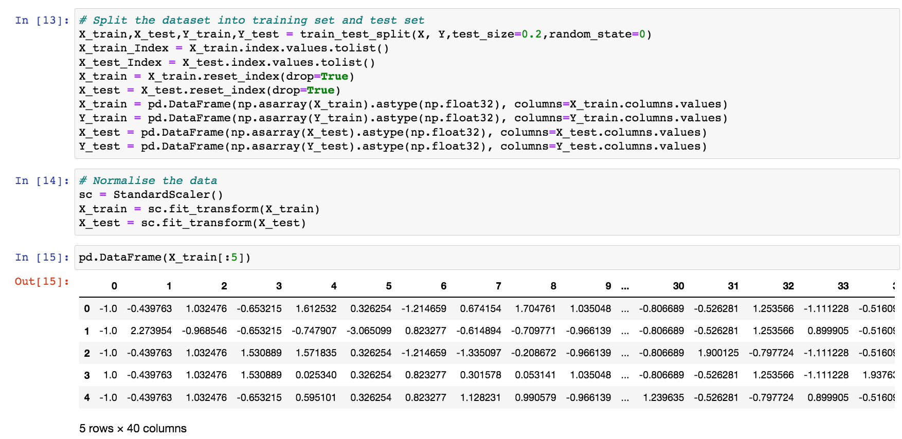
Feature Normalisation/Data Split
Feature scaling: all features are converted to the same scale
To avoid the features with high values dominating when creating the model

Slide 8
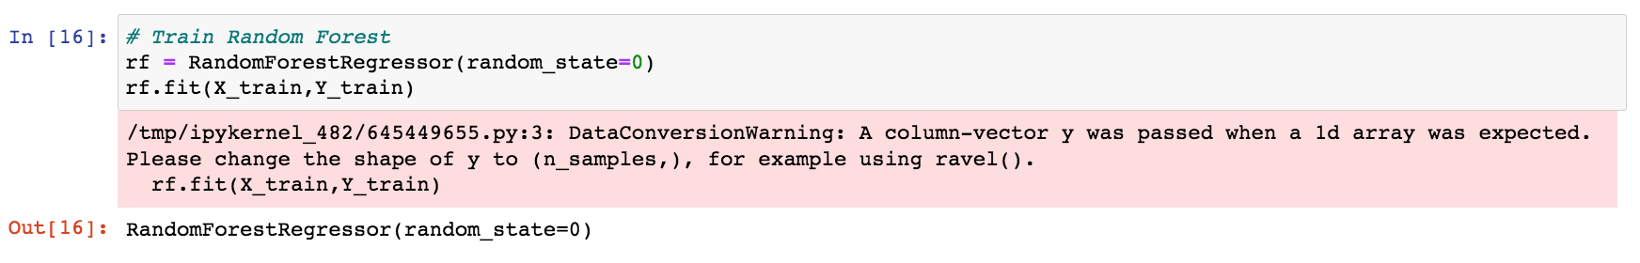
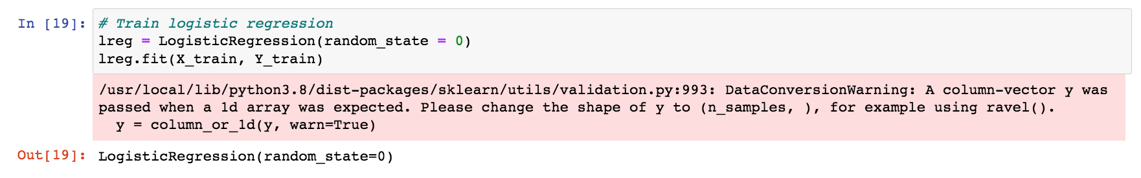
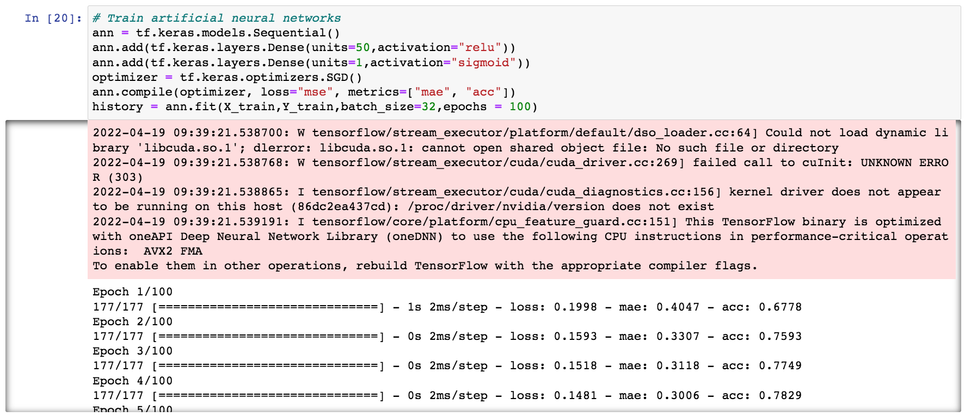
Model Training
Three regression models were tried:
Random Forests
Logistic Regression
ANN
Optimizer: SGD
Epochs: 100
One hidden layer
50 units

Slide 9
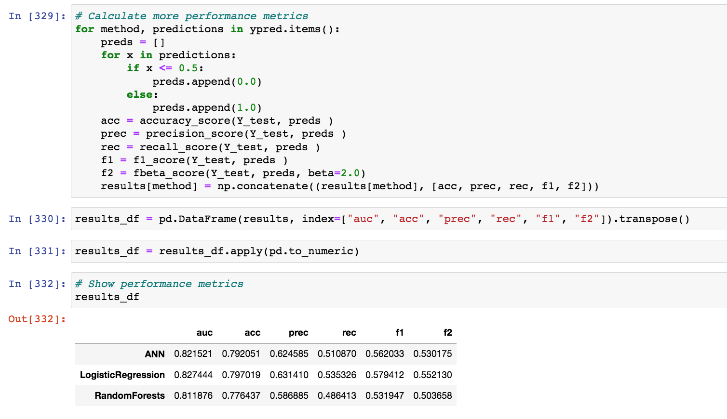
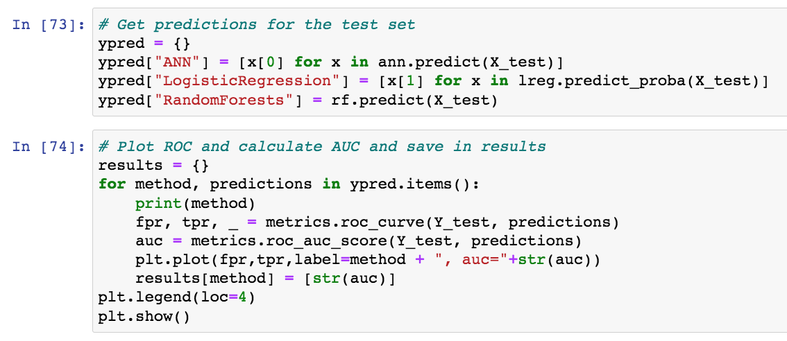
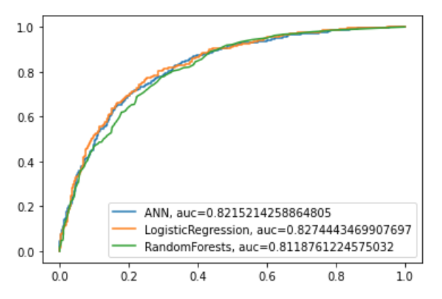
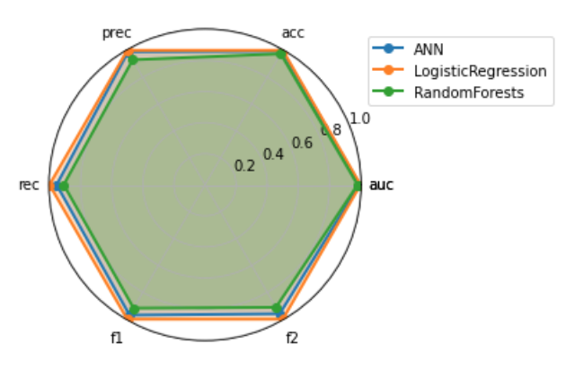
Offline Evaluation (Model Performance)

Slide 10
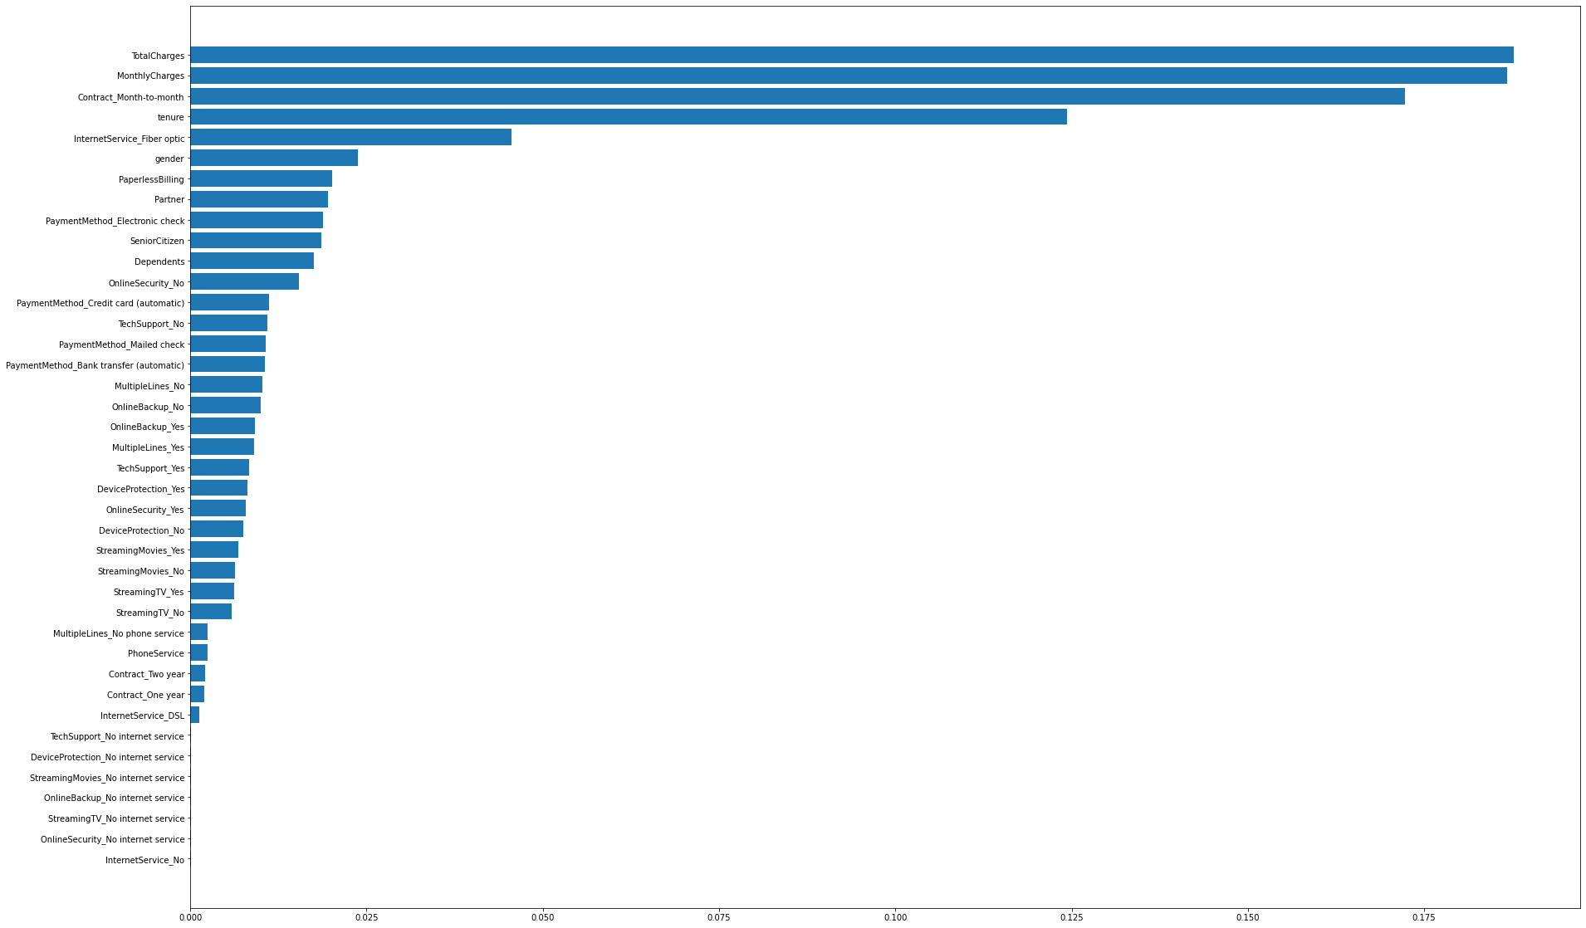
Offline Evaluation (Model Performance)
Important features obtained using Random Forest:
Top features:
Charges
Contract type
We can possibly offer promotions focused on charges and/or contract type to change churn propensity in high-risk customers

Slide 11
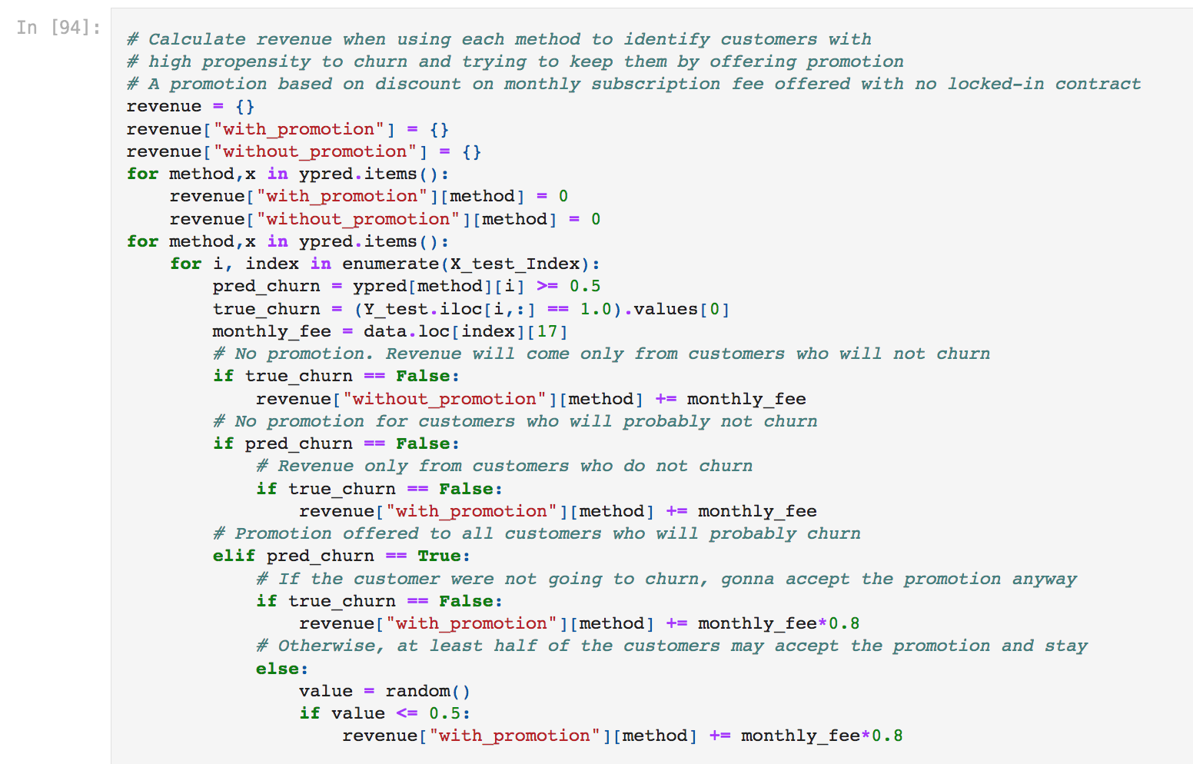
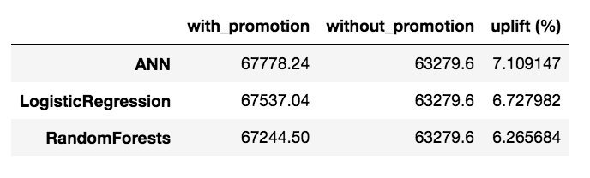
Offline Evaluation (Promotion Performance)
Assumption:
We can retain customers with a high propensity to churn by offering 20% discount on monthly subscription fees
At least half of the customers offered the promotion will take it and stay
Under this assumption, employing machine learning techniques can bring up to around 7.1% uplift in monthly revenues from subscription fees

Slide 12
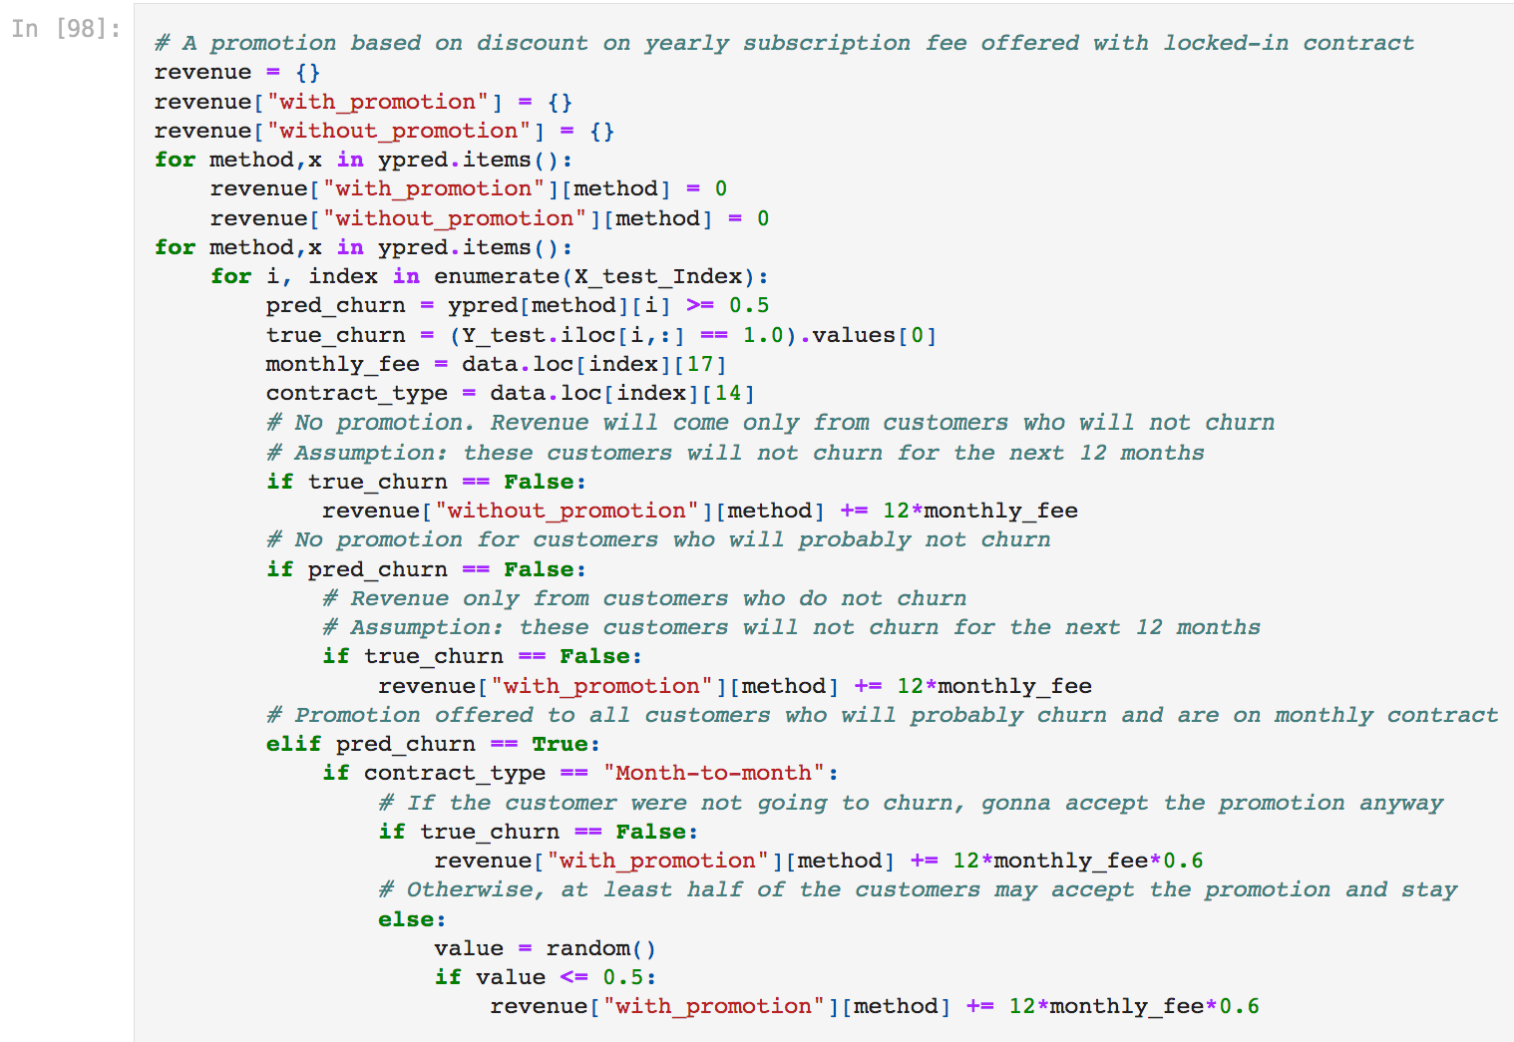
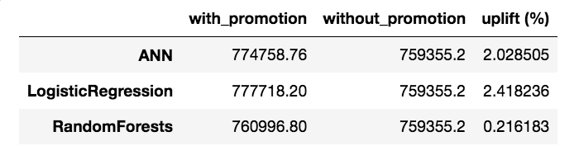
Offline Evaluation (Promotion Performance)
Assumption:
We can retain customers with a high propensity to churn by offering 40% discount on yearly subscription fee and locked-in for whole year
Customers with low churn risk will not churn for the next 12 months
At least half of the customers offered the promotion will take it and stay
Around 2.4% uplift in annual revenue using locked-in contract promotion
RandomForest has worse performance than other solutions using this strategy:
Probably due to poor performance on month-to-month contract types

Slide 13
Model Deployment and AB testing
Evaluation of promotion strategies on test set is restricted by assumptions
AB testing needs to be done to fully evaluate the model
Customers are randomly split into two groups with 33% in each
A: no promotion is offered to customers
B: a monthly promotion offered to customers with high churn predicted propensity
C: a yearly promotion (locked-in contract) offered to high-risk customers
Total revenues from monthly subscriptions are calculated for both groups after several months following the promotions
Do we get more more revenue from group B/C than A?
Are the uplifts statistically significant?
Which strategy results in better customer retention?

Slide 14
Summary and Future Work
We proposed an ML based solution to predict churn propensity of customers from an interne service provider
Three solutions were implemented and compared offline using model performance metrics
Promotion strategies suggested based on insights obtained from feature importance analysis
Promotion strategy performances were compared offline under assumptions
Promotion strategies can perform very differently when coupled with different models
Future work involves testing the model and promotion strategies under real scenario and deploying the winner solution to production

