Slide 1
SAN Storage Area Network

Slide 2
Agenda
Introduction
SAN Architecture
Fibre Channel & IP SAN
SAN Security
IP SAN & Fibre Channel Security
SAN Standards & Organization
SAN Best Practices & Checklist
Conclusion

Slide 3
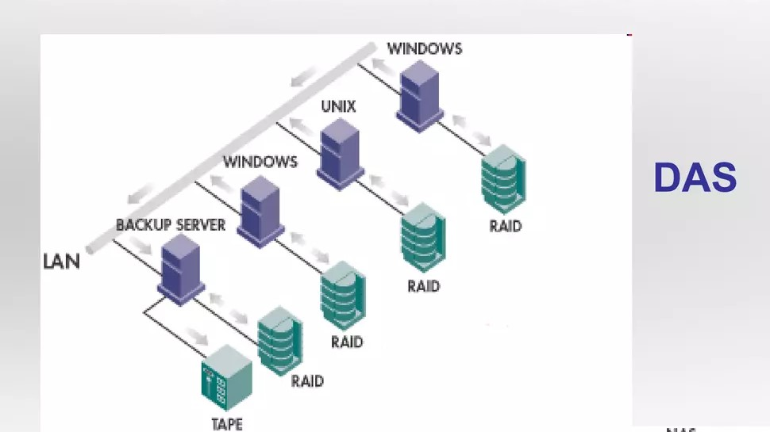
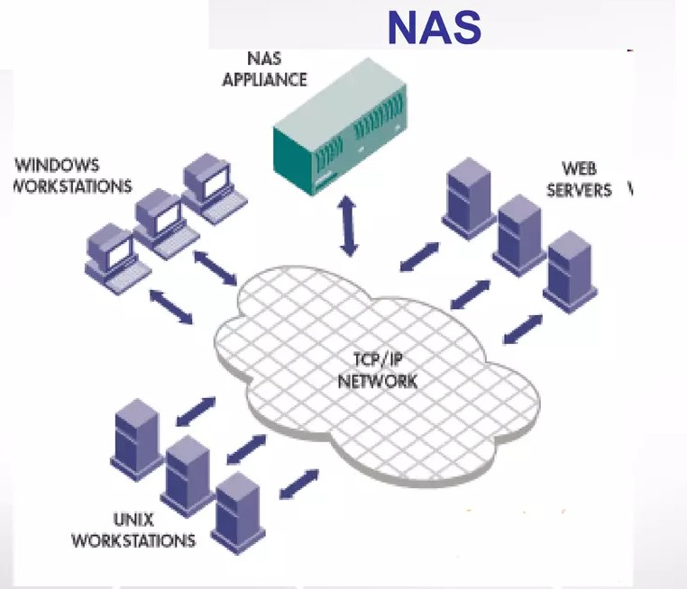
Storage models

Slide 4
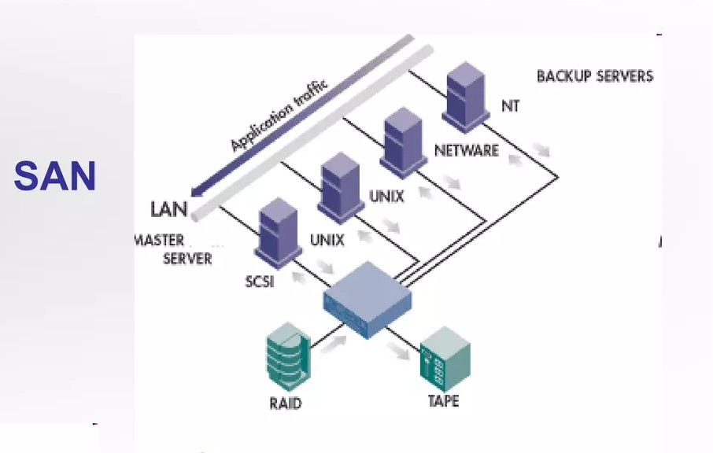
Storage models

Slide 5
What is SAN ?
A storage area network (SAN) is a network designed to attach computer storage devices such as disk array controllers and tape libraries to servers.

Slide 6
Introduction
Need for SAN in Business :
Provide High Availability
Improve Data Storage Managemen , Reduce Cost
Improve Data Backup Efficiency
Enable Storage Virtualization
Enable Efficient Hardware Deployment

Slide 7
SAN Architecture
Server Layer
Fabric Layer
NT Server
Unix Server
Database Server
Fiber Channel Switch
Fiber Channel Bridges

