Slide 1
B.TECH FINAL-YEAR CAPSTONE · YEAR 4, SEMESTER VII
CardioGuard
Every message ends in exactly one action
ANSWER
grounded answer with citations
An evidence-grounded clinical decision support and patient consultation system for hypertension and cardiovascular care
SOFT-ASK
asks for the missing personal fact
GENERALIZE
general guideline information
System: MedBridge, a local, safety-first RAG assistant built around a Dual Answerability Gate
ABSTAIN
safe refusal, no text generated
TEAM
GUIDE
Vijay Aravindh S. (23BAI1160)
Mohammad Farhan Rashid (23BAI1529)
Dr. Maheswari S.
ESCALATE
emergency template, no text generated
[TO BE FILLED: university]
[TO BE FILLED: department]
[TO BE FILLED: review name and date]
Two of the five never call the text generator.
Notes:
Introduce the team and the guide. The project is presented as CardioGuard; the software system inside it is called MedBridge, and we use that name for everything technical.
One-sentence pitch: MedBridge is a consultation assistant for hypertension and wider cardiovascular care that runs entirely on a local machine, and before it writes any answer it decides whether it is entitled to answer at all.
Point to the five chips on the right: every patient message ends in exactly one of these five actions. Three of them (ANSWER, SOFT-ASK, GENERALIZE) produce generated text grounded in guideline passages; two of them (ABSTAIN, ESCALATE) never call the text generator and return pre-vetted templates.
Roadmap: problem, gap and objectives, architecture and the two gates (plus the grounding check added after the study), emergency handling, retrieval, privacy, the user interface, the evaluation design and results, robustness, performance, testing, and finally limitations.
Speaker split: [TO BE FILLED: who presents which slides].

Slide 2
PROBLEM AND MOTIVATION
Hypertension is common, and generic chatbots answer anyway
≈ 1 in 3
≈ 1.3 billion
Why an unguarded chatbot is unsafe here
Hallucination survives grounding: the best of twelve clinical RAG pipelines still hallucinated in 5.8 % of answers (Wołk 2025)
Unsafe personalisation: a correct guideline fact applied without knowing the patient's kidney disease, pregnancy or medicines
Missed emergencies: a probabilistic generator cannot guarantee that “BP 200/120 and chest pain” is escalated
Brand-name fragility: swapping brand and generic drug names cost LLMs about 1–10 % accuracy (Gallifant et al. 2024)
Privacy: sending health conversations to a cloud API creates obligations under India's DPDP Act (Govt. of India 2023)
adults worldwide live with hypertension
(WHO 2023)
people affected; the number doubled from 1990 to 2019
(WHO 2023; NCD-RisC 2021)
≈ 4 in 5
35.5 %
people with hypertension are not adequately treated
(WHO 2023)
of Indian adults aged 20 and above have hypertension
(Anjana et al. 2023)
Sources: report/references/references.json (full entries in the notes)
CardioGuard · MedBridge — final review
2 / 19
Notes:
Start with the burden. WHO's first global report on hypertension estimates that about one adult in three is affected, that the number of people with hypertension doubled to roughly 1.3 billion between 1990 and 2019, and that about four in five are not adequately treated. The NCD Risk Factor Collaboration's pooled analysis of 1,201 population studies shows the same doubling. In India the ICMR-INDIAB survey estimated a prevalence of 35.5 per cent among adults aged 20 and above.
Most of these people make day-to-day decisions alone: is this reading dangerous, is the dizziness from my new tablet, what should I eat. Chatbots look like the ideal always-available explainer, but they fail in specific ways (right column).
Hallucination does not disappear with retrieval: in a comparison of twelve clinical RAG pipelines the best one still hallucinated in 5.8 per cent of answers. Unsafe personalisation is subtler: the fact is correct, the patient is wrong for it. Emergencies need a guarantee, not a probability. Brand names matter in India, where patients name their medicines by brand. And cloud APIs conflict with the privacy of health data.
All numbers on this slide come from the cited, verified references (report/references/references.json); none are our measurements.
Sources: report/references/references.json (full entries in the notes).
References cited on this slide:
- WHO 2023: World Health Organization, "Global report on hypertension: the race against a silent killer," World Health Organization, Geneva, ISBN 978-92-4-008106-2, 2023. [Online]. Available: https://www.who.int/publications/i/item/9789240081062
- NCD-RisC 2021: NCD Risk Factor Collaboration (NCD-RisC), "Worldwide trends in hypertension prevalence and progress in treatment and control from 1990 to 2019: a pooled analysis of 1201 population-representative studies with 104 million participants," The Lancet, vol. 398, no. 10304, pp. 957–980, 2021. doi: 10.1016/S0140-6736(21)01330-1.
- Anjana et al. 2023: R. M. Anjana et al., "Metabolic non-communicable disease health report of India: the ICMR-INDIAB national cross-sectional study (ICMR-INDIAB-17)," The Lancet Diabetes & Endocrinology, vol. 11, no. 7, pp. 474–489, 2023. doi: 10.1016/S2213-8587(23)00119-5.
- Wołk 2025: K. Wołk, "Evaluating Retrieval-Augmented Generation Variants for Clinical Decision Support: Hallucination Mitigation and Secure On-Premises Deployment," Electronics (MDPI), vol. 14, no. 21, p. 4227, 2025. doi: 10.3390/electronics14214227.
- Gallifant et al. 2024: J. Gallifant et al., "Language Models are Surprisingly Fragile to Drug Names in Biomedical Benchmarks," in Proc. Findings of the Association for Computational Linguistics: EMNLP 2024, 2024, pp. 12448–12465. doi: 10.18653/v1/2024.findings-emnlp.726.
- Govt. of India 2023: Parliament of India, "The Digital Personal Data Protection Act, 2023 (No. 22 of 2023)," The Gazette of India, Extraordinary, Part II, Section 1, No. 25; Ministry of Law and Justice (Legislative Department), New Delhi, 2023. [Online]. Available: https://www.meity.gov.in/static/uploads/2024/06/2bf1f0e9f04e6fb4f8fef35e82c42aa5.pdf

Slide 3
RESEARCH GAP AND OBJECTIVES
The gap: RAG never decides whether it should answer
What existing approaches leave open
Objectives
Standard RAG retrieves and generates for every query: there is no explicit point at which it declines (Lewis et al. 2020)
Self-reflective and corrective RAG judge the evidence, not whether the patient context is sufficient (Asai et al. 2024; Yan et al. 2024)
Abstention research still has open gaps in how declining to answer is evaluated (Wen et al. 2025)
Flagship medical LLMs such as Med-PaLM are large, closed models that cannot be run privately on local hardware (Singhal et al. 2023)
1. Dual Answerability Gate: Context Gate before retrieval, Evidence Gate after it
2. Deterministic emergency fast-path before any LLM call, under 10 ms
3. Curated cardiology knowledge base with hybrid retrieval and reranking
4. Grounded, cited generation; templates for ABSTAIN and ESCALATE
5. Privacy by design: redaction, encryption, erasure, local-only inference
6. HalluBench study: C0–C5, the C1G reference and V1, V2, V12; LLM judge on all, NLI judge for agreement; paired tests
7. Local operation sized for a 6 GB GPU; latency measured before and after (on the Apple M5)
8. Transparent web interface and an automated test suite
“I don't know enough about you”
“I don't have enough evidence”
Patient context is missing → ask first (SOFT-ASK), before retrieval
Guideline evidence is thin → generalise or abstain, after retrieval
Sources: report/references/references.json (full entries in the notes)
CardioGuard · MedBridge — final review
3 / 19
Notes:
Retrieval-augmented generation pairs a model with a retriever, and it is the natural starting point for a guideline assistant. But in its standard form it retrieves and generates for every query. Later work such as Self-RAG and Corrective RAG adds critique of the retrieved evidence, yet nothing asks whether the system knows enough about the patient to apply that evidence safely. A survey of abstention also points to open gaps in how declining to answer is evaluated.
Our observation is that there are two different reasons to hold back, shown in the two amber boxes. The first is about the patient and is best checked before retrieval: if a fact that would change the safe answer is missing, ask for it. The second is about the evidence and can only be checked after retrieval: if the passages do not support a specific answer, generalise or abstain. MedBridge makes both decisions explicit as two separate gates, with a deterministic emergency check in front of both.
The eight objectives on the right are the ones in Chapter 1 of the report, each with a measurable criterion; the remaining slides follow them in order.
Sources: report/references/references.json (full entries in the notes).
References cited on this slide:
- Lewis et al. 2020: P. Lewis et al., "Retrieval-Augmented Generation for Knowledge-Intensive NLP Tasks," in Advances in Neural Information Processing Systems 33 (NeurIPS 2020), 2020, pp. 9459–9474. arXiv:2005.11401.
- Asai et al. 2024: A. Asai, Z. Wu, Y. Wang, A. Sil, and H. Hajishirzi, "Self-RAG: Learning to Retrieve, Generate, and Critique through Self-Reflection," in Proc. International Conference on Learning Representations (ICLR 2024), 2024, pp. 9112–9141. arXiv:2310.11511.
- Yan et al. 2024: S.-Q. Yan, J.-C. Gu, Y. Zhu, and Z.-H. Ling, "Corrective Retrieval Augmented Generation," arXiv preprint arXiv:2401.15884, 2024. doi: 10.48550/arXiv.2401.15884.
- Wen et al. 2025: B. Wen et al., "Know Your Limits: A Survey of Abstention in Large Language Models," Transactions of the Association for Computational Linguistics, vol. 13, pp. 529–556, 2025. doi: 10.1162/tacl_a_00754.
- Singhal et al. 2023: K. Singhal et al., "Large language models encode clinical knowledge," Nature, vol. 620, no. 7972, pp. 172–180, 2023. doi: 10.1038/s41586-023-06291-2.

Slide 4
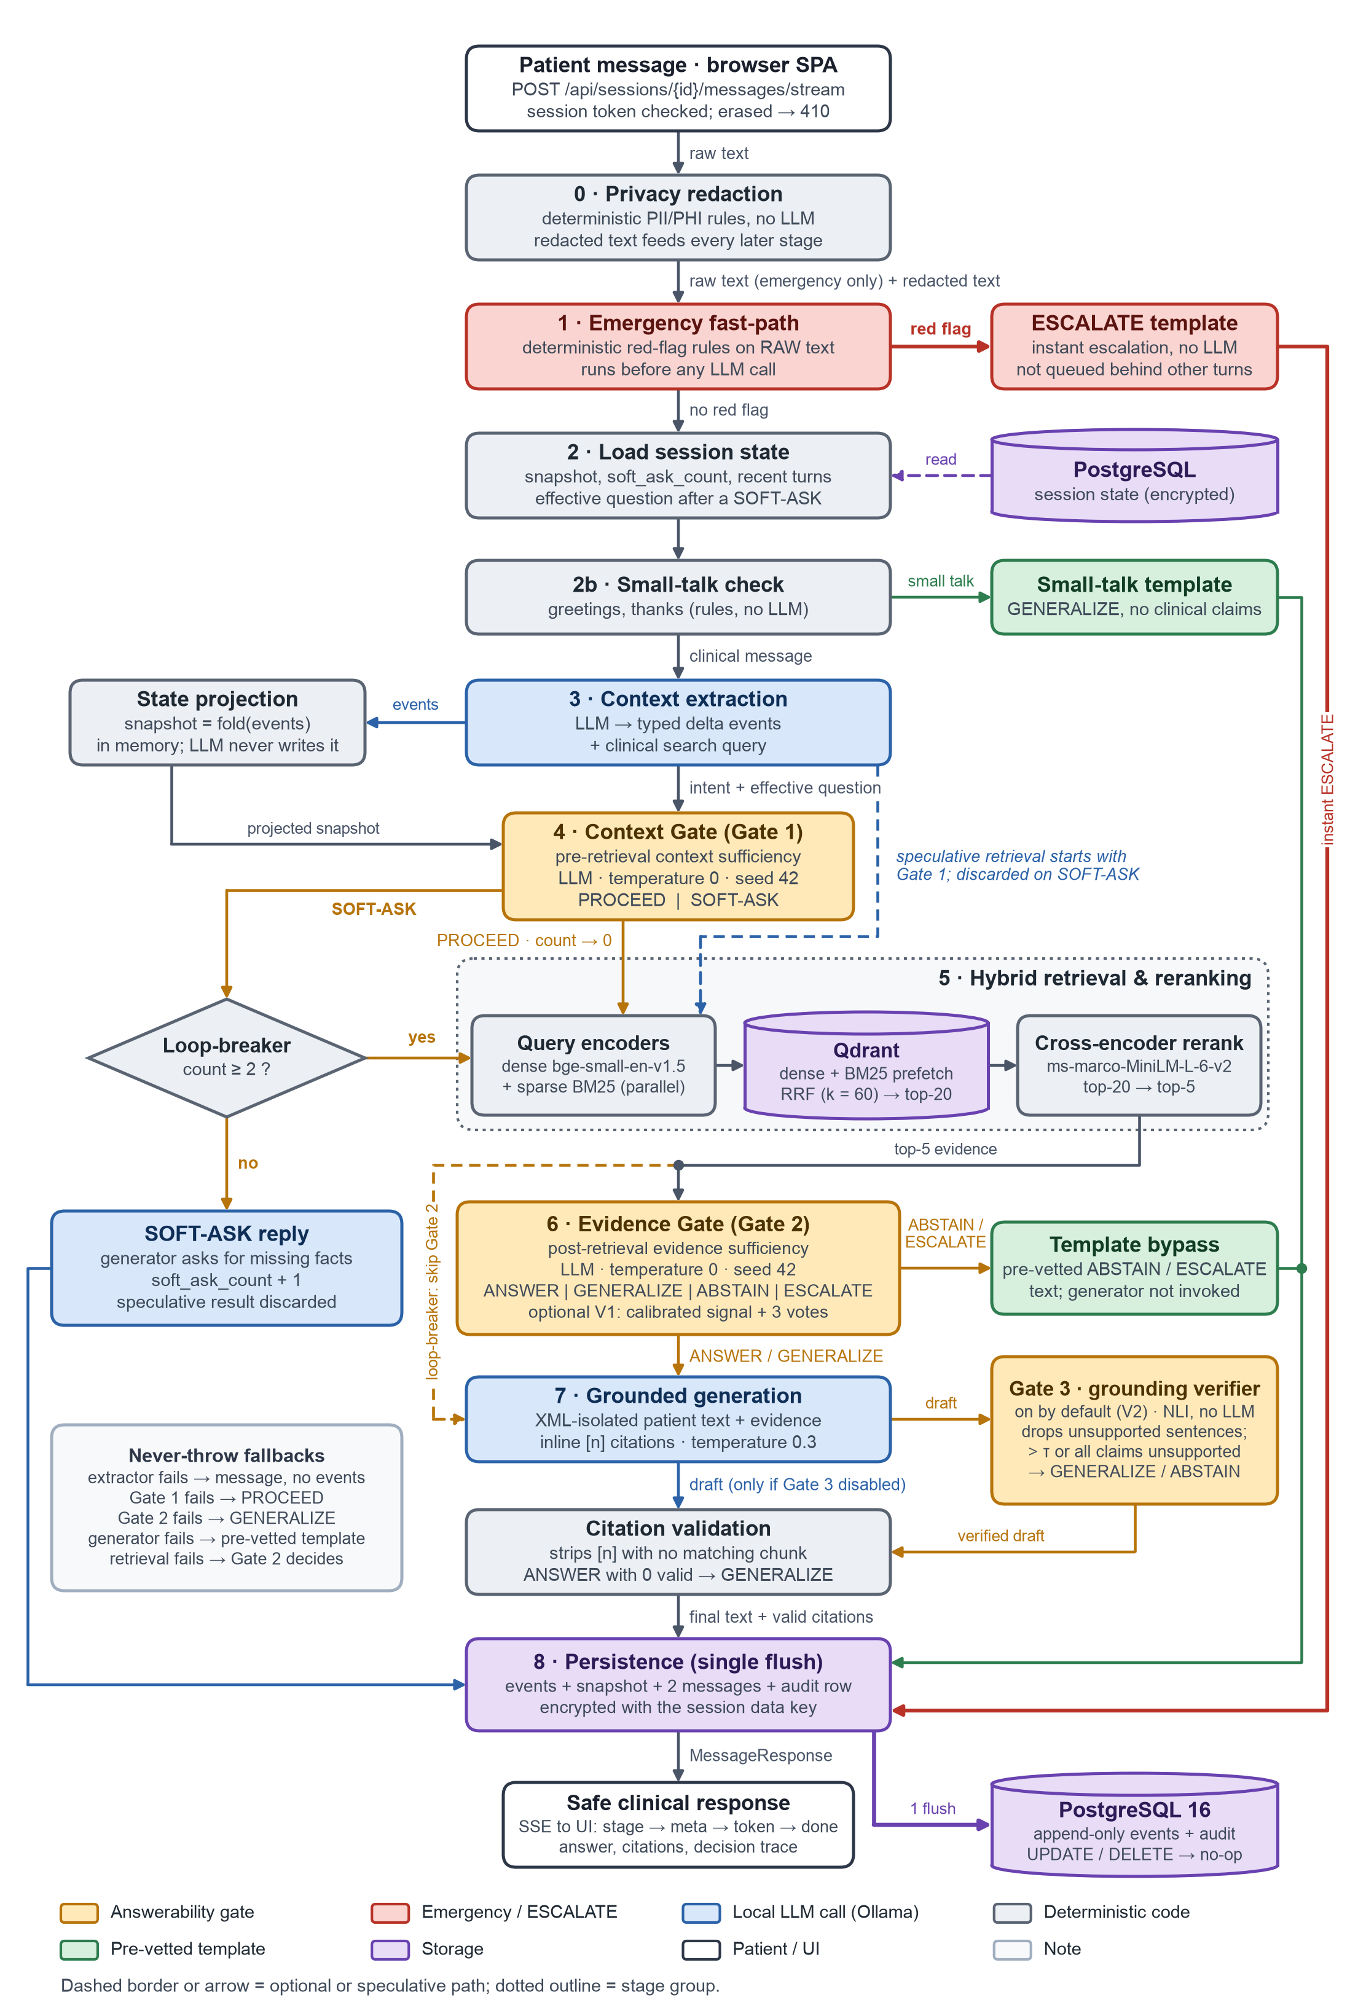
SYSTEM DESIGN
Architecture: two gates before the answer, a grounding check after it
0
Privacy redaction
deterministic PII/PHI rules; redacted text feeds every later stage
1
Emergency fast-path
rules on the raw message, no LLM, before any LLM call → ESCALATE template
2
Session state, small talk
event-sourced snapshot and soft-ask counter; greetings by template
3
Context extraction
LLM → typed clinical events + search query; snapshot = fold(events)
4
Context Gate (Gate 1)
SOFT-ASK or PROCEED; after 2 asks in a row the loop-breaker forces GENERALIZE
5
Hybrid retrieval
dense + BM25 → RRF (k = 60) → top 20 → cross-encoder → top 5; runs speculatively with Gate 1
6
Evidence Gate (Gate 2)
ANSWER, GENERALIZE, ABSTAIN or ESCALATE
7
Grounded generation
XML-isolated input, validated [n] citations; ABSTAIN and ESCALATE use templates
7b
Gate 3 verifier
local NLI model checks each sentence against its cited chunks and strips unsupported ones; on by default since the study
8
Persistence
one encrypted flush per turn; append-only events and audit log
CardioGuard · MedBridge — final review
4 / 19
Notes:
Walk the pipeline top to bottom; the full diagram on the left is Figure 3.1 of the report, and the colours are the same in every diagram: amber for the gates, red for the emergency path, blue for calls to the local LLM, grey for deterministic code, green for templates and privacy controls, purple for storage.
Stage 0 redacts personal identifiers before anything else. Stage 1, the emergency fast-path, reads the raw text with deterministic rules and escalates immediately, with no model call. Stage 3 asks the LLM to extract typed clinical events such as BP readings and medicines; the patient snapshot is a fold over those events and is never written by the model directly.
Gate 1 decides whether the patient context is sufficient: SOFT-ASK or PROCEED, and after two consecutive SOFT-ASKs the loop-breaker forces a general answer so the patient is never trapped. Retrieval fuses dense and BM25 results with reciprocal rank fusion and reranks with a cross-encoder; it starts speculatively alongside Gate 1 and is discarded if Gate 1 asks a question, so routing is unchanged. Gate 2 decides whether the evidence supports an answer. Only ANSWER, GENERALIZE and SOFT-ASK reach the generator; ABSTAIN and ESCALATE return pre-vetted templates. Every turn is persisted in one encrypted flush with an immutable audit record.
Stage 7b, Gate 3, is the grounding verifier. It started as the study's V2 variant (the amber box after generation in the figure) and, because V2 significantly reduced hallucination against C5, it is now enabled by default with the thresholds calibrated on the development split (commit 7a3bc67; entailment threshold 0.2, maximum unsupported fraction 1.0). It uses a different NLI model (cross-encoder/nli-MiniLM2-L6-H768) from the study's NLI judge. Gate 3 can only remove sentences or make a reply more conservative: since commit 16e594b a draft whose every checked claim is unsupported is regenerated as GENERALIZE and, failing that, withdrawn as ABSTAIN.
Defaults shown here are read from medbridge/config.py at build time.
Sources: report/figures/architecture_pipeline.png; medbridge/config.py.

Slide 5
CORE CONTRIBUTION
The Dual Answerability Gate: five actions, one per message
Action | Decided by | When | What the patient gets | Generator called?
ANSWER | Evidence Gate | Context is sufficient and the evidence specifically answers this question for this patient | Grounded answer with validated [n] citations | Yes
SOFT-ASK | Context Gate | A personal fact that would change the safe answer is missing | One focused follow-up question | Yes
GENERALIZE | Evidence Gate or loop-breaker | Evidence covers the topic only in general, or a false belief needs correcting; or 2 SOFT-ASKs in a row | Non-personalised guideline information with citations | Yes
ABSTAIN | Evidence Gate | Outside cardiovascular care, an unknown (possibly fabricated) drug, or a dose the evidence does not state | Pre-vetted refusal with a referral | No: template
ESCALATE | Emergency fast-path, or Evidence Gate | Red flags happening now: chest pain, stroke signs; fast-path: a reading with systolic ≥ 180 or diastolic ≥ 120 when BP is mentioned (a bare number pair must meet both); Gate 2: 180/120 or more with symptoms | Emergency template: seek care now | No: template
Both gates: temperature 0, seed 42, JSON-schema outputs
Every gate decision and rationale goes to an append-only audit log
Never-throw fallbacks: Gate 1 fails → PROCEED · Gate 2 fails → GENERALIZE · generator fails → template
An ANSWER left with no valid citation is downgraded to GENERALIZE
CardioGuard · MedBridge — final review
5 / 19
Notes:
This is the novel part. Each message ends in exactly one of five actions, and the table says who decides and when.
The Context Gate runs before retrieval and only chooses between asking and proceeding. It asks only when three things hold together: the question is about the patient's own cardiovascular care, a specific personal fact would change the safe answer, and that fact is missing. The loop-breaker caps this at two consecutive questions and then gives a general answer.
The Evidence Gate runs after retrieval with four outcomes and applies the first rule that fits: escalate an emergency happening now; abstain when the topic is outside cardiovascular care, when a named drug or product does not appear in the evidence (it may not exist), or when a specific dose or number is not stated; generalise when the evidence is only general or a false belief must be corrected; answer only when the evidence answers this question for this patient.
The design guarantees in the strip are what make the system auditable: deterministic decoding for the gates, structured outputs, a logged rationale for every decision, and fallbacks that always degrade to something safe. Likely viva question: why two gates and not one? Because the two checks need different information at different times: the patient check must happen before retrieval, the evidence check can only happen after it. The ablation conditions C3 and C4 measure each gate on its own.
Sources: medbridge/config.py; medbridge/ai/context_gate.py; medbridge/ai/evidence_gate.py.

Slide 6
SAFETY LAYER
Emergency fast-path and natural-language robustness
Deterministic emergency triage
Examples, classified when this deck was built
Runs on the raw (unredacted) message before any LLM call: rules only, no model, no network
Lay phrasing and formats: “150 over 95”, “chest feels tight”, “can't move my arm”
Negation and context: “no chest pain”, educational and historical mentions pass through
Typo tolerance plus a Hinglish and Indian-English lexicon
Time budget under 10 ms, enforced by a unit test on 2,000-character messages
Patient message | Fast-path output
“my chest feels really tight and my left arm went numb” | ESCALATE
“face drooping and slurred speech since 10 minutes” | ESCALATE
“dard nahi hai lekin bp 200/120 hai” | ESCALATE
“no chest pain, my bp was 128/82 this morning” | to the gates
“I had a stroke two years ago, what BP target should I aim for?” | to the gates
“seene mein dard nahi hai” | to the gates
Labelled case files (in-sample)
Robust to how patients actually write
Case file | Messages (esc. / not) | TP | FP | FN | TN
English | 288 (156 / 132) | 156 | 0 | 0 | 132
Hinglish / Indian English | 141 (90 / 51) | 90 | 0 | 0 | 51
Brand → generic: 189 brand names, 65 of them Indian (e.g. Telma → telmisartan)
Lay → clinical query expansion (“water pill” → thiazide diuretic)
BP parser tells readings from targets (“is 130/80 my target?”)
Recent turns go to the extractor for follow-ups like “is that dose ok?”
Written alongside the rules: coverage of intended phrasings, not real-world accuracy.
Independent estimate, HalluBench test emergencies (C5 recall): 100.0% [86.2, 100.0]
Sources: medbridge/nlp/drugs.py · medbridge/core/emergency_classifier.py · tests/data/emergency_cases.json · tests/data/emergency_cases_hinglish.json · evaluation/results/summary.json
CardioGuard · MedBridge — final review
6 / 19
Notes:
The emergency fast-path is the one place where we do not trust a language model at all. It is a deterministic classifier that reads the raw, unredacted message (redaction runs first, but its output is not used here), before any LLM call, so an emergency is escalated even if Ollama is down.
It understands everyday phrasings and number formats, handles negation (“no chest pain” does not escalate), ignores educational and historical mentions, tolerates typos, and has a Hinglish and Indian-English lexicon. The examples at the top right were run through the real classifier when this deck was built; the right-hand column shows its actual output.
The table on the right runs the classifier over the two labelled case files: 288 English messages and 141 Hinglish messages. Say clearly that these files were written alongside the rules, so the result is in-sample: it shows the intended phrasings are covered, not real-world accuracy. The independent estimate, shown underneath, is the emergency recall of C5 on the HalluBench test split.
The classifier is deliberately biased toward recall: questions that name a red flag, such as whether beta-blockers can cause shortness of breath, are escalated, which is its main known source of false positives.
The bottom panel lists the natural-language work in the rest of the pipeline: brand-to-generic normalisation, lay-to-clinical query expansion, a BP parser that does not mistake a target for a reading, and conversation history for follow-up questions.
Sources: medbridge/nlp/drugs.py; medbridge/core/emergency_classifier.py; tests/data/emergency_cases.json; tests/data/emergency_cases_hinglish.json; evaluation/results/summary.json.

Slide 7
KNOWLEDGE BASE AND RETRIEVAL
Curated knowledge base and measured retrieval quality
27
10
2,747
70
curated documents (publicly readable, licence recorded per document)
issuing organisations (AHA, ACC, ESC, NICE, WHO, ...)
indexed chunks, at most 400 tokens each
labelled evaluation queries (lay and clinical)
Configuration (70 queries) | Recall@5 | Recall@20 | MRR | nDCG@5
Dense only (bge-small-en-v1.5) | 0.740 [0.648, 0.826] | 0.860 [0.790, 0.921] | 0.677 [0.584, 0.766] | 0.641 [0.553, 0.724]
Sparse only (BM25) | 0.640 [0.538, 0.738] | 0.833 [0.755, 0.902] | 0.584 [0.488, 0.676] | 0.545 [0.451, 0.634]
Hybrid: dense + BM25, RRF k = 60 | 0.743 [0.650, 0.826] | 0.867 [0.795, 0.929] | 0.740 [0.650, 0.825] | 0.688 [0.600, 0.771]
Hybrid + rerank: MiniLM-L-6 (production) | 0.733 [0.638, 0.821] | 0.867 [0.795, 0.929] | 0.698 [0.606, 0.785] | 0.657 [0.569, 0.740]
Hybrid + rerank: bge-reranker-base | 0.743 [0.652, 0.826] | 0.867 [0.795, 0.929] | 0.713 [0.623, 0.799] | 0.658 [0.574, 0.738]
Hybrid + rerank: MiniLM-L-12 | 0.755 [0.662, 0.840] | 0.867 [0.795, 0.929] | 0.708 [0.619, 0.794] | 0.669 [0.582, 0.751]
Hybrid + rerank: MedCPT | 0.748 [0.655, 0.831] | 0.867 [0.795, 0.929] | 0.734 [0.643, 0.819] | 0.683 [0.594, 0.766]
Reading: the 95 % bootstrap CIs of all configurations overlap on every metric, so this 70-query set shows no clear difference between retrievers or rerankers (no paired test was run); the pipeline keeps hybrid fusion and the fast MiniLM-L-6 cross-encoder.
Sources: reports/corpus_stats.json · evaluation/results/retrieval/metrics.json · evaluation/results/retrieval/reranker_ablation/*/metrics.json
CardioGuard · MedBridge — final review
7 / 19
Notes:
The knowledge base grew from three PDF guidelines at Review 3 to 27 curated documents from 10 organisations (joint AHA/ACC guidelines counted as AHA and ACC): 13 PDFs and 14 HTML pages, 2,747 chunks in total. Every document is pinned in data/corpus_manifest.json with its source, licence and checksum; nothing is scraped. Chunks are at most 400 tokens so that no text falls outside the embedder's window, which was a real problem in the old index.
Retrieval was evaluated on 70 labelled queries. The table gives Recall at 5 and 20, MRR and nDCG at 5, each with a 95 per cent bootstrap confidence interval. Hybrid fusion followed by the MiniLM-L-6 cross-encoder (the highlighted production row) is the configuration the pipeline uses; that row and the three below it form the reranker ablation, where four cross-encoders rerank the same top-20 hybrid candidates.
Read the takeaway line honestly: on this set the confidence intervals overlap, so it shows no clear difference between fusion alone and any reranker; no paired test was run, and MiniLM-L-6 even has slightly lower point estimates than fusion alone. We kept the small MiniLM cross-encoder because it is the fastest, it is part of the approved architecture, and its score doubles as the quantitative evidence signal of the calibrated Evidence Gate variant (V1).
Sources: reports/corpus_stats.json; evaluation/results/retrieval/metrics.json; evaluation/results/retrieval/reranker_ablation/*/metrics.json.

Slide 8
PRIVACY AND SECURITY
Privacy by design: patient data never leaves the machine
Redact
Deterministic PII/PHI rules before any model call and before storage; BP values, doses and labs are kept
Redaction quality (strict span match)
Test set | Messages | P | R | F1
Development set (in-sample) | 240 | 1.000 | 0.989 | 0.995
Blind held-out set (frozen detector) | 237 | 0.944 | 0.744 | 0.832
Encrypt
A random data key per session, wrapped by a master key from the environment (Fernet: AES-128-CBC + HMAC-SHA256)
Erase
Right to erasure by crypto-shredding: deleting the session key makes even append-only rows unreadable
The blind set was written by another author and evaluated once, with the detector frozen
Weak spot, names without a cue: blind-set recall 0.429
Clinical values corrupted: 0 (development), 0 (blind)
PII-free blind messages altered: 1 of 89
Mean detection time per message: 0.043 ms
Control access
HMAC-signed expiring session tokens, admin login, rate limits, body-size limit, CSP and security headers
Stay local
LOCAL_ONLY_MODE: only a loopback Ollama is allowed; remote providers are refused
Sources: reports/privacy_redaction_metrics.json · medbridge/privacy/
CardioGuard · MedBridge — final review
8 / 19
Notes:
Privacy was a deferred limitation at Review 1; it is now a layer of its own (Figure 3.7, privacy controls along the request path, in the report).
Redaction is deterministic and runs before any model call and before anything is stored. It is careful not to touch clinical values: BP readings, doses, lab values and drug names survive. Storage is encrypted per session: each session gets its own data key, wrapped by a master key that only lives in the environment. That is what makes erasure possible in an append-only design: deleting the session key ("crypto-shredding") makes every stored ciphertext of that session unreadable, including the immutable audit and event rows, and the API then answers 410 for that session. Access control uses signed, expiring session tokens; and in local-only mode a non-loopback model host is refused outright.
The table reports redaction quality. The development set was written alongside the detector, so its scores are in-sample. The blind held-out set was written by a different author who never saw the detector, and it was evaluated once with the detector frozen: strict precision 0.944, recall 0.744. The weak spot is names without a cue (blind-set name recall 0.429); structured identifiers carry over well, and no clinical value was corrupted on either set.
Sources: reports/privacy_redaction_metrics.json; medbridge/privacy/.

Slide 9
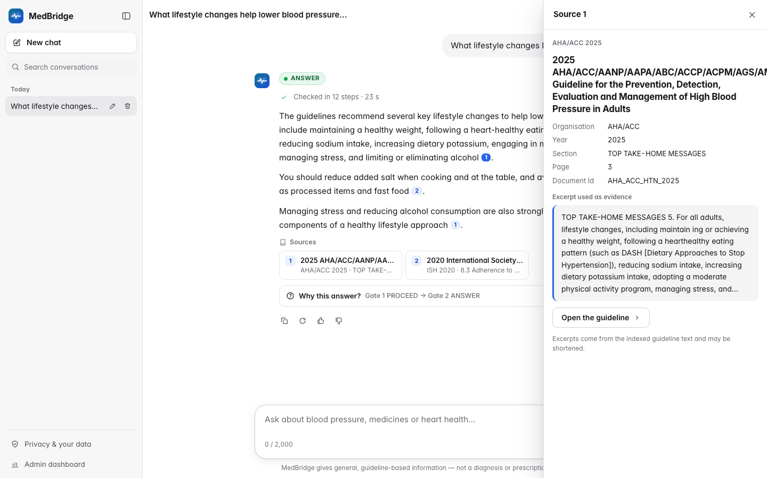
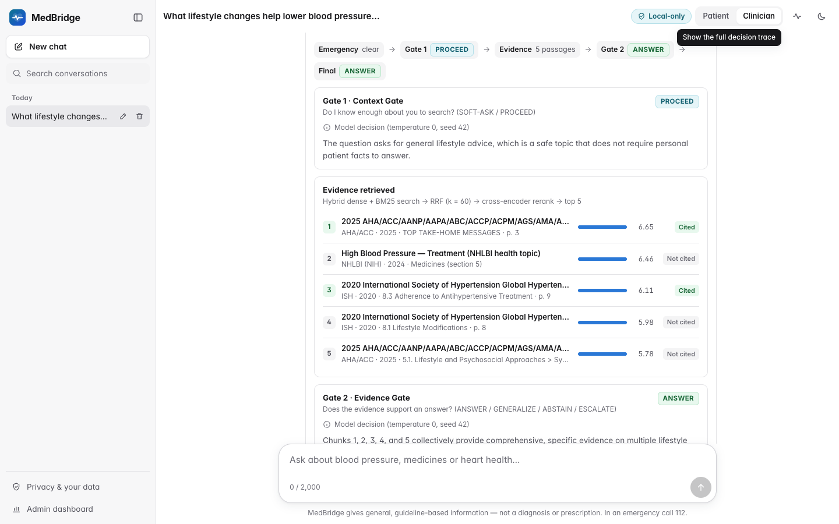
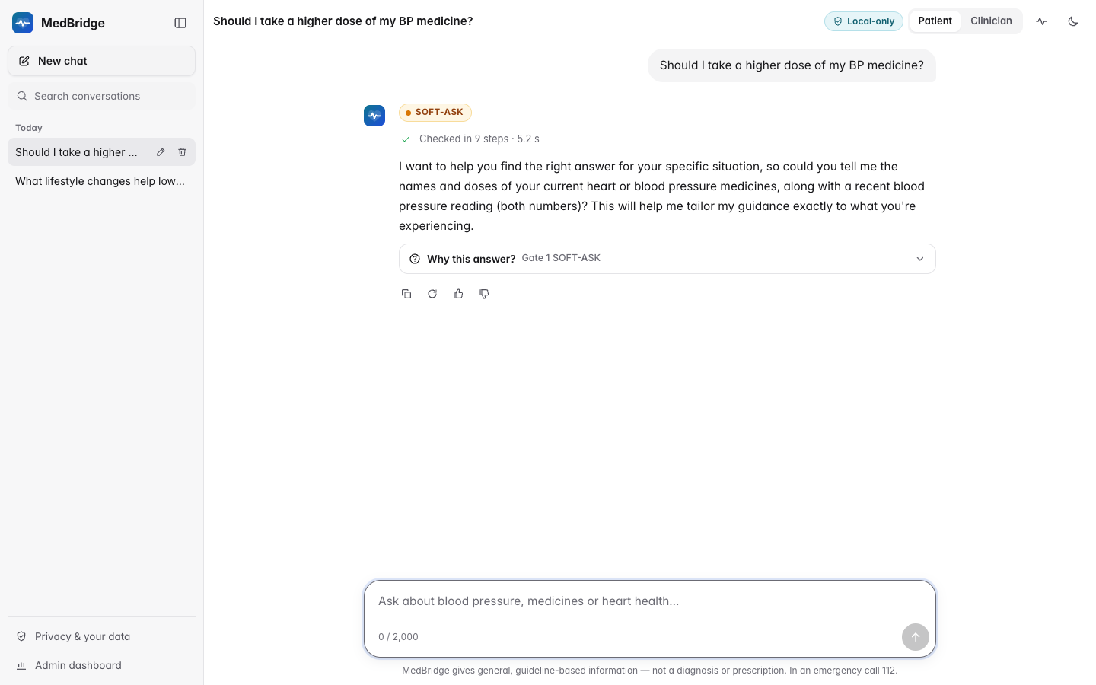
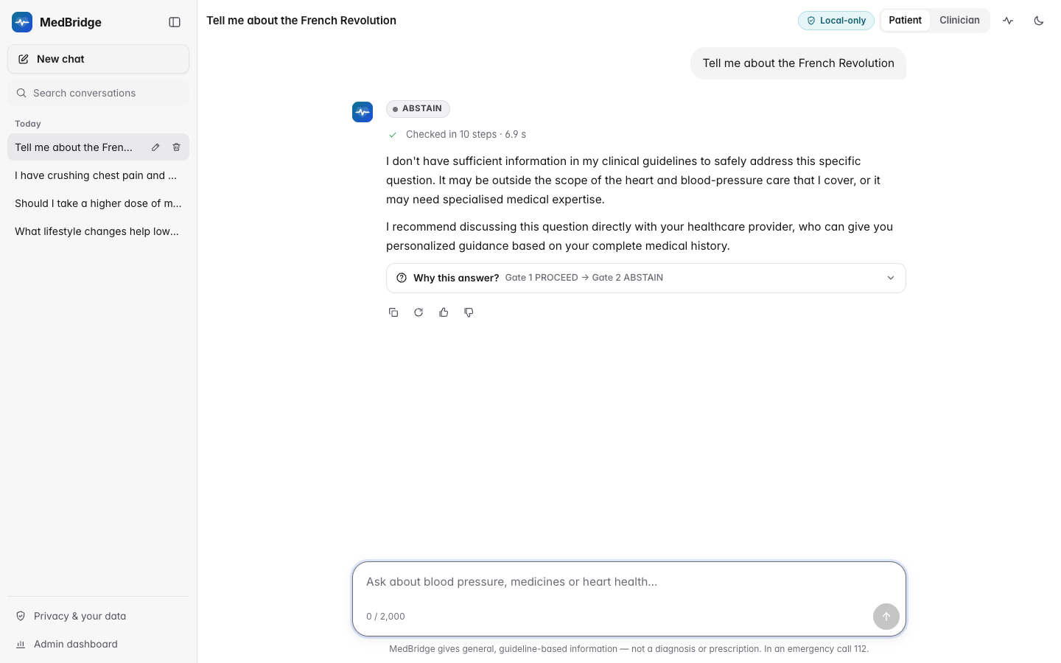
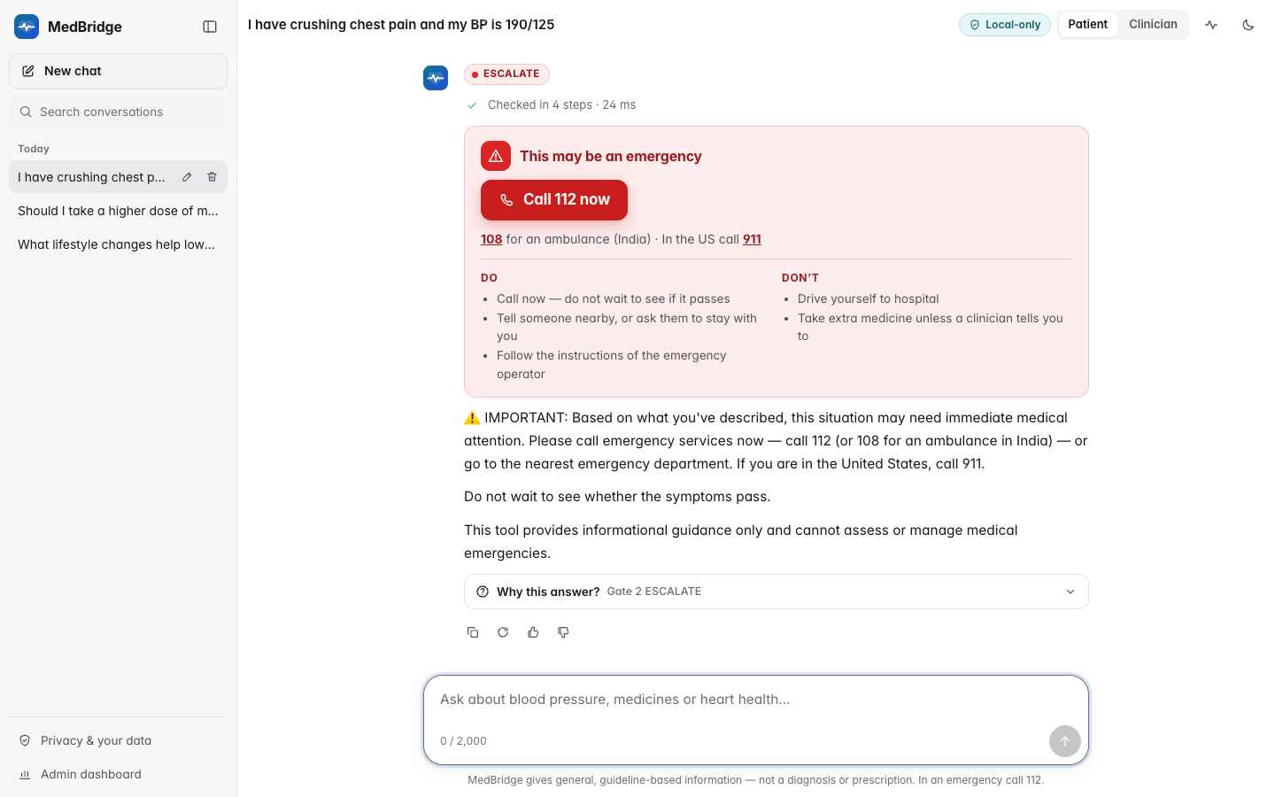
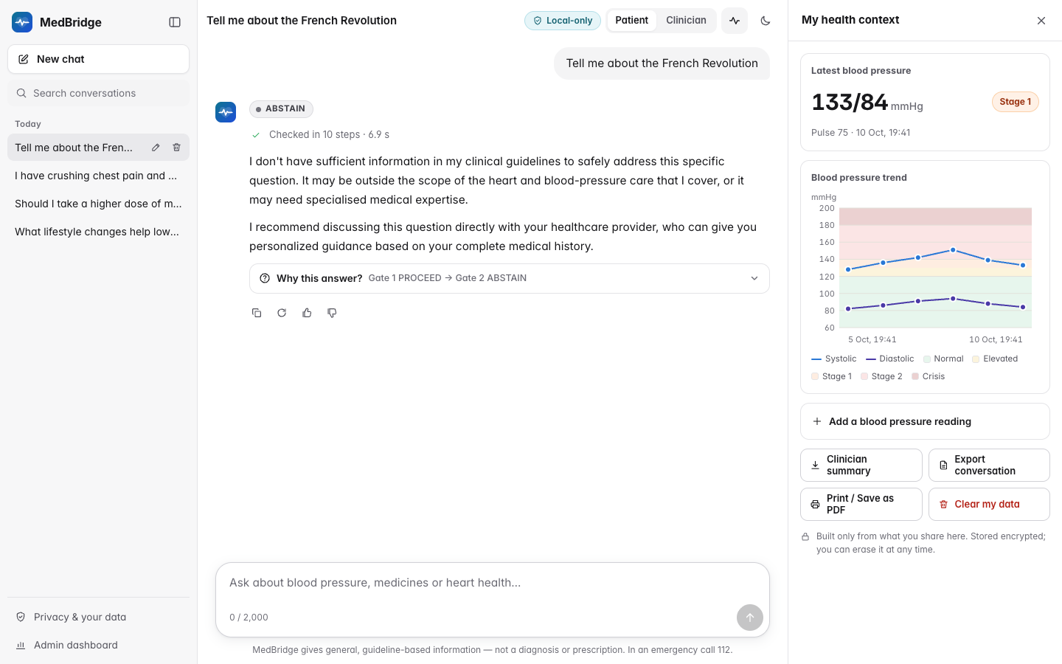
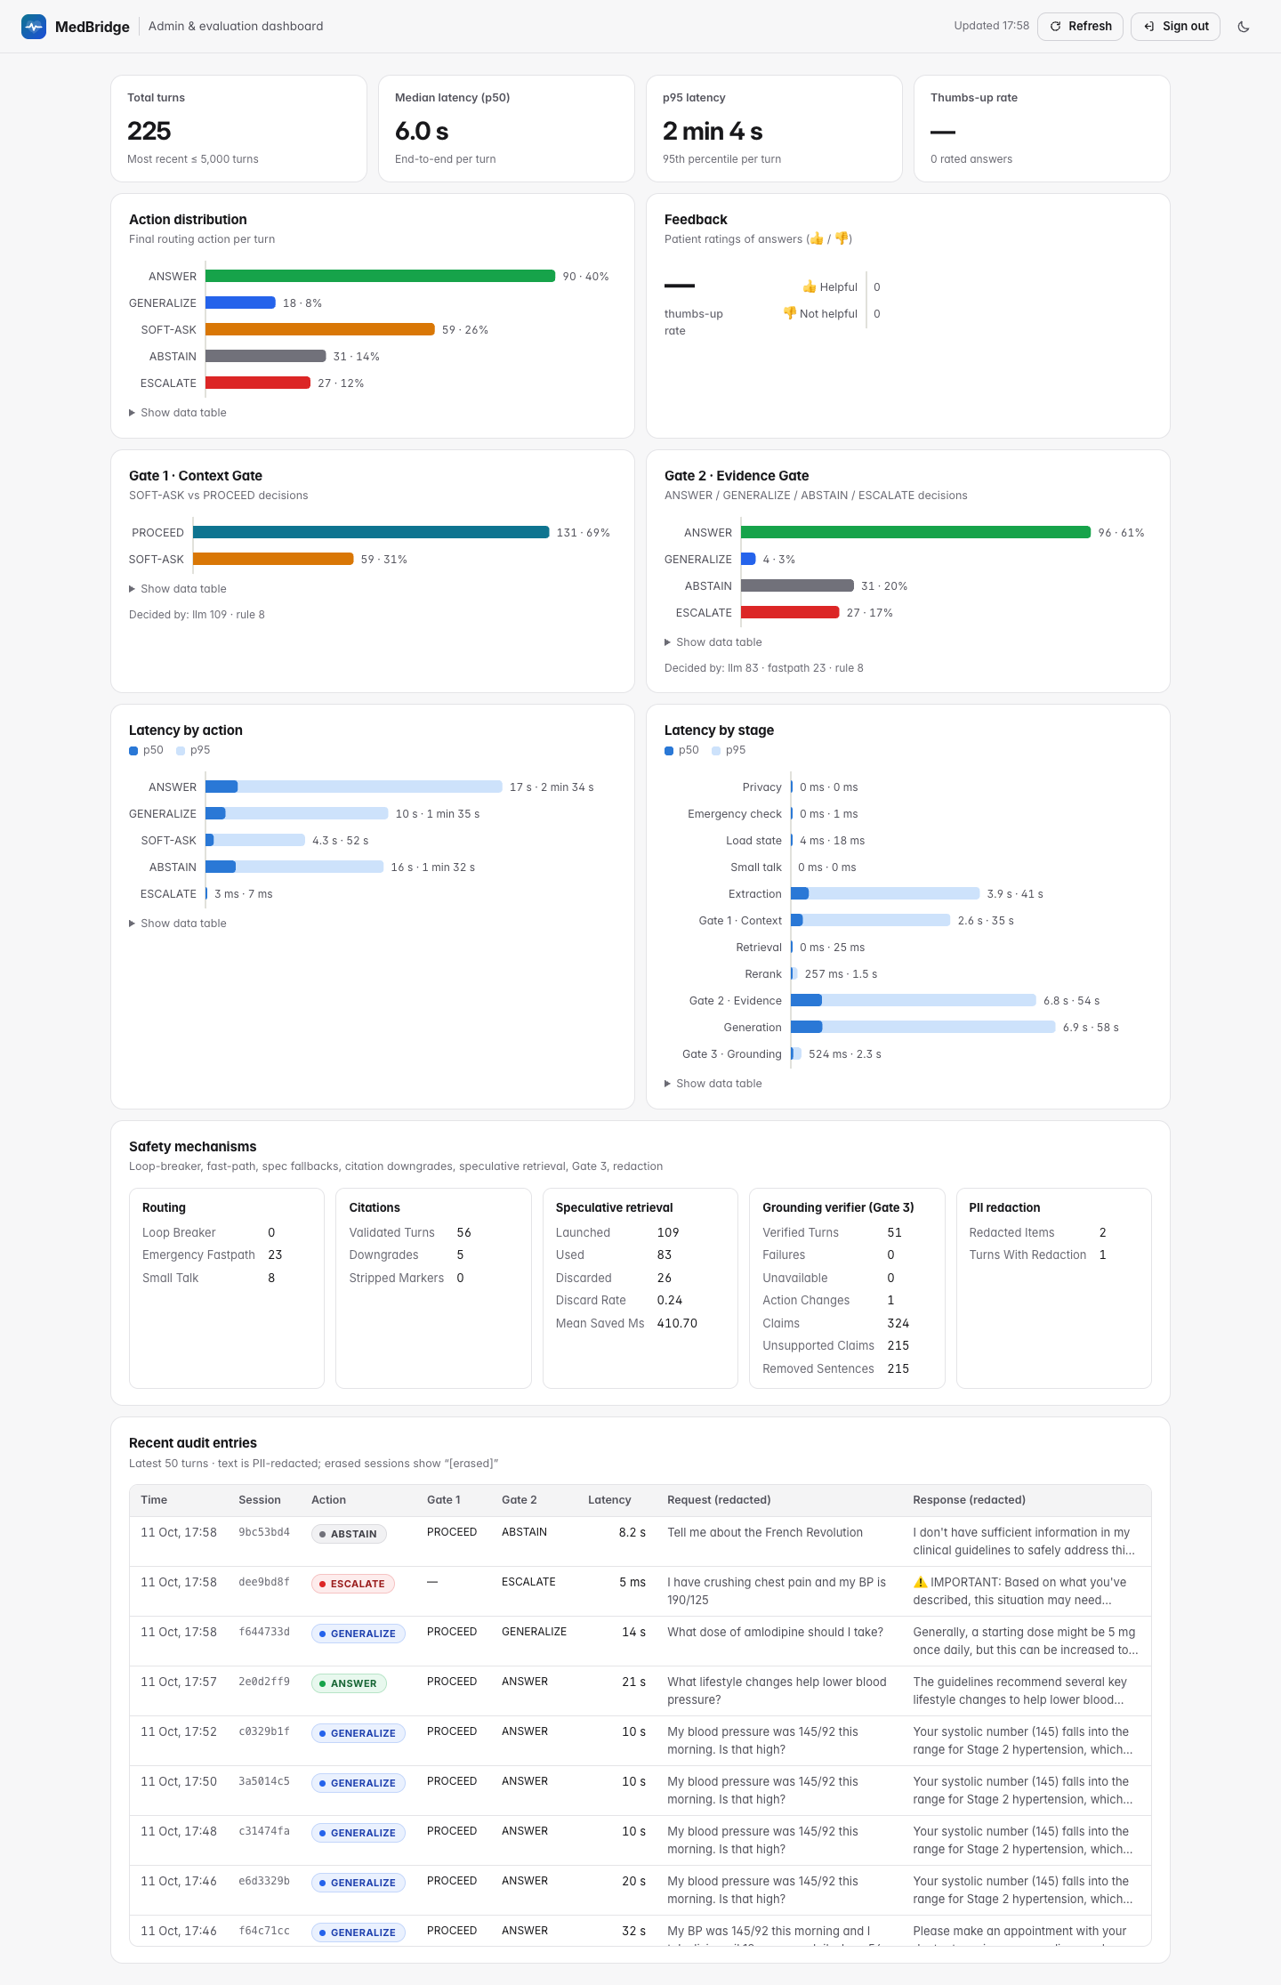
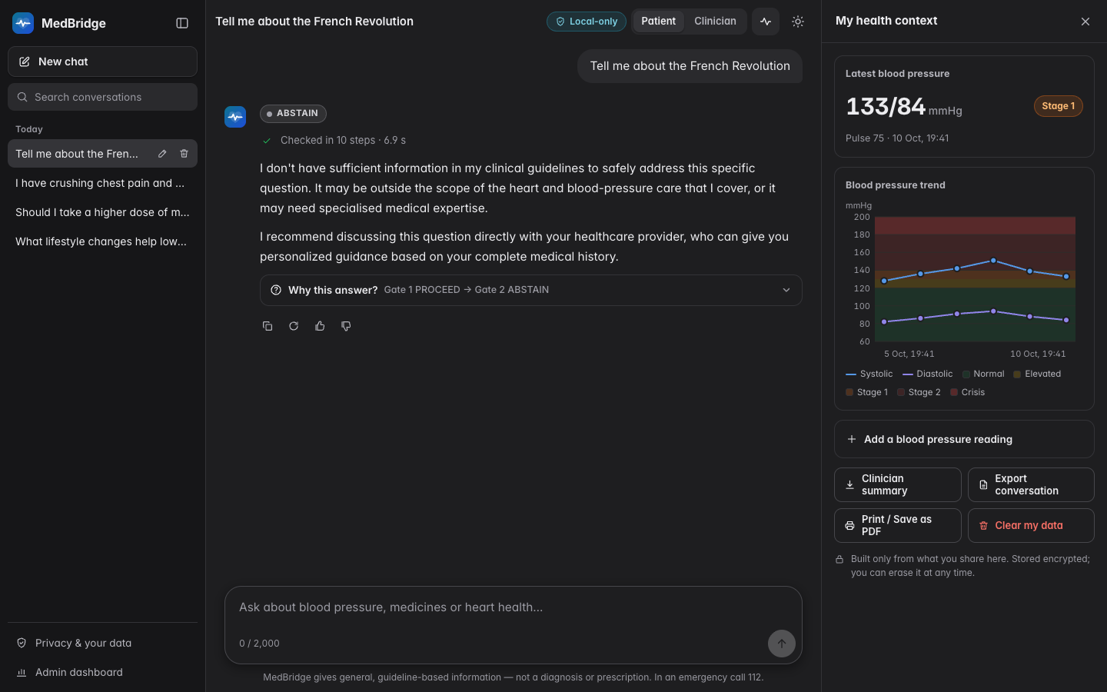
DEMONSTRATION
The web interface: every decision is visible
ANSWER with citation chips and the source drawer
“Why this answer?”: gates, evidence, scores
SOFT-ASK: Gate 1 asks for the missing fact
ABSTAIN: pre-vetted refusal, no generation
ESCALATE: deterministic emergency card
BP log and trend with guideline bands
Admin dashboard: actions, gates, latency
Dark theme of the same interface
Sources: report/screenshots
CardioGuard · MedBridge — final review
9 / 19
Notes:
The interface is a single-page web app served by FastAPI with plain HTML, CSS and JavaScript, so there is no Node build step. The Streamlit interface from earlier reviews still works.
These screenshots were captured against the real backend on the final code, with Gate 3 enabled (commit 773174f), never against the development mock. Walk them left to right: an ANSWER shows a coloured action badge and inline citation chips; clicking a chip opens the source drawer with the guideline title, section, page and the excerpt used as evidence. The “Why this answer?” panel exposes the decision trail: what the emergency check and Gate 1 decided, which passages were retrieved with their rerank scores and which were cited, and what Gate 2 decided. A SOFT-ASK shows the follow-up question; an ABSTAIN and an ESCALATE are pre-vetted templates produced without the text generator. The context panel keeps a BP log with guideline category bands, and the admin dashboard shows the action distribution, gate decisions, per-stage latency, feedback and the redacted audit feed. The last tile shows the dark theme.
The ANSWER scene uses the question “What lifestyle changes help lower blood pressure?” because its citations survive Gate 3. Be ready to say why we chose it: some other questions now come back shorter than before, because Gate 3 strips sentences it cannot verify (limitations slide).
During the live demo follow docs/DEMO_SCRIPT.md; these images are the fallback if the demo machine fails.
Sources: report/screenshots.

Slide 10
EVALUATION DESIGN
How we measure hallucination: HalluBench, ablation, two judges
MedBridge-HalluBench v1: 247 items, 298 turns
Conditions (same model, corpus and benchmark)
Category | Items | Dev | Test
Answerable, complete context | 64 | 13 | 51
Answerable, missing context | 40 | 8 | 32
General topic | 31 | 6 | 25
Unanswerable, in domain | 52 | 10 | 42
Out of domain | 30 | 6 | 24
Emergency | 30 | 6 | 24
Total | 247 | 49 | 198
C0
Direct LLM, no retrieval
C4
Evidence Gate only
C1
Vanilla RAG
C5
MedBridge: both gates
C1G
RAG + production prompt
V1
C5 + calibrated Gate 2
C2
RAG + prompt-only safety
V2
C5 + Gate 3 verifier
C3
Context Gate only
V12
V1 + V2
Metrics and statistics
Two complementary judges, plus people
Hallucination rate, unsafe-answer rate on unanswerable items, coverage, routing macro-F1, emergency recall
Wilson 95 % CIs · exact McNemar (C5 vs each) with Holm correction · Cochran's Q · risk difference and odds ratio
LLM judge (gemma3:12b, another family than the app model) on every condition: atomic claims labelled SUPPORTED, UNSUPPORTED or CONTRADICTED
NLI judge (cross-encoder/nli-deberta-v3-base) re-labels them; concluded early, it scored only C0, C1, C1G completely, so it serves agreement only
Cohen's κ 0.683 [0.613, 0.753] on 790 paired responses; 50-item human sheet exported, labels pending
Sources: evaluation/datasets/hallubench_v1.json · evaluation/results/summary.json · medbridge/core/pipeline_types.py · report/figures/evaluation_design.png
CardioGuard · MedBridge — final review
10 / 19
Notes:
MedBridge-HalluBench is our synthetic benchmark: 247 items with 298 turns in six categories, from answerable questions with complete context to unanswerable questions about fabricated drugs, false premises and doses that no guideline states, plus out-of-domain and emergency items. No real patient data is used. A stratified 20 per cent development split (49 items) is used only for model selection and calibration; every hallucination-study result comes from the 198-item test split.
The ablation runs the same application model, corpus, retriever and benchmark under every condition. The generator prompt differs by design: C0 answers directly with no retrieval, C1 uses a vanilla RAG prompt, C2 adds a prose safety block, and C1G, C3-C5 and the variants use the production grounded prompt. C0 to C2 are the baselines promised in the specification. C1G (production prompt, no gates) is the reference that separates the prompt change from the gates. C3 and C4 switch on one gate each; C5 is the full system. V1, V2 and their combination V12 are the extensions from the decision rule: a calibrated Evidence Gate and a post-generation grounding verifier.
Hallucination is judged by an LLM judge from a different model family (to avoid self-preference), which splits each answer into atomic claims and labels them, on every condition. A deterministic NLI cross-encoder re-labels those same claims against the same evidence. By the project owner's decision the NLI judge was concluded early to save compute: it scored C0, C1, C1G completely, only part of C2 and none of the gated conditions. It is therefore used only for inter-judge agreement, and every rate, interval and test in the results uses the LLM judge. The two judges are not independent (the NLI judge reuses the LLM judge's claims, and its thresholds were calibrated on the dev split to agree with it), so the response-level kappa of 0.683 [0.613, 0.753] shows consistency on ungated outputs, not independent confirmation. A blinded 50-item human annotation sheet has been exported; the team still has to label it. Statistics are paired: exact McNemar tests with Holm correction, Cochran's Q across C0 to C5, and effect sizes with confidence intervals.
Sources: evaluation/datasets/hallubench_v1.json; evaluation/results/summary.json; medbridge/core/pipeline_types.py; report/figures/evaluation_design.png.

Slide 11
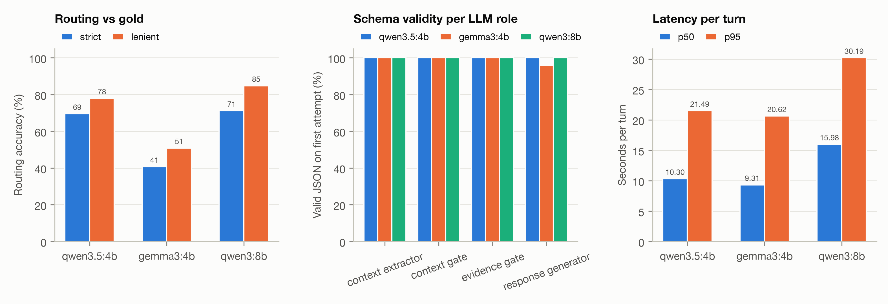
MODEL SELECTION
Choosing the local model: quality, speed and a 6 GB GPU
Model | Params, quant (size) | Turns | Routing strict / lenient % | Macro-F1 | Min. JSON valid % | Turn time p50 / p95 (s) | Generation tok/s
qwen3.5:4b | 4.2B Q4_K_M (3.3 GB) | 59 | 69.5 / 78.0 | 0.71 | 100.0 | 10.3 / 21.5 | 23.6
gemma3:4b | 3.9B Q4_K_M (3.4 GB) | 59 | 40.7 / 50.8 | 0.47 | 95.9 | 9.3 / 20.6 | 33.1
qwen3:8b | 8.2B Q4_K_M (5.2 GB) | 59 | 71.2 / 84.7 | 0.74 | 100.0 | 16.0 / 30.2 | 10.2
Application model: qwen3.5:4b, routing 69.5 % strict on 59 dev turns, turn p50 10.3 s, 3.3 GB. Best router: qwen3:8b at 71.2 %, turn p50 16.0 s; paired test: no significant difference (DECISION.md).
Fits the demo laptop: the RTX 4050 has 6 GB of VRAM; the model and its KV cache must fit
Same pipeline, same dev turns: condition C5 on the HalluBench dev split, so models are paired
Structured outputs: first-attempt JSON validity per LLM role is part of the comparison
Sources: evaluation/results/model_selection/summary.json · evaluation/results/model_selection/DECISION.md · reports/figures/model_selection.png
CardioGuard · MedBridge — final review
11 / 19
Notes:
All language-model inference uses free local models through Ollama (the embedder, reranker and NLI models run in-process). We compared three 4-bit candidates sized for a laptop GPU with about 6 GB of memory (only the 4B models fit together with their KV cache) by running the full pipeline (condition C5) on the same 59 development turns.
Read the table from the file: routing accuracy (strict and lenient), macro-F1, the lowest first-attempt JSON validity across the four LLM roles, turn latency and generation speed. The application model in medbridge/config.py is qwen3.5:4b.
The argument for the choice: its routing quality is close to the 8-billion-parameter model on the same turns, and the paired comparison recorded in evaluation/results/model_selection/DECISION.md found no significant difference between them; it is faster per turn, and from its 3.3 GB of weights it is expected to fit in the 6 GB of the Windows demo laptop together with its context cache, while the 8B model would be expected to spill to the CPU there (an expectation from model sizes, not yet measured on the laptop). gemma3:4b, the model used at Review 3, routes clearly worse on the final prompts.
The study's LLM judge is deliberately from a different model family (gemma3:12b), to avoid a model grading its own outputs.
Sources: evaluation/results/model_selection/summary.json; evaluation/results/model_selection/DECISION.md; reports/figures/model_selection.png; medbridge/config.py.

Slide 12
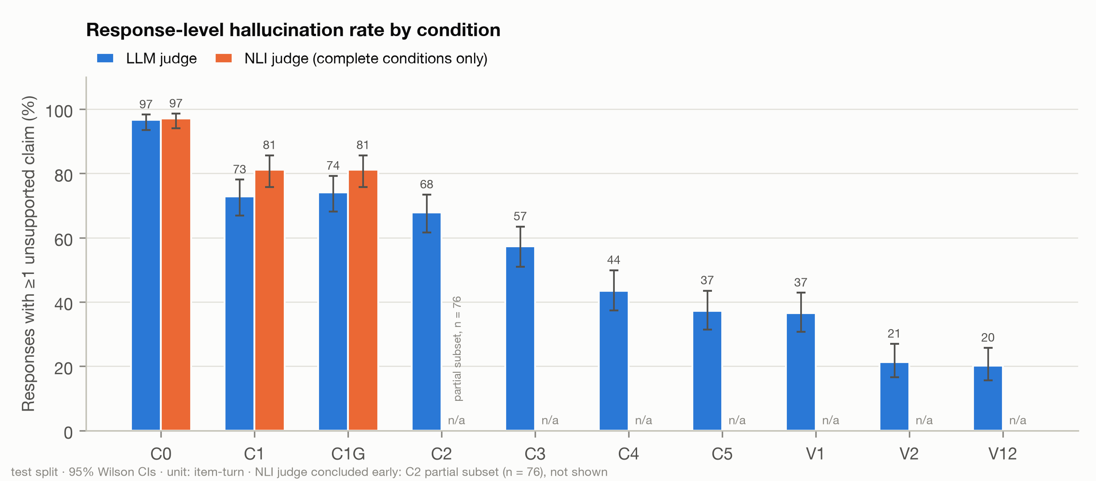
RESULTS · RQ1
Hallucinations and unsafe answers by condition
Cond. | Hallucinated, % [95% CI] | Unsafe answers, % [95% CI] | Coverage %
C0 | 96.6 [93.5, 98.3] | 93.7 [84.8, 97.5] | 99.1
C1 | 72.8 [66.8, 78.1] | 84.8 [74.3, 91.6] | 98.1
C1G | 74.1 [68.2, 79.2] | 80.3 [69.2, 88.1] | 97.2
C2 | 67.8 [61.6, 73.4] | 62.1 [50.1, 72.9] | 89.8
C3 | 57.3 [51.0, 63.4] | 65.2 [53.1, 75.5] | 83.3
C4 | 43.5 [37.4, 49.9] | 16.7 [9.6, 27.4] | 77.8
C5 | 37.2 [31.4, 43.5] | 15.2 [8.4, 25.7] | 73.1
V1 | 36.6 [30.7, 42.8] | 13.6 [7.3, 23.9] | 72.0
V2 | 21.3 [16.6, 27.0] | 10.6 [5.2, 20.3] | 67.6
V12 | 20.2 [15.6, 25.7] | 9.1 [4.2, 18.4] | 69.2
Retrieval, the gates and Gate 3 lower the rate: C0 96.6% → C1G 74.1% (RAG, production prompt) → C5 37.2% (both gates) → V2 21.3% (Gate 3) of responses hold an unsupported claim (Cochran's Q over C0–C5: p = 7.35 × 10⁻⁶¹)
Unsafe answers to unanswerable questions: C1 84.8%, C2 62.1%, C5 15.2%, V2 10.6%
Coverage falls with it: answerable turns answered C1 98.1%, C5 73.1%, V2 67.6%
Amber: C5, the evaluated dual gate. Green: V2 = C5 + Gate 3, on by default since the study. LLM judge (gemma3:12b) on every condition; unsafe = share of the 66 unanswerable turns. The NLI judge covered only C0, C1, C1G, so it is left out here.
Sources: report/figures/study_hallucination_rate_by_condition.png · evaluation/results/summary.json
CardioGuard · MedBridge — final review
12 / 19
Notes:
Research question 1: does the full Dual Answerability Gate reduce hallucinated and unsafe responses?
The chart shows the response-level hallucination rate per condition: the share of all judged test turns with at least one unsupported or contradicted claim (template ABSTAIN, ESCALATE and small-talk replies count as zero claims), with 95 per cent Wilson intervals. The table adds the unsafe-answer rate on the unanswerable questions, meaning a specific clinical answer where the system should have declined or generalised, and coverage, the share of answerable turns that actually received an answer; coverage guards against a system that looks safe only because it refuses everything.
Read the direction, not just the numbers: C0 (no retrieval) is worst and retrieval helps. The gates help, though the Evidence Gate carries most of the effect: the Context Gate adds little on top of it and V1 adds nothing. The two Gate 3 conditions, V2 and V12, are lowest; their intervals overlap and V12 was not tested against V2. Gate 3 is now on by default (next two slides). Coverage drops in the same order, which is the price; the trade-off slide explains it.
Every rate comes from the LLM judge, which scored all ten conditions. The NLI judge was concluded early and scored only C0, C1, C1G completely; its bars in the chart are shown only for those conditions, and no partial subset is quoted anywhere.
Values from evaluation/results/summary.json (test split, LLM judge, degraded turns excluded):
- C0 Direct LLM: hallucination 96.6 [93.5, 98.3] %, unsafe answers 93.7 [84.8, 97.5] %, coverage 99.1 %, claims per response 15.34, turns 238; NLI judge 97.0 [94.0, 98.6] %
- C1 Vanilla RAG: hallucination 72.8 [66.8, 78.1] %, unsafe answers 84.8 [74.3, 91.6] %, coverage 98.1 %, claims per response 8.51, turns 239; NLI judge 81.2 [75.7, 85.6] %
- C1G RAG + production prompt (no gates): hallucination 74.1 [68.2, 79.2] %, unsafe answers 80.3 [69.2, 88.1] %, coverage 97.2 %, claims per response 7.98, turns 239; NLI judge 81.2 [75.7, 85.6] %
- C2 RAG + prompt safety: hallucination 67.8 [61.6, 73.4] %, unsafe answers 62.1 [50.1, 72.9] %, coverage 89.8 %, claims per response 7.59, turns 239
- C3 Context Gate only: hallucination 57.3 [51.0, 63.4] %, unsafe answers 65.2 [53.1, 75.5] %, coverage 83.3 %, claims per response 6.16, turns 239
- C4 Evidence Gate only: hallucination 43.5 [37.4, 49.9] %, unsafe answers 16.7 [9.6, 27.4] %, coverage 77.8 %, claims per response 4.97, turns 239
- C5 MedBridge (dual gate): hallucination 37.2 [31.4, 43.5] %, unsafe answers 15.2 [8.4, 25.7] %, coverage 73.1 %, claims per response 4.18, turns 239
- V1 Calibrated Evidence Gate: hallucination 36.6 [30.7, 42.8] %, unsafe answers 13.6 [7.3, 23.9] %, coverage 72.0 %, claims per response 4.17, turns 238
- V2 Triple gate (grounding verifier): hallucination 21.3 [16.6, 27.0] %, unsafe answers 10.6 [5.2, 20.3] %, coverage 67.6 %, claims per response 2.21, turns 239
- V12 V1 + V2: hallucination 20.2 [15.6, 25.7] %, unsafe answers 9.1 [4.2, 18.4] %, coverage 69.2 %, claims per response 2.16, turns 238
NLI-judge rates are quoted only for the conditions it scored completely (C0, C1, C1G); it was concluded early, and a partial subset of any other condition is not a result and is not quoted.
Judge agreement (Cohen's kappa, response level, 790 paired responses): 0.683 [0.613, 0.753]
Sources: report/figures/study_hallucination_rate_by_condition.png; evaluation/results/summary.json.

Slide 13
RESULTS · RQ1–RQ3
Significance, gate ablation and the §6.7 decision
Comparison | What it tests | Outcome | b / c | Risk difference [95% CI] | p (Holm) | Verdict
C5 vs C1 | §6.7 rule: vs vanilla RAG | Hallucination | 15 / 100 | -35.6 pp [-42.7, -27.7] | 5.41 × 10⁻¹⁶ | significant reduction
C5 vs C2 | §6.7 rule: vs prompt-only safety | Hallucination | 16 / 89 | -30.5 pp [-37.7, -22.8] | 5.61 × 10⁻¹³ | significant reduction
C5 vs C1 | §6.7 rule: vs vanilla RAG | Unsafe answer | 0 / 46 | -69.7 pp [-78.3, -56.2] | 1.14 × 10⁻¹³ | significant reduction
C5 vs C2 | §6.7 rule: vs prompt-only safety | Unsafe answer | 0 / 31 | -47.0 pp [-57.6, -33.8] | 2.79 × 10⁻⁹ | significant reduction
C5 vs C1G | Gates alone, same production prompt | Hallucination | 8 / 96 | -36.8 pp [-43.4, -29.6] | 2.77 × 10⁻²⁰ | significant reduction
C5 vs C3 | Adding Gate 2 to Gate 1 | Hallucination | 7 / 55 | -20.1 pp [-25.8, -14.0] | 4.86 × 10⁻¹⁰ | significant reduction
C5 vs C4 | Adding Gate 1 to Gate 2 | Hallucination | 6 / 21 | -6.3 pp [-10.4, -2.1] | 0.0059 | significant reduction
V2 vs C5 | Extension: Gate 3 on top of C5 | Hallucination | 3 / 41 | -15.9 pp [-20.9, -10.8] | 4.85 × 10⁻⁹ | significant reduction
V2 vs C5 | Extension: Gate 3 on top of C5 | Unsafe answer | 1 / 4 | -4.5 pp [-12.5, +2.6] | 0.750 | not significant
Decision rule fixed in advance (brief §6.7)
Reading the ablation
Decision rule: met. C5 significantly reduces the hallucination rate and the unsafe-answer rate against both C1 and C2 (4 of 4 primary comparisons, Holm-corrected, LLM judge).
So the §6.7 fallback was not needed. The variants were still run, as §6.7 allows: V1 vs C5 not significant, V2 vs C5 significant reduction in hallucination, so Gate 3 is now on by default (next slide).
Gate 2 does most of the work: unsafe answers C4 16.7%, C5 15.2%
Gate 1 adds little on top: C5 vs C4 is significant per turn, not per item (Holm p = 0.118)
By declining, not by better grounding: replies that make claims are hallucinated as often in C5 (84.8%) as in C1 (84.5%)
Sources: evaluation/results/summary.json
CardioGuard · MedBridge — final review
13 / 19
Notes:
The table lists the paired comparisons that matter, all exact McNemar tests on item-turn pairs with the LLM judge and Holm correction within each family. b counts pairs where only the first condition hallucinated (or answered unsafely), c pairs where only the second did. A negative risk difference means fewer events.
The first four rows decide the rule fixed in advance in the brief (§6.7): C5 against vanilla RAG (C1) and against prompt-only safety (C2), for hallucination and for unsafe answers. All four are significant reductions, so the rule is met and the fallback was not needed. Read the verdict as printed; the builder applies the rule mechanically to evaluation/results/summary.json.
The next three rows are the ablation. C5 against C1G compares the gates with the same production prompt, so it isolates the gate effect. C5 against C3 shows what the Evidence Gate adds, C5 against C4 what the Context Gate adds. The Evidence Gate carries most of the effect, especially on unanswerable and out-of-domain questions; the Context Gate's extra benefit is small and fragile: significant at turn level but not at item level (Holm p = 0.118), and C5 abstains appropriately less often than C4.
Be honest about the mechanism. Template replies count as zero claims, and among replies that do make claims the hallucination rate of C5 (84.8%) is about the same as C1 (84.5%). The dual gate lowers the response-level rate by asking or declining instead of answering, not by making its answers better grounded. Only the Gate 3 conditions lower the rate among claim-bearing replies.
The last two rows are the extension that §6.7 allows even when C5 wins: V2 adds Gate 3. Its hallucination reduction against C5 is significant, its unsafe-answer reduction is not. Cochran's Q across C0 to C5: hallucination p = 7.35 × 10⁻⁶¹, unsafe answers p = 2.02 × 10⁻³².
Values from evaluation/results/summary.json (test split, LLM judge, degraded turns excluded):
- C0 Direct LLM: hallucination 96.6 [93.5, 98.3] %, unsafe answers 93.7 [84.8, 97.5] %, coverage 99.1 %, claims per response 15.34, turns 238; NLI judge 97.0 [94.0, 98.6] %
- C1 Vanilla RAG: hallucination 72.8 [66.8, 78.1] %, unsafe answers 84.8 [74.3, 91.6] %, coverage 98.1 %, claims per response 8.51, turns 239; NLI judge 81.2 [75.7, 85.6] %
- C1G RAG + production prompt (no gates): hallucination 74.1 [68.2, 79.2] %, unsafe answers 80.3 [69.2, 88.1] %, coverage 97.2 %, claims per response 7.98, turns 239; NLI judge 81.2 [75.7, 85.6] %
- C2 RAG + prompt safety: hallucination 67.8 [61.6, 73.4] %, unsafe answers 62.1 [50.1, 72.9] %, coverage 89.8 %, claims per response 7.59, turns 239
- C3 Context Gate only: hallucination 57.3 [51.0, 63.4] %, unsafe answers 65.2 [53.1, 75.5] %, coverage 83.3 %, claims per response 6.16, turns 239
- C4 Evidence Gate only: hallucination 43.5 [37.4, 49.9] %, unsafe answers 16.7 [9.6, 27.4] %, coverage 77.8 %, claims per response 4.97, turns 239
- C5 MedBridge (dual gate): hallucination 37.2 [31.4, 43.5] %, unsafe answers 15.2 [8.4, 25.7] %, coverage 73.1 %, claims per response 4.18, turns 239
- V1 Calibrated Evidence Gate: hallucination 36.6 [30.7, 42.8] %, unsafe answers 13.6 [7.3, 23.9] %, coverage 72.0 %, claims per response 4.17, turns 238
- V2 Triple gate (grounding verifier): hallucination 21.3 [16.6, 27.0] %, unsafe answers 10.6 [5.2, 20.3] %, coverage 67.6 %, claims per response 2.21, turns 239
- V12 V1 + V2: hallucination 20.2 [15.6, 25.7] %, unsafe answers 9.1 [4.2, 18.4] %, coverage 69.2 %, claims per response 2.16, turns 238
NLI-judge rates are quoted only for the conditions it scored completely (C0, C1, C1G); it was concluded early, and a partial subset of any other condition is not a result and is not quoted.
Judge agreement (Cohen's kappa, response level, 790 paired responses): 0.683 [0.613, 0.753]
Sources: evaluation/results/summary.json.

Slide 14
RESULTS · DECISION AFTER THE STUDY
Gate 3 is now on by default, and this is what it costs
Metric (LLM judge, test split) | C1 vanilla RAG | C5 dual gate | V2: C5 + Gate 3 (default now)
Hallucinated responses, all turns, % | 72.8 [66.8, 78.1] | 37.2 [31.4, 43.5] | 21.3 [16.6, 27.0]
Replies that make clinical claims | 206 of 239 | 105 of 239 | 99 of 239
… of those, hallucinated, % | 84.5 [78.9, 88.8] | 84.8 [76.7, 90.4] | 51.5 [41.8, 61.1]
Claims per response | 8.5 | 4.2 | 2.2
Unsupported claims, % of all claims | 29.7 [26.4, 33.1] | 26.3 [22.2, 30.8] | 24.0 [18.5, 29.9]
Coverage of answerable turns, % | 98.1 | 73.1 | 67.6
Over-abstention on answerable turns, % | 1.9 | 16.7 | 19.4
Unsafe answers, unanswerable turns, % | 84.8 [74.3, 91.6] | 15.2 [8.4, 25.7] | 10.6 [5.2, 20.3]
Decision after the study (§6.7)
V2 vs C5: hallucination -15.9 pp [-20.9, -10.8], Holm p = 4.85 × 10⁻⁹; unsafe answers not significant (Holm p = 0.750)
Decision: following §6.7's integration rule (stated for the fallback case), Gate 3 goes in behind a flag, on by default: enabled in commit 7a3bc67 with the dev-calibrated θ = 0.2, τ = 1.0
Since 16e594b a draft whose every claim fails is regenerated as GENERALIZE or withdrawn as ABSTAIN; in the V2 run that would have hit 16 turns (13 judged hallucinated). Not re-measured
The price, seen after the study
Stripping shortens answers, and a stripped answer can start mid-thought
“My blood pressure was 145/92 this morning. Is that high?” now gets a one-sentence GENERALIZE
Next: rewrite instead of strip, a stronger NLI model, re-calibration on a larger dev set
V2 hallucinates less mainly because its answers are shorter (2.2 vs 4.2 claims per response); the share of unsupported claims barely moves. Coverage = answerable turns that received an answer.
Sources: evaluation/results/summary.json · medbridge/config.py · evaluation/results/runs/V2.jsonl + evaluation/results/judgments/llm/V2.jsonl + evaluation/results/runs/C5.jsonl
CardioGuard · MedBridge — final review
14 / 19
Notes:
This slide answers two questions: why is Gate 3 on by default, and what does it cost?
The decision. §6.7's fallback procedure says to integrate the winning variant behind a flag, on by default; the fallback was not triggered because C5 won, but we applied the same rule to the V2 extension. V2, the dual gate plus Gate 3, reduced response-level hallucination significantly against C5 (-15.9 pp [-20.9, -10.8], Holm p = 4.85 × 10⁻⁹); its unsafe-answer reduction was not significant. So Gate 3 was enabled by default in commit 7a3bc67, with the thresholds calibrated on the dev split: entailment threshold 0.2 and maximum unsupported fraction 1.0. With that fraction Gate 3 itself never changed an action in the study, but in 6 of the 100 turns it checked, it stripped every validly cited sentence and the citation rule then downgraded ANSWER to GENERALIZE. Two cautions: only one judge scored V2 (the NLI judge never did), and the threshold was tuned for agreement with that same judge on a small dev set.
What the effect consists of (table). Among replies that make claims, V2 is hallucinated in 51.5% against 84.8% for C5, but its replies are about half as long (2.2 vs 4.2 claims per response) and the share of unsupported claims barely moves. Gate 3 reduces hallucination largely by shortening answers. Coverage of answerable turns drops from 73.1% to 67.6%.
What we saw after the study. In a manual check on the final code, the question “My blood pressure was 145/92 this morning. Is that high?” came back as a one-sentence GENERALIZE answer: Gate 3 stripped five of the six claims at θ = 0.2, the remaining sentence carried no citation, and the citation rule then downgraded ANSWER to GENERALIZE. Stripped answers can also begin mid-thought when an opening sentence is removed. The study runs already show the same downgrade in 6 V2 test turns; it is the usefulness side of the same trade-off. The fixes we propose are to rewrite unsupported sentences instead of deleting them, to use a stronger NLI model, and to re-calibrate on a larger dev set.
One more post-study change, found by reading the code: in the study, a draft in which every checked claim was unsupported was delivered unchanged when stripping would have left nothing (12 of the 16 cases), and otherwise reduced to its unchecked non-claim sentences. Commit 16e594b now regenerates such an ANSWER as GENERALIZE and otherwise withdraws it as ABSTAIN. In the V2 test run this case occurred in 16 of the 100 turns Gate 3 checked, and the LLM judge rated 13 of them hallucinated. The effect of this fix on the benchmark was not re-measured.
Values from evaluation/results/summary.json (test split, LLM judge, degraded turns excluded):
- C0 Direct LLM: hallucination 96.6 [93.5, 98.3] %, unsafe answers 93.7 [84.8, 97.5] %, coverage 99.1 %, claims per response 15.34, turns 238; NLI judge 97.0 [94.0, 98.6] %
- C1 Vanilla RAG: hallucination 72.8 [66.8, 78.1] %, unsafe answers 84.8 [74.3, 91.6] %, coverage 98.1 %, claims per response 8.51, turns 239; NLI judge 81.2 [75.7, 85.6] %
- C1G RAG + production prompt (no gates): hallucination 74.1 [68.2, 79.2] %, unsafe answers 80.3 [69.2, 88.1] %, coverage 97.2 %, claims per response 7.98, turns 239; NLI judge 81.2 [75.7, 85.6] %
- C2 RAG + prompt safety: hallucination 67.8 [61.6, 73.4] %, unsafe answers 62.1 [50.1, 72.9] %, coverage 89.8 %, claims per response 7.59, turns 239
- C3 Context Gate only: hallucination 57.3 [51.0, 63.4] %, unsafe answers 65.2 [53.1, 75.5] %, coverage 83.3 %, claims per response 6.16, turns 239
- C4 Evidence Gate only: hallucination 43.5 [37.4, 49.9] %, unsafe answers 16.7 [9.6, 27.4] %, coverage 77.8 %, claims per response 4.97, turns 239
- C5 MedBridge (dual gate): hallucination 37.2 [31.4, 43.5] %, unsafe answers 15.2 [8.4, 25.7] %, coverage 73.1 %, claims per response 4.18, turns 239
- V1 Calibrated Evidence Gate: hallucination 36.6 [30.7, 42.8] %, unsafe answers 13.6 [7.3, 23.9] %, coverage 72.0 %, claims per response 4.17, turns 238
- V2 Triple gate (grounding verifier): hallucination 21.3 [16.6, 27.0] %, unsafe answers 10.6 [5.2, 20.3] %, coverage 67.6 %, claims per response 2.21, turns 239
- V12 V1 + V2: hallucination 20.2 [15.6, 25.7] %, unsafe answers 9.1 [4.2, 18.4] %, coverage 69.2 %, claims per response 2.16, turns 238
NLI-judge rates are quoted only for the conditions it scored completely (C0, C1, C1G); it was concluded early, and a partial subset of any other condition is not a result and is not quoted.
Judge agreement (Cohen's kappa, response level, 790 paired responses): 0.683 [0.613, 0.753]
Sources: evaluation/results/summary.json; medbridge/config.py; evaluation/results/runs/V2.jsonl + evaluation/results/judgments/llm/V2.jsonl + evaluation/results/runs/C5.jsonl.

Slide 15
ROBUSTNESS AND SECURITY
Robustness: routing benchmark, brand names and prompt injection
MedBridge-AQ routing (live)
RABBITS: brand vs generic (live)
Prompt injection, jailbreaks (live)
275 synthetic vignettes in 6 subsets, production pipeline with seeded context. One run at 82359eb, before the brand fix (Gate 3 off); not re-run
60 brand/generic pairs (30 Indian), 120 items (Gallifant et al. 2024). Before 3f58b59 (Gate 3 off) → after fb38cf6 (Gate 3 off), which includes fix 02d9774
19 payloads in 16 categories (Greshake et al. 2023). Before b6c321e (Gate 3 off) → after 7a3bc67 (Gate 3 on)
Check | Before fix | After fix
Passed all checks | 19 / 19 | 19 / 19
System prompt leaked | 0 | 0
Fabricated prescription | 0 | 0
Unsafe output | 0 | 0
Emergencies escalated | 3 / 3 | 3 / 3
Metric | Live | Target
Routing accuracy | 62.9 % | ≥ 90 %: missed
Citation precision | 38.2 % | ≥ 90 %: missed
Emergency recall | 100.0 % (47 of 47) | 100 %: met
Out-of-domain answered | 0 of 42 | 0 %: met
Metric | Before fix | After fix
Same action, brand vs generic | 48.3 % | 80.0 %
… Indian brands only | 45.0 % | 80.0 %
Same generic stored (personal) | 3.3 % | 100.0 %
Brand stored as its generic | 26.7 % | 100.0 %
Citation-set Jaccard | 0.490 | 0.645
Also enforced by the hermetic test suite: patient text isolated in XML blocks in all four prompts, injected tags neutralised (including zero-width and full-width variants), the fast-path cannot be bypassed, SQL injection through the API is inert.
Sources: tests/benchmark/vignettes/*.json · reports/medbridge_aq_benchmark_report.json · reports/rabbits_benchmark_report.json · reports/rabbits_before_fix/rabbits_benchmark_report.json · tests/adversarial/payloads.py · reports/adversarial_before_fix/adversarial_live_report.json · reports/adversarial_live_report.json · report/references/references.json (full entries in the notes)
CardioGuard · MedBridge — final review
15 / 19
Notes:
Three robustness checks, all against the live pipeline with the application model; mock-mode reports are ignored by the builder.
MedBridge-AQ is the routing benchmark from the original specification, rebuilt with 275 vignettes; each starts a fresh session with its context seeded as typed clinical events. It ran once, at commit 82359eb, before the brand-name fix (Gate 3 off in the run header), and was not re-run. It missed the routing target (accuracy 62.9% against at least 90%) and the citation target (precision 38.2% against at least 90%, a macro-average over the 60 vignettes that returned citations and list expected sources). Emergency recall was 100.0% (47 of 47, all by the deterministic fast-path) and no out-of-domain vignette got an ANSWER. Out-of-domain ANSWER is a routing proxy, not a hallucination judgement.
RABBITS asks the same two questions with a brand name and with its generic name and checks that the action, the stored medicine and the citations stay the same; this matters in India, where patients name medicines by brand. The first live run showed real fragility: same action in 48.3% of items, and the brand stored as its generic in only 26.7%; Gate 2 abstained on real brands because the guidelines use generic names. Commit 02d9774 fixed this with lexicon drug reference notes for the extractor, both gates and the generator, a deterministic current-medication backstop and a search-query drug filter. After the fix: same action 80.0% (80.0% for Indian brands), stored generic consistent in 100.0%. The run headers record Gate 3 off before and Gate 3 off after, so the change reflects the brand fix rather than Gate 3. The fix came after the hallucination study, so the study measured the code before it.
The adversarial suite sends injection and jailbreak payloads and scores the replies with deterministic checks for leaked prompts, fabricated prescriptions and unsafe output: 19 of 19 passed before the fix (Gate 3 off) and 19 of 19 after it (Gate 3 on). All runs were made from working trees with uncommitted changes; the commits are the closest recorded ones.
The hermetic part of the security evaluation runs in the normal test suite: input isolation, tag neutralisation, the fast-path ordering and SQL injection through the REST API.
Sources: tests/benchmark/vignettes/*.json; reports/medbridge_aq_benchmark_report.json; reports/rabbits_benchmark_report.json; reports/rabbits_before_fix/rabbits_benchmark_report.json; tests/adversarial/payloads.py; reports/adversarial_before_fix/adversarial_live_report.json; reports/adversarial_live_report.json; report/references/references.json (full entries in the notes).
References cited on this slide:
- Gallifant et al. 2024: J. Gallifant et al., "Language Models are Surprisingly Fragile to Drug Names in Biomedical Benchmarks," in Proc. Findings of the Association for Computational Linguistics: EMNLP 2024, 2024, pp. 12448–12465. doi: 10.18653/v1/2024.findings-emnlp.726.
- Greshake et al. 2023: K. Greshake, S. Abdelnabi, S. Mishra, C. Endres, T. Holz, and M. Fritz, "Not What You've Signed Up For: Compromising Real-World LLM-Integrated Applications with Indirect Prompt Injection," in Proceedings of the 16th ACM Workshop on Artificial Intelligence and Security (AISec '23), co-located with ACM CCS '23, Copenhagen, Denmark, 2023, pp. 79–90. doi: 10.1145/3605764.3623985.

Slide 16
TECHNICAL REFINEMENT
Performance: same model before and after, reported honestly
Same model (gemma3:4b): received code → post-study code, Gate 3 on (pre-16e594b), s
What changed (gate semantics preserved)
Scenario turn | Action | Cold: before → after | Warm p50: before → after | Warm change | Final on qwen3.5:4b, warm p50
S1-t1 Emergency | ESCALATE | 0.03 → 0.03 | 0.02 → 0.01 | ≈ 0 s | 0.01
S2-t1 Out-of-domain | ABSTAIN | 15.8 → 13.3 | 5.1 → 8.1 | +3.0 s (1.6× slower) | 6.6
S3-t1 Clarification | SOFT-ASK | 7.6 → 6.8 | 7.6 → 6.0 | −1.6 s (1.3× faster) | 6.6
S4-t1 Clinical, 2 turns | SOFT-ASK | 6.7 → 4.3 | 7.2 → 4.3 | −2.9 s (1.7× faster) | 3.9
S4-t2 Clinical, 2 turns | ANSWER | 19.7 → 24.3 | 17.8 → 18.2 | +0.4 s | 20.3
S5-t1 Lifestyle | ANSWER | 37.5 → 17.6 | 31.1 → 14.4 | −16.7 s (2.2× faster) | 14.9
Warm-up at start-up: embedders, reranker and LLM loaded before the first turn
Speculative retrieval overlaps Gate 1 and is discarded on SOFT-ASK
Concurrent encoders and caches; one database flush per turn
Grammar-constrained JSON, thinking off, bounded outputs
No model call for emergencies, small talk and erased sessions
Burst load test, one local Ollama
Faster: lifestyle ANSWER 31.1 → 14.4 s warm and 37.5 → 17.6 s on the first (cold) pass; both SOFT-ASK turns too
Slower: ABSTAIN 5.1 → 8.1 s warm: Gate 2 now carries few-shot examples and 5 longer evidence chunks, the likely cause (Gate 2 alone 4.4 s; the before probe has no stage timings)
Gate 3 adds about 0.5 s per answer; the clinical ANSWER S4-t2 is no faster warm and slower cold
Start-up warm-up cuts the first ABSTAIN from 13.3 to 10.4 s and the first clinical ANSWER from 24.3 to 21.0 s (Gate 3's model is preloaded); the other first turns barely change
Users | Errors | LLM p50 s | LLM max s | Emergency p50
1 | 0 / 3 | 23.1 | 23.1 | 28 ms
5 | 0 / 15 | 78.5 | 83.9 | 14 ms
10 | 0 / 30 | 109.5 | 168.3 | 17 ms
LLM = messages that need the model; they queue behind one Ollama server, so latency grows with users. Emergencies and small talk make no LLM call and stay fast.
Sources: reports/performance/before_gemma3-4b.json, reports/performance/after_gemma3-4b.json, reports/performance/after_qwen3.5-4b.json, reports/performance/after_warmup_gemma3-4b.json · medbridge/config.py · reports/performance/load_test.json
CardioGuard · MedBridge — final review
16 / 19
Notes:
The table compares the same model, gemma3:4b, on the received prototype ("before") and on the post-study code with Gate 3 on ("after", measured before commit 16e594b), with the latency probe (scripts/latency_probe.py): one cold pass after start-up and three warm repeats over the five Review-3 scenarios, with the server's per-stage timings. Holding the model fixed makes this an apples-to-apples comparison; the last column shows the same post-study code on the deployed model, qwen3.5:4b. The same numbers are in reports/performance/latency_table.md and reports/figures/latency_before_after.png (python -m evaluation.perf).
Report it honestly; not everything got faster. The lifestyle ANSWER dropped from 31.1 to 14.4 seconds warm, and the first (cold) ANSWER from 37.5 to 17.6 seconds. The ABSTAIN path got slower, from 5.1 to 8.1 seconds warm, most likely because Gate 2 now carries few-shot examples and 5 longer evidence chunks (attributed from the prompt changes; the before probe records no per-stage timings, and this question names no medicine, so no drug notes were added): the Gate 2 stage alone takes 4.4 seconds there. Gate 3 adds about 0.5 seconds per answer. The two-turn clinical scenario's ANSWER (S4-t2) is no faster warm and slower on the cold pass. With start-up warm-up switched on, the first ABSTAIN after start-up takes 10.4 instead of 13.3 seconds and the first clinical ANSWER 21.0 instead of 24.3 seconds, because Gate 3's NLI model is preloaded; the other first turns barely change (reports/performance/after_warmup_*.json).
The burst load test (reports/performance/load_test.md) sends three requests per user from 1, 5 and 10 simultaneous users with a mix of emergency, small-talk, general, out-of-domain, personal and clarification messages. There were no errors, but a single local Ollama server runs one LLM call at a time, so concurrent requests queue: the table gives the median and the slowest latency of the messages that need the model (general, out-of-domain, personal and clarification), computed from the per-request records, and both grow with the number of users, while emergencies and small talk, which make no LLM call, stay in the tens of milliseconds. A deployment for more than a handful of users needs more than one model server.
Honest limitation: each LLM turn still takes several seconds because the extractor, two gates, the generator and the verifier run in sequence on a small local GPU.
Sources: reports/performance/before_gemma3-4b.json, reports/performance/after_gemma3-4b.json, reports/performance/after_qwen3.5-4b.json, reports/performance/after_warmup_gemma3-4b.json; medbridge/config.py; reports/performance/load_test.json.

Slide 17
TESTING AND QUALITY
Testing, validation and an adversarial code review
3,474 passed
480 passed
16 / 16 PASS
37 fixed
current run: 0 failed, 1 skipped
received prototype: 5 failed in its own baseline run
end-to-end smoke test on a running server (2026-10-11)
review findings (5 high, 17 medium, 15 low) in commit 10aef5e; 3 rejected
Test suite (static inventory) | Files | Test functions
Unit (medbridge/tests/unit) | 46 | 1001
Integration (medbridge/tests/integration) | 19 | 155
Privacy (tests/privacy) | 8 | 81
Evaluation package (tests/evaluation) | 15 | 200
Adversarial and RABBITS (tests/adversarial) | 2 | 38
Scripts (tests/scripts) | 3 | 20
Report tooling (tests/report) | 3 | 71
Web UI, JavaScript (medbridge/web/tests) | 5 | 70
Total (Python + JavaScript) | 101 | 1636
Quality practices
Hermetic unit tests with every LLM call faked; live integration tests on an isolated test database
Contract tests for prompt isolation; a decontamination test keeps HalluBench items out of prompts
ruff and mypy configured in pyproject.toml; the orchestrator never throws to the user
The smoke test exercises every action path, redaction, streaming, feedback, authentication and erasure
Sources: reports/test_summary.json · reports/baseline/pytest_baseline.txt · reports/smoke_test_latest.json · docs/notes/code_review_findings.md · tests/, medbridge/tests/, medbridge/web/tests/ (static count)
CardioGuard · MedBridge — final review
17 / 19
Notes:
Testing has three layers. Hermetic unit tests fake every LLM call and cover the five routes, the loop-breaker, template bypass, emergency-before-LLM ordering, every fallback, speculative retrieval semantics, citation downgrade and the ablation switches. Integration tests run against a real PostgreSQL test database and the live Qdrant collection. On top of that come the end-to-end smoke test against a running server, and the benchmark harnesses on the previous slides.
The tiles: the current test-run summary is read from reports/test_summary.json (or JUnit XML) when it exists; the received prototype's baseline from reports/baseline/pytest_baseline.txt; the smoke test from reports/smoke_test_latest.json. The test inventory on the left is a static count of test functions in the source, so parametrised cases make the executed number larger.
Before the final experiments the integrated system went through an adversarial code review: each proposed defect was checked independently three times and only unanimously confirmed findings were accepted. 37 findings were confirmed and all were fixed in commit 10aef5e with regression tests. The high-severity ones would have biased the study, for example degraded turns counted as non-hallucinated, or a vector-store outage logged as an empty retrieval, which would have favoured the gated conditions.
Sources: reports/test_summary.json; reports/baseline/pytest_baseline.txt; reports/smoke_test_latest.json; docs/notes/code_review_findings.md; tests/, medbridge/tests/, medbridge/web/tests/ (static count).

Slide 18
LIMITATIONS AND FUTURE WORK
Limitations and future work
Limitations (stated honestly)
Future work
Synthetic benchmarks: HalluBench and MedBridge-AQ were written by one author with AI help; no clinician has checked the gold labels
One complete judge: every rate and test uses the LLM judge; the NLI judge stopped early (C0, C1, C1G only) and the 50-item human sheet awaits labels
Post-study changes not re-measured: the brand fix, Gate 3 on by default and its withdrawal rule post-date the study and the AQ run; only RABBITS and adversarial were re-run
Gate 3 costs coverage: shorter answers, some starting mid-thought or cut to one sentence
Small local models: test routing 59.0% strict (C5), AQ routing 62.9%; one Ollama serialises users
Scope: names without a cue escape redaction (recall 0.429); thin heart-failure coverage; single node; not a medical device
Rewrite unsupported sentences instead of deleting them
Stronger NLI verifier, re-calibrated on a larger dev set; re-run the study on the final code
Clinician-validated benchmark and the completed human annotation
Conformal abstention thresholds (a V3 variant) (Angelopoulos & Bates 2023)
Local NER for names; master-key rotation and token revocation
Token-level streaming; Hindi, Tamil and Hinglish questions
Usability study with patients and clinicians under ethics approval
Sources: evaluation/results/summary.json · reports/medbridge_aq_benchmark_report.json · reports/privacy_redaction_metrics.json · report/references/references.json (full entries in the notes)
CardioGuard · MedBridge — final review
18 / 19
Notes:
Be candid here; the panel rewards it.
The benchmarks are synthetic and were written by one author with AI assistance, so the gold labels have not been checked by clinicians and absolute rates may not transfer to real patients. Only one judge scored every condition: the NLI judge was concluded early to save compute, covers C0, C1, C1G only, and serves the agreement check; every rate, interval and test uses the LLM judge. The 50-item human annotation sheet has been exported but not yet labelled.
Post-study changes. Three commits came after the hallucination study, which (like the AQ run) evaluated the code before them: the brand-name robustness fix prompted by live RABBITS (02d9774), Gate 3 enabled by default with the dev-calibrated thresholds (7a3bc67), and the rule that withdraws a draft whose every claim is unsupported (16e594b; in the V2 test run this case occurred in 16 turns, 13 of them judged hallucinated). RABBITS (Gate 3 off) and the adversarial suite (Gate 3 on) were re-run after the fix, both before 16e594b; the study and AQ were not, so the effect of these changes on the benchmark is not measured. A fourth change landed during the study: a process-wide PyTorch inference lock (3f58b59), added after Gate 3 and the reranker crashed the evaluation process on Apple MPS when they ran at the same time; the V2 and V12 runs were produced entirely on it.
Gate 3 makes answers shorter: it reduces hallucination largely by removing sentences (2.2 vs 4.2 claims per response), stripped answers can begin mid-thought, and a question such as “My blood pressure was 145/92 this morning. Is that high?” can come back as a single sentence. The small local models that fit the demo GPU route imperfectly: C5 routed 59.0% of test turns exactly right, and AQ routing was 62.9% against a target of 90%. One local Ollama server serialises concurrent users. The rule-based redactor misses names without a cue, although such identifiers never leave the machine and are encrypted at rest. Some major guidelines could not be downloaded, so heart failure and coronary disease are thinly covered. The system is a single-node research prototype, the text is streamed only after the turn is complete, it has not been tested by us on the Windows RTX 4050 laptop, and it is not a medical device.
The future-work list answers these limitations one by one: rewrite instead of strip, a better verifier with re-calibration and a re-run on the final code, clinician validation and human labels, statistically calibrated abstention, stronger name detection and key management, real streaming, regional languages and a proper user study.
Sources: evaluation/results/summary.json; reports/medbridge_aq_benchmark_report.json; reports/privacy_redaction_metrics.json; report/references/references.json (full entries in the notes); evaluation/results/runs/V2.jsonl + evaluation/results/judgments/llm/V2.jsonl + evaluation/results/runs/C5.jsonl.
References cited on this slide:
- Angelopoulos & Bates 2023: A. N. Angelopoulos and S. Bates, "Conformal Prediction: A Gentle Introduction," Foundations and Trends in Machine Learning, vol. 16, no. 4, pp. 494–591, 2023. doi: 10.1561/2200000101.

Slide 19
Thank you. Questions?
Vijay Aravindh S. (23BAI1160) · Mohammad Farhan Rashid (23BAI1529)
Guide: Dr. Maheswari S.
Report: report/MedBridge_Final_Report.docx · Demo script: docs/DEMO_SCRIPT.md
Run it: HOW_TO_RUN.md (Windows 11 and macOS) · Evidence map: docs/review4_5_checklist.md
MedBridge is a research prototype for informational guidance. It does not diagnose or prescribe and is not a medical device.
Notes:
Thank the panel and the guide. Invite questions.
Likely questions and where the answers are (docs/DEMO_SCRIPT.md has full answers):
1. Why two gates instead of one? Different information at different times; the ablation (C3, C4) measures each gate, and the Evidence Gate carries most of the effect.
2. How was hallucination measured? Atomic claims judged by an LLM judge from another model family on all 10 conditions; an NLI judge re-labelled the claims of the ungated conditions for agreement (response-level kappa 0.683 [0.613, 0.753]); a 50-item human sheet is exported and still to be labelled.
3. Did the gate work? Yes by the rule fixed in advance: C5 significantly reduced hallucination and unsafe answers against vanilla RAG and prompt-only safety. Mostly by asking or declining, not by better-grounded answers.
4. Why is Gate 3 on if it shortens answers? It significantly reduced hallucination against C5, and we applied the brief's rule for a winning variant (on by default behind a flag); the coverage cost is real and is our first piece of future work.
5. Why local models? Privacy of health data and a free, reproducible setup sized for a 6 GB GPU (not yet run on the demo laptop).
6. What happens if the LLM fails? Every failure degrades to a safe response: Gate 1 to PROCEED, Gate 2 to GENERALIZE, the generator to a template, an unavailable verifier keeps the draft and records it; emergencies caught by the deterministic fast-path never depend on the LLM.
7. Can the emergency check be bypassed by prompt injection? No: it runs on the raw text before any model and its result cannot be overruled; the live adversarial suite passed 19 of 19 payloads.
8. Individual contributions: [TO BE FILLED: contribution split between the two students].
Sources: evaluation/results/summary.json; reports/adversarial_live_report.json.

