Slide 1
MATRIX HACKATHON 2026 · DRKVSRIT × DATA SCIENCE
advisor · step 4 of 5
AI-Powered Personal
Investment Advisor
1
2
3
4
5
STEP 4 · RECOMMENDATION
Recommended for you
EQUITY 76% · DEBT 15% · GOLD 9%
EXPECTED RETURN
WORST-CASE
Advice that doesn’t just tell you what to do — it proves why, against real market data.
11.2%
−18%
Emergency fund covered → equity unlocked
rule: 6 months expenses before any equity
5-step wizard
Real market data
Offline-safe AI
100% free
Team404 — A.kruthika · Shaik Zeeshan · M. Farhan Adil · M. Noel
DRKVSRIT × Data Science · 1 Oct 2026

Slide 2
THE PROBLEM
One decision, four hidden inputs — nothing connects them
WHAT ACTUALLY DECIDES THE ANSWER
₹
Budget
↑
Experience
✕
What people get today
income − expenses − dependents
beginner or seasoned investor
✕
Same portfolio advice, regardless of context
✕
Past losses never explained — only regret
⌂
Background
◎
Risk comfort
✕
Decisions run on hype, panic and FOMO
prior assets, past losses
willingness vs. real capacity
Result: everyone gets the same generic tip.
No tool reads all four together.
The gap: emotion fills in where data is missing.
A beginner cannot tell signal from noise.
Team404 · Matrix Hackathon 2026
02

Slide 3
OUR APPROACH
A 5-step wizard that asks what real advice needs
1
2
3
4
5
PROFILE
LOSS ANALYSIS
RISK CHECK
DUAL PLAN
OPTIMIZER
1
Profile
2
Loss analysis
3
Risk check
4
Dual plan
5
Optimizer
Age, income, expenses, dependents, goals, emergency fund, risk 1–5
Your dates matched to real price history — cause, not guesswork
Capacity × willingness: the lower of the two binds
Recommended-for-you and build-your-own, with reasoning shown
Dip → top-up · drift → rebalance · volatility spike → hold
RULE ENGINE
● LIVE DATA
RULE ENGINE
RULE ENGINE
● LIVE DATA
Deterministic AI — runs offline, no API key, cannot crash on an outage.
Every number is computed in-app from yfinance data (12 live tickers).
Team404 · Matrix Hackathon 2026
03

Slide 4
INSIDE THE ENGINE
Every claim is proven against real market data
1 · Why you lost — named & evidenced
2 · Dual plan — ours and yours
PEAK_BUY
PANIC_SELL
HYPE_CHASE
CONCENTRATION
Recommended for you
Build your own
HOLD_THROUGH_CRASH
MISMATCH_RISK
110 − age glide path
+ emergency-fund gate
“You bought 11 Feb, within 0.8% of the 90-day high — and exited 8.8% below the 30-day high.”
evidence from real price history · explained in beginner language
live sliders · trade-off curve
High-risk path: live momentum, volatility & drawdown per pick · Low-risk path: SIP 3 / 5 / 10-year scenarios
110 − age
min(capacity, willingness)
6-month fund gate
equity glide path — the older you get, the safer
enthusiasm ≠ capacity — the lower binds
no equity until the emergency fund is full
Advisory logic is transparent: every flag, badge and number traces back to a rule or a real price.
Team404 · Matrix Hackathon 2026
04

Slide 5
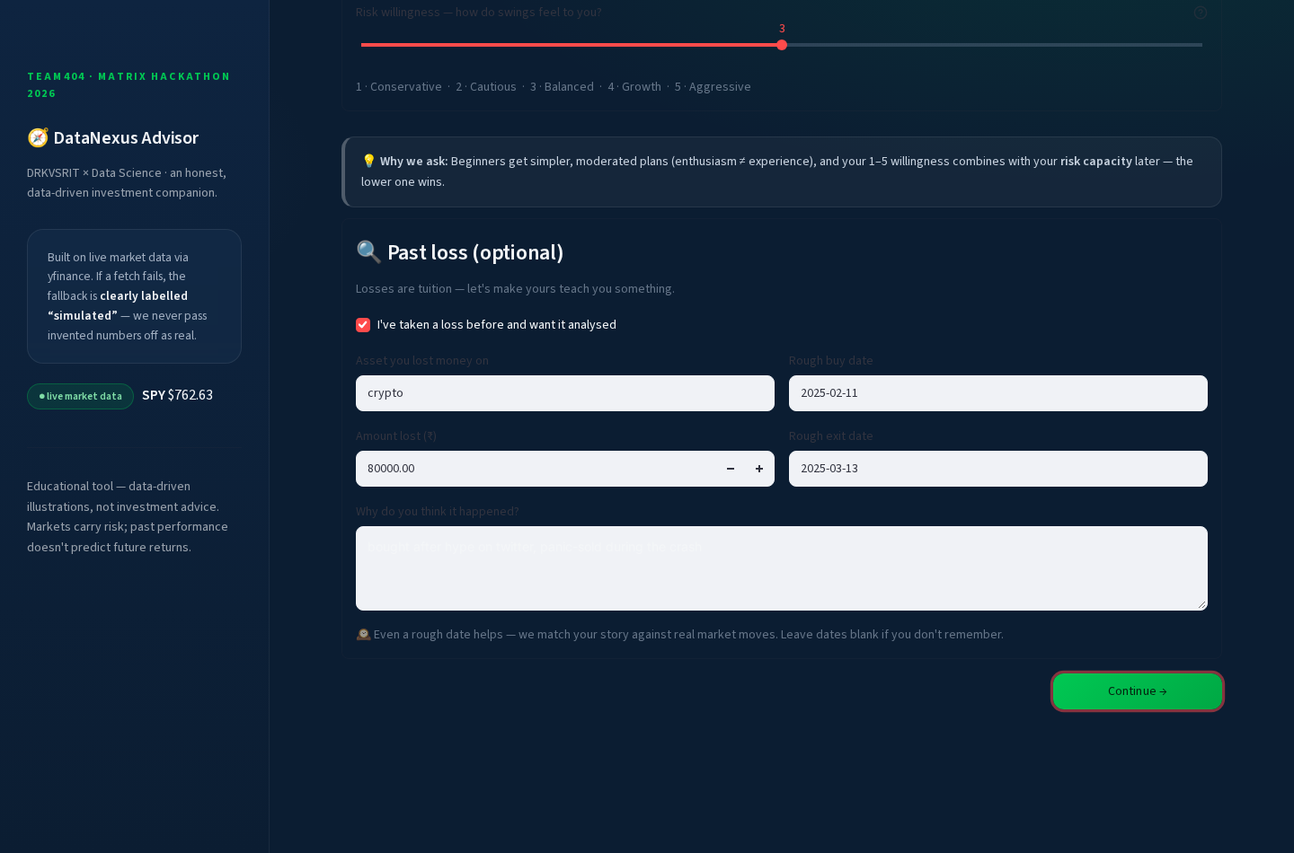
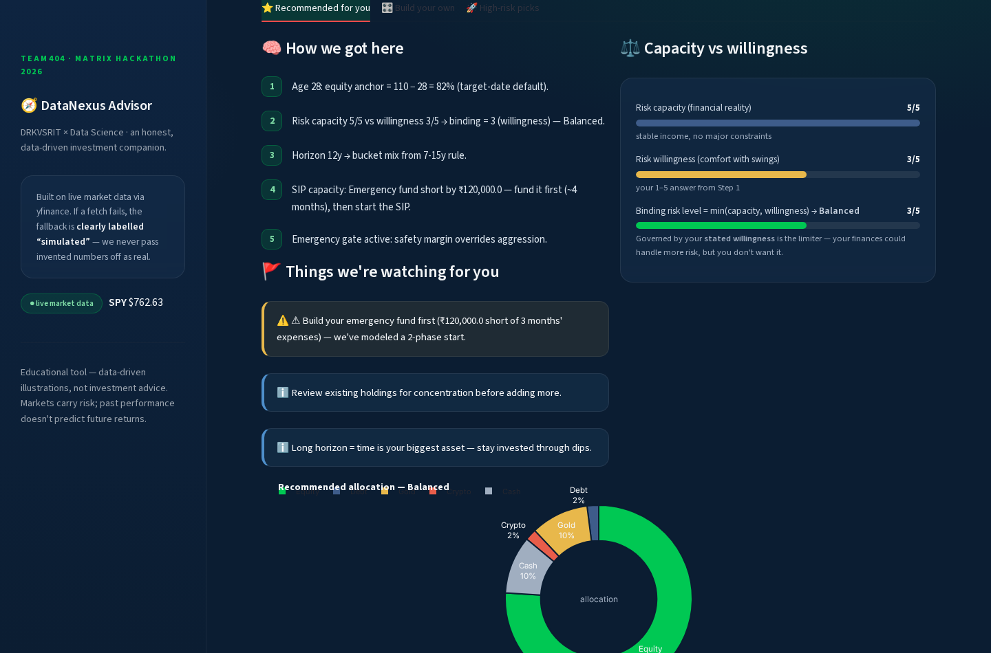
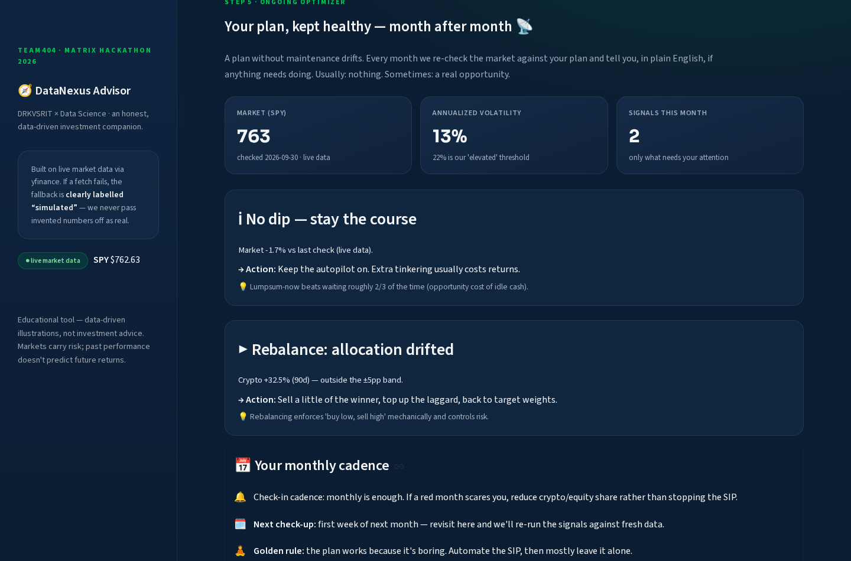
LIVE DEMO
From intake to optimizer — five steps, one sitting
1 · PROFILE
2 · LOSS
3 · RISK
4 · PLAN
5 · OPTIMIZE
localhost:8501
localhost:8501
localhost:8501
1
Rich intake
4
Dual plan
5
Optimizer
Age 28 · ₹80k income · goal in 12y · risk 4/5
76% equity, guard-rail flags, step-by-step why
Live signals: dip → top-up · drift → rebalance
Steps 2 & 3 (loss proof and risk check) run on the same rail — one flow, no dead ends.
Team404 · Matrix Hackathon 2026
05

Slide 6
IMPACT
From regret to discipline
GUIDED STEPS, ZERO JARGON
LIVE TICKERS VIA YFINANCE
API KEYS — OFFLINE-SAFE
COST — FREE & OPEN
5
12
0
₹0
✓
↺
↑
Explained, not told
Losses become lessons
Habits over hype
Beginners see the why behind every number — no jargon, no guesswork.
Past mistakes are proven with real price history, then turned into rules.
SIP and rebalancing replace panic, FOMO and regret.
Thank you — Team404
DRKVSRIT × DATA SCIENCE
real market data
offline-safe
AI-Powered Personal Investment Advisor · background analysis & risk-based planning
Team404 · Matrix Hackathon 2026
06

