Slide 1
UNIT 5 • REINFORCEMENT LEARNING PROJECT
Bandit-Based
Material Screening
Using the Epsilon-Greedy Multi-Armed Bandit Algorithm
A simulated experiment comparing adaptive material selection with random selection
Student: ____________________ Course: ____________________

Slide 2
1. Problem & Motivation
Project 5: Active learning for synthesizing new materials
Problem
Project objective
Testing every candidate material can consume time and resources. The goal is to learn which candidates are promising while limiting unnecessary tests.
Simulate 8 candidate materials with different expected performance.
Select one material per test and observe a noisy reward.
Learn to favor candidates with higher expected rewards.
Compare the learned strategy with random selection.
Important: this is an educational simulation, not a real laboratory materials experiment.
RL-Based Material Screening | Unit 5
2

Slide 3
2. Method: Epsilon-Greedy Bandit
The agent balances exploration (trying options) and exploitation (using current knowledge).
STATE
Estimated reward for each of the 8 materials
Decision rule
With probability ε = 0.1, choose a random material (explore). Otherwise, choose the material with the highest estimated reward (exploit).
ACTION
Choose one material to test
REWARD
Noisy performance observation from the selected material
Experiment setup
8 candidate materials
500 tests per run
30 independent runs
Reward noise: standard deviation 1
UPDATE
Update that material's estimated average reward
RL-Based Material Screening | Unit 5
3

Slide 4
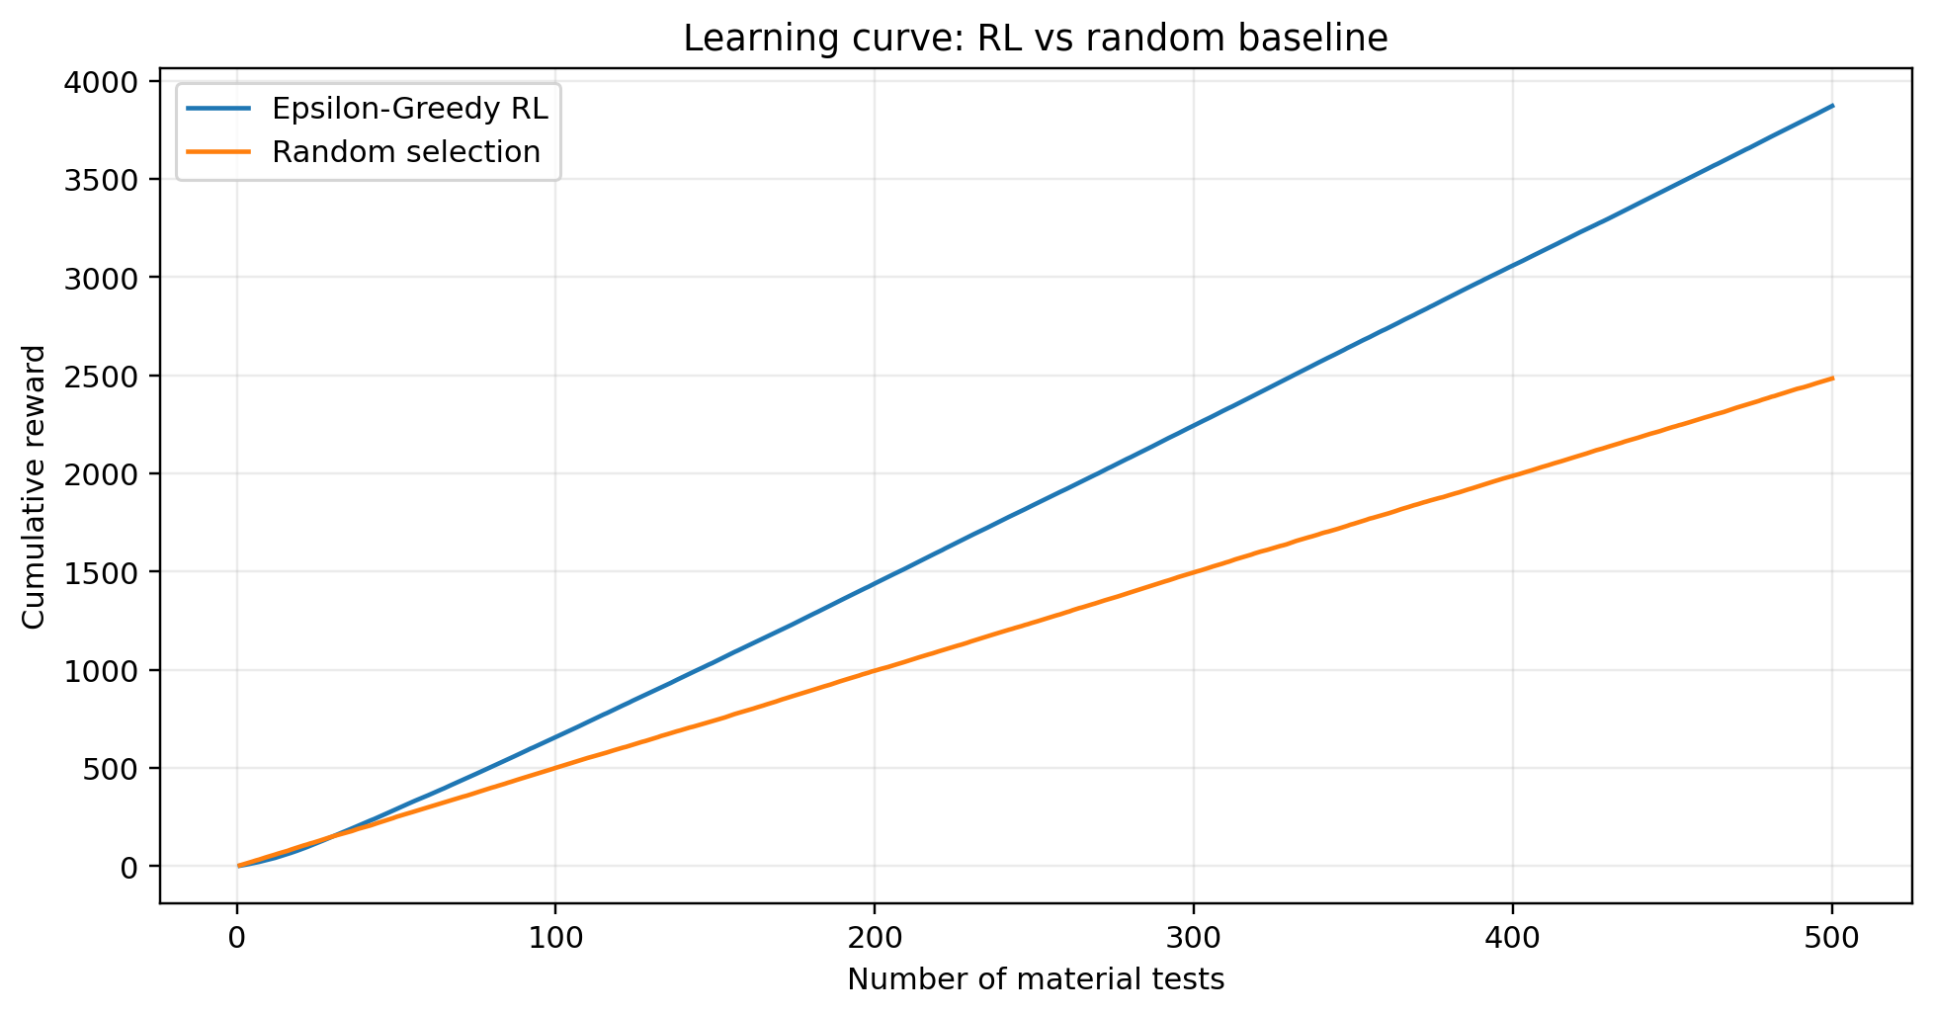
3. Results: RL vs Random Baseline
Average cumulative reward over 30 simulation runs
Simulation setup
8 materials
500 tests per run
30 runs
ε = 0.1
Best expected reward: 8.5
Best candidate: Material 8
Interpretation: the RL agent should outperform random selection as it increasingly favors higher-reward candidates.
RL-Based Material Screening | Unit 5
4

Slide 5
4. Conclusion, Limitations & Ethics
What the experiment demonstrates—and what it does not.
Conclusion
Limitations
Ethics & next steps
Bandit learning can prioritize promising candidates.
Epsilon-Greedy balances exploration and exploitation.
A random baseline provides a simple comparison.
Rewards are simulated, not measured from real materials.
Only 8 candidates and one reward metric are used.
Performance depends on the assumed reward distributions.
Do not present simulated values as laboratory results.
Real screening needs validated measurements and domain expertise.
Future work: test with a public materials dataset.
Takeaway: Reinforcement learning can make sequential testing more data-efficient.
RL-Based Material Screening | Unit 5
5

