Slide 1

MDS Program
Farhan – Jiayi – Yibin – Jason - Long

Slide 2
MDS Program
Farhan – Jiayi – Yibin – Jason - Long
The Problem
Having a meaningful discussion on Canvas is hard
Students don’t have readily available and relevant information in time

Slide 3
The Problem
Having a meaningful discussion on Canvas is hard
Students don’t have readily available and relevant information in time
Our Solution
Sofos is:
Real-time system generating discussion recommendations
Helping you get more relevant ideas to ask better questions
Reinforcing your learning experience, having deeper discussions

Slide 4
Our Solution
Sofos is a:
Real-time system that generates discussion recommendations
Get more relevant ideas to ask better questions
Reinforcing your learning experience, having deeper discussions
The Problem
Live Demo
Having a meaningful discussion on Canvas is hard
Students don’t have readily available and relevant information in time

Slide 5

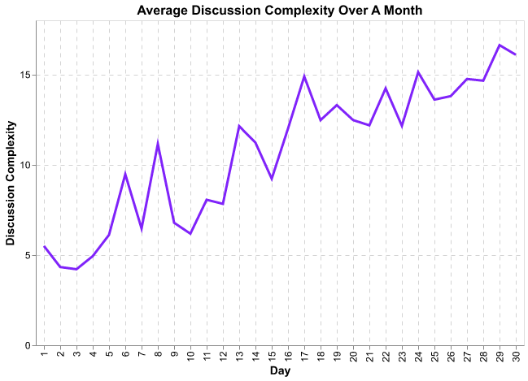



Live Demo
Our Solution
Metrics
Sofos is:
Real-time system generating discussion recommendations
Helping you get more relevant ideas to ask better questions
Reinforcing your learning experience, having deeper discussions

Slide 6
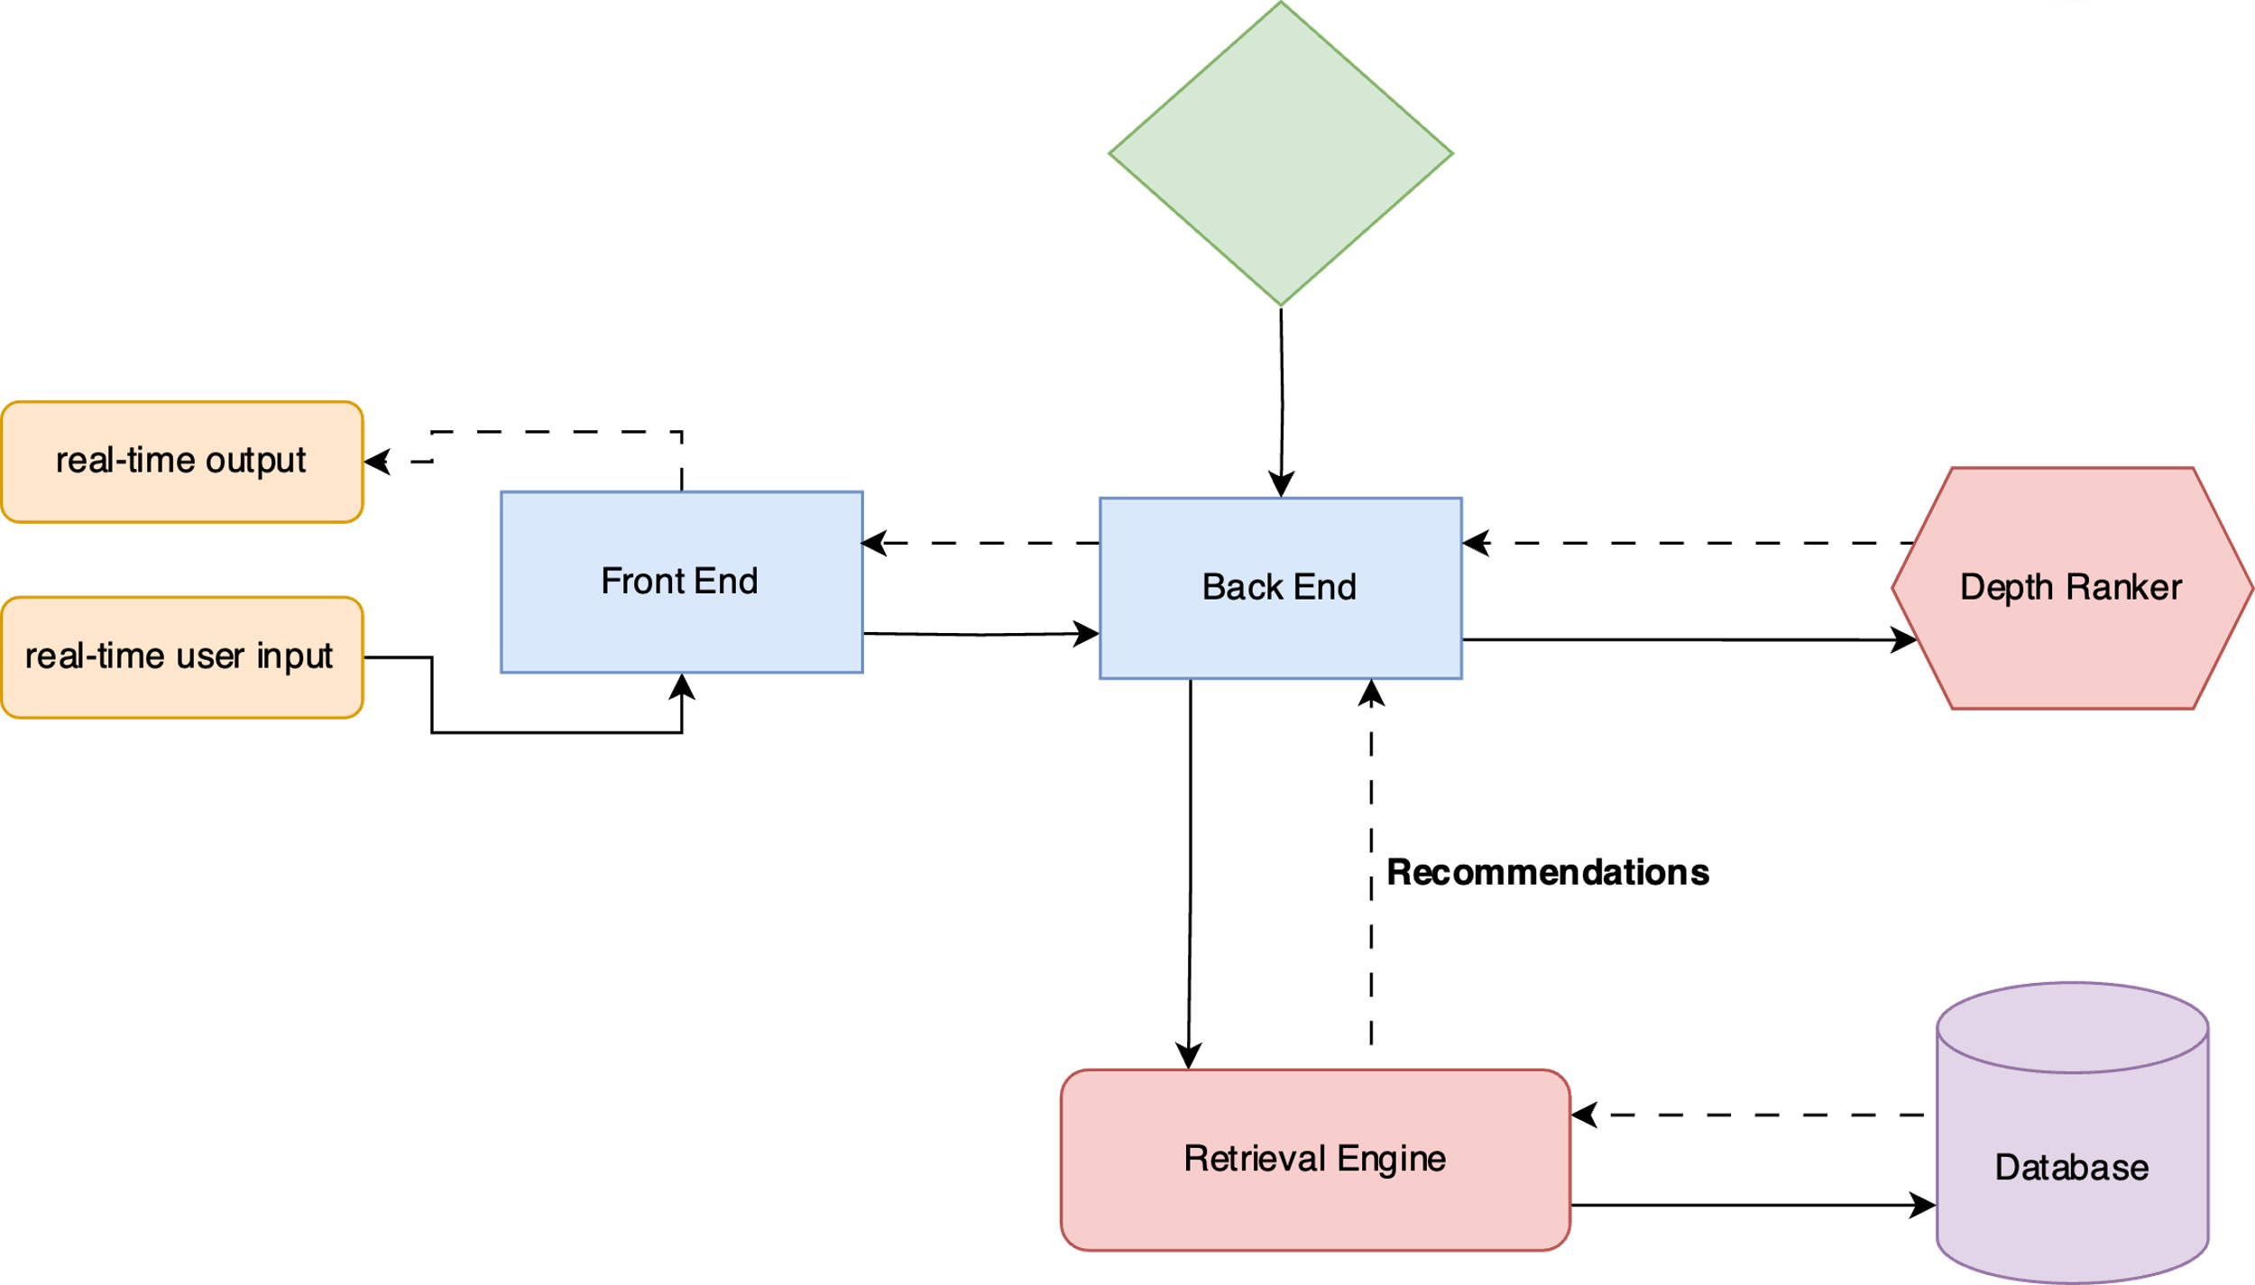
Metrics
Live Demo
How it works

Slide 7
How it works
Live Demo

Slide 8
MDS Program
Farhan – Jiayi – Yibin – Jason - Long

