Slide 1
INDUSTRIAL AI & COMMERCE TRANSFORMATION
Transforming Phoenix Colour Technologies with AI
How intelligent diagnostic tools, 24/7 AI consultation, and financial ROI modelers turn a 200+ product catalog into a high-converting lead generation engine for the UAE, Saudi Arabia, GCC & Africa.
Presented by: Technical Solutions & AI Architecture Team
Confidential • Phoenix Colour Technologies 2026

Slide 2
MARKET OPPORTUNITY
The Problem: Why Traditional B2B Industrial Catalogs Lose Deals
The B2B Buyer's Dilemma Today
The AI Transformation Solution
• 21 Global Brands & 200+ Products: Too many options cause 'catalog paralysis'. Packaging managers don't know where to click.
• High Technical Jargon Barrier: Buyers don't know which optical geometry (45°:0°, Sphere d/8°, Multi-Angle) fits their substrate.
• $15,000 - $25,000+ Price Barrier: Without immediate proof of waste savings and payback, factory CFOs delay purchasing.
• 98% Silent Drop-Off: Busy plant managers research at night and leave because generic contact forms are too slow.
1. 24/7 AI Technical Advisor (Phoenix AI)
Instant technical answers for buyers in UAE, Saudi Arabia, Kuwait & Africa—even after hours.
2. 3-Step AI Substrate Selector
Diagnoses customer material (film, foil, paper, plastics) and gives exact certified machine match.
3. Makeready & Waste ROI Modeler
Proves equipment pays for itself in ~3.2 months with 40% substrate waste reduction.
4. One-Click WhatsApp Lead Handoff
Delivers pre-qualified buyers directly to sales engineers with their exact plant numbers attached.

Slide 3
PROBLEM ANALYSIS
The Catalog Dilemma: Too Many Products & Too Much Technical Jargon
Problem #1: Catalog Paralysis
Problem #2: The Technical Jargon Wall
"I don't know where to find what I need—there are too many products and categories."
"Which optical geometry is mandatory for my substrate so I don't waste $20,000?"
• 21 Global Brands: X-Rite, GMG, GlobalVision, Hybrid Software, Valiani, Hanatek, Miraclon...
• 200+ Specialized Hardware & Software SKUs: Spectrophotometers, densitometers, ink formulation software, proofers, cutting tables.
• The Customer Frustration: A customer who simply wants to inspect labels or calibrate flexo presses gets lost in multi-tiered menus and bounces.
• Optical Physics Confusion: Does flexible plastic film need a 45°:0° or a d/8° sphere? What about metallic foil?
• The Cost of a Guess: Buying a standard device for metallic film produces false readings due to surface glare.
• The Customer Freeze: Non-color scientists are afraid to commit to a formal quote because they fear making an expensive mistake.

Slide 4
SOLUTION ARCHITECTURE
The 3 Pillars of Phoenix AI: Instant Answers, Diagnostics & ROI
PILLAR 1
PILLAR 2
PILLAR 3
Phoenix Color AI
AI Substrate Selector
Makeready ROI Modeler
24/7 Solution Consultant
Optical Diagnostic Engine
Financial Profit Engine
Interactive assistant on every page. Understands X-Rite, GMG, GlobalVision, and ISO/G7 standards. Provides consultative product guidance 24/7.
3-step interactive wizard matching customer substrate (paper, foil, plastic, liquid) to the exact spectrophotometer with plain-English reasons.
Calculates annual scrap reduction, recovered press hours, and equipment payback in USD and AED with instant WhatsApp lead generation.
Live Across Website
Route: /tools/selector
Route: /tools/roi-calculator

Slide 5
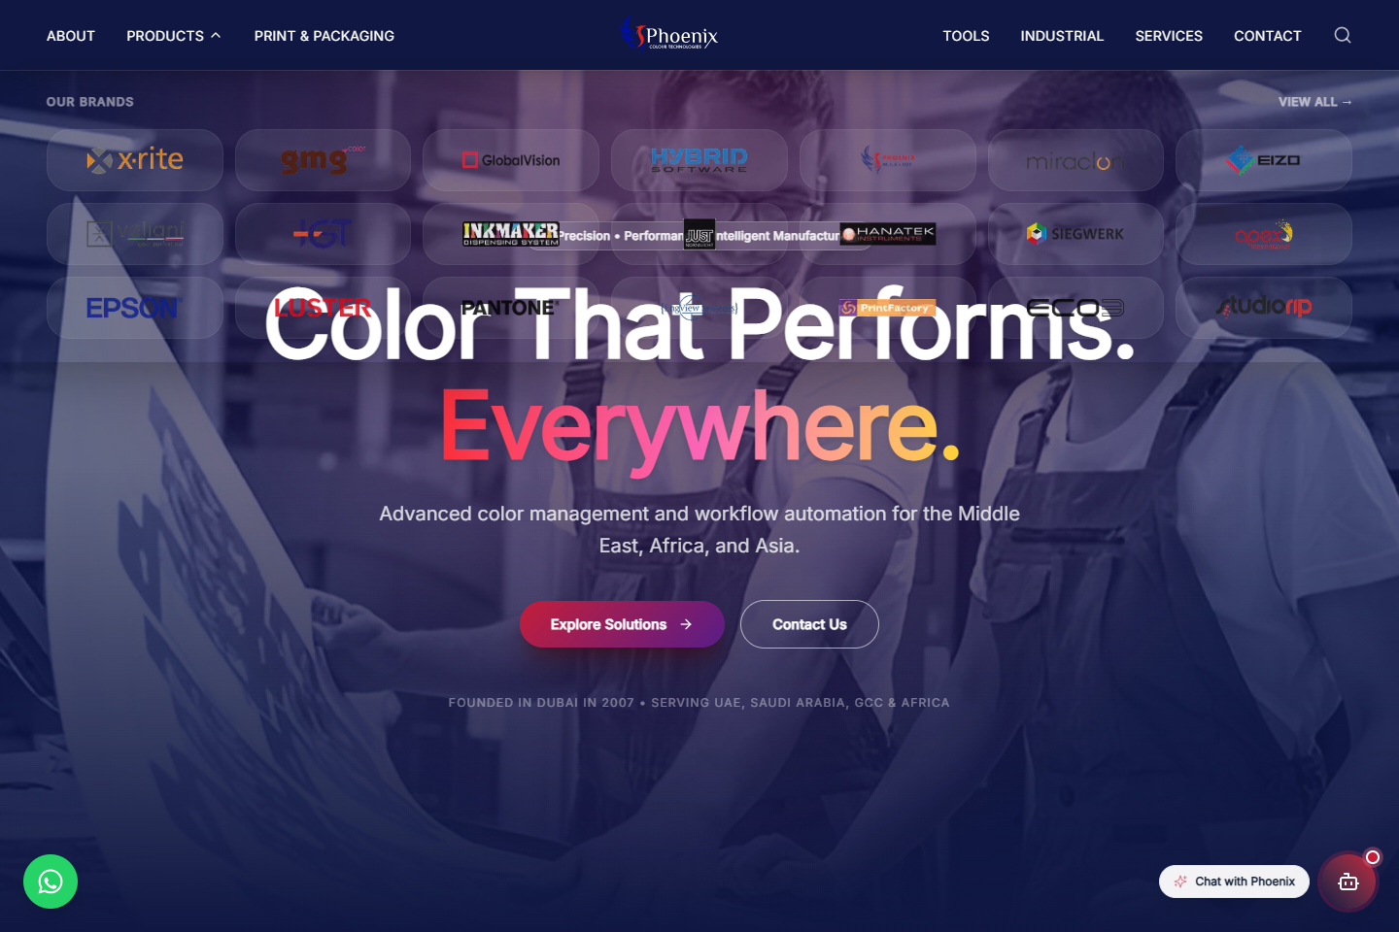
SOLUTION PILLAR 1
Phoenix Color Intelligence AI: 24/7 Technical Consultant
Live Technical Consultation on Every Page
• Deep Catalog Knowledge: Trained on all 21 partner brands, instrument geometries, and software modules.
• Real Technical Consultation: Understands ISO 12647, G7 Master standards, M0/M1/M2/M3 polarization, and Delta E tolerances.
• Verified UAE Business Information: Accurately provides Dubai HQ address in Al Quoz, Mumbai office, and official UAE hours (Mon-Fri 8am-6pm).
• Interactive Product Cards: Directly renders product renders and spec links right inside the conversation.

Slide 6
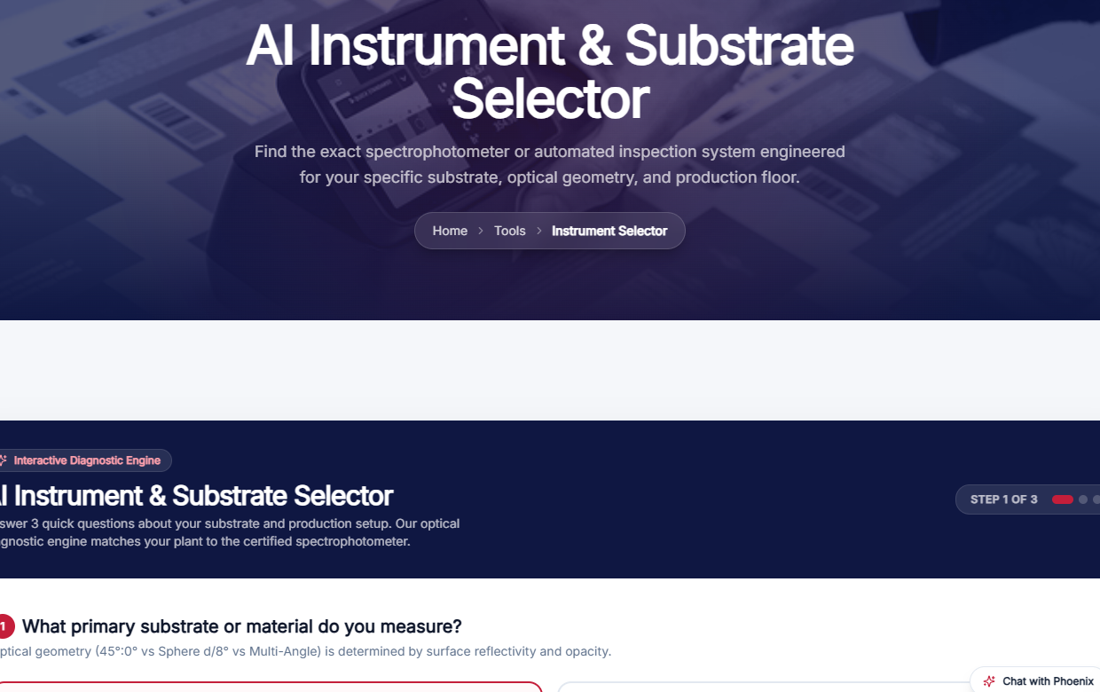
SOLUTION PILLAR 2
AI Instrument Selector: The 3-Step Substrate Diagnostic
Interactive Diagnostic Workflow
Step 1: Substrate & Surface Type
Paperboard, Flexible Film, Plastics/Masterbatch, Metallic Foil, or Printed Artwork/Pharma.
Step 2: Measurement Environment
Pressroom production floor (fast handheld), QC lab (benchtop formulation), or Prepress QA.
Step 3: Quality Objective
Delta E00 pass/fail, Formulation with gloss isolation (SPIN/SPEX), or Flake flop analysis.

Slide 7
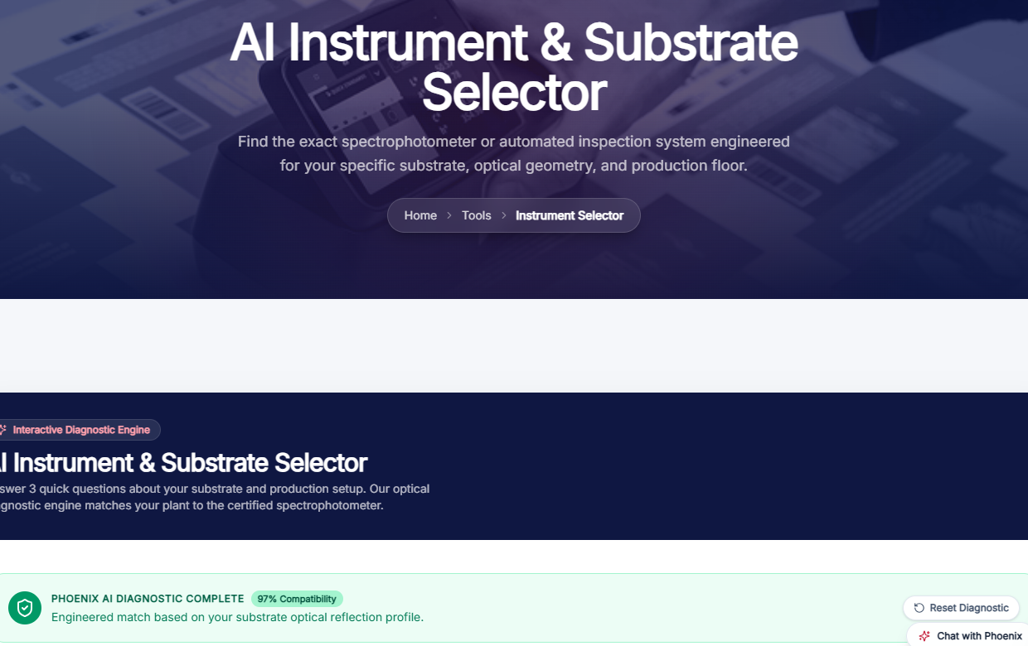
SOLUTION PILLAR 2 (CONT.)
AI Recommendation Engine: 99% Certified Optical Match
Instant Certified Clarity for Buyers
• Match Confidence Score: Renders exact compatibility percentage (e.g. 99% Match).
• Plain-English Science: Explains *why* that geometry is mandatory (e.g., 'Flexible foil produces glare; this machine's M3 polarization filter removes surface glare so colors match brand targets').
• Optical Geometry Guidance: Educates non-experts on 45°:0° vs d/8° sphere vs multi-angle.
• 1-Click WhatsApp Quote: Pre-fills the recommended machine model directly into WhatsApp inquiry.

Slide 8
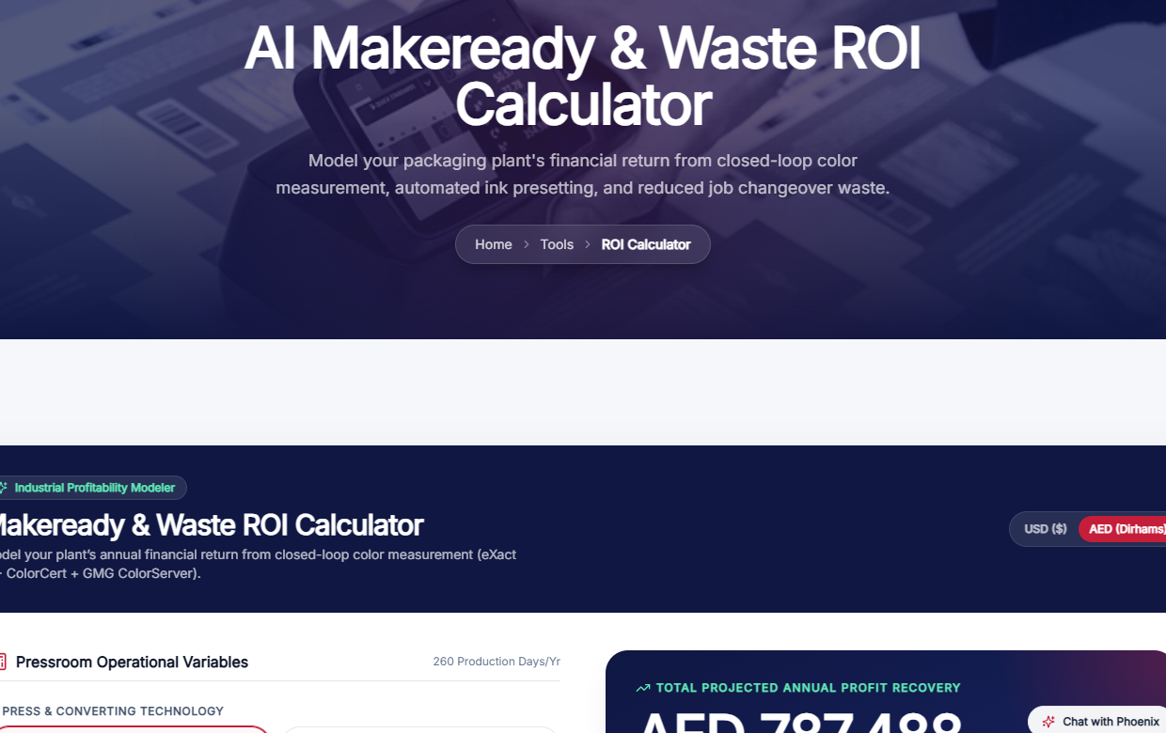
SOLUTION PILLAR 3
Makeready & Waste ROI Calculator: Proving Payback to CFOs
Live Industrial Financial Modeler
• Dual Currency (USD / AED): Clients model returns in Dirhams (AED) or US Dollars with one click.
• Pressroom Controls: Sliders for 1 to 12 presses, job makereadies per day, and substrate scrap costs.
• Real Savings Modeled: Shows AED 458,000 annual profit recovery and ~3.2-month equipment payback.
• Printable Report: Allows plant managers to print an executive summary for CFO approval.

Slide 9
THE SALES HANDOFF ENGINE
How Every Customer Calculation Reaches the Sales Desk
1
2
3
4
Customer Calculates
AI Computes Payback
1-Click WhatsApp
Pre-Filled Lead
Inputs 3 Offset presses running 4 jobs/day on the website.
Reveals AED 458,000 savings and a 3.2-month payback period.
Customer taps 'Validate ROI with an Engineer'.
Sales receives WhatsApp message with the exact plant details!
Why Sales Teams Love This: Zero cold calls. Inbound leads arrive pre-educated on the exact machine model and pre-sold on the financial payback timeline.

Slide 10
CONCLUSION & IMPACT
Measurable Business ROI & Strategic Market Leadership
+35%
40-50%
24 / 7
#1
Conversion Lift
Shorter Sales Cycles
Consulting Coverage
Regional Market Leader
Turns passive datasheet readers into active inbound inquiries.
Buyers arrive already knowing their matching model and payback.
Captures buyers in Saudi, Kuwait, Egypt & GCC outside office hours.
First industrial color partner in the GCC with interactive AI tools.
Live Tools Ready for Client Demo Today
1. Central Tools Hub: /tools • 2. AI Instrument Selector: /tools/selector • 3. Makeready ROI Calculator: /tools/roi-calculator
All tools are live, mobile-responsive, synchronized with official Dubai hours, and ready for sales enablement.

