Slide 1
EEE306
Project Presentation
A Project on:
Analysis of Low Inertia 14-BUS system and Implementation of a Zonal UFLs Scheme using PSS/E
Group08
SAMIN ZAWAD -1706136
MAHADI HASSAN -1706137
MD. TAJBID ZAMAN RHYTHM -1706152
FARHAN HAMID -1706175
AHNAF SHAHRIYAR -1706176
MD. FATIN ISHRAQ FARUQUI -1706179
ZAWAD ZULFIKER -1706193
Date: 01/03/2023
EEE-412: Power Systems II Lab

Slide 2
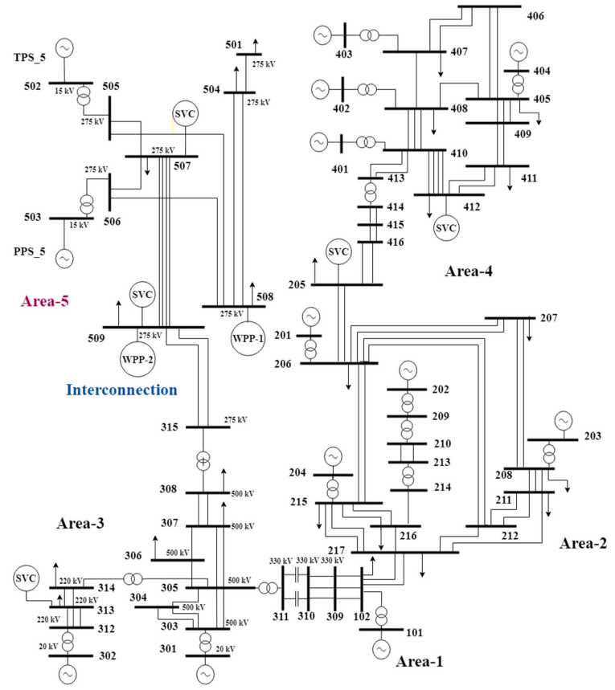
South Australian 14 Bus System

Slide 3
Base Case
The initial base case of the power system
consisted of the following elements:
14 Buses
15 Lines
9 Transformers
6 Sync Gen, 2 SVC
2 WTG ( 40% Renewable Penetration)

Slide 4
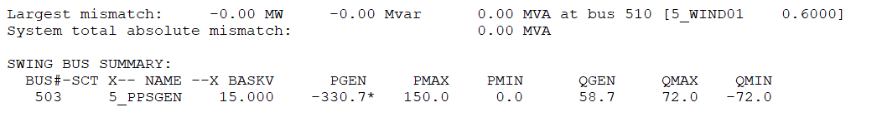
Load Flow
NSM=6
- 502_4
NSM=5
- 502_3
NSM=4

Slide 5
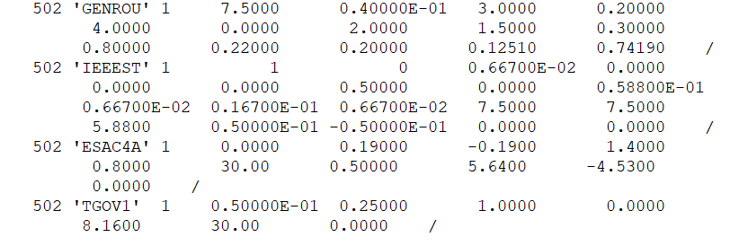
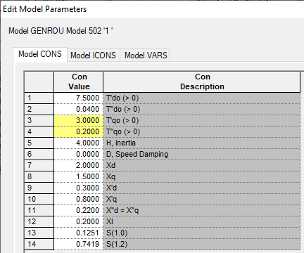

DYR File (Sync. Gen.)
Generator Model
Stabilizer Model
Exciter Model
Turbine Governor Model

Slide 6
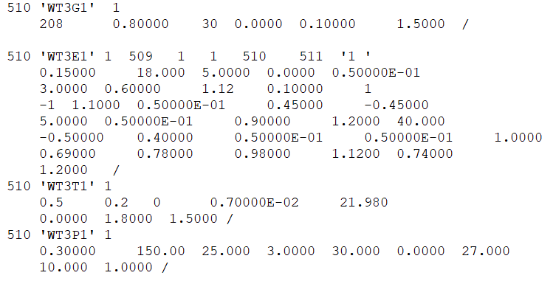
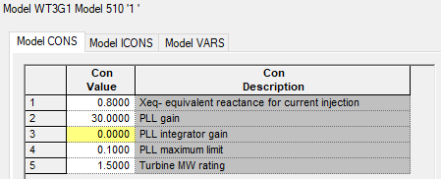

DYR File (Wind Turbine Gen.)
Type 3 Generator Model
Electrical Control Model
Mechanical Model
Pitch Control Model

Slide 7
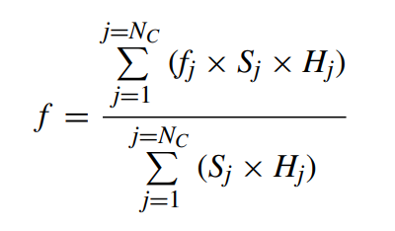
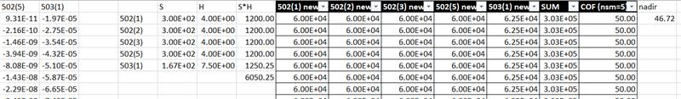
Plotting COF (Load Bus)

Slide 8
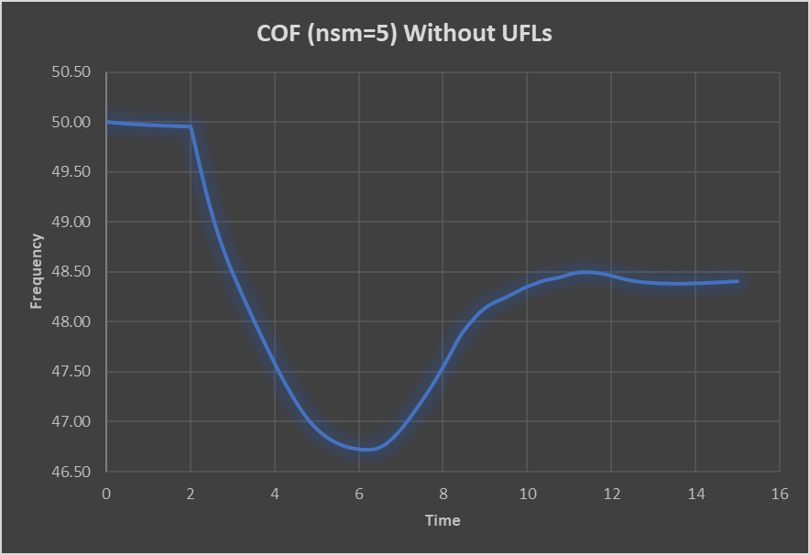
Dynamic Analysis
Without UFLS
Nadir = 46.72 Hz

Slide 9
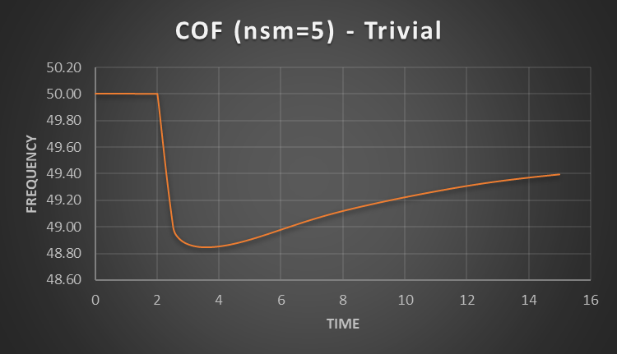
Dynamic Analysis
Stage and Frequency | Load shedding factor (%) (ALL PQ BUS)
1st Stage (49.25 Hz) | 20
2nd Stage (48.75 Hz) | 20
3rd Stage (49.75 Hz) | 10
With UFLS
(Trivial)
Nadir = 48.85 Hz

Slide 10
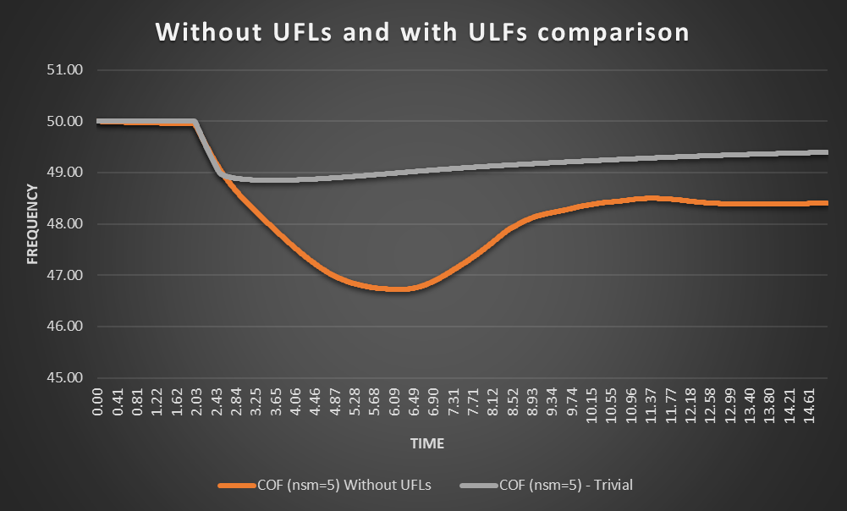
Dynamic Analysis
Comparison
2.13 Hz

Slide 11
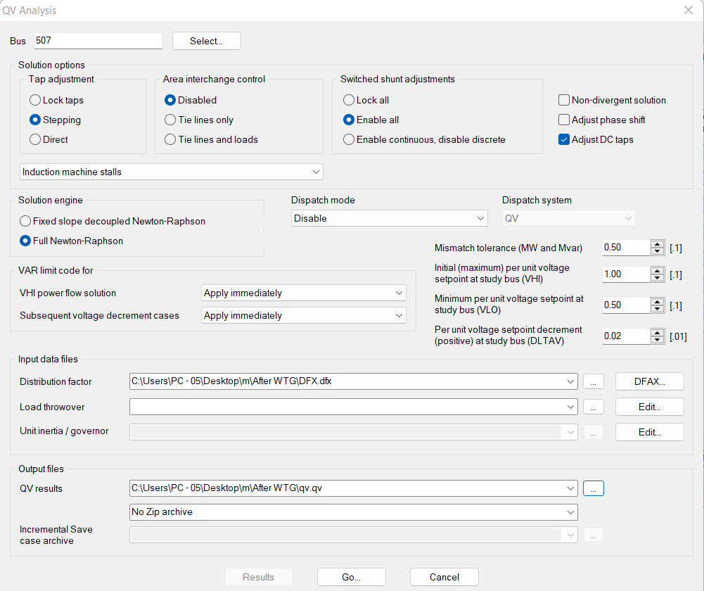
Selected Bus
Tap Adjustment
Q-V Analysis
Various Setpoints
DFX File Loading
Output File Loading

Slide 12
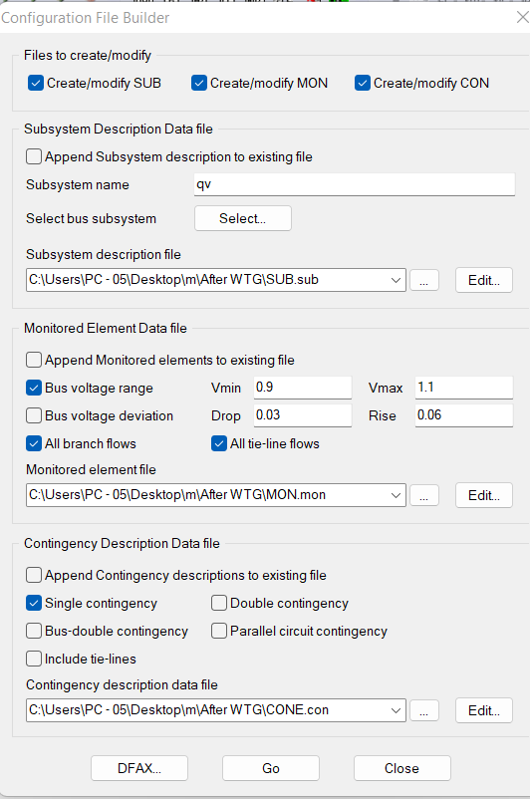
Q-V Analysis
Subsystem Name
SUB File Generation
File Generation
Voltage Limit
.MON File Generation
.CON File Generation

Slide 13
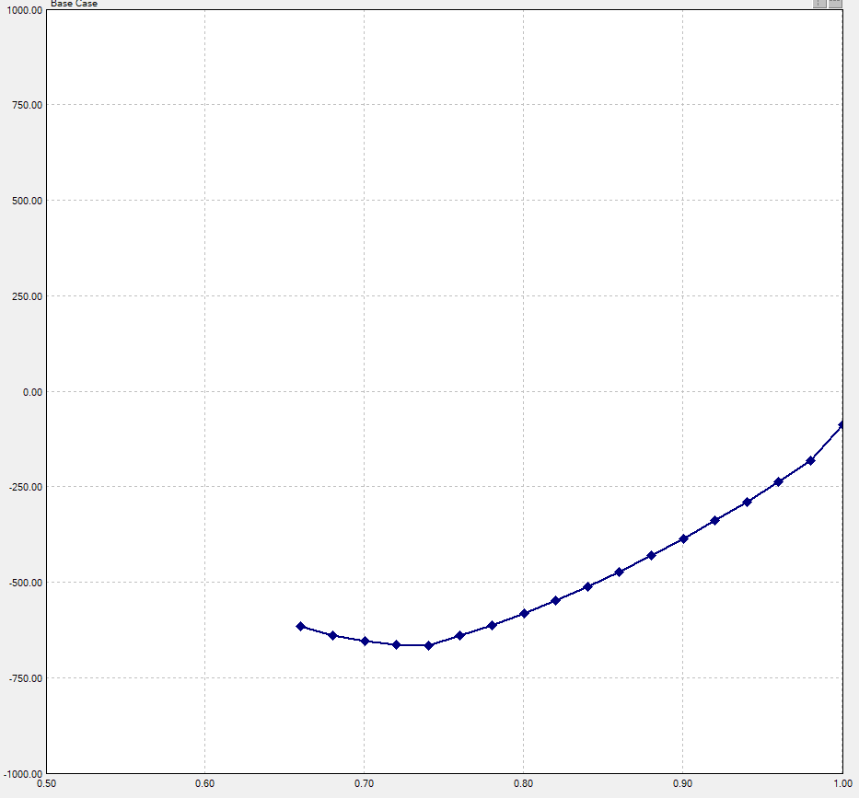
BUS 507
Reactive Power Margin (RPM) = 648.10

Slide 14
Strength Index of the load busses
Bus ID | Reactive power margin (RPM) | Strength
504 | 745.08 | 2
507 | 648.10 | 3
508 | 874.04 | 1
509 | 270.73 | 4

Slide 15
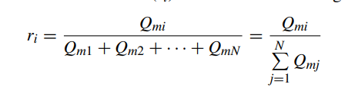



Load Shed Percentage Calculation
Reactive margin factor
Nth Load Shed
Load Shedding Factor
First Load Shed
Second Load Shed
Load Shed= Load Shedding Factor x Initial Load
Third Load Shed

Slide 16
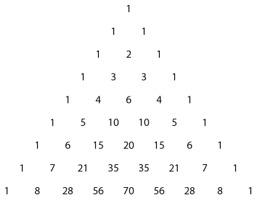
Pascal Triangle

Slide 17
Reactive Power Margin
BUS ID | Reactive power margin(MVAr) | Reactive power margin(p.u on 100 MVA System base) | Inverse of reactive power margin(p.u) | Reactive margin factor
504 | 745.08 | 7.45 | 0.1342 | 0.1735
507 | 648.10 | 6.48 | 0.1543 | 0.1995
508 | 874.04 | 8.74 | 0.1144 | 0.1479
509 | 270.73 | 2.70 | 0.3703 | 0.4789
2
Bus Strength Sequence
3
1
4

Slide 18
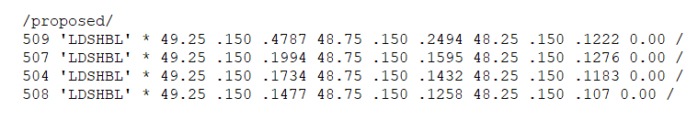
% Load Shed
BUS ID | Load shedding factor (%)
 | 1st stage ( 49.25 Hz) | 2nd stage (48.75 Hz) | 3rd stage (48.25 Hz)
504 | 17.34 | 14.32 | 11.84
507 | 19.94 | 15.95 | 12.77
508 | 14.77 | 12.58 | 10.71
509 | 47.87 | 24.94 | 12.99
PSSE implementation

Slide 19
Dynamic Analysis
With UFLS
(Trivial)
Nadir = 48.85 Hz

Slide 20
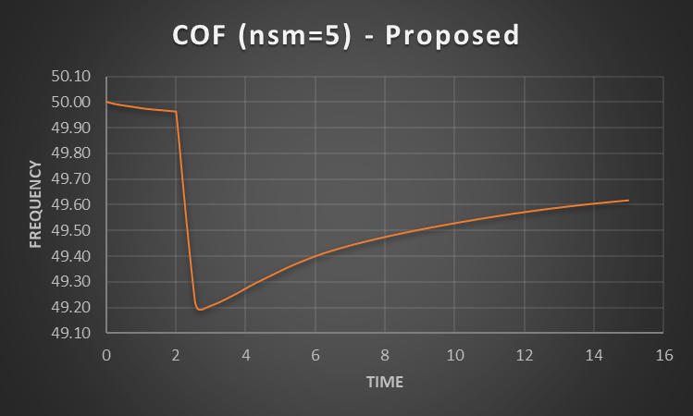
Dynamic Analysis
With UFLS
(Proposed)
Nadir = 49.19Hz

Slide 21
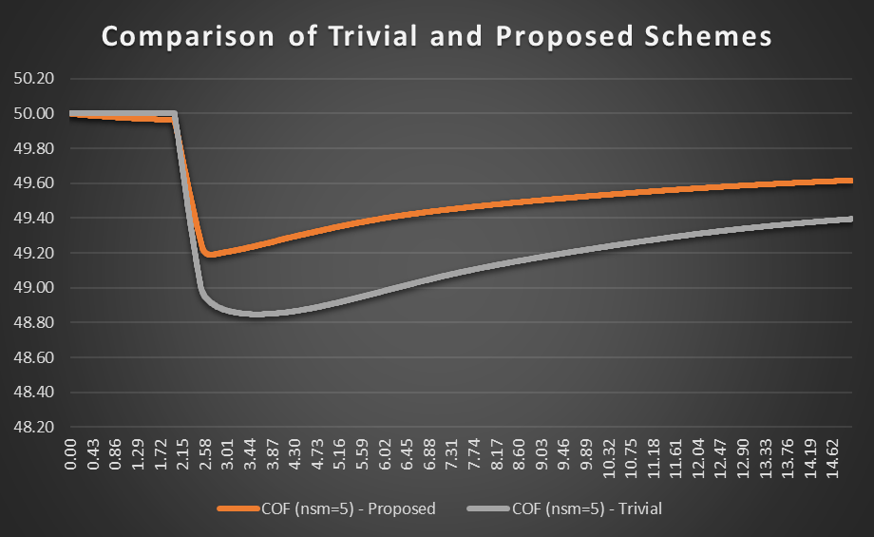
Dynamic Analysis
Comparison
0.34 Hz

Slide 22
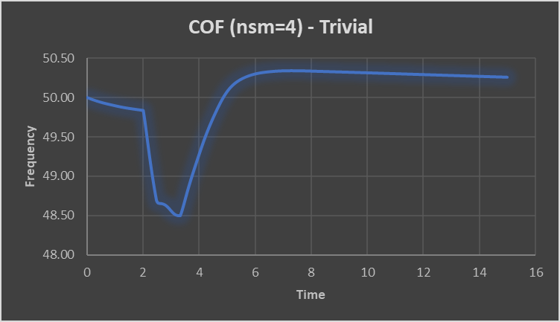
Dynamic Analysis
With UFLS
(Trivial)
Nadir = 48.49 Hz

Slide 23
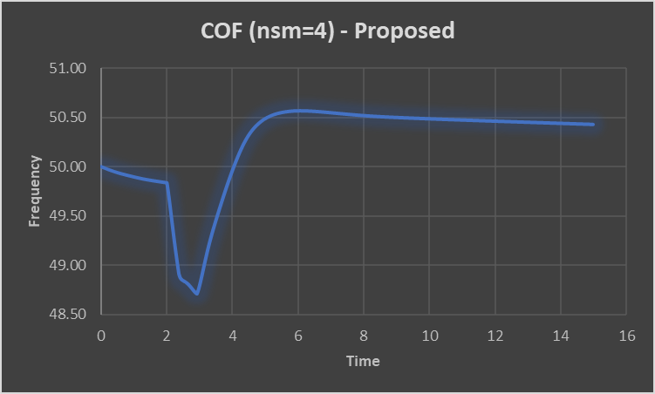
Dynamic Analysis
With UFLS
(Proposed)
Nadir = 48.71 Hz

Slide 24
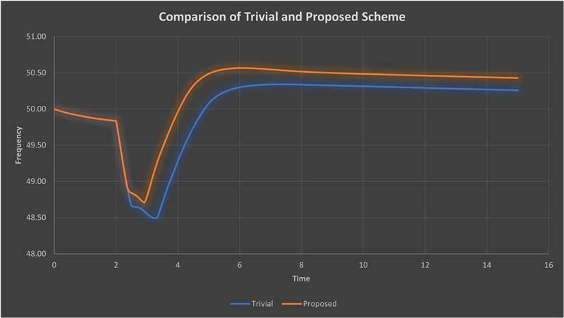
Dynamic Analysis
Comparison
0.22 Hz

Slide 25

Thank You.
Group
08

