Slide 1

EEE316
Project Presentation
Group02
Battery Charger with Variable DC Output Using A Buck-Boost Converter with Auto Cut-off Feature
Farhan Hamid (1706175)
Taki Tazwoar Ali (1706181)
Shariyar Kabir (1706184)
Md. Fardin Islam Alvi (1706183)
Ferdous Hasan Fahim (1706180)

Slide 2

Case Summary
The case summary of our power electronics
project highlights the following incidents:
A 12-volt battery management system
An auto cutoff mechanism
DC to DC converter implementation
Overall Simulink simulation

Slide 3

Approach
Following are the approaches which were
taken to perform the simulation:
A bidirectional dc to dc buck-boost converter was designed to implement the battery management system
An ideal switching was implemented with respect to the voltage capacity of the battery
A reference current value was taken to initiate either charging or discharging of battery
A PI controller was introduced to reduce the steady state error of the feedback along with gaining overall stability of the circuit

Slide 4
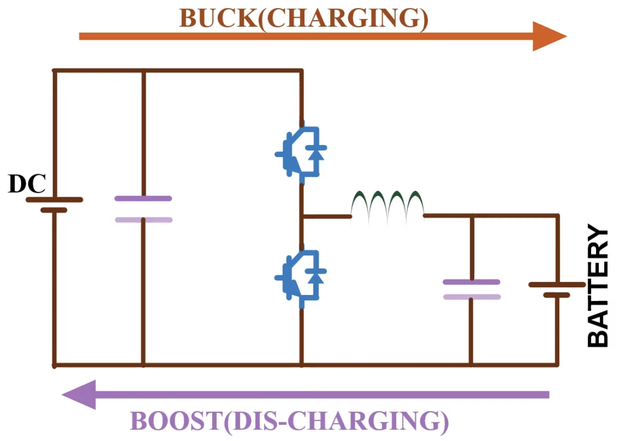
Bidirectional DC to DC Converter
The circuit works as a buck converter when the battery is charging & works as a boost converter when the battery is discharging.

Slide 5
Bidirectional Operations
Battery Operation | Mos01 ON,Mos02 OFF | Mos01 OFF,Mos02 ON
Charging | Charges via the source | Charges vis the current source made up from inductor
Discharging | Discharges via the load | Discharges via the internal loop impedances

Slide 6
Reference Current Value
Charging: (+)ve value
Positive reference value of current will operate the circuit in buck operation & charge the battery.
Discharging: (-)ve value
Negative reference value of current will operate the circuit in boost operation & discharge the battery.

Slide 7
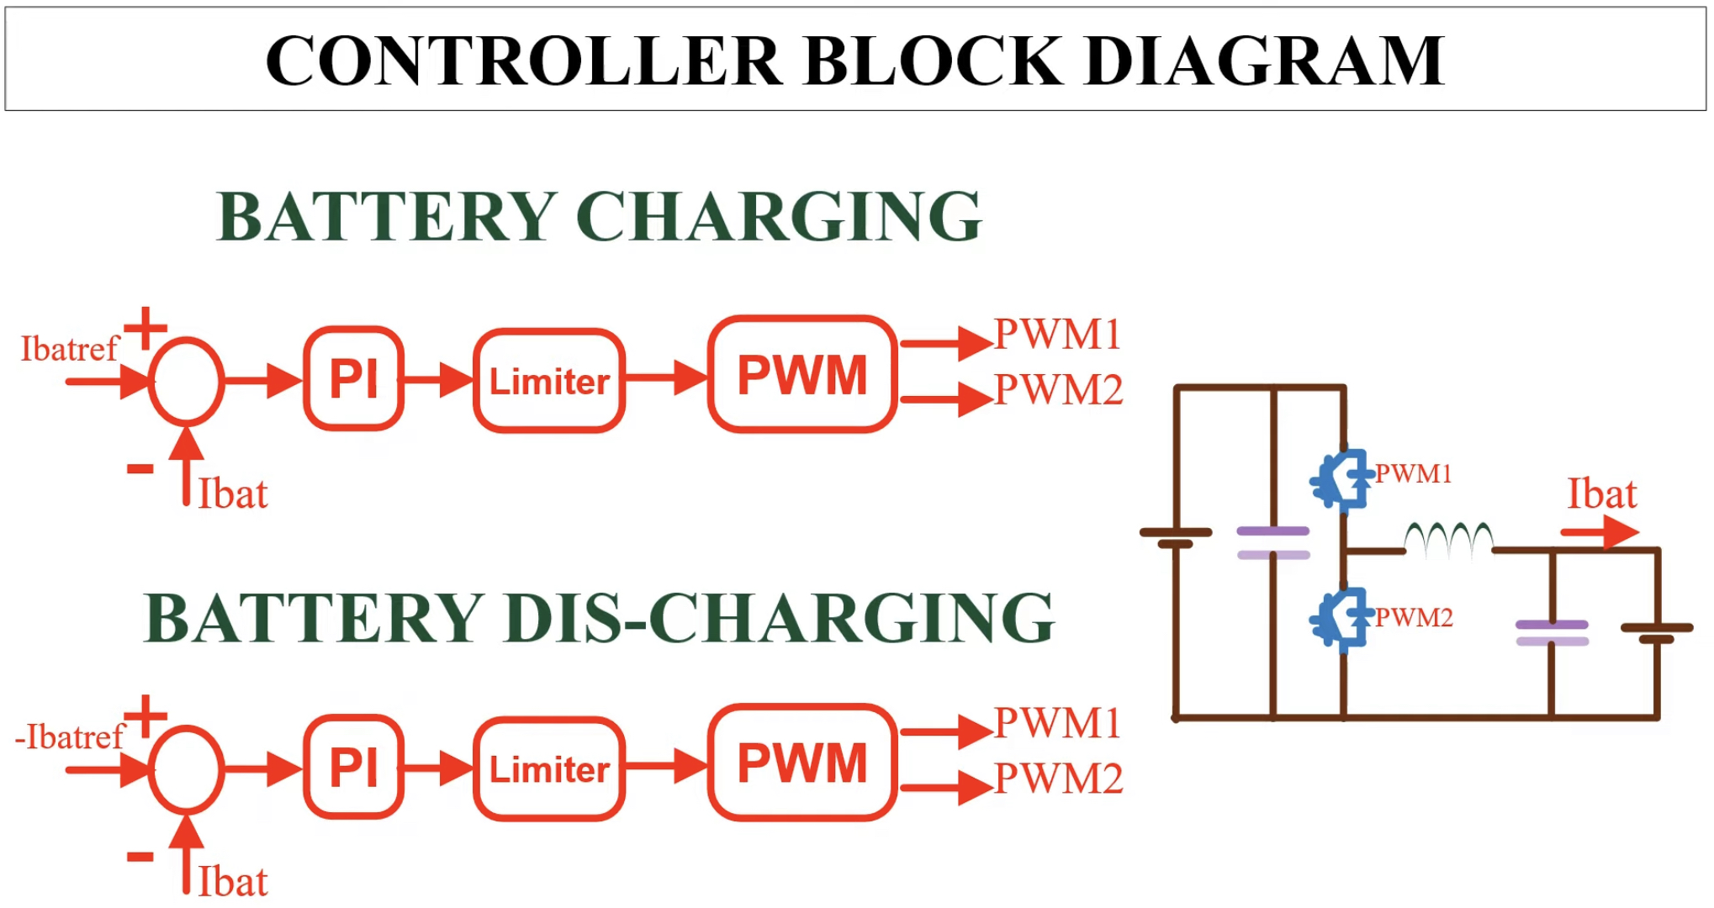

Slide 8
Thank You.
Group
02

