Slide 1
EEE304 Project Presentation
Four Way Smart Traffic Control System With Pedestrian Movement
Group: 04
Farhan Hamid - 1706175
Taki Tazwoar Ali - 1706181
Shariyar Kabir - 1706184
Fardin Alvi - 1706183
Ferdous Hasan Fahim -1706180

Slide 2
Project Brief:
In this project, modelling of smart traffic system of four-way four-lane road along with pedestrian crossing has been implemented using PWM generator, ring counters, and logic gates.
The layout of the road has a symmetrical top view with a roundabout at the junction of the four roads. All roads are divided by road-divider Islands and each side of the roads has dual lanes.
In this scheme, transport passing and pedestrian crossing, both have been implemented without completely stopping all the roads for a single second and it was ensured that the rush of the passing transports or cars can be minimized efficiently.
.

Slide 3
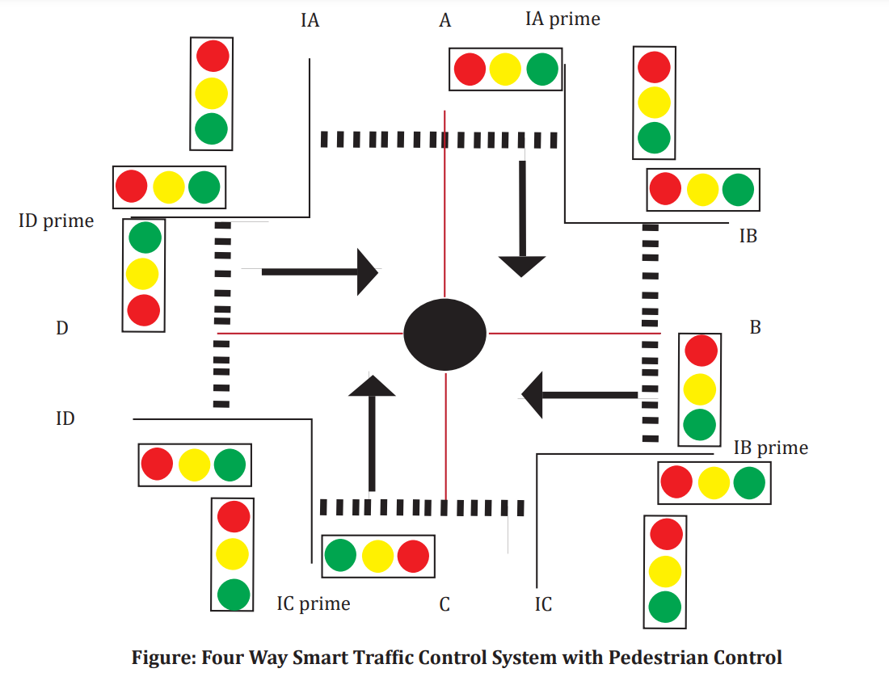
System Notations:
Roads:
Four Roads have been marked as A, B, C, D.
Pedestrian Paths:
If anyone stands on Road A Island facing towards the roundabout, then the path from his standing island to his right-hand side footpath of Road A is marked as Pedestrian path IA.
The path from his standing island to his left-hand side footpath of Road A is marked as Pedestrian path IA/.
Similar definition is taken for pedestrian paths IB, IB/, IC, IC/, ID, ID/.

Slide 4
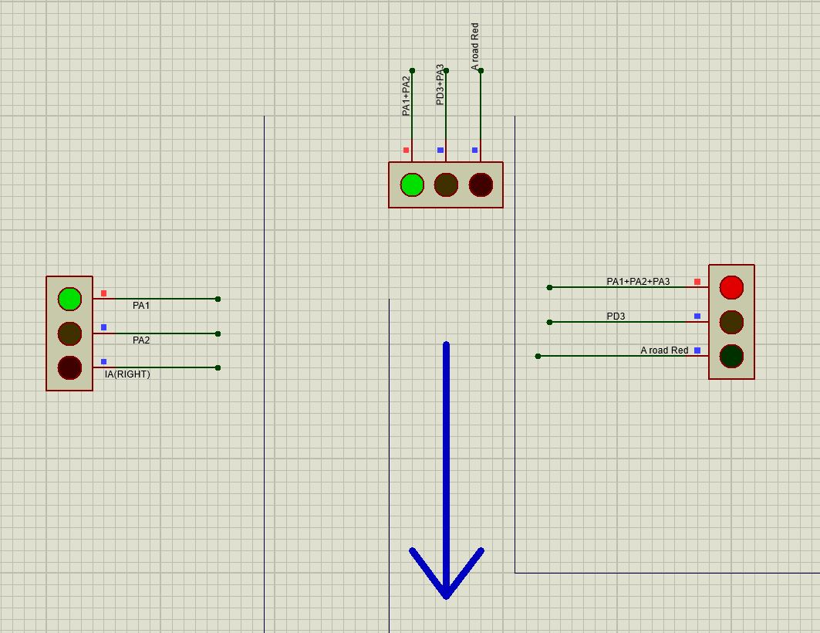
System Functions:
The first trigger is for road A. At first, Transports will come out of Road A and enter into Road B, C, D. At this time, outgoings from Road B, C, D remain off.
At this time-the pedestrian path, IA is free for the pedestrians of this portion of the road.

Slide 5
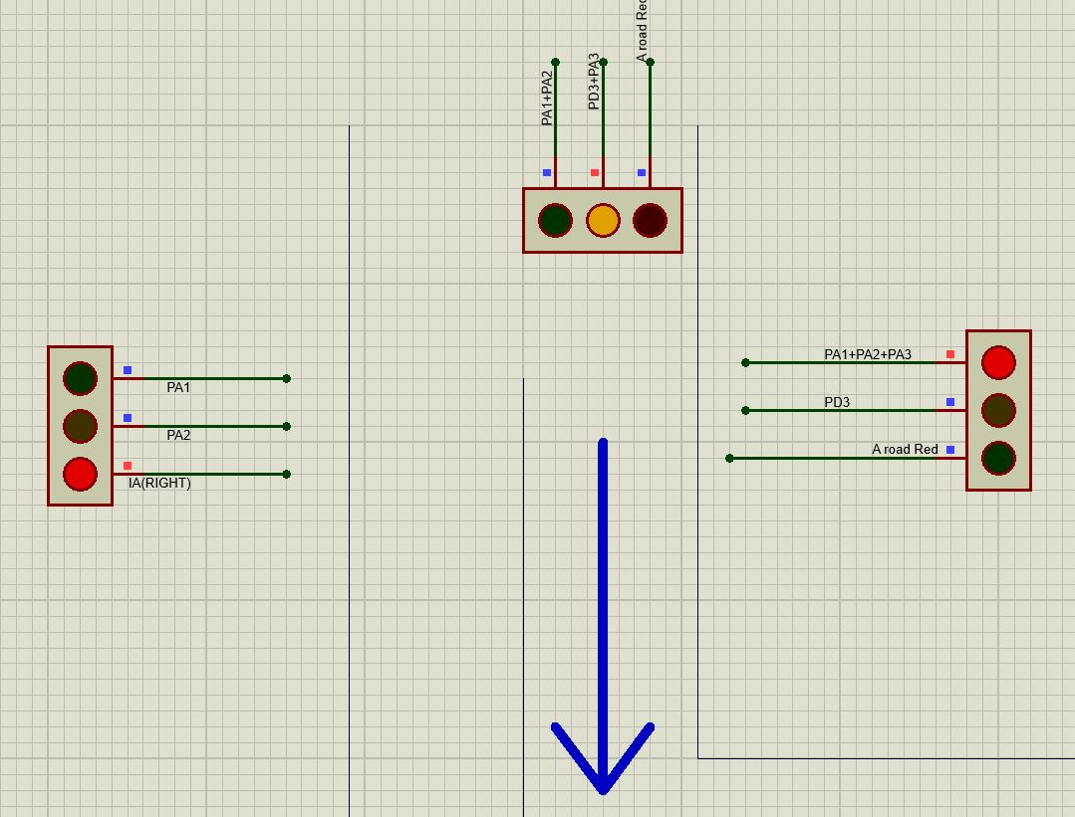
System Functions:
After that, the yellow light of Road A would give a signal for the outgoing transports of road A that, now they have to stop and wait.
At the same time, the yellow light of Road B would give a signal for the outgoing transports of road B that, they would start soon

Slide 6
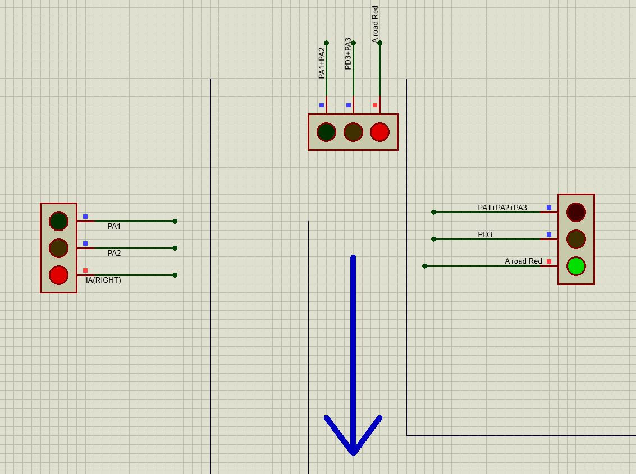
System Functions:
After that, outgoing transports of road A are stored for the next three triggers of this cycle, and at the same time, Pedestrian path IA/ is free, and the pedestrians can move from the island to A/ side and vice versa.

Slide 7
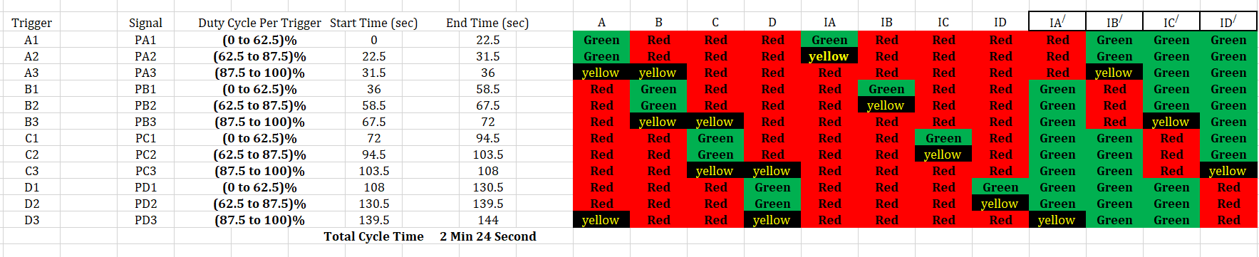
Logic Analysis and Circuit Synthesis:
Road Branch | Red Signal | Yellow Signal | Green Signal
Road A | PB1+PB2+PB3+ PC1+PC2+PC3+ PD1+PD2= A Road Red | PD3+PA3= A Road Yellow | PA1+PA2
Road B | PC1+PC2+PC3+ PD1+PD2+PD3+ PA1+PA2 = B Road Red | PA3+PB3= B Road Yellow | PB1+PB2
Road C | PD1+PD2+PD3+ PA1+PA2+PA3+ PB1+PB2= C Road Red | PB3+PC3= C Road Yellow | PC1+PC2
Road D | PA1+PA2+PA3+ PB1+PB2+PB3+ PC1+PC2= D Road Red | PC3+PD3= D Road Yellow | PD1+PD2
Pedestrian IA | A Road Red+ A Road Yellow | PA2 | PA1
Pedestrian IB | B Road Red+ B Road Yellow | PB2 | PB1
Pedestrian IC | C Road Red+ C Road Yellow | PC2 | PC1
Pedestrian ID | D Road Red+ D Road Yellow | PD2 | PD1
Pedestrian IA/ | PA1+PA2+PA3 | PD3 | A Road Red
Pedestrian IB/ | PB1+PB2+PB3 | PA3 | B Road Red
Pedestrian IC/ | PC1+PC2+PC3 | PB3 | C Road Red
Pedestrian ID/ | PD1+PD2+PD3 | PC3 | D Road Red

Slide 8
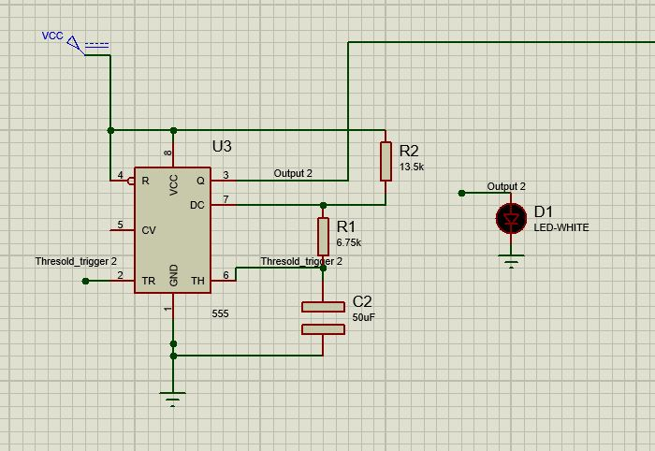
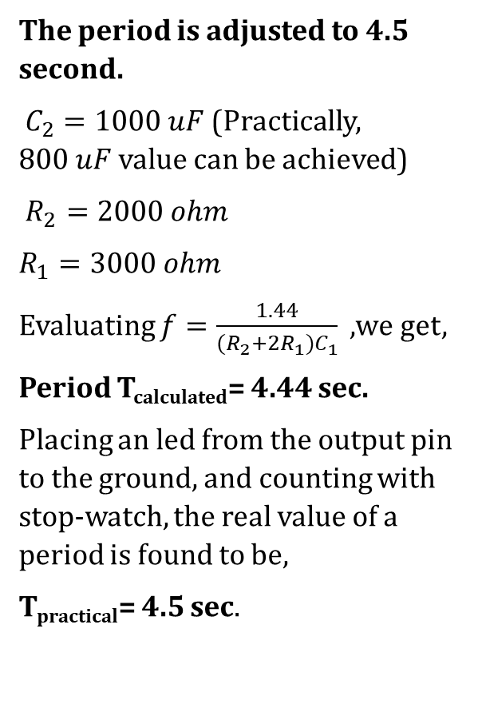
PWM Generation by Astable Operation of 555 Timer
The period is adjusted to 4.5 second.
$C_{2}=1000 uF$ (Practically, $800 uF$ value can be achieved)
$R_{2}=2000 ohm$
$R_{1}=3000 ohm$
Evaluating $f=\frac{1.44}{(R_{2}+2R_{1})C_{1}} ,$we get,
Period T_{calculated}= 4.44 sec.
Placing an led from the output pin to the ground, and counting with stop-watch, the real value of a period is found to be,
T_{practical}= 4.5 sec.

Slide 9
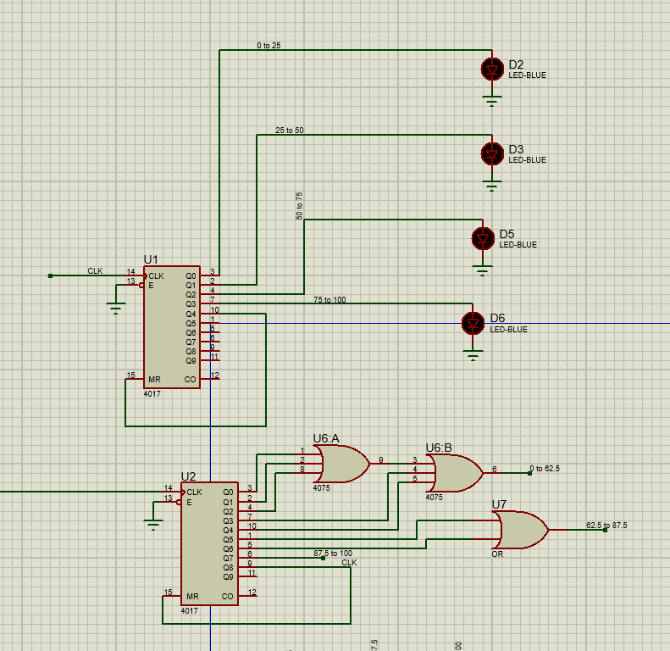
Trigger Signal Generation by Ring Counter (IC 4017)
Ring counter shifts the input pulses from output Q₀ to successive outputs with just a completion of a period of the PWM and resets at the pin with which the Reset Pin 15 is connected to. This is why the duty cycle is not important here.
Pin 14 takes the positive edge of the clock signal as trigger.
In the above figure, the upper ring counter U1 is used for activating each roads A, B, C, D, and the lower counter U2 is used for each trigger. Most importantly, after a full set of triggers, the trigger counter U2 resets, and at the same time, the activating counter U1changes its output signal.

Slide 10
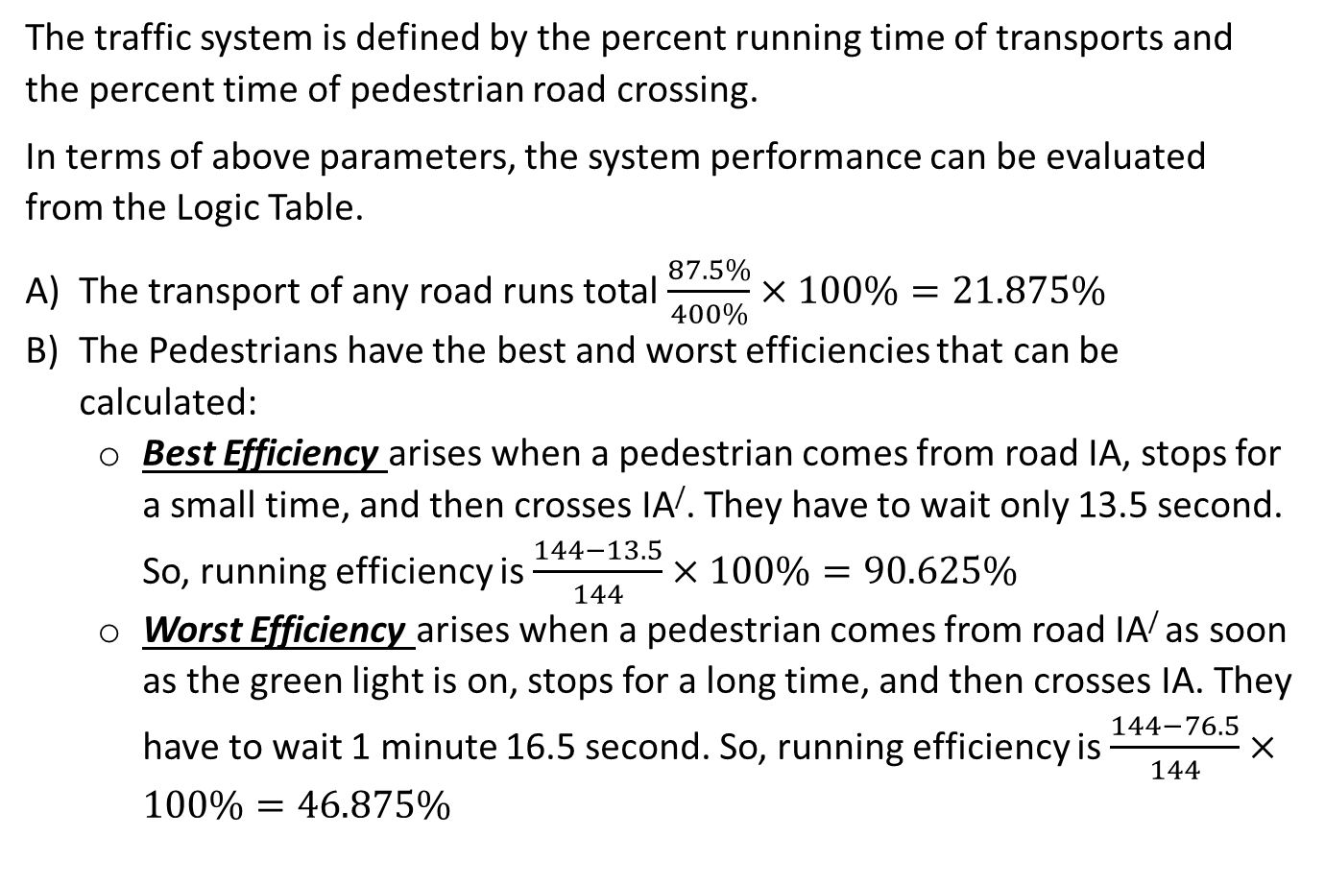
System Performance & Limitations:
The traffic system is defined by the percent running time of transports and the percent time of pedestrian road crossing.
In terms of above parameters, the system performance can be evaluated from the Logic Table.
The transport of any road runs total $\frac{87.5\%}{400\%}×100\%=21.875\%$
The Pedestrians have the best and worst efficiencies that can be calculated:
Best Efficiency arises when a pedestrian comes from road IA, stops for a small time, and then crosses IA/. They have to wait only 13.5 second. So, running efficiency is $\frac{144−13.5}{144}×100\%=90.625\%$
Worst Efficiency arises when a pedestrian comes from road IA/ as soon as the green light is on, stops for a long time, and then crosses IA. They have to wait 1 minute 16.5 second. So, running efficiency is $\frac{144−76.5}{144}×100\%=46.875\%$

Slide 11
Software Simulation

Slide 12
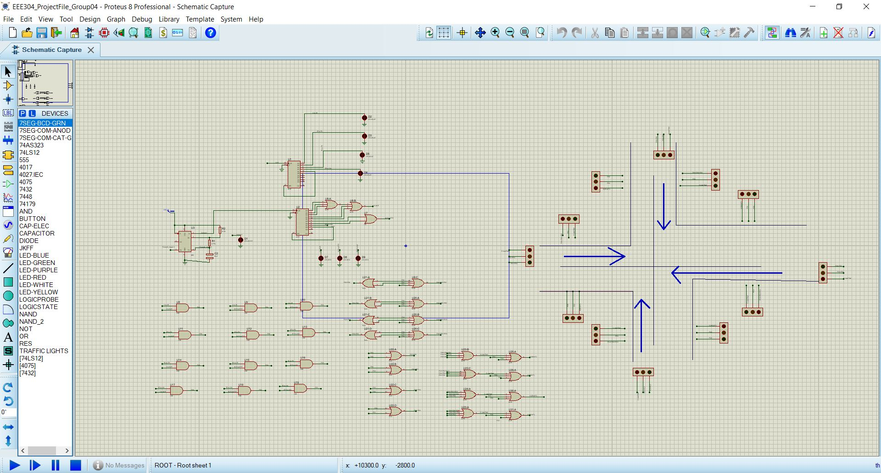
Proteus Simulation

Slide 13
WAIT...!

Slide 14
Hardware Demonstration

Slide 15
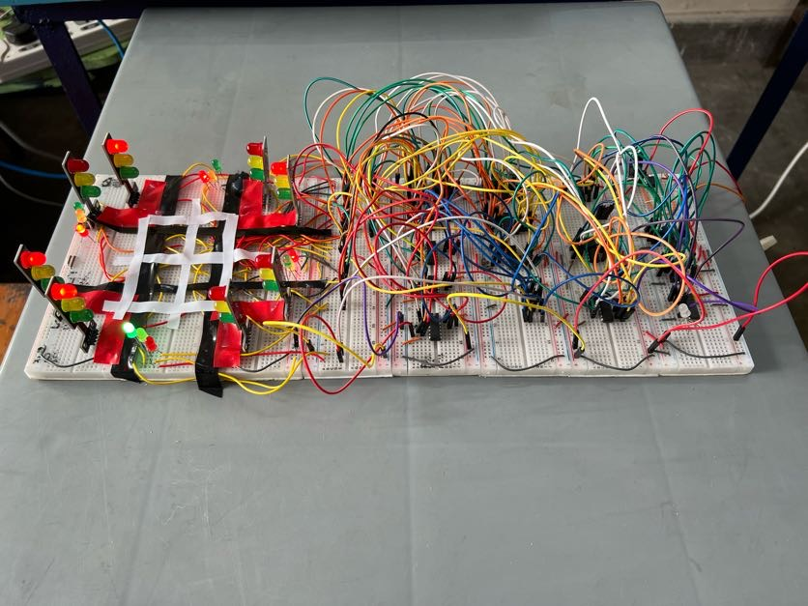
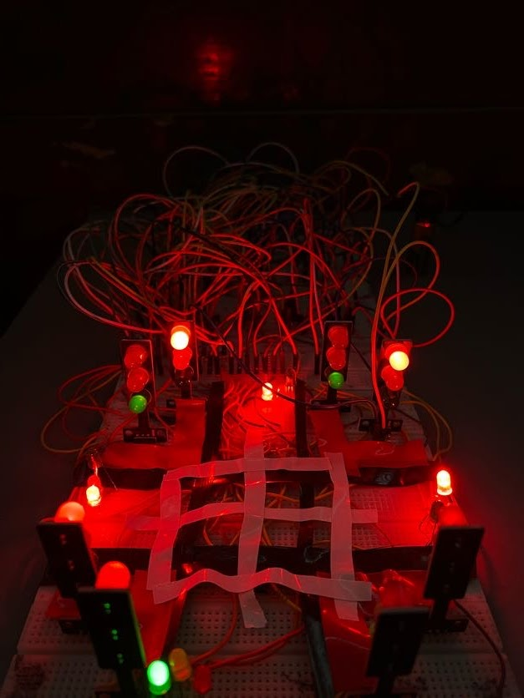
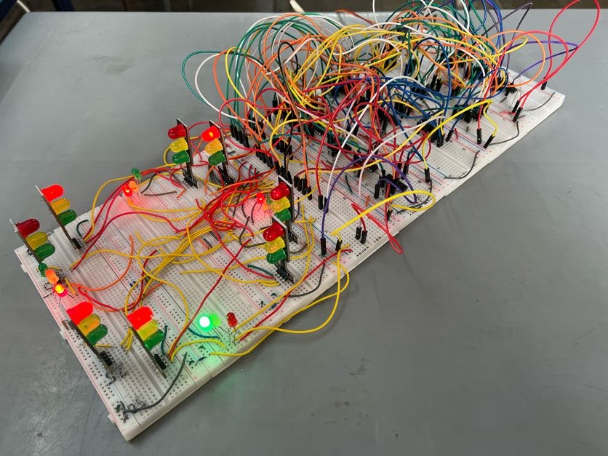
Hardware Demonstration

Slide 16
THANK YOU!
THAT’LL
BE
ALL!

