Slide 1

EEE306
Project Presentation
Group05
Investigating The Effect of HVDC Connection & Large Industrial Loads in IEEE 39-Bus Network
Farhan Hamid (1706175)
Nausin Tabassum Kudrot (1706158)
Ferdous Hasan Fahim (1706180)
Fariha Ferdousi (1706143)

Slide 2
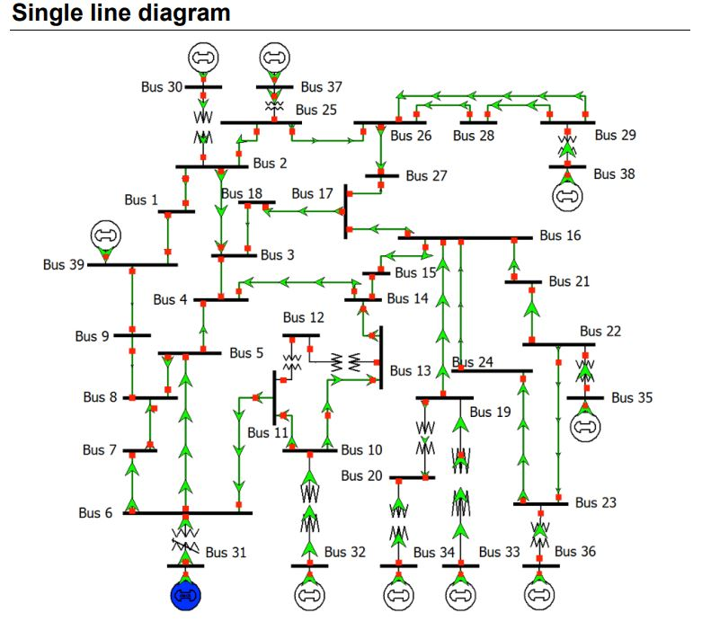
IEEE 39 bus test system shown aside. Nominal frequency is 50 Hz. IEEE 39 bus system is well known as 10-machine New-England Power System. This case is used to study simultaneous damping of local and inter-are modes in a system with a highly symmetrical structure.

Slide 3

Base Case
The initial base case of the power system
consisted of the following elements:
39 Buses
30 Lines
12 Transformers
10 Generators
19 Loads
Afterwards Induction Motors & HVDC lines were added to study their effects on the power system which caused some errors that were resolved later on.

Slide 4
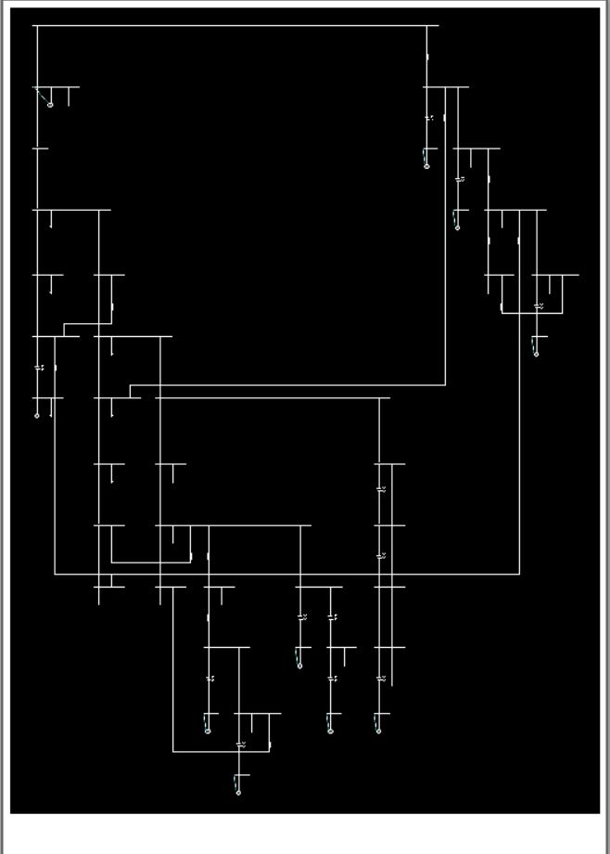
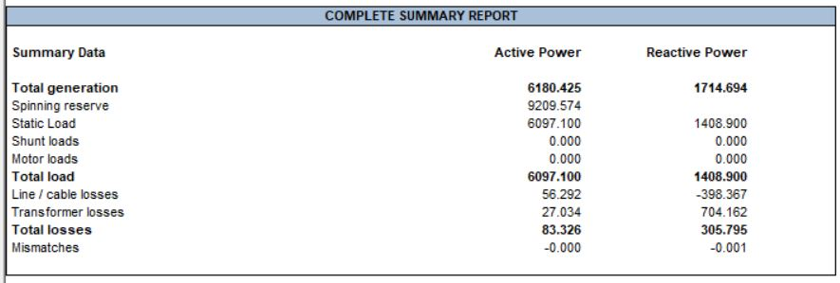
Base Case One Line Diagram
Base Case summary report before adding HVDC line & induction motors

Slide 5
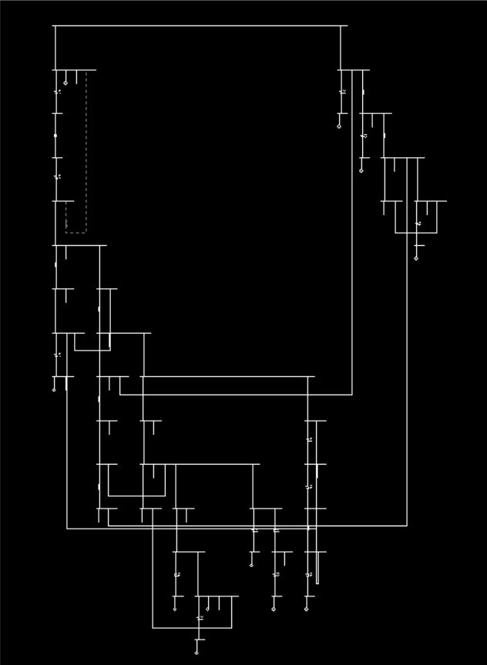
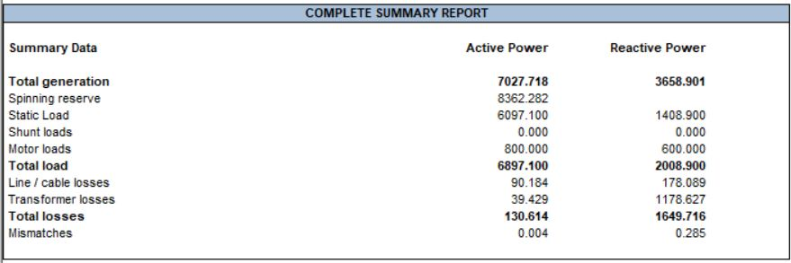
Base Case One Line Diagram (with IM & HVDC line)
Base Case summary report after adding HVDC line & induction motors

Slide 6

Abnormalities
Following are the errors which were
addressed:
Some buses couldn’t match their voltage limits due to the addition of HVDC line.
Power flow of a line overloaded, breaching its loading limit
Operating power of a transformer connected to the slack generator overloads due to the generator producing a very hefty amount of voltage.
Some generators also breach their reactive limits due to the addition of Induction Motors, making more reactive power drawn.

Slide 7
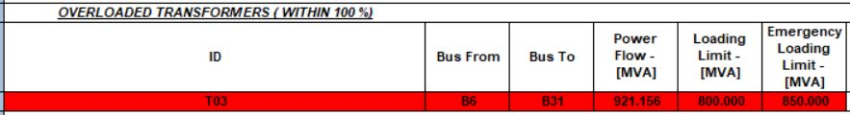
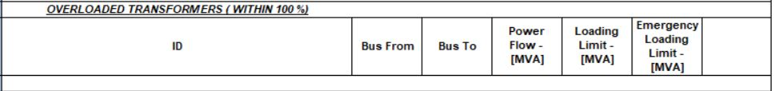
Our Approach to Solve
In our upcoming sessions we’ll discuss on how the following approaches helped us to solve all the abnormal conditions in the power system:
Distributed Swing Power
Allotting excess power to a single generator proved unacceptable as some deviation from the desired value caused is large [Ref:Abnorm03]
Thus this method aims to reduce the generation of the slack generator whilst increasing power generation of the other selected generators.
Overloaded Transformer abnormality (above) solved using the Distributed Swing Power method (below) in PSAF.

Slide 8
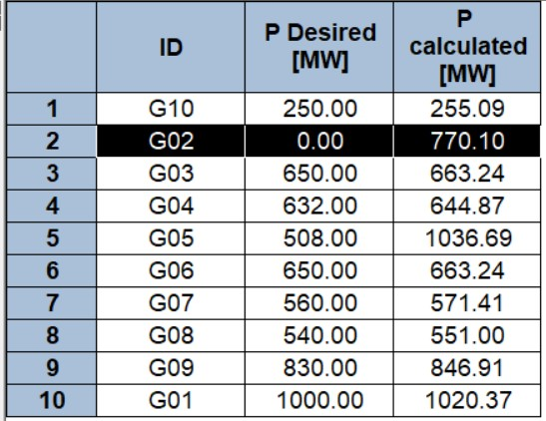
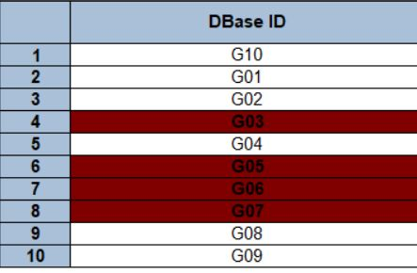
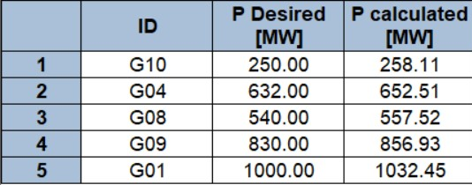
Distributed Swing Power
In the traditional load flow computation, the scheduled generations (Pgen) at swing generators are irrelevant. For that reason, users may leave Pgen = 0. In the distributed swing load flow, valid swing generations must be input correctly. If Pgen = 0 MW is entered at a swing bus, then the program will reschedule its generation. After the base case run, all the generators were used in the distributed swing method to find the calculated active power(770.10 MW) of the swing generator. [Photo01]
After the complete base case run, we saw these four generators exceeding their reactive limits; so these four along with the swing gen were left out from the swing distribution. [Photo02]
After the swing power distribution, a log sheet generated showing the updated power generation of the rest of the generators. [Photo3]

Slide 9

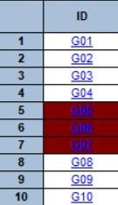

Distributed Swing Power
The redistribution helped to overcome the overloaded line problem along with one generator(G03) falling back to its optimum limits.

Slide 10
The rest of the abnormalities were solved using two methods alternatively as we were instructed to:
Static VAR Compensator
In Solve Case 01 , we added a total of five SVC’s to solve the three out of reactive limit generators case & to keep the bus voltages in their limits.
Shunt Capacitor
In Solve Case 02 , we added a total of five SC’s to solve the three out of reactive limit generators case & to keep the bus voltages in their limits.

Slide 11
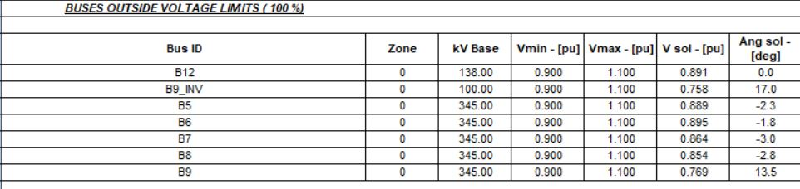
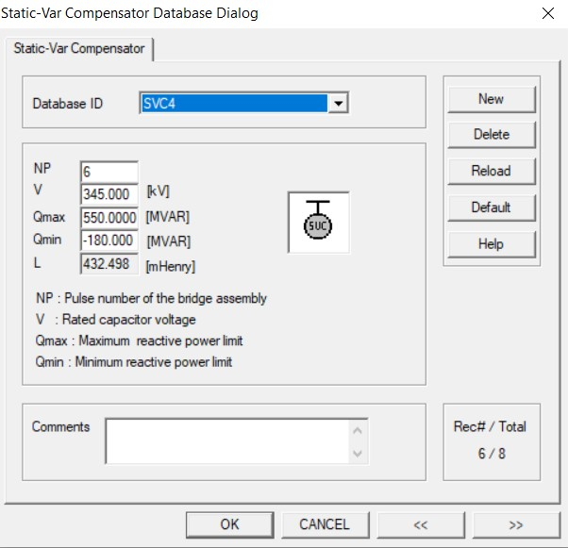
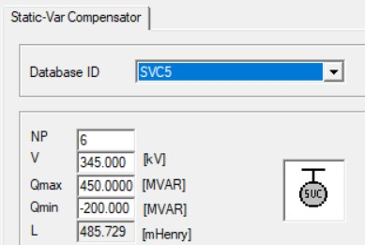
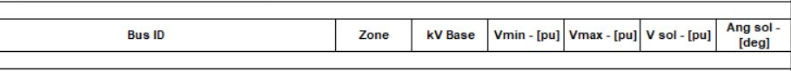
SolveCase01: Static VAR Compensator
Following are the two applications in this regards:
Buses Outside Voltage Limit Resolved
From branch data ,
Reactive power requirements for B5 > 483 MVAR Reactive power requirements for B7 > 381.5 MVAR
SVC 4 and SVC 5 are connected at bus B5 and B7 respectively with ratings around 550 MVAR & 450 MVAR respectively in order to compensate the reactive power requirements of bus B5 and B7.

Slide 12
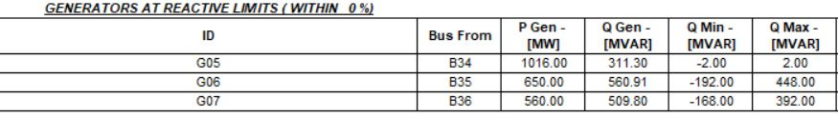

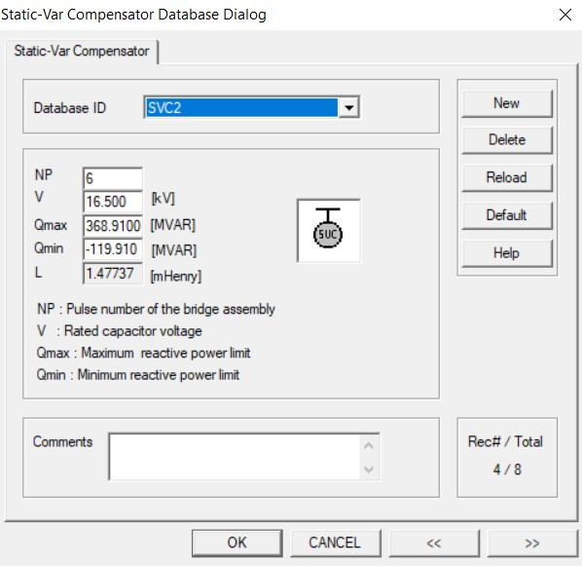

SolveCase01: Static VAR Compensator
Following are the two applications in this regards:
Generators Breaching Reactive Limit Resolved
Maximum reactive power limit of SVC,
Q_{max}(SVC) > {Q_{MVAR,Generator}- |Q_{min,SVC}|}
Minimum reactive power limit of SVC,
|Q_{min,SVC}| > {Q_{MVAR,Generator}- Q_{max,SVC}}
Q_{max,} Q_{min} of SVC 1 ,SVC 2, and
SVC 3 are accordingly. These Q_{max,} Q_{min} values are selected greater than the critical values so that SVC can also compensate the power losses of the buses.

Slide 13
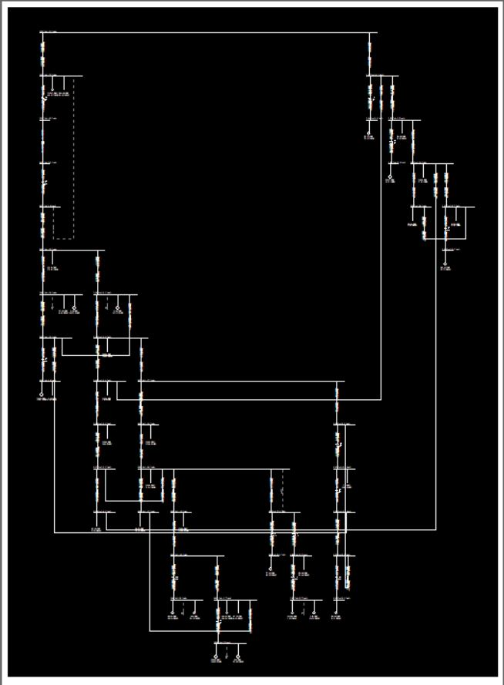
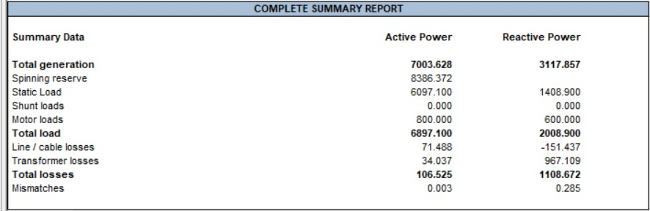
SVC Case One Line Diagram
SolveCase01: Static VAR Compensator summary report

Slide 14
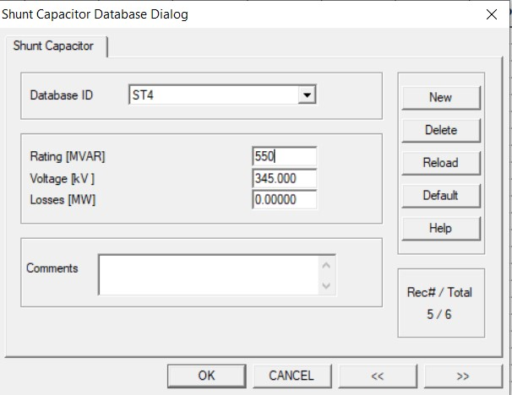
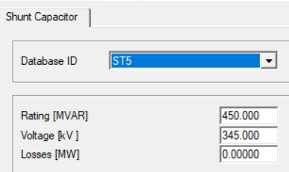
SolveCase02: Shunt Capacitor
Following are the two applications in this regards:
Buses Outside Voltage Limit Resolved
From branch data ,
Reactive power requirements for
B5 > 483 MVAR Reactive power requirements for
B7 > 381.5 MVAR
SC 4 and SC 5 are connected at bus B5 and B7 respectively with ratings around 550 MVAR & 450 MVAR respectively in order to compensate the reactive power requirements of bus B5 and B7.

Slide 15

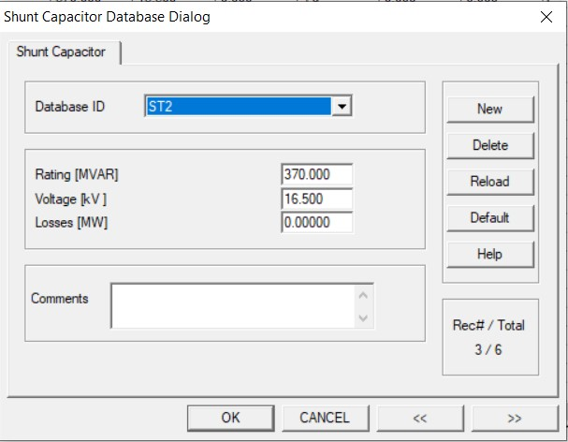

SolveCase02: Shunt Capacitor
Following are the two applications in this regards:
Generators Breaching Reactive Limit Resolved
Maximum reactive power requirements for G5,G6 and G7 is,
Q_{req}= Q_{MVAR,Generator} – | Q_{min,Generator} |
The MVAR rating of SC1,SC2 and SC3 are set at a value slightly less than the Q_{req} for optimum operation.

Slide 16
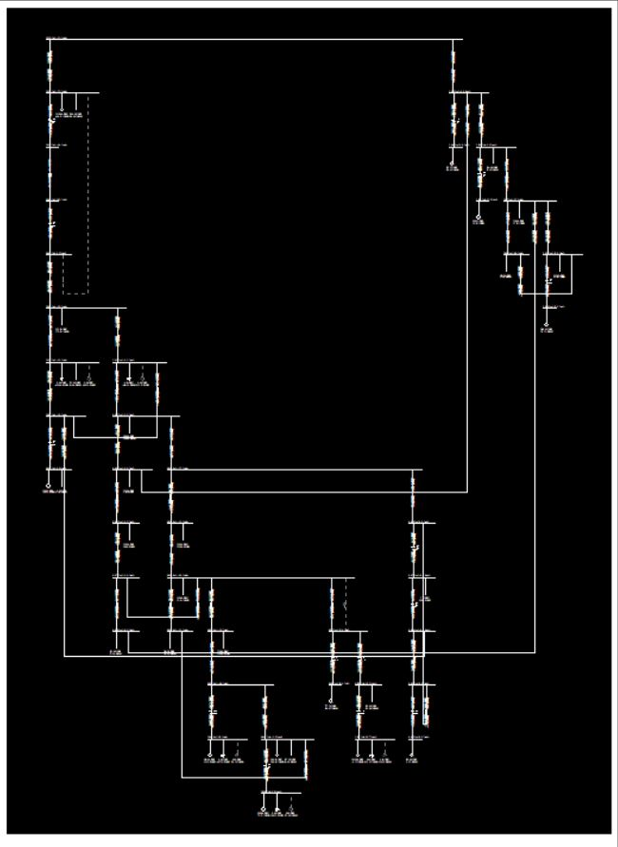
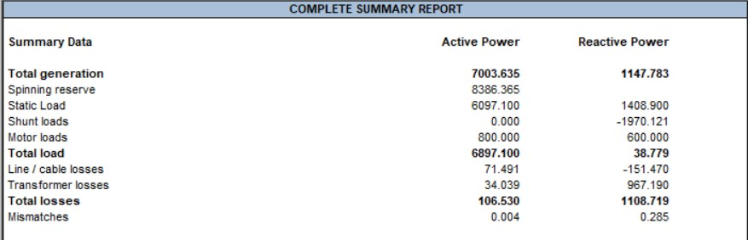
SC Case One Line Diagram
SolveCase02: Shunt Capacitor summary report

Slide 17
Different Shunt Controllers
The shunt capacitor & SVC increase the static voltage stability margin and power transfer capability, however, SVC provides better behaviour in terms of loss reduction and voltage profile. The increase in losses with a shunt capacitor under lightly loaded conditions is due to the poor voltage profile. A remote voltage control scheme can be implemented to solve the voltage control problem at the shunt capacitor bus.
Overall, SVC behaves better than a simple shunt capacitor, however, these controllers are expensive when compared to the shunt capacitor. A complete cost–benefit analysis has to be carried out to justify the economic viability of the SVC.
COST COMPARISON
SHUNT CONTROLLER | COST(US $)
SHUNT CAPACITOR | 8/kVAR
Static VAR Compensator | 40/kVAR (controller portion)

Slide 18

"What is a soul? It's like electricity - we don't really know what it is, but it's a force that can light a room!"

Slide 19
Thank You.
Group
05

