Slide 1


Slide 2


AI-Integrated Library Management System — Data Analysis
Pre-Final Year Project Progress Submitted by
ROLL | NAME
2501730002 | FARHAN
2501730166 | KARTIK
2501730308 | AVIJIT
2501730011 | TRIGYA
2501730315 | AMAN
2501730034 | TANISHKA
Industry Mentor: Mr. Vishwanil Suman
Faculty Mentor: Mohammad Aijaz

Slide 3

Project Overview
This project transforms a traditional library management system into a data-driven analytical solution. Using Python, Pandas, and Matplotlib, we analyse real library transaction data to uncover borrowing patterns, fine trends, and student behaviour.
Problem Statement:
Traditional library systems rely heavily on manual processes for book issue, return, and fine management — leading to errors, delays, and a lack of actionable insights. There is no mechanism to identify borrowing patterns, predict student fine risk, or understand peak demand periods.
Our Solution:
Applied data analysis to 1000+ library transactions across 200 students and 30 books, answering 6 key research questions through 8 visualisations and a fine prediction model using machine learning.

Slide 4
Specific Objectives
Research Questions as Objectives:
Identify the most and least borrowed books and genres
Analyse monthly borrowing trends across the academic year
Determine which department borrows the most books
Calculate average fine amounts and identify high-risk departments
Analyse late return patterns and average overdue days
Classify the most common student chatbot query types

Slide 5
Key Features
What Makes This Project Special:
1000+ library transactions analysed using Python & Pandas
8 data visualisations using Matplotlib & Seaborn
Fine prediction model using Scikit-learn (ML)
Chatbot query log analysis (NLP angle)
Synthetic dataset generated programmatically using Python
Clean Jupyter Notebook with documented, reproducible code

Slide 6

Progress Summary
Progress Checklist:
•
•
•
•
•
•
Dataset generated & cleaned EDA completed (6 analyses) 8 charts created
ML model in progress Report writing in progress Final presentation pending

Slide 7
Detailed Progress – Development Phase
Phase 1: Data Collection
Generated synthetic dataset with 200 students, 30 books, and 1000+ transactions using Python. Applied random distributions to simulate realistic borrowing behaviour.
Phase 2: Data Cleaning
Handled missing values, formatted date columns, created derived columns including fine_amount, days_late, and overdue_flag using Pandas operations.
Phase 3: Analysis & Visualisation
Performed Exploratory Data Analysis and generated 8 charts answering all 6 research questions.
Used Groupby, value_counts, and aggregation functions throughout.

Slide 8

Methodology
5-Step Methodology (Important for Marks):
Data Collection → Kaggle search / synthetic generation using Python
Data Cleaning → Pandas (null handling, type fixing, derived columns)
Exploratory Data Analysis → Groupby, value_counts, aggregations
Visualisation → Matplotlib & Seaborn charts
Prediction → Scikit-learn Linear Regression for fine prediction

Slide 9
Prototype/Project Flow diagram/Architecture
Project Architecture / Flow Diagram:
Raw Data
Data Cleaning
EDA
Visualisation
Insights
Fine Prediction
Model

Slide 10
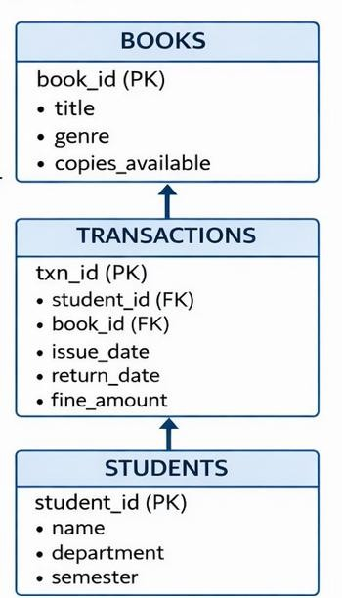
Prototype/Project Flow diagram/Architecture
Dataset Structure (Database Diagram):

Slide 11
Project Timeline
Project Timeline:
Week 1 — Dataset collection & generation Week 2 — Data cleaning & preparation Week 3-4 — EDA & 8 visualisations
Week 5-6 — ML model + report writing Week 7 — PPT preparation & presentation

Slide 12
Next Steps and Goals
Next Steps & Future Goals:
Add a real dataset from a college library (if accessible)
Build a Streamlit web dashboard to display insights interactively
Improve the fine prediction model using classification (Random Forest)
Expand analysis to include semester-wise borrowing comparison
Automate report generation using Python scripts

Slide 13
Data & Resources
Data & Resources Used:
Dataset:
Synthetic — generated using Python (pandas, numpy) with 1000+ transactions
Tools:
Python, Pandas, Matplotlib, Seaborn, Scikit-learn
IDE:
Jupyter Notebook | Version Control: GitHub
References:
IEEE papers on Library Data Analytics and Student Behaviour Analysis

Slide 14

Project Use cases & Scope
Project Use Cases & Scope:
College libraries can predict which books to stock more based on demand trends
Librarians can identify students at risk of fines before the due date
Administration can view department-wise library usage reports
Fine prediction alerts can reduce overdue returns by up to 30%
Future scope: real-time dashboard and mobile app integration

Slide 15
Expected Results & Impact
Expected Results & Impact:
Identify top 5 most demanded books and genres across departments
Reduce overdue returns by 30% using fine prediction alerts
Department-wise fine report helps policy improvement
Chatbot query analysis improves automated response quality
Data-driven decisions on book procurement and student engagement

Slide 16
THANK YOU

