Slide 1


MALLA REDDY INSTITUTE OF TECHNOLOGY (RJ)
Maisammaguda, Dhulapally (Post Via Hakimpet), Secunderabad-10.
A
MAJOR PROJECT
PRESENTATION
on
“ DEFENCE STRATERGIES FOR EPIDEMIC CYBER SECURITY THREATS : MODELLING AND ANALYSIS USING MACHINE LEARNING APPROACHES”
UNDER THE GUIDANCE BY
Mr.N.Pavan
Assistant Professor
MADE BY
B.Pavan - 21RJ1A0529
B.Sindhuja - 21RJ1A0538
Farhan Uddin - 21RJ1A0516
CH.Rahul - 21RJ1A0544

Slide 2
CONTENTS
Abstract
Introduction
Existing System and Disadvantages
Proposed System and Advantages
Modules
System Architecture
System Requirements
UML Diagrams
Results
Conclusion
Future Enhancement

Slide 3
ABSTRACT
Cyberattacks today can spread quickly across computers, just like diseases spread among people. These are called epidemic cyber threats. They can affect many systems at once and are hard to stop using old methods.
This project uses a special model called SEIAR (Susceptible, Exposed, Infected, Awaiting Detection, Recovered) to show how these threats move through different stages. We also use Random Forest, a machine learning technique, to predict how the attacks will spread and help stop them early.

Slide 4
INTRODUCTION
Cybersecurity is a major concern due to increased digital dependence.
Epidemic threats spread quickly across networks.
This project introduces a smarter way to model, analyze, and control such fast-spreading cyber threats.
Machine learning helps detect unknown attacks by learning from past data

Slide 5
EXISTING SYSTEM
Mostly rely on signature-based detection, missing new threats.
Use rule-based firewalls and IDS, which can’t detect complex attacks.
Analyze network traffic at limited points, lacking a full view.
Machine learning use is limited to small datasets or specific attacks.
No integrated real-time system for large-scale epidemic threat defense.

Slide 6
DISADVANTAGES
Unable to detect new or unknown cyber threats effectively.
Generates many false positives, leading to alert fatigue.
Poor scalability in handling large or complex network environments.
Slow to respond to rapidly evolving cyber attacks.
Lacks automated and intelligent threat analysis capabilities.

Slide 7
PROPOSED SYSTEM :
Uses smart computer programs (machine learning) to find new and old cyber threats.
Watches the network all the time and spots problems automatically.
Looks at the whole network data to catch threats better.
Can grow easily to protect big and busy networks.
Makes quick and accurate decisions to stop attacks faster.

Slide 8
ADVANTAGES
Finds new and unknown attacks easily.
Works by itself, saving time.
Gives fewer wrong warnings.
Can protect big networks well.
Stops attacks faster with smart decisions.

Slide 9
MODULES :
Data Collection & Preprocessing
Feature Selection & Engineering
Model Training & Evaluation
Real-Time Threat Detection & Response
Visualization & Reporting

Slide 10
SYSTEM REQUIREMENTS:
Hardware Requirements:
Processor : Intel i5
RAM : 8GB
Storage : 1TB HDD/SSD

Slide 11
Software Requirements:
Operating System : Windows
Programming Language : Python
Libraries : Scikit-learn, NumPy, Pandas

Slide 12
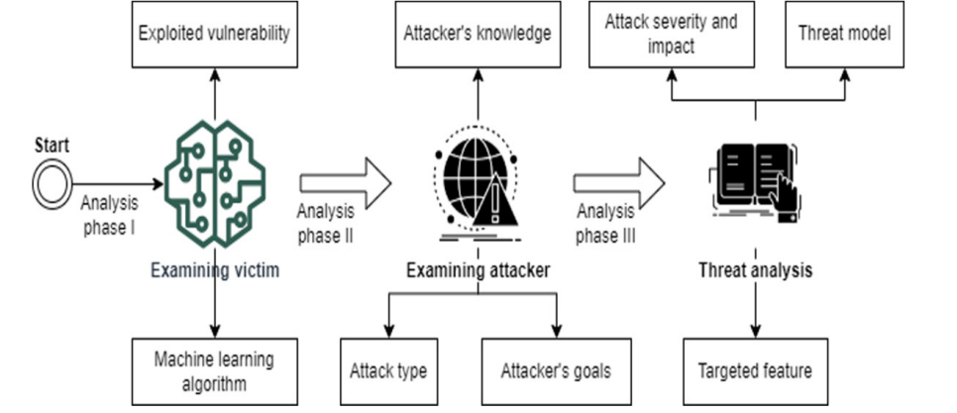
ARCHITECTURE DIAGRAM

Slide 13
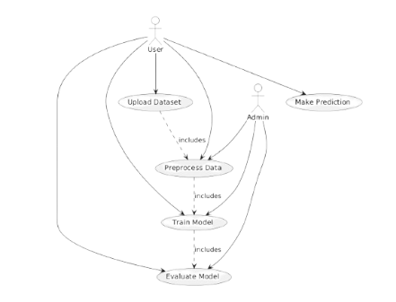
UML DIAGRAMS
USE CASE DIAGRAM :

Slide 14
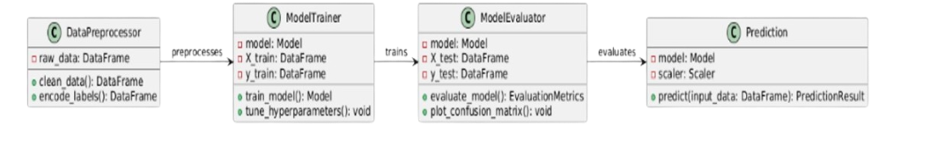
CLASS DIAGRAM:

Slide 15
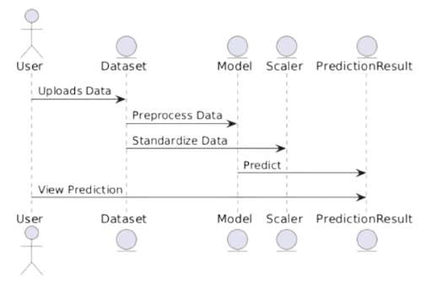
SEQUENCE DIAGRAM:

Slide 16
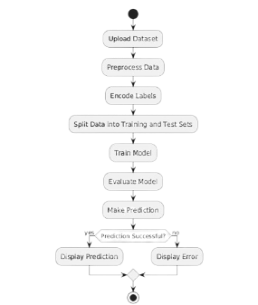
ACTIVITY DIAGRAM:

Slide 17
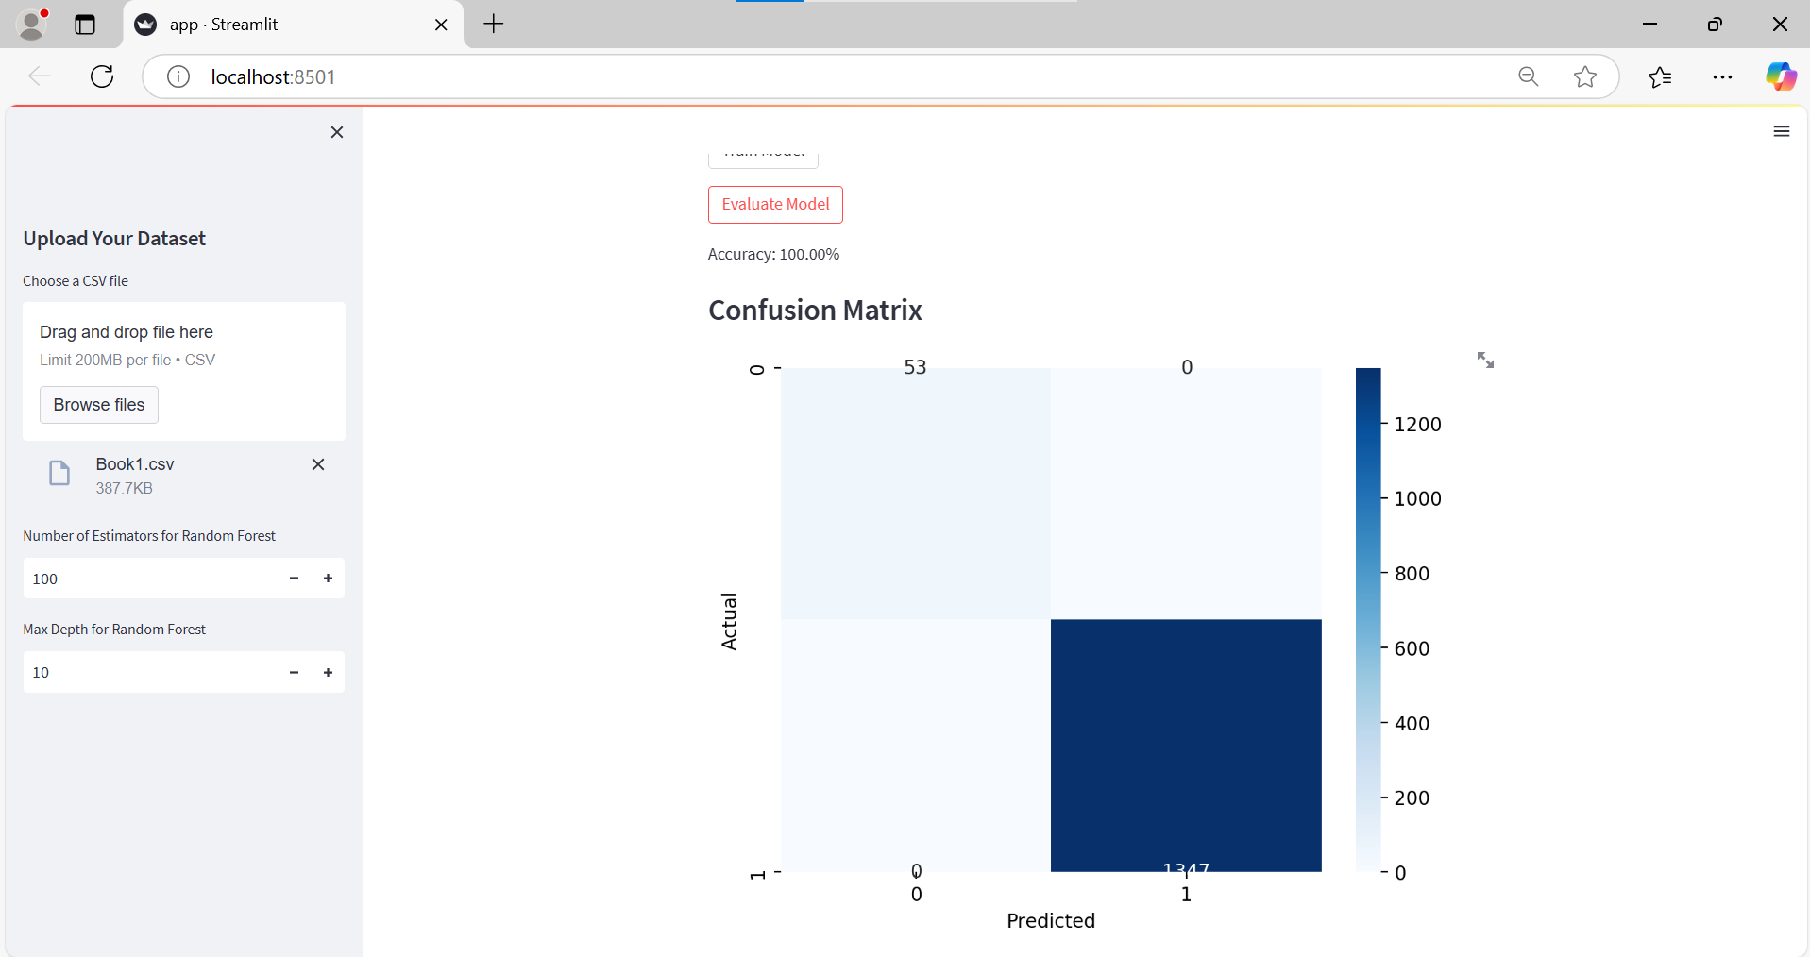
RESULTS
Heatmap showing prediction results: true positives, false positives, etc.

Slide 18
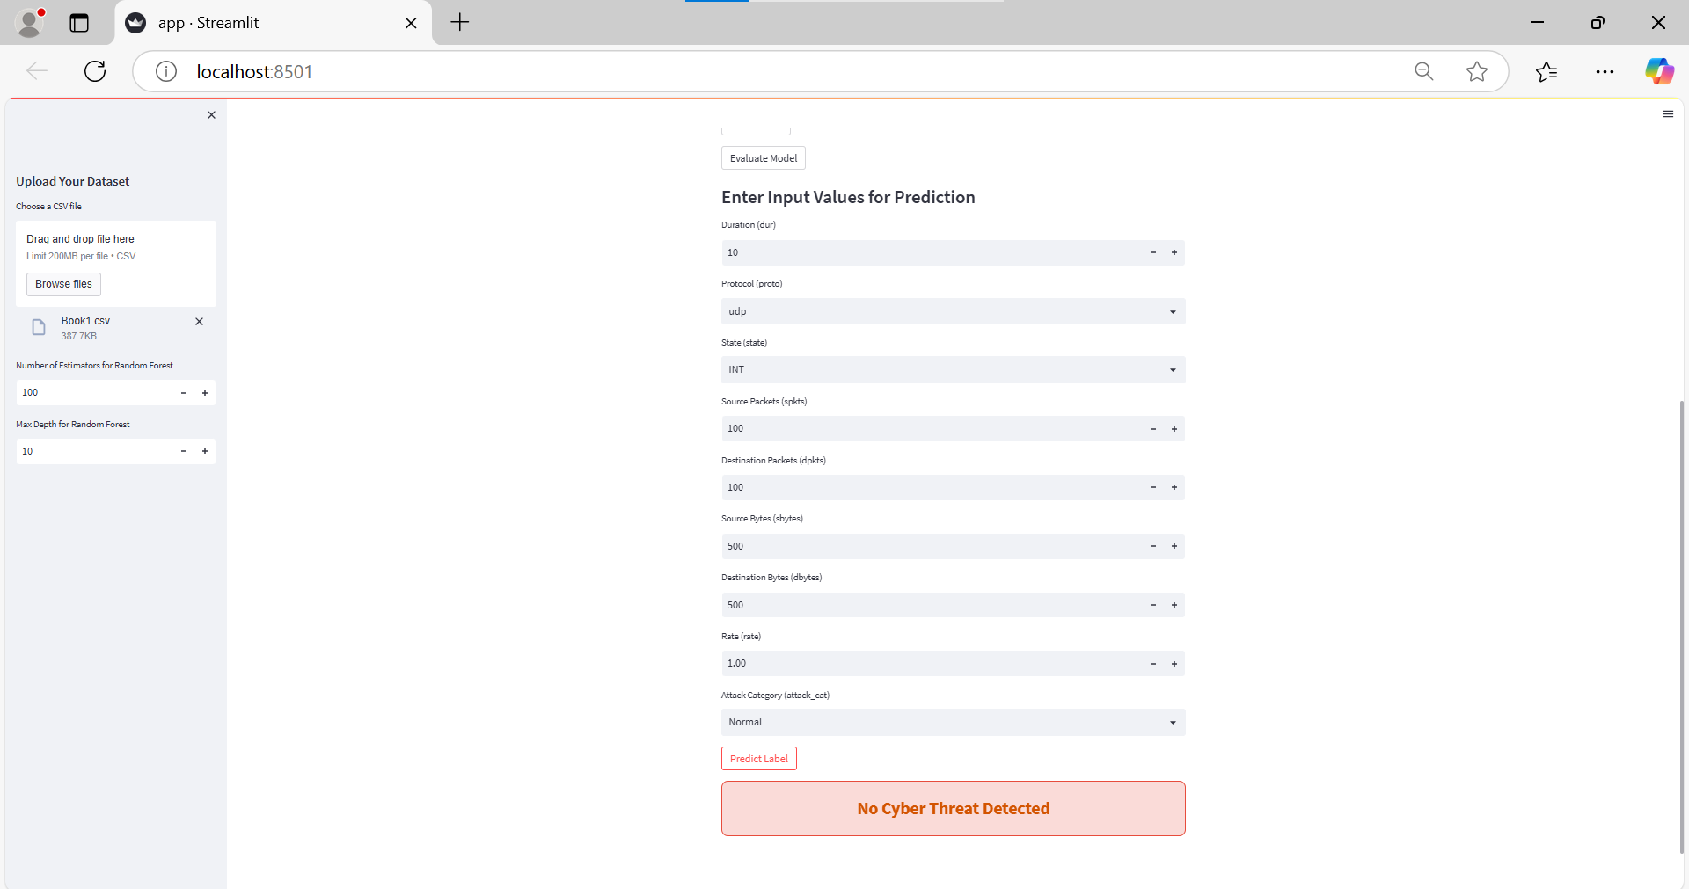
Bar chart visualizing which features had the most influence on predictions.

Slide 19
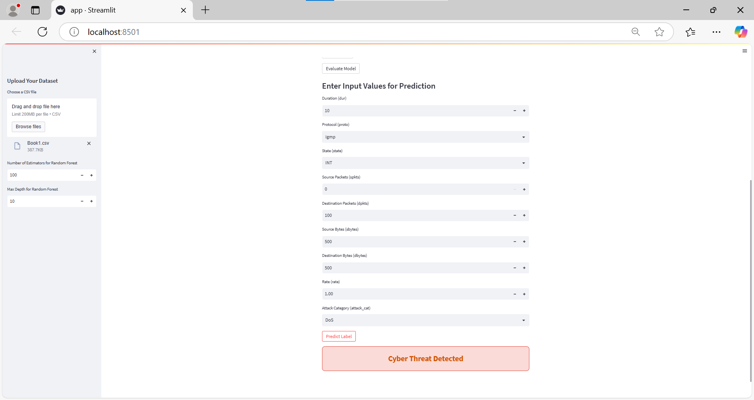
User interface displaying whether a cyber threat was detected or not.

Slide 20
CONCLUSION
Our system enhances cybersecurity by using AI and machine learning to detect and prevent evolving threats in real time. The SEIAR model tracks attack spread, while the Random Forest algorithm accurately predicts threats. This approach improves detection speed, accuracy, and adaptability, making cyber defense smarter, faster, and more efficient than traditional methods.

Slide 21
FUTURE ENHANCEMENT
Add smarter machine learning to detect threats better.
Connect with cloud systems for wider protection.
Send real-time alerts to mobile devices.
Support more types of cyber attacks.
Add auto-update features to stay current.

Slide 22
THANKYOU

