Slide 1
Conversational AI and ML for Diabetes Risk Assessment
Presented by
Exam Roll:
202217 and 202198
Sunday, 13 July, 2025
Notes:
1

Slide 2
Slide Outline
Introduction
Problem Statement
Objectives of the Project
System Overview
Diabetes in Bangladesh
Overview of Existing Solutions
Related Work
Rise of Conversational AI in Healthcare
Methodology Overview
Dataset Overview
Data Preprocessing
Model Training Approach
Why Multiple Algorithms?
Local LLMs for Prompt Engineering
Prompt Engineering Pipeline
Chatbot Development Process
Web Application Architecture
Comparative Model Results
Addressing Class Imbalance
Predictive Feature Analysis (SHAP)
Conversational Agent Behavior
Prediction Interface Overview
Limitations & Future Work
Conclusion
2
Notes:
2

Slide 3
Introduction
Diabetes is a global health concern with increasing prevalence.
In Bangladesh, around 10 million people are affected.
Early diagnosis is essential to reduce health risks and complications.
Traditional methods:
- Require clinical visits, labs, expert interpretation.
- Are not accessible to all, especially in rural areas.
Need for an intelligent, scalable, and accessible health screening solution.
3

Slide 4
Problem Statement
• Diabetes is a chronic disease with long-term health and economic impacts.
• In Bangladesh:
• Delayed diagnosis due to lack of facilities and awareness
•Traditional diagnosis methods are invasive,time-consuming and urban-centric.
• Current ML/XAI solutions:
• Don’t consider regional contexts or demographic factors
• This project aims to develop a locally adapted,AI-powered system for early diabetes risk prediction.
4

Slide 5
Objectives of the Project
• Build an XAI-driven ML framework for diabetes risk prediction.
• Use a Conversational AI chatbot to collect patient input via natural language.
• Improve transparency and trust using SHAP and other explainable AI tools.
• Focus on Bangladeshi health context using a local dataset(DiaHealth).
• Create a scalable web application for deployment in rural/low-resource settings.
5

Slide 6
System Overview
• Goal: Integrate ML + Conversational AI for early diabetes . screening.
Components:
• ML Model: Trained on the DiaHealth dataset
• Conversational Agent: LLM- powered chatbot to interact with
patients.
• Explainability Layer: SHAP & LIME for feature interpretation.
• Web App: Django-based deployment platform.
6

Slide 7
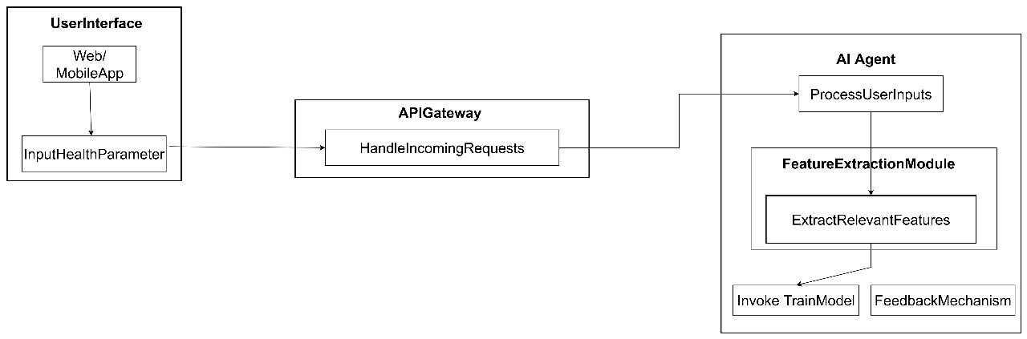
System Overview
7

Slide 8
Diabetes in Bangladesh
• Rapid urbanization, sedentary lifestyle, and poor diet have increased diabetes rate
• Bangladesh:
• Over 8.4 million diabetics (IDF, 2021)
• Projected to increase significantly in coming years.
• Many remain undiagnosed until complications occur.
• Limited access to healthcare in rural areas.
A digital, AI-powered screening solution is urgently needed.
8

Slide 9
Overview of Existing Solutions
• ML-based diabetes prediction models exist:
• Logistic Regression, Random Forest, XGBoost, etc.
• But...
• Often built on foreign datasets
• Lack interpretability (black box)
• Ignore local context and healthcare infrastructure
• Poor handling of class imbalance and missing values
Our project addresses all these gaps.
9

Slide 10
Related Work
Study | Approach | Accuracy | Notes
Tasin et al. | ML + XAI | 81 % | Used LIME,SHAP
Dharmarathne et al. | XGB + SHAP | 80% | Self-explaining UI
Iparraguirre et al. | RF+Feature Selection | 85% | UK Dataset
Tripathi et al. | RF | 87.66% | Pima Dataset
Lugner et al. | XGBoost | 92% | Used biological markers
Most studies lack real-time prediction,
explainability, or local context.
10

Slide 11
Rise of Conversational AI in Healthcare
• LLMs (like GPT-4, MedPaLM, BioGPT) are now used in:
• Medical education
• Patient triage
• Risk assessment
• Prompt-based models + RAG = High trust and accuracy
• Infusing clinical knowledge and domain prompts improves LLM performance.
11

Slide 12
Methodology Overview
• Data Collection (DiaHealth Dataset)
• Data Preprocessing (cleaning, balancing)
• Model Training (XGBoost, LightGBM, RF, etc.)
• Prompt Engineering with Local LLMs
• Chatbot Development
• Web App using Django
12

Slide 13
Dataset Overview
• Dataset: DiaHealth (Bangladeshi dataset)
• Records: 5,437 patients
• Target: Diabetic (Yes/No)
• 14 Key Features:
• Age, Gender, Glucose, BMI
• Blood Pressure (Systolic, Diastolic)
• Family History (Diabetes, Hypertension)
• Cardiovascular conditions, Stroke
Labeled binary outcome: Diabetic or Not.
13

Slide 14
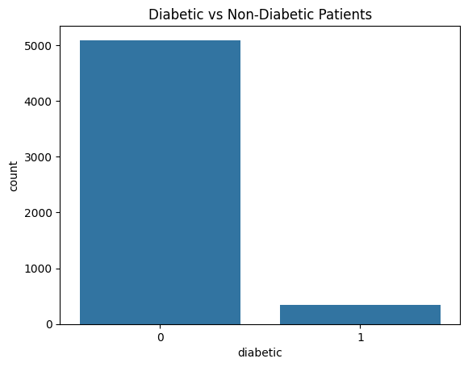
Dataset Overview
The dataset has significant imbalance
which will be addressed.
14

Slide 15
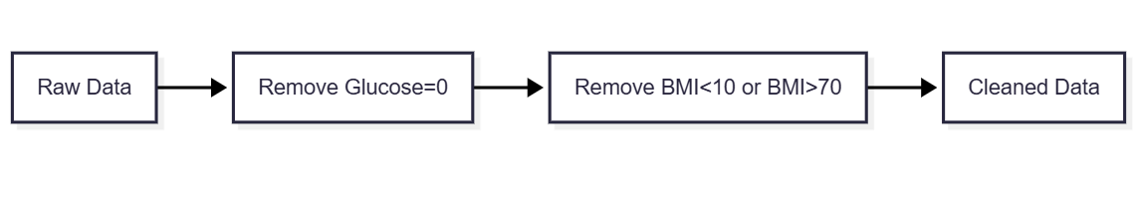
Data Preprocessing
• Invalid Value Removal
• Glucose = 0? → Remove
• Outlier Filtering
• BMI < 10 or > 70 → Remove
15

Slide 16
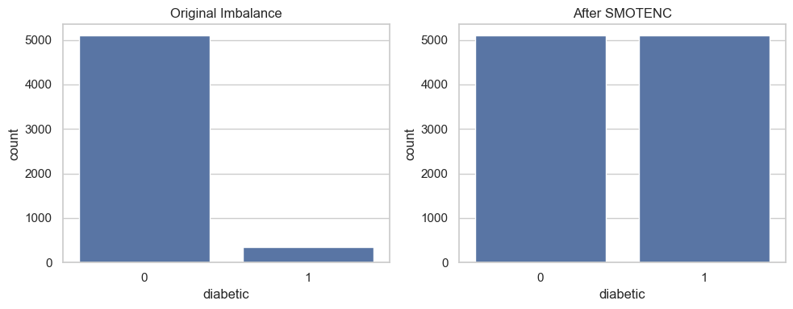
Data Preprocessing
Balancing
Used SMOTENC (categorical + numeric)
Final dataset was balanced 50/50
16

Slide 17
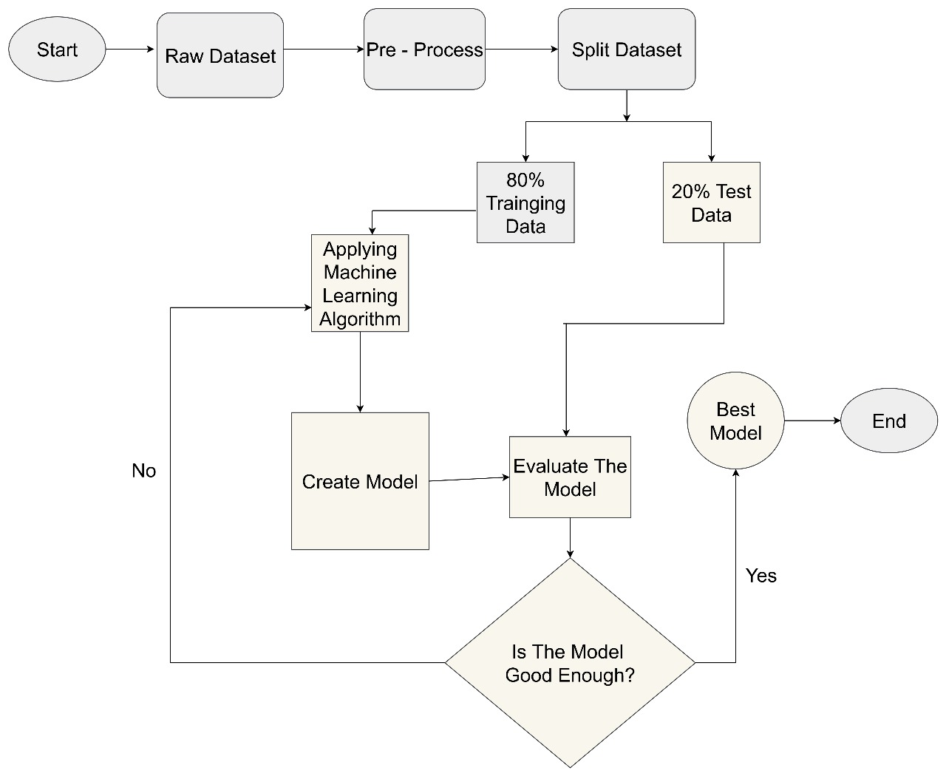
Model Training Approach
fig: Approaches for model training
17

Slide 18
Model Training Approach
80/20 Train-Test split.
5 Models Used:
1.Logistic Regression (LR)
2. Random Forest(RF)
3. XGBoost
4. LightGBM
5. Neural Network (NN)
fig: Approaches for model training
18

Slide 19
Why Multiple Algorithms?
Model | Strength
Logistic Regression | Simple,Interpretable
Random Forest | Good for feature ranking
XGBoost | High Accuracy,handles imbalance
LightGBM | Fast,efficient with large data
Neural Network | Captures non-linear patterns
19

Slide 20
Local LLMs for Prompt Engineering
Model | Instruction Following | Few-shot Support | Hallucination Control | Context Window | VRAM Needed
LLaMA 3(8GB) | Excellent | Strong | Good | 8K(up to 128K with tweaks) | 12-16 GB
DeepSeek-V2(7B) | Good | Strong | Fair | 128K | 8-12 GB
Mistral-7B instruct | Moderate | Moderate | Fair | 32K | 8-10 GB
MedAlpaca-7B | Good | Moderate | Low | 4K-8K | 8-12 GB
Qwen 2(7B) | Excellent | Strong | Good | 128K | 10-14 GB
20

Slide 21
Local LLMs for Prompt Engineering
Findings: LLaMA-3 and DeepSeek-R1 showed the best overall results for prompt engineering in our experiments. LLaMA-3 follows structured instructions accurately and reduces hallucinations, making it well-suited for healthcare-oriented dialogues.
Note: Tested on arc750 GPU with 8GB VRAM
21

Slide 22
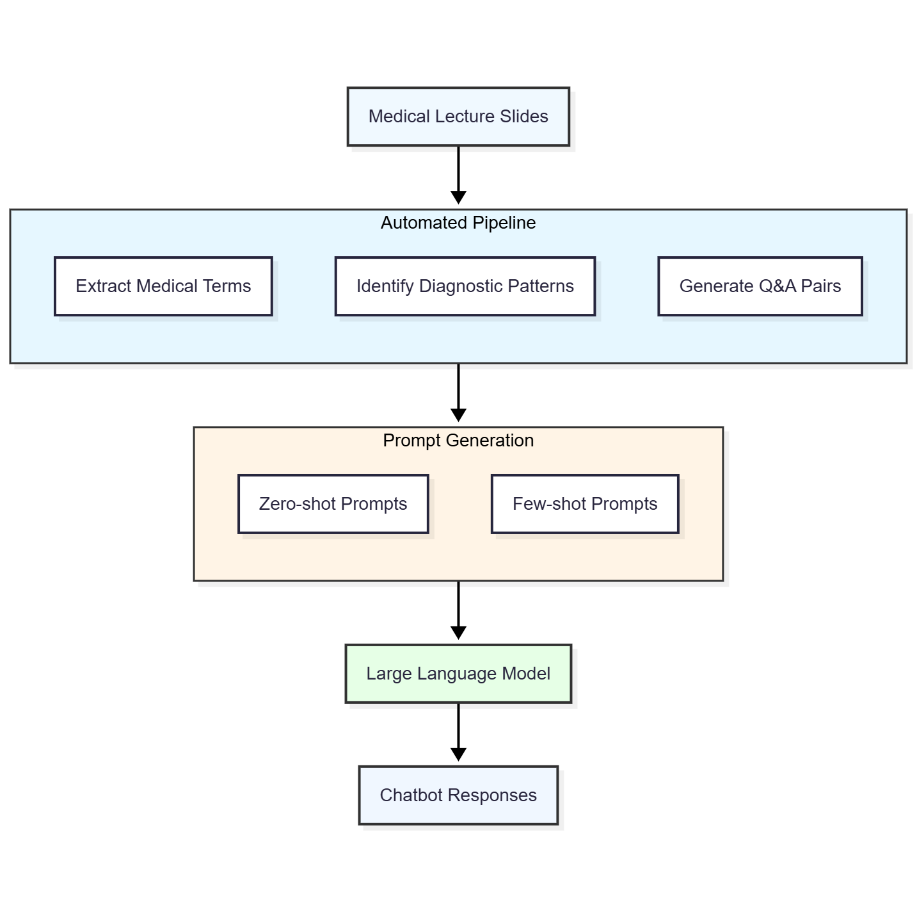
Prompt Engineering Pipeline
Medical colleges slides → Preprocessed
Extracted medical symptoms patterns
Generated zero-shot & few-shot prompts
Real-time LLM interaction(no fine tuning)
22

Slide 23
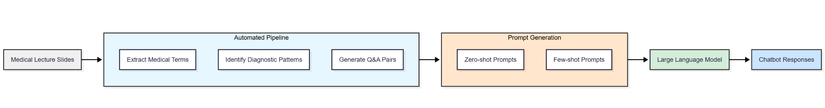
Chatbot Development Process
Used Ollama + LM Studio
Real-time responses through prompt chaining
No retrieval augmentation or model training
Built solely via structured prompting
23

Slide 24
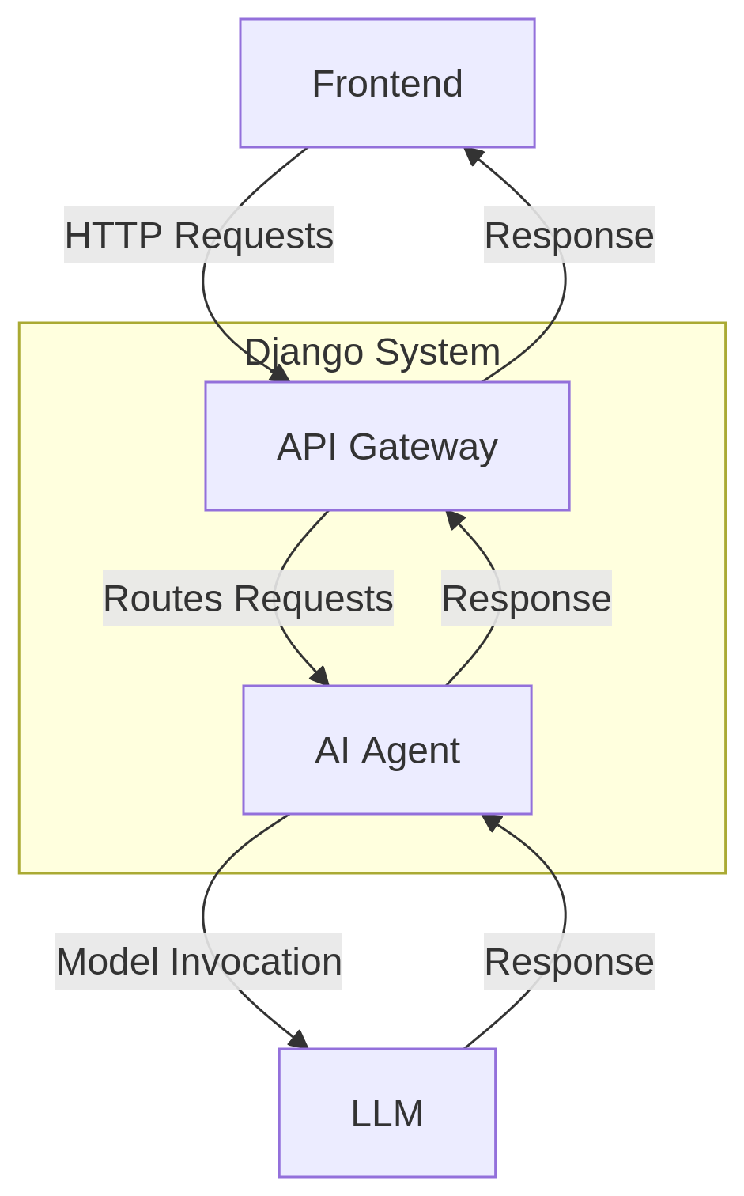
Web Application
Architecture
Build with Django + REST Framework
Frontend: Input form + Chat interface
API Gateway: Routes chat/model requests
AI Agent: Model invocation and logic.
24

Slide 25
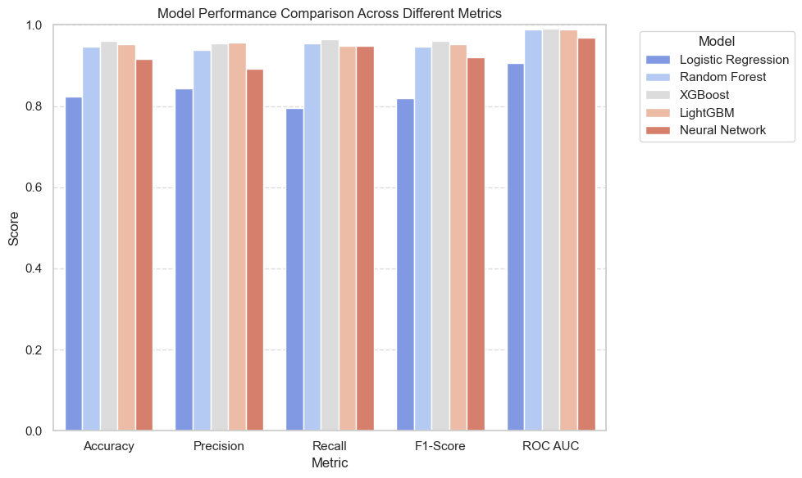
Comparative Model Results
Metric | XGBoost | LightGBM | RF | LR | NN
Accuracy | 95.97% | 95.24% | 94.60% | 82.43% | 91.70%
ROC AUC | 0.9909 | 0.9889 | 0.9882 | 0.9056 | 0.9693
F1-Score | 0.9599 | 0.9521 | 0.9464 | 0.8188 | 0.9196
25

Slide 26
Comparative Model Results
XGBoost performed the best overall
Accuracy:95.97%
26

Slide 27
Addressing Class Imbalance
Original Ratio: 1 diabetic : 9 non-diabetic
Technique: SMOTENC (for mixed categorical-numerical)
Impact:
Diabetic samples boosted from 500 → 4,500
Validation accuracy improvement: 13.9%
27

Slide 28
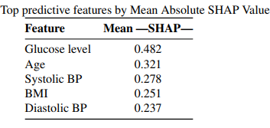
Predictive Feature Analysis (SHAP)
Tool: SHAP (SHapley Additive exPlanations)
Purpose: Identify feature impact on prediction
Key Predictors:
Glucose Level
Age
BP (Systolic, Diastolic)
BMI
Hypertension
28

Slide 29
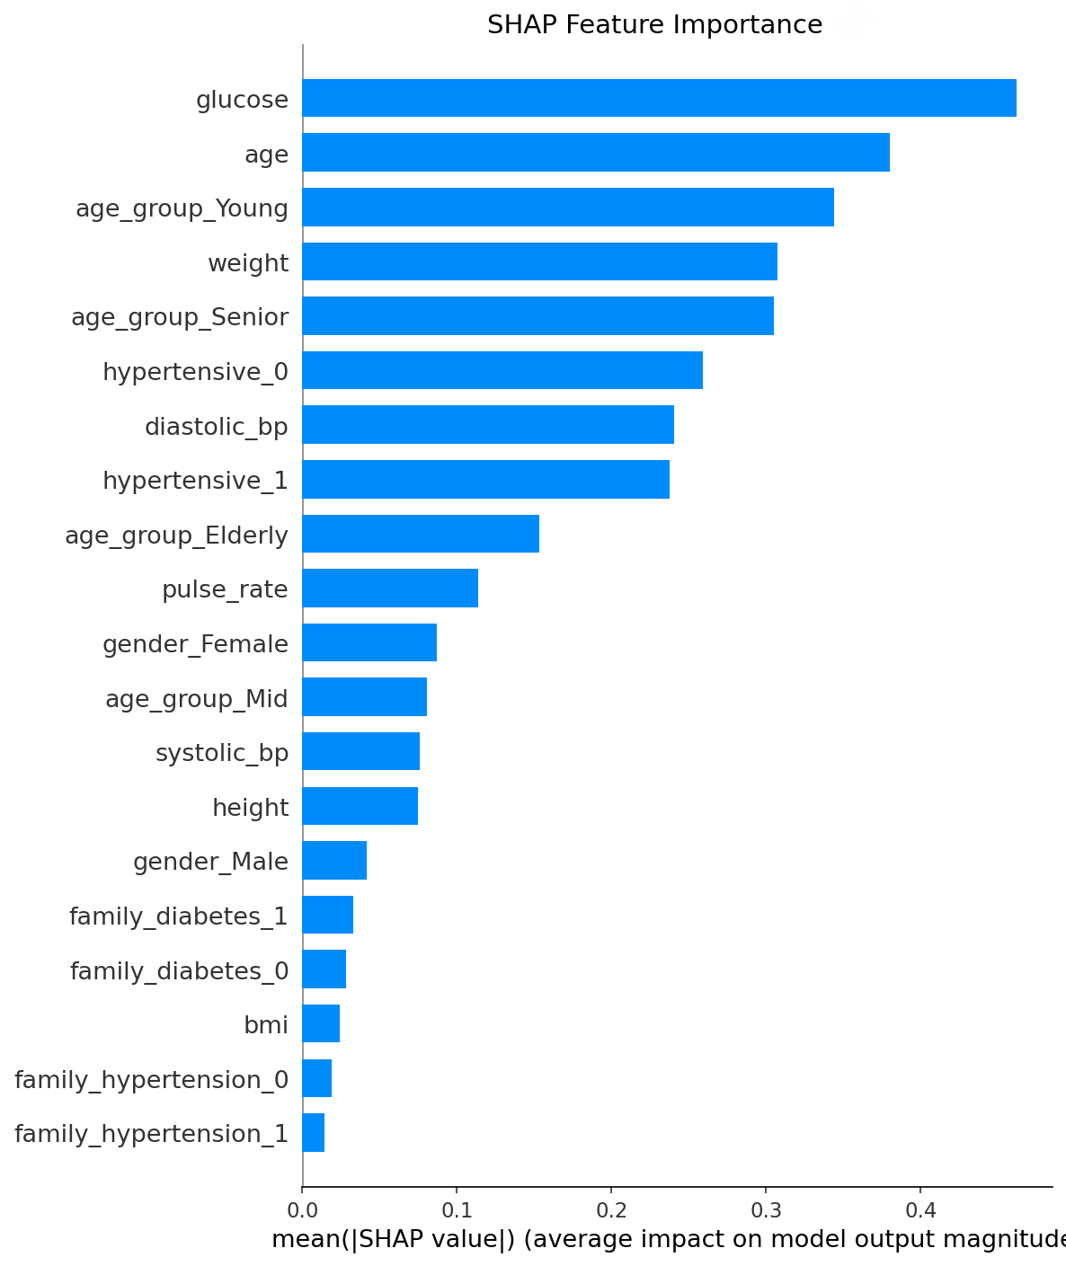
Predictive Feature Analysis (SHAP)
29

Slide 30
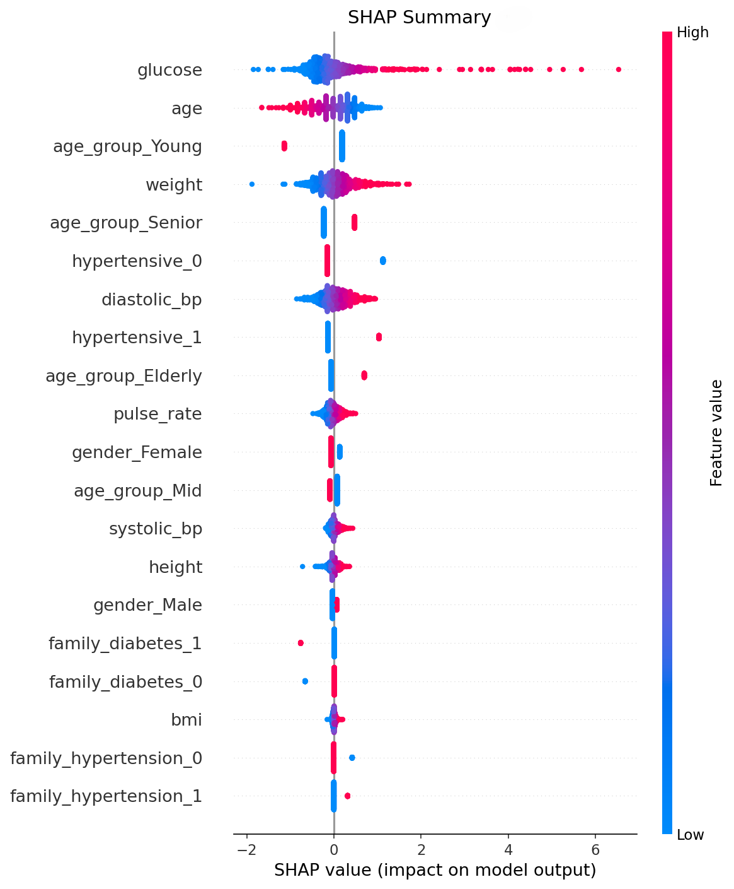
Predictive Feature Analysis (SHAP)
30

Slide 31
Predictive Feature Analysis (SHAP)
The SHAP summary plot reveals distinct contribution patterns:
Glucose Level: High values (red) show strong positive correlation with outcome, while low values (blue) correlate negatively
Age: Advanced age (red) significantly increases prediction probability
Age Groups: ’Young’ category lowers predictions, while ’Senior’ increases
them
Weight: Higher values generally elevate predicted outcomes
Hypertensive Status: Hypertension presence (1) increases predictions
Blood Pressure: Both diastolic and systolic elevations correlate with increased outcomes
31

Slide 32
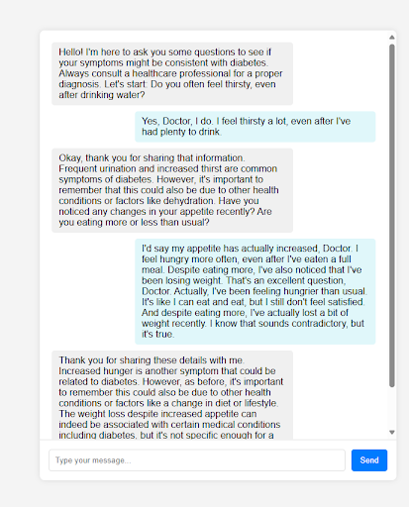
Conversational Agent Behavior
Avg. Questions per session: 6.2
Decision logic:
If the LLM predicts that the user may have diabetes→ Redirect to web form
Built entirely with structured prompt logic
32

Slide 33
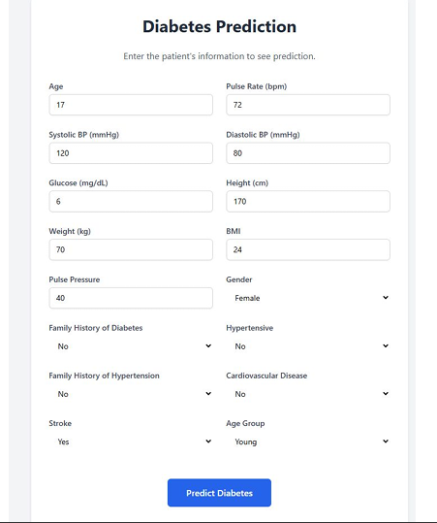
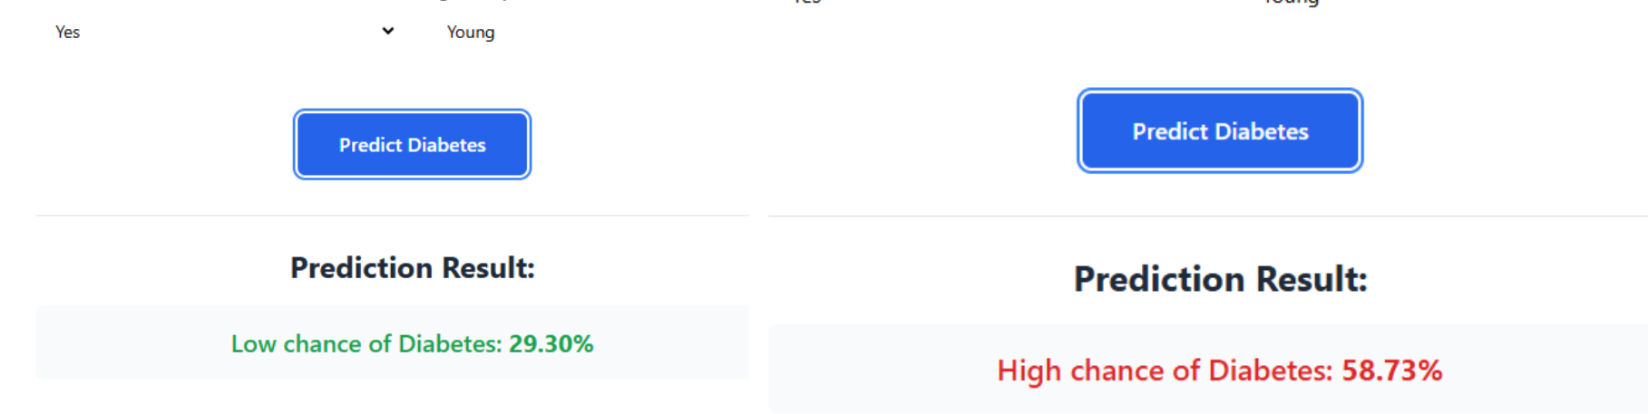
Prediction Interface Overview
User inputs data (age, glucose, BMI, etc.)
Prediction generated by best-performing model
Result shown with risk percentage
33

Slide 34
Limitations & Future Work
Limitations: small dataset, no real-time integration, English-only chatbot
Future: Bangla support, wearable integration, clinical validation
Limited VRAM for LLM trained
No direct feedback from expert doctors
34

Slide 35
Conclusion
Project delivers a scalable, explainable diabetes risk prediction system
Combines ML + LLMs + local healthcare knowledge
Provides a way of diagnosis where there is no doctor available right away
35

Slide 36
Thank You
36

