Slide 1
CSE-243
(Algorithms Design and Analysis)
Lecture 03-04: Introduction to Algorithms
Instructor
Md. Sabir Hossain
Assistant Professor
Dept. of CSE, CUET
Acknowledgment: Most of the content of this slide is adopted from the book: Introduction to Algorithms, Third Edition (International Edition), Thomas H. Cormen, Charles E. Leiserson, Ronald L. Rivest, Clifford Stein, ISBN-13: 978-0262033848.

Slide 2
Recap
About the Course Teachers
Algorithms in Life, How?
Applications/Necessity of Algorithms
Algorithm Basics
Example: Sorting Algorithm
Book References
Prerequisite Knowledge: Data Structure
Expected Outcome from this course
Road Map of this Course
Project and research performed by the undergraduate students

Slide 3
Today’s Target
Pseudo-code
Designing an algorithm
Example: Max
Analysis of algorithms
Why study algorithms and performance?
Pseudo-code of Insertion-sort
Analysis Insertion-sort
Running Time & Types
Need Asymptotic Analysis

Slide 4
Algorithms: Formal Definition
Definition: An algorithm is a sequence of unambiguous instructions for solving a problem.
Properties of an algorithm
Finite: the algorithm must eventually terminate
Complete: Always give a solution when one exists
Correct (sound): Always give a correct solution
For an algorithm to be an acceptable solution to a problem, it must also be effective. That is, it must give a solution in a ‘reasonable’ amount of time
Efficient= runs in polynomial time. Thus, effective≠ efficient
There can be many algorithms to solve the same problem

Slide 5
Algorithms: General Techniques
There are many broad categories of algorithms
Deterministic versus Randomized (e.g., Monte-Carlo)
Exact versus Approximation
Sequential/serial versus Parallel, etc.
Some general styles of algorithms include
Brute force (enumerative techniques, exhaustive search)
Divide & Conquer
Transform & Conquer (reformulation)
Greedy Techniques
Backtracking
Dynamic Programming

Slide 6
Today’s Target
Pseudo-code
Designing an algorithm
Example: Max
Analysis of algorithms
Why study algorithms and performance?
Pseudo-code of Insertion-sort
Analysis Insertion-sort
Running Time & Types
Need Asymptotic Analysis

Slide 7
Good Pseudo-Code: Example
Intersection
Input: Two finite sets A, B
Output: A finite set C such that C = A ∩ B
C←0
If |A|>|B|
Then Swap(A,B)
End
For every x ∈ A Do
If x ∈ B
Then C ← C ∪ {x} Union(C,{x})
End
End
Return C

Slide 8
Algorithms: Pseudo-Code
Algorithms are usually presented using pseudo-code
Bad pseudo-code
gives too many details or
is too implementation specific (i.e., actual C++ or Java code or giving every step of a sub-process such as set union)
Good pseudo-code
Is a balance between clarity and detail
Abstracts the algorithm
Makes good use of mathematical notation
Is easy to read and
Facilitates implementation (reproducible, does not hide away important information)

Slide 9
Writing Pseudo-Code: Advice
Input/output must properly defined
All your variables must be properly initialized, introduced
Variables are instantiated, assigned using ←
All `commands' (while, if, repeat, begin, end) bold face \bf
For i ← 1 to n Do
All functions in small caps Union(s,t) \sc
All constants in courier: pi ← 3.14 \tt
All variables in italic: temperature ← 78 (\it, \em)
LaTeX: Several algorithm formatting packages exist on WWW

Slide 10
Today’s Target
Pseudo-code
Designing an algorithm
Example: Max
Analysis of algorithms
Why study algorithms and performance?
Pseudo-code of Insertion-sort
Analysis Insertion-sort
Running Time & Types
Need Asymptotic Analysis

Slide 11
Designing an Algorithm
A general approach to designing algorithms is as follows
Understanding the problem, assess its difficulty
Choose an approach (e.g., exact/approximate, deterministic/ probabilistic)
Choose appropriate data structures
Choose a strategy
Prove
Termination
Completeness
Correctness/soundness
Evaluate complexity
Implement and test it
Compare to other known approach and algorithms

Slide 12
Algorithm Example: Max
When designing an algorithm, we usually give a formal statement about the problem to solve
Problem
Given: a set A={a₁,a₂,…,a_{n}} of integers
Question: find the index i of the maximum integer a_{i}
A straightforward idea is
Simply store an initial maximum, say a₁
Compare the stored maximum to every other integer in A
Update the stored maximum if a new maximum is ever encountered

Slide 13
Pseudo-code of Max
Max
Input: A finite set A={a₁,a₂,…,a_{n}} of integers
Output: An index i such that a_{i} = max{a₁,a₂,…,a_{n}}
index ← 1
For i =2 to n Do
If a_{i} > a_{index}
Then index ← i
End
End
Return a_{index}

Slide 14
Today’s Target
Pseudo-code
Designing an algorithm
Example: Max
Analysis of algorithms
Why study algorithms and performance?
Pseudo-code of Insertion-sort
Analysis Insertion-sort
Running Time & Types
Need Asymptotic Analysis

Slide 15

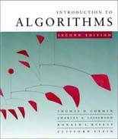
Analysis of algorithms
The theoretical study of computer-program performance and resource usage.
What’s more important than performance?
modularity
correctness
maintainability
functionality
robustness
user-friendliness
programmer time
simplicity
extensibility
reliability

Slide 16
Today’s Target
Pseudo-code
Designing an algorithm
Example: Max
Analysis of algorithms
Why study algorithms and performance?
Pseudo-code of Insertion-sort
Analysis Insertion-sort
Running Time & Types
Need Asymptotic Analysis

Slide 17
Why study algorithms and performance?
Algorithms help us to understand scalability.
Performance often draws the line between what is feasible and what is impossible.
Algorithmic mathematics provides a language
for talking about program behavior.
Performance is the currency of computing.
The lessons of program performance generalize to other computing resources.
Speed is fun!

Slide 18
Today’s Target
Pseudo-code
Designing an algorithm
Example: Max
Analysis of algorithms
Why study algorithms and performance?
Pseudo-code of Insertion-sort
Analysis Insertion-sort
Running Time & Types
Need Asymptotic Analysis

Slide 19
The problem of sorting
Input: sequence ⟨a₁, a₂, …, a_{n}⟩ of numbers.
Output: permutation ⟨a'₁, a'₂, …, a'_{n}⟩ such that a'₁ ≤ a'₂ ≤ … ≤ a'_{n} .
Example:
Input: 8 2 4 9 3 6
Output: 2 3 4 6 8 9

Slide 20
Insertion sort
INSERTION-SORT (A, n)
for j ← 2 to n
do key ← A[ j] i ← j – 1
⊳ A[1 . . n]
“pseudocode”
while i > 0 and A[i] > key
do A[i+1] ← A[i] i ← i – 1
A[i+1] = key

Slide 21
Insertion sort
INSERTION-SORT (A, n)
for j ← 2 to n
do key ← A[ j] i ← j – 1
⊳ A[1 . . n]
“pseudocode”
while i > 0 and A[i] > key
do A[i+1] ← A[i] i ← i – 1
A[i+1] = key
n
1
i
j
A:
key
sorted

Slide 22
Example of insertion sort
8 2 4 9 3 6

Slide 23
Example of insertion sort
8 2 4 9 3 6

Slide 24
Example of insertion sort
8 2 4 9 3 6
2 8 4 9 3 6

Slide 25
Example of insertion sort
8 2 4 9 3 6
2 8 4 9 3 6

Slide 26
Example of insertion sort
8 | 2 | 4 | 9 | 3 | 6
2 | 8 | 4 | 9 | 3 | 6
2 | 4 | 8 | 9 | 3 | 6

Slide 27
Example of insertion sort
8 | 2 | 4 | 9 | 3 | 6
2 | 8 | 4 | 9 | 3 | 6
2 | 4 | 8 | 9 | 3 | 6

Slide 28
Example of insertion sort
8 | 2 | 4 | 9 | 3 | 6
2 | 8 | 4 | 9 | 3 | 6
2 | 4 | 8 | 9 | 3 | 6
2 | 4 | 8 | 9 | 3 | 6

Slide 29
Example of insertion sort
8 | 2 | 4 | 9 | 3 | 6
2 | 8 | 4 | 9 | 3 | 6
2 | 4 | 8 | 9 | 3 | 6
2 | 4 | 8 | 9 | 3 | 6

Slide 30
Example of insertion sort
8 | 2 | 4 | 9 | 3 | 6
2 | 8 | 4 | 9 | 3 | 6
2 | 4 | 8 | 9 | 3 | 6
2 | 4 | 8 | 9 | 3 | 6
2 | 3 | 4 | 8 | 9 | 6

Slide 31
Example of insertion sort
8 | 2 | 4 | 9 | 3 | 6
2 | 8 | 4 | 9 | 3 | 6
2 | 4 | 8 | 9 | 3 | 6
2 | 4 | 8 | 9 | 3 | 6
2 | 3 | 4 | 8 | 9 | 6

Slide 32
Example of insertion sort
8 | 2 | 4 | 9 | 3 | 6
2 | 8 | 4 | 9 | 3 | 6
2 | 4 | 8 | 9 | 3 | 6
2 | 4 | 8 | 9 | 3 | 6
2 | 3 | 4 | 8 | 9 | 6
2 | 3 | 4 | 6 | 8 | 9 | done

Slide 33
Today’s Target
Pseudo-code
Designing an algorithm
Example: Max
Analysis of algorithms
Why study algorithms and performance?
Pseudo-code of Insertion-sort
Analysis Insertion-sort
Running Time & Types
Need Asymptotic Analysis

Slide 34
Running time
The running time depends on the input: an already sorted sequence is easier to sort.
Parameterize the running time by the size of the input, since short sequences are easier to sort than long ones.
Generally, we seek upper bounds on the running time, because everybody likes a guarantee.

Slide 35
Kinds of analyses
Worst-case: (usually)
T(n) = maximum time of algorithm on any input of size n.
Average-case: (sometimes)
T(n) = expected time of algorithm over all inputs of size n.
Need assumption of statistical distribution of inputs.
Best-case: (bogus)
Cheat with a slow algorithm that works fast on some input.

Slide 36
Today’s Target
Pseudo-code
Designing an algorithm
Example: Max
Analysis of algorithms
Why study algorithms and performance?
Pseudo-code of Insertion-sort
Analysis Insertion-sort
Running Time & Types
Need Asymptotic Analysis

Slide 37
Machine-independent time
What is insertion sort’s worst-case time?
It depends on the speed of our computer:
relative speed (on the same machine),
absolute speed (on different machines).
BIG IDEA:
Ignore machine-dependent constants.
Look at growth of T(n) as n → ∞ .
“Asymptotic Analysis”

Slide 38
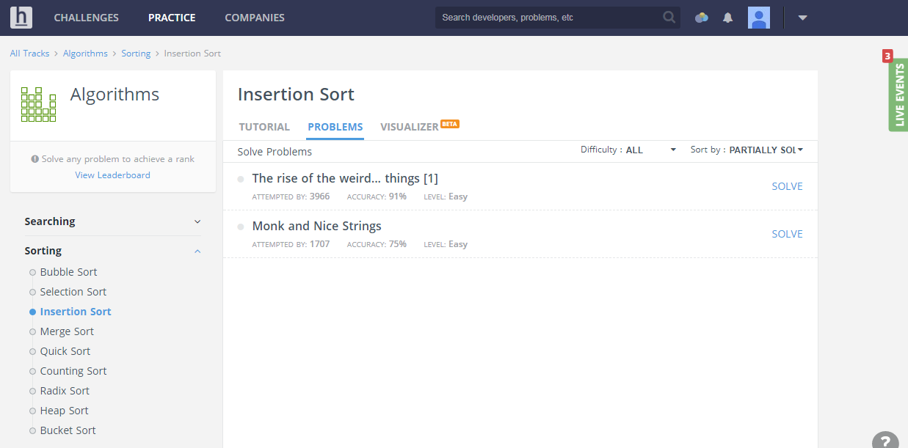
Insertion Sort Related Challenges

Slide 39
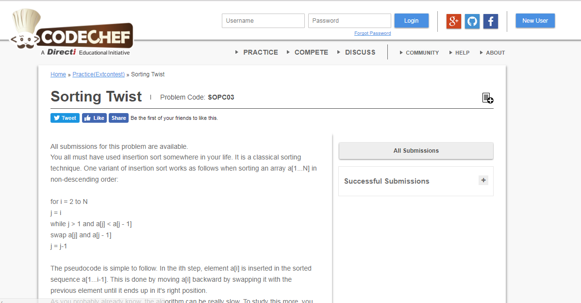
Insertion Sort Related Challenges

Slide 40
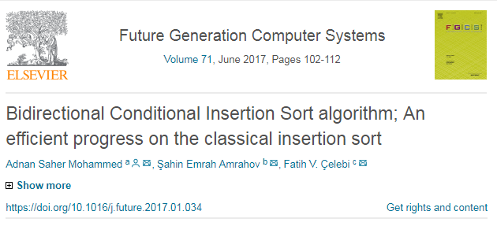
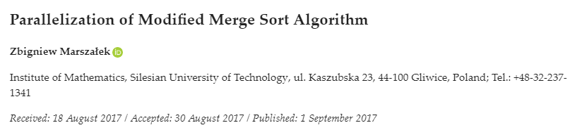
Insertion Sort Related Research
2017: Bidirectional Conditional Insertion Sort algorithm; An efficient progress on the classical insertion sort
http://linkinghub.elsevier.com/retrieve/pii/S0167739X17301711
https://arxiv.org/pdf/1608.02615.pdf
2017: Based on this paper another work:
Parallelization of Modified Merge Sort Algorithm
http://www.mdpi.com/2073-8994/9/9/176/htm

Slide 41
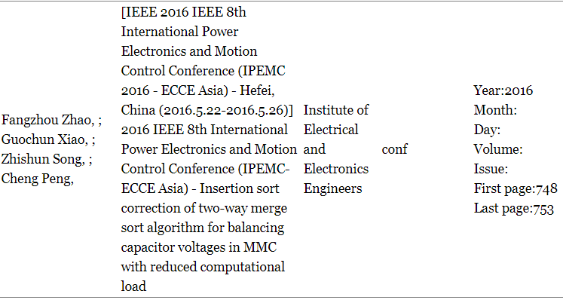
More Research on Insertion Sort

Slide 42
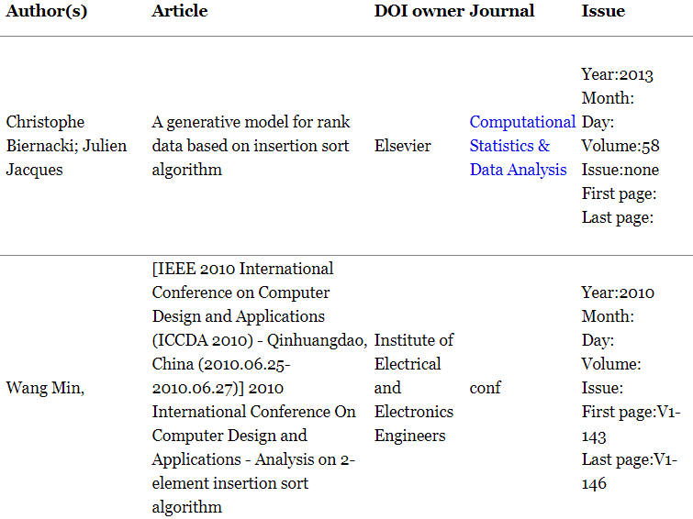
More Research on Insertion Sort

Slide 43
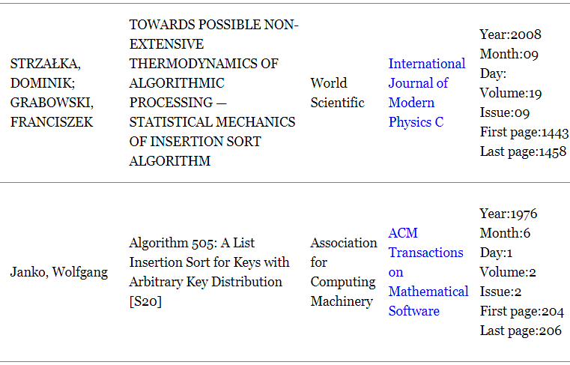
More Research on Insertion Sort

Slide 44
References
https://visualgo.net/en/sorting
https://www.cs.usfca.edu/~galles/visualization/Algorithms.html
Introduction to Algorithms, Third Edition (International Edition), Thomas H. Cormen, Charles E. Leiserson, Ronald L. Rivest, Clifford Stein, ISBN-13: 978-0262033848.
https://www.hackerearth.com/practice/algorithms/sorting/insertion-sort/practice-problems/
https://www.codechef.com/problems/SOPC03

Slide 45
Allah Hafez

