Slide 1
A* Search

Slide 2
Tree search algorithms
Basic idea:
  Exploration of state space by generating successors of already-explored states (a.k.a.~expanding states).
  Every states is evaluated: is it a goal state?

Slide 3


Tree search example

Slide 4

Tree search example

Slide 5


Tree search example

Slide 6
Best-first search
Idea: use an evaluation function f(n) for each node
  f(n) provides an estimate for the total cost.
  Expand the node n with smallest f(n).
Implementation:
Order the nodes in fringe increasing order of cost.

Slide 7

Romania with straight-line dist.

Slide 8
A* search
Idea: avoid expanding paths that are already expensive
Evaluation function f(n) = g(n) + h(n)
g(n) = cost so far to reach n
h(n) = estimated cost from n to goal
f(n) = estimated total cost of path through n to goal
Best First search has f(n)=h(n)
Uniform Cost search has f(n)=g(n)

Slide 9
Admissible heuristics
A heuristic h(n) is admissible if for every node n,
h(n) ≤ h*(n), where h*(n) is the true cost to reach the goal state from n.
An admissible heuristic never overestimates the cost to reach the goal, i.e., it is optimistic
Example: h_{SLD}(n) (never overestimates the actual road distance)
Theorem: If h(n) is admissible, A* using TREE-SEARCH is optimal

Slide 10
Dominance
If h₂(n) ≥ h₁(n) for all n (both admissible)
then h₂ dominates h₁
h₂ is better for search: it is guaranteed to expand
less or equal nr of nodes.
Typical search costs (average number of nodes expanded):
d=12 IDS = 3,644,035 nodes
A*(h₁) = 227 nodes
A*(h₂) = 73 nodes
d=24 IDS = too many nodes
A*(h₁) = 39,135 nodes
A*(h₂) = 1,641 nodes

Slide 11
Relaxed problems
A problem with fewer restrictions on the actions is called a relaxed problem
The cost of an optimal solution to a relaxed problem is an admissible heuristic for the original problem
If the rules of the 8-puzzle are relaxed so that a tile can move anywhere, then h₁(n) gives the shortest solution
If the rules are relaxed so that a tile can move to any adjacent square, then h₂(n) gives the shortest solution

Slide 12

Consistent heuristics
A heuristic is consistent if for every node n, every successor n' of n generated by any action a,
h(n) ≤ c(n,a,n') + h(n')
If h is consistent, we have
f(n’) = g(n’) + h(n’) (by def.)
= g(n) + c(n,a,n') + h(n’) (g(n’)=g(n)+c(n.a.n’))
≥ g(n) + h(n) = f(n) (consistency)
f(n’) ≥ f(n)
i.e., f(n) is non-decreasing along any path.
Theorem:
If h(n) is consistent, A* using GRAPH-SEARCH is optimal
It’s the triangle
inequality !
keeps all checked nodes
in memory to avoid repeated
states

Slide 13

A* search example

Slide 14

A* search example

Slide 15

A* search example

Slide 16

A* search example

Slide 17

A* search example

Slide 18

A* search example

Slide 19
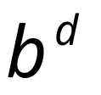
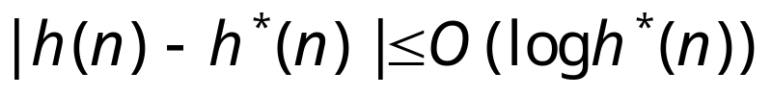
Properties of A*
Complete? Yes (unless there are infinitely many nodes with f ≤ f(G) , i.e. step-cost > ε)
Time/Space? Exponential:
except if:
Optimal? Yes
Optimally Efficient: Yes (no algorithm with the
same heuristic is guaranteed to expand fewer nodes)

Slide 20
Memory Bounded Heuristic Search: Recursive BFS
How can we solve the memory problem for A* search?
Idea: Try something like depth first search, but let’s not forget everything about the branches we have partially explored.
We remember the best f-value we have found so far in the branch we are deleting.

Slide 21
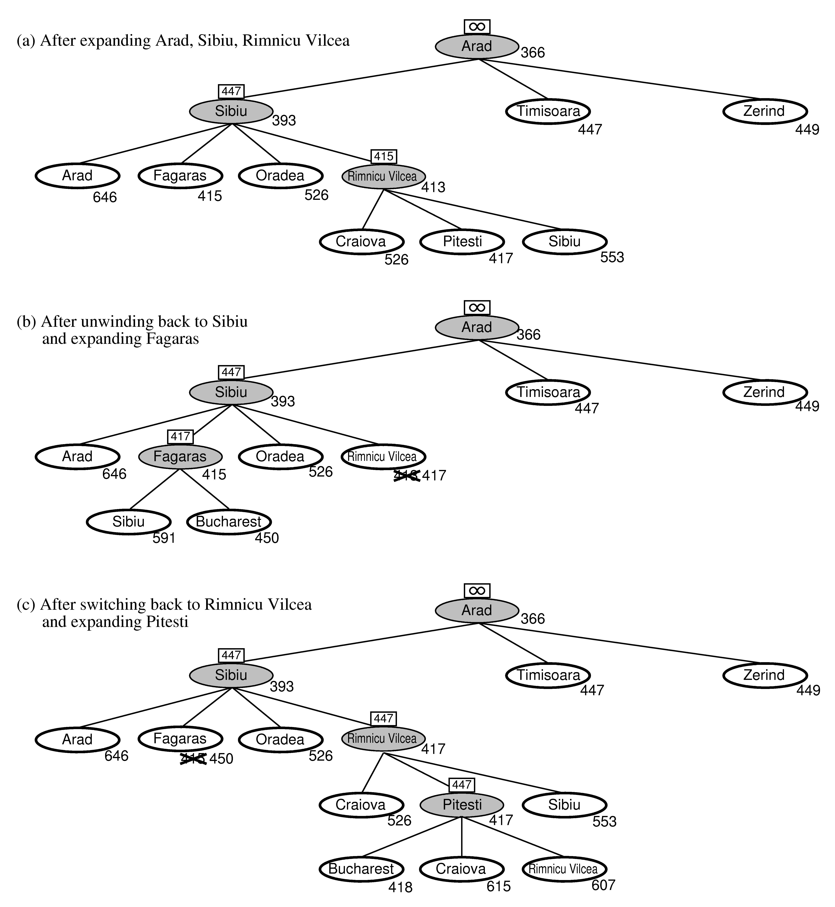
RBFS:
best alternative
over fringe nodes,
which are not children:
i.e. do I want to back up?
RBFS changes its mind
very often in practice.
This is because the
f=g+h become more
accurate (less optimistic)
as we approach the goal.
Hence, higher level nodes
have smaller f-values and
will be explored first.
Problem: We should keep
in memory whatever we can.

Slide 22
Simple Memory Bounded A*
This is like A*, but when memory is full we delete the worst node (largest f-value).
Like RBFS, we remember the best descendent in the branch we delete.
If there is a tie (equal f-values) we delete the oldest nodes first.
simple-MBA* finds the optimal reachable solution given the memory constraint.
Time can still be exponential.
A Solution is not reachable
if a single path from root to goal
does not fit into memory

