Slide 1
Multiple Sequence Alignment
Lecture 5

Slide 2

Neighbor joining
Based on the current distance matrix calculate the matrix Q.
Find the pair of distinct taxa i and j ( ) for which Q(i,j) has its lowest value.
Calculate the distance from each of the taxa in the pair to this new node.
Calculate the distance from each of the taxa outside of this pair to the new node.
Start the algorithm again

Slide 3
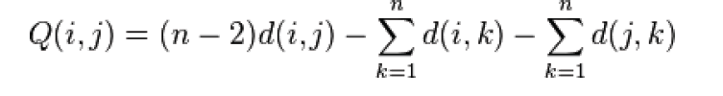
Neighbor joining
Based on the current distance matrix calculate the matrix Q.
 | S₁ | S₂ | S₃ | S₄ | S₅
S₁ | 0 | 5 | 9 | 9 | 8
S₂ |  | 0 | 10 | 10 | 9
S₃ |  |  | 0 | 8 | 7
S₄ |  |  |  | 0 | 3
S₅ |  |  |  |  | 0
 | S₁ | S₂ | S₃ | S₄ | S₅
S₁ | 0 | -50 | -38 | -34 | -34
S₂ |  | 0 | -38 | -34 | -34
S₃ |  |  | 0 | -40 | -40
S₄ |  |  |  | 0 | -48
S₅ |  |  |  |  | 0

Slide 4
Neighbor joining
2. Find the pair of distinct taxa i and j (i != j) for which Q(i,j) has its lowest value.
 | S₁ | S₂ | S₃ | S₄ | S₅
S₁ | 0 | 5 | 9 | 9 | 8
S₂ |  | 0 | 10 | 10 | 9
S₃ |  |  | 0 | 8 | 7
S₄ |  |  |  | 0 | 3
S₅ |  |  |  |  | 0
 | S₁ | S₂ | S₃ | S₄ | S₅
S₁ | 0 | -50 | -38 | -34 | -34
S₂ |  | 0 | -38 | -34 | -34
S₃ |  |  | 0 | -40 | -40
S₄ |  |  |  | 0 | -48
S₅ |  |  |  |  | 0

Slide 5
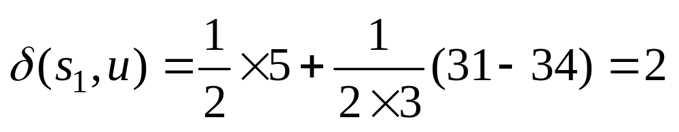
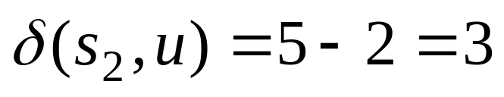
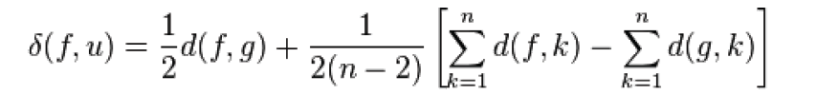
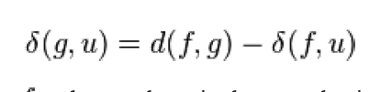
Neighbor joining
3. Join S₁ and S₂.
 | S₁ | S₂ | S₃ | S₄ | S₅
S₁ | 0 | 5 | 9 | 9 | 8
S₂ |  | 0 | 10 | 10 | 9
S₃ |  |  | 0 | 8 | 7
S₄ |  |  |  | 0 | 3
S₅ |  |  |  |  | 0
S₁
2
u
S₂
3

Slide 6
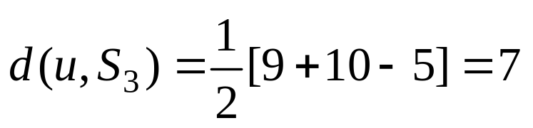
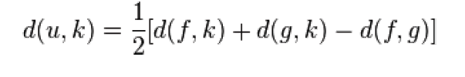
Neighbor joining
4. Find other distance
 | S₁ | S₂ | S₃ | S₄ | S₅
S₁ | 0 | 5 | 9 | 9 | 8
S₂ |  | 0 | 10 | 10 | 9
S₃ |  |  | 0 | 8 | 7
S₄ |  |  |  | 0 | 3
S₅ |  |  |  |  | 0
 | u | S₃ | S₄ | S₅
u | 0 | 7 | 7 | 6
S₃ |  | 0 | 8 | 7
S₄ |  |  | 0 | 3
S₅ |  |  |  | 0

Slide 7
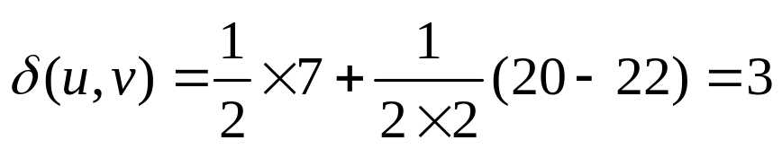
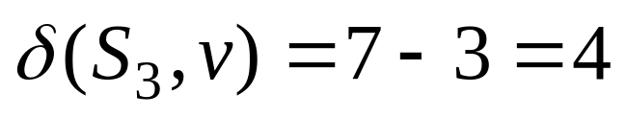
Neighbor joining
Q matrix
2
4
v
u
3
 | u | S₃ | S₄ | S₅
u | 0 | 7 | 7 | 6
S₃ |  | 0 | 8 | 7
S₄ |  |  | 0 | 3
S₅ |  |  |  | 0
3
 | u | S₃ | S₄ | S₅
u | 0 | -28 | -24 | -24
S₃ |  | 0 | -24 | -24
S₄ |  |  | 0 | -28
S₅ |  |  |  | 0

Slide 8
Neighbor joining
Q matrix
 | v | S₄ | S₅
v | 0 | 4 | 3
S₄ |  | 0 | 3
S₅ |  |  | 0
2
4
v
u
3
2
2
3
1

Slide 9
Neighbor joining
Aligns each sequence against each other giving a similarity matrix
Similarity = exact matches / sequence length (percent identity)
 | S₁ | S₂ | S₃ | S₄ | S₅
S₁ | 0 | 5 | 9 | 9 | 8
S₂ |  | 0 | 10 | 10 | 9
S₃ |  |  | 0 | 8 | 7
S₄ |  |  |  | 0 | 3
S₅ |  |  |  |  | 0
 | S₁ | S₂ | S₃ | S₄
S₁ | -
S₂ | 0.17 | -
S₃ | 0.87 | 0.28 | -
S₄ | 0.59 | 0.33 | 0.62 | -
S₃
S₁
S₁
2
4
v
S₃
u
3
2
2
S₄
S₄
3
S₂
S₂
1
S₅

Slide 10
Unweighted pair group method with arithmetic meant (UPGMA)
The oldest tree reconstructions method (1960)
Requires a distance matrix, e.g.:
 | S₁ | S₂ | S₃ | S₄
S₁ | 0
S₂ | dAB | 0
S₃ | dCA | dBC | 0
S₄ | dAD | dBD | dCD | 0

Slide 11
Unweighted pair group method with arithmetic meant (UPGMA)
UPGMA is a three steps method:
  Cluster the two species with the smallest distance putting then into a single group. Assume that in the example dAB is the smallest, hence a new group (AB) is created.
  Recalculate the distance matrix with the new group (AB) against C and D:
    d(AB)C = 0.5 * (dAC+dBC)
    d(AB)D = 0.5 * (dAD+dBD)
  With the new distance matrix repeat 1 until all species have been grouped.

Slide 12
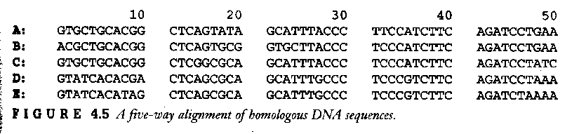
Unweighted pair group method with arithmetic mean (UPGMA)
 | S₁ | S₂ | S₃ | S₄ | S₅
S₁ | 0
S₂ | 9 | 0
S₃ | 8 | 11 | 0
S₄ | 12 | 15 | 10 | 0
S₅ | 15 | 18 | 13 | 5 | 0

Slide 13
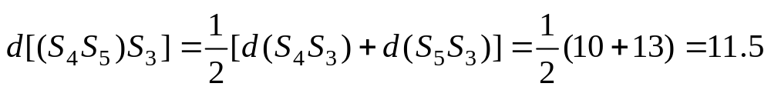
Unweighted pair group method with arithmetic mean (UPGMA)
 | S₁ | S₂ | S₃ | S₄ | S₅
S₁ | 0
S₂ | 9 | 0
S₃ | 8 | 11 | 0
S₄ | 12 | 15 | 10 | 0
S₅ | 15 | 18 | 13 | 5 | 0
 | S₁ | S₂ | S₃ | S₄S₅
S₁ | 0
S₂ | 9 | 0
S₃ | 8 | 11 | 0
S₄ S₅ | 13.5 | 16.5 | 11.5 | 0
S₄
S₅

Slide 14
Unweighted pair group method with arithmetic mean (UPGMA)
 | S₃S₁ | S₂ | S₄S₅
 | 0
S₂ | 10 | 0
S₄ S₅ | 16.5 | 12.5 | 0
S₁
S₃
S₂
S₄
S₅

Slide 15
Thank You

