Slide 1

CSE 473
Pattern Recognition

Slide 2
Outline
Bayesian classifier

Slide 3
Classification Example 1
Given:
  A doctor knows that meningitis causes stiff neck 50% of the time
  one of every 50,000 persons has meningitis
  one of every 20 persons has stiff

Slide 4
Classification Example 1
Given:
  A doctor knows that meningitis causes stiff neck 50% of the time
  one of every 50,000 persons has meningitis
  one of every 20 persons has stiff
If a patient has stiff neck, does he/she has meningitis?

Slide 5
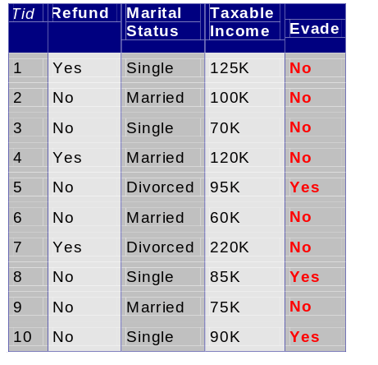
Classification Example 2
A married person with income 100K did not refund the loan previously

Slide 6
Classification Example 2
A married person with income 100K did not refund the loan previously
Can we trust him?

Slide 7
Classification Example 3
The sea bass/salmon example
  We know the previous counts of salmon/sea bass
  Can we predict which fish is coming in the conveyor?

Slide 8
Bayes Classifier
A probabilistic framework for solving classification problems
Bayes theorem:

Slide 9
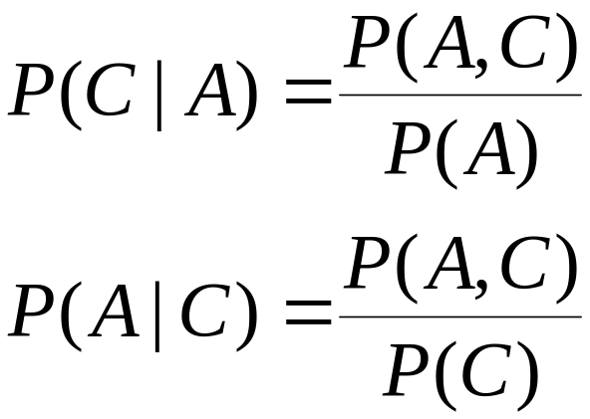
Bayes Classifier
A probabilistic framework for solving classification problems
Conditional Probabilities:

Slide 10
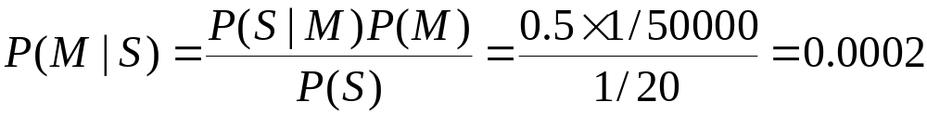
Example 1
Given:
  A doctor knows that meningitis causes stiff neck 50% of the time
  Prior probability of any patient having meningitis is 1/50,000
  Prior probability of any patient having stiff neck is 1/20
If a patient has stiff neck, does he/she has meningitis?

Slide 11
Example 3
The sea bass/salmon example
  We know the previous counts of salmon/sea bass
    amount of catches
    classes or state of nature (Salmon/Sea bass)
    state of nature is a random variable

Slide 12
Example 3
The sea bass/salmon example
    if the catch of salmon and sea bass is equi-probable
      P(ω₁) = P(ω₂) (uniform priors)
      P(ω₁) + P( ω₂) = 1 (exclusivity and exhaustivity)

Slide 13
Decision rule with only the prior information
  Decide ω₁ if P(ω₁) > P(ω₂) otherwise decide ω₂
  Misclassify many fishes

Slide 14
Use of the class –conditional information
  Use lightness
P(x | ω₁) and P(x | ω₂) describe lightness in sea bass and salmon

Slide 15
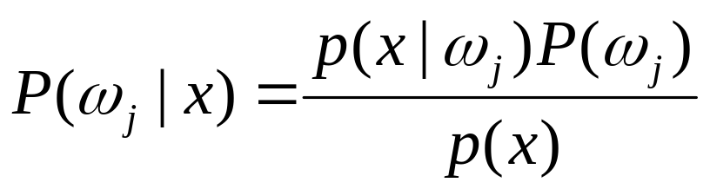
Given the lightness evidence x, calculate Posterior from Likelihood and evidence
  Posterior = (Likelihood. Prior) / Evidence

Slide 16

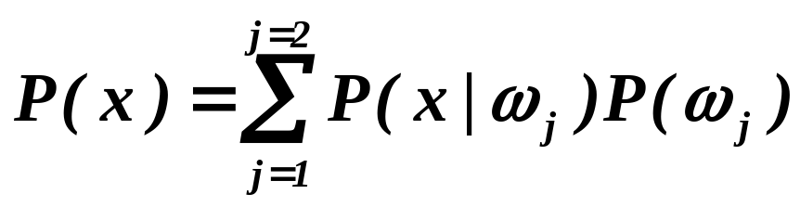
Given the lightness evidence x, calculate Posterior from Likelihood and evidence
  Where in case of two categories

Slide 17
Decision given the posterior probabilities
X is an observation for which:
if P(ω₁ | x) > P(ω₂ | x) True state of nature = ω₁
if P(ω₁ | x) < P(ω₂ | x) True state of nature = ω₂

Slide 18
Decision given the posterior probabilities
X is an observation for which:
if P(ω₁ | x) > P(ω₂ | x) True state of nature = ω₁
if P(ω₁ | x) < P(ω₂ | x) True state of nature = ω₂
Therefore:
whenever we observe a particular x, the probability of error is :
P(error | x) = P(ω₁ | x) if we decide ω₂
P(error | x) = P(ω₂ | x) if we decide ω₁

Slide 19
Minimizing the probability of error
Decide ω₁ if P(ω₁ | x) > P(ω₂ | x);
otherwise decide ω₂
Therefore:
P(error | x) = min [P(ω₁ | x), P(ω₂ | x)]
(Bayes decision)

Slide 20
Bayesian Decision Theory – Continuous Features
Generalization of the preceding ideas
  Use of more than one feature
  Use more than two states of nature
  Allowing actions and not only decide on the state of nature
  Introduce a loss of function which is more general than the probability of error

Slide 21
Let {ω₁, ω₂,…, ω_{c}} be the set of c states of nature
(or “categories”)
Let {α₁, α₂,…, α_{a}} be the set of possible actions
Let λ(α_{i} | ω_{j}) be the loss incurred for taking
action α_{i} when the state of nature is ω_{j}

Slide 22
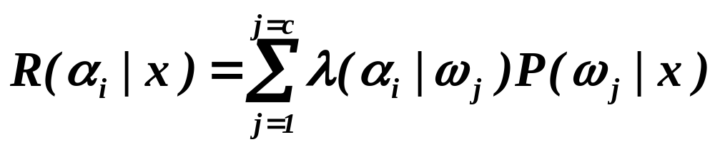
The risk to take decision α_{i} is
Overall risk
R = Sum of all R(α_{i} | x) for i = 1,…,a
Minimizing R Minimizing R(α_{i} | x) for i = 1,…, a

Slide 23
Two-category classification
    α₁ : deciding ω₁
    α₂ : deciding ω₂
    λ_{ij} = λ(α_{i} | ω_{j})
loss incurred for deciding ω_{i} when the true state of nature is ω_{j}
Conditional risk:
R(α₁ | x) = λ₁₁P(ω₁ | x) + λ₁₂P(ω₂ | x)
R(α₂ | x) = λ₂₁P(ω₁ | x) + λ₂₂P(ω₂ | x)

Slide 24
Our rule is the following:
if R(α₁ | x) < R(α₂ | x)
action α₁: “decide ω₁” is taken
This results in the equivalent rule :
decide ω₁ if:
(λ₂₁- λ₁₁) P(x | ω₁) P(ω₁) >
(λ₁₂- λ₂₂) P(x | ω₂) P(ω₂)
and decide ω₂ otherwise

Slide 25
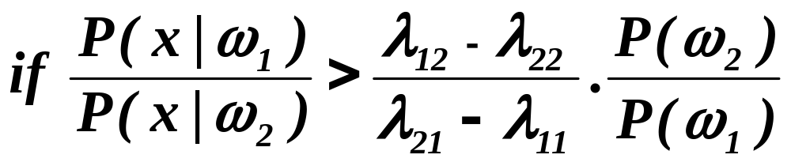
Likelihood ratio:
The preceding rule
(λ₂₁- λ₁₁) P(x | ω₁) P(ω₁) >
(λ₁₂- λ₂₂) P(x | ω₂) P(ω₂)
is equivalent to the following rule:
Then take action α₁ (decide ω₁)
Otherwise take action α₂ (decide ω₂)

Slide 26
Likelihood ratio:
The preceding rule
(λ₂₁- λ₁₁) P(x | ω₁) P(ω₁) >
(λ₁₂- λ₂₂) P(x | ω₂) P(ω₂)
is equivalent to the following rule:
Likelihood ratio
Then take action α₁ (decide ω₁)
Otherwise take action α₂ (decide ω₂)

Slide 27
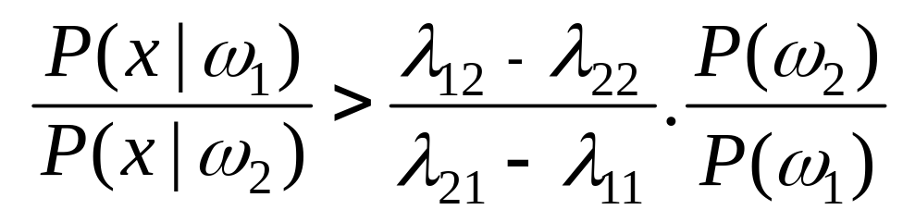
Optimal decision property
“If the likelihood ratio exceeds a threshold value independent of the input pattern x, we can take optimal actions”

Slide 28

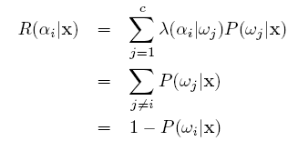
Minimum Error Rate Classification
Assume the loss function for two class case:
The Risk is now:

Slide 29
Minimum Error Rate Classification
Assume the loss function for two class case:
The Risk is now:
Minimizing R Minimizing R(α_{i} | x) Maximizing P(ω_{i} | x)

Slide 30
Minimum Error Rate Classification
Our rule was:
if R(α₁ | x) < R(α₂ | x)
action α₁: “decide ω₁” is taken
which is equivalent to:

Slide 31
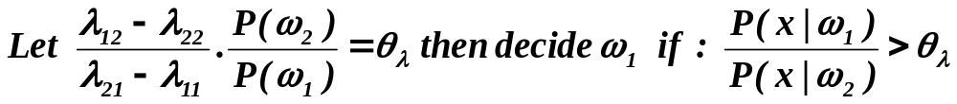
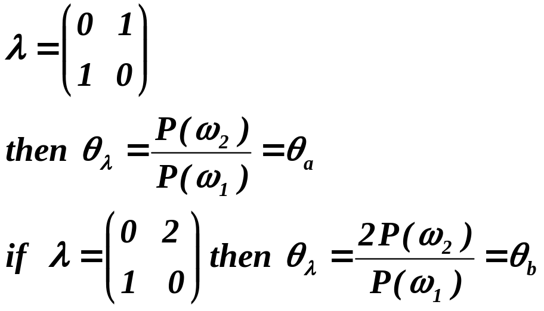
Regions of decision and zero-one loss function, therefore:
If λ is the zero-one loss function which means:

Slide 32
