Slide 1

CSE 473
Pattern Recognition

Slide 2
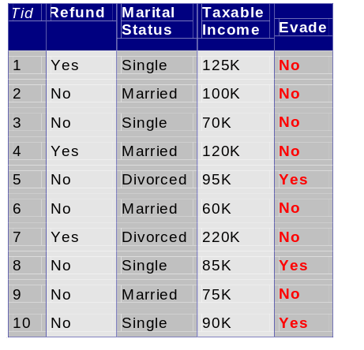
Classification Example 2
A married person with income 120K did not refund the loan previously
Can we trust him?

Slide 3
Bayesian Classifiers
We have multiple attributes (A₁, A₂,…,A_{n})
  Goal is to predict class C
  Specifically, we want to find the value of C that maximizes P(C| A₁, A₂,…,A_{n} )
Can we estimate P(C| A₁, A₂,…,A_{n} ) directly from data?

Slide 4
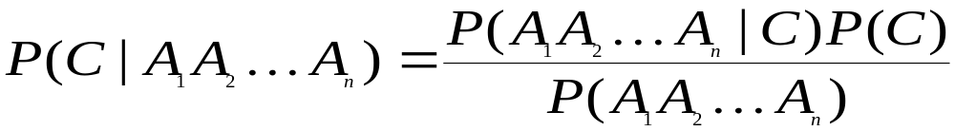
Bayesian Classifiers
Approach:
  compute the posterior probability P(C | A₁, A₂, …, A_{n}) for all values of C using the Bayes theorem
  Choose value of C that maximizes
  P(C | A₁, A₂, …, A_{n})
  Equivalent to choosing value of C that maximizes
  P(A₁, A₂, …, A_{n}|C) P(C)
How to estimate P(A₁, A₂, …, A_{n} | C )?

Slide 5
Naïve Bayes Classifier
Assume independence among attributes A_{i} when class is given:
  P(A₁, A₂, …, A_{n} |C) = P(A₁| C_{j}) P(A₂| C_{j})… P(A_{n}| C_{j})
  Can estimate P(A_{i}| C_{j}) for all A_{i} and C_{j}.
  the new pattern is classified to C_{j} if P(C_{j}) Π P(A_{i}| C_{j}) is maximal.

Slide 6
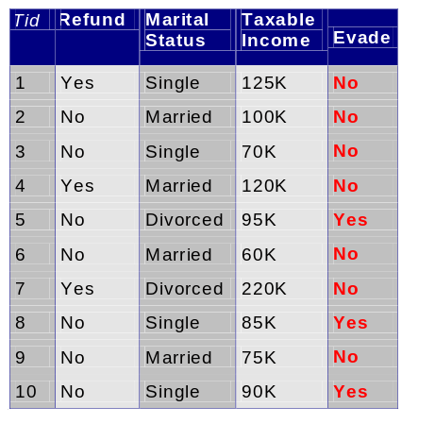
How to Estimate Probabilities from Data?
Class: P(C) = N_{c}/N
  e.g., P(No) = 7/10,
  P(Yes) = 3/10
For discrete attributes:
P(A_{i} | C_{k}) = |A_{ik}|/ N_{c}
  where |A_{ik}| is number of instances having attribute A_{i} and belongs to class C_{k}
  Examples:
  P(Status=Married|No) = 4/7
  P(Refund=Yes|Yes)=0
k

Slide 7
How to Estimate Probabilities from Data?
For continuous attributes:
  Discretize the range into bins
    one ordinal attribute per bin
    violates independence assumption
  Two-way split: (A < v) or (A > v)
    choose only one of the two splits as new attribute
  Probability density estimation:
    Assume attribute follows a normal distribution
    Use data to estimate parameters of distribution
    (e.g., mean and standard deviation)
    Once probability distribution is known, can use it to estimate the conditional probability P(A_{i}|c)

Slide 8
The Normal Density
Density which is analytically tractable
Continuous density
A lot of processes are asymptotically Gaussian
Handwritten characters, speech sounds are ideal or prototype corrupted by random process (central limit theorem)
[The theorem states that if a random variable is the outcome of a summation of a number of independent random variables, its pdf approaches the Gaussian function as the number of summands tends to infinity]

Slide 9
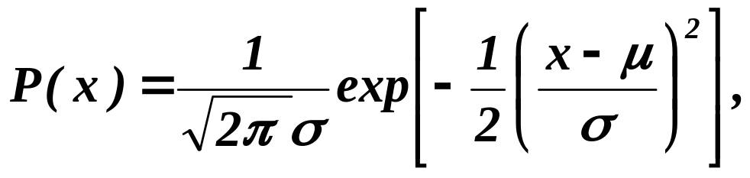
The Normal Density
Univariate density
Where:
μ = mean (or expected value) of x
σ² = expected squared deviation or variance

Slide 10
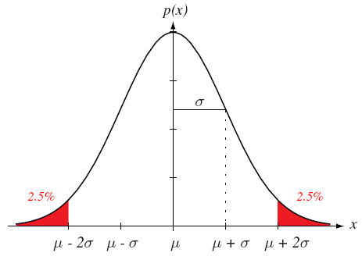
68-95-99.7 rule

Slide 11
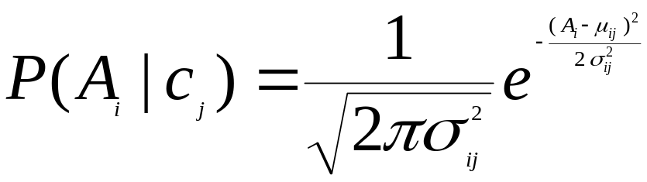
How to Estimate Probabilities from Data?
Normal distribution:
  One for each (A_{i},c_{i}) pair
For (Income, Class=No):
  If Class=No
    sample mean = 110K
    sample variance = 2975

Slide 12
How to Estimate Probabilities from Data?
Normal distribution:
  One for each (A_{i},c_{i}) pair
For (Income, Class=No):
  If Class=No
    sample mean = 110K
    sample variance = 2975

Slide 13
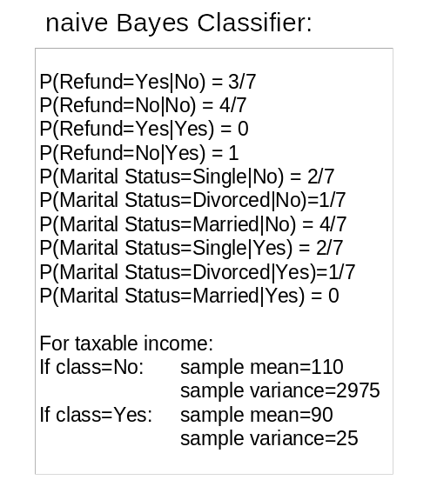
Example of Naïve Bayes Classifier
Given a Test Record:
P(X|Class=No) = P(Refund=No|Class=No)
× P(Married| Class=No)
× P(Income=120K| Class=No)
= 4/7 × 4/7 × 0.0072 = 0.0024
P(X|Class=Yes) = P(Refund=No| Class=Yes)
× P(Married| Class=Yes)
× P(Income=120K| Class=Yes)
= 1 × 0 × 1.2 × 10⁻⁹ = 0
Since P(X|No)P(No) > P(X|Yes)P(Yes)
Therefore P(No|X) > P(Yes|X)
=> Class = No

Slide 14
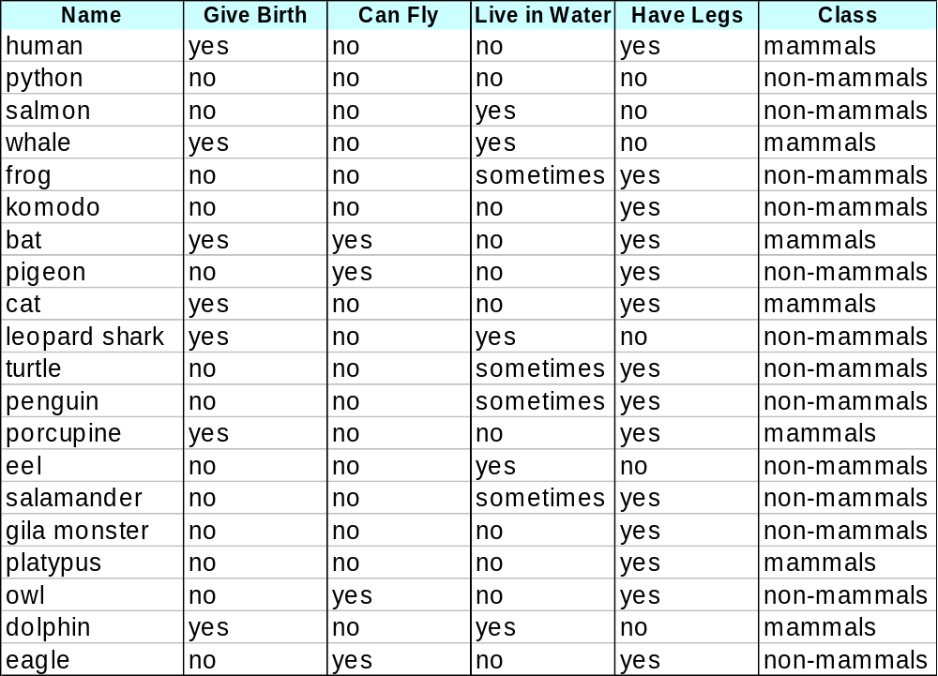
Example-2 of Naïve Bayes Classifier

Slide 15
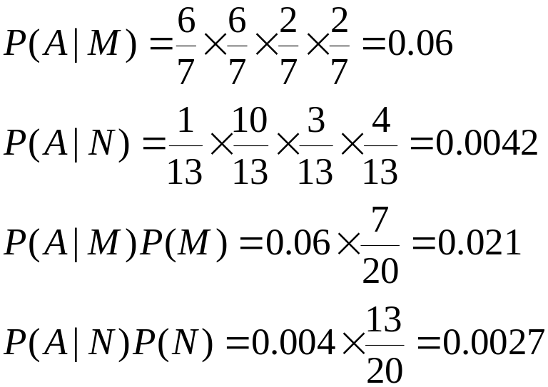
Example-2 of Naïve Bayes Classifier
A: attributes
M: mammals
N: non-mammals
P(A|M)P(M) > P(A|N)P(N)
=> Mammals

Slide 16
Naïve Bayes (Summary)
Robust to isolated noise points
Handle missing values by ignoring the instance during probability estimate calculations
Robust to irrelevant attributes
Independence assumption may not hold for some attributes
  Use other techniques such as Bayesian Belief Networks (BBN)

