Slide 1

CSE 473: Pattern Recognition

Slide 2
What is Cluster Analysis?
Finding groups of objects such that the objects in a group will be similar (or related) to one another and different from (or unrelated to) the objects in other groups
Inter-cluster distances are maximized
Intra-cluster distances are minimized

Slide 3
Notion of a Cluster can be Ambiguous
  Depending on the similarity measure, the clustering criterion and the clustering algorithm different clusters may result. Subjectivity is a reality to live with from now on.
How many clusters?
Six Clusters
Two Clusters
Four Clusters

Slide 4
Notion of a Cluster can be Ambiguous
Let these animals to be clustered
  Blue shark, sheep, cat, Dog, Lizard, sparrow, viper, seagull, gold fish, frog, red mullet

Slide 5
  A real example
Blue shark,
sheep, cat,
dog
Lizard, sparrow, viper, seagull, gold fish, frog, red mullet
Two clusters
Clustering criterion:
How mammals bear
their progeny
Gold fish, red mullet, blue shark
Sheep, sparrow,
dog, cat, seagull,
lizard, frog, viper
Two clusters
Clustering criterion:
Existence of lungs

Slide 6
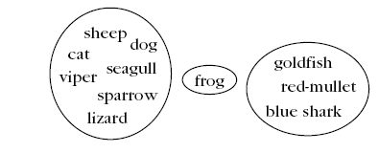
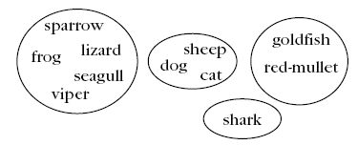
  A real example
Three clusters
Clustering criterion:
Their living
environment
Four clusters
Clustering criterion:
Bear progeny and Existence of lungs

Slide 7
Clustering Task Stages
  Feature Selection: Information rich features-Parsimony
  Proximity Measure: This quantifies the term similar or dissimilar.
  Clustering Criterion: This consists of a cost function or some type of rules.
  Clustering Algorithm: This consists of the set of steps followed to reveal the structure, based on the similarity measure and the adopted criterion.
  Validation of the results.
  Interpretation of the results.

Slide 8
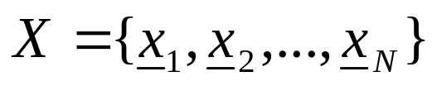
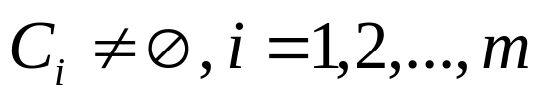
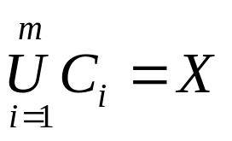
Clustering Definitions
Hard Clustering: Each point belongs to a single cluster
    Let
    An m-clustering R of X, is defined as the partition of X into m sets (clusters), C₁, C₂,…,C_{m}, so that
  In addition, data in C_{i} are more similar to each other and less similar to the data in the rest of the clusters.

Slide 9


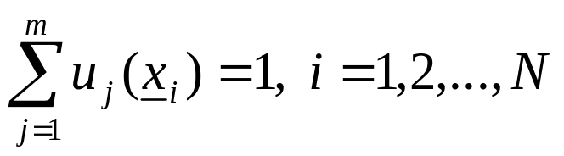
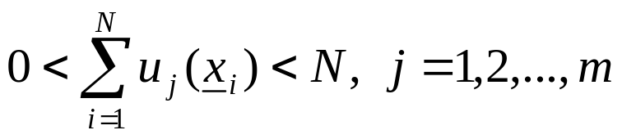
Clustering Definitions
  Fuzzy clustering: Each point belongs to all clusters up to some degree.
  A fuzzy clustering of X into m clusters is characterized by m functions
    is the representative of jth cluster

Slide 10
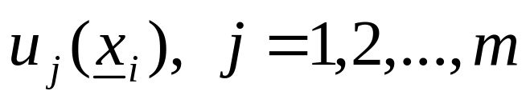
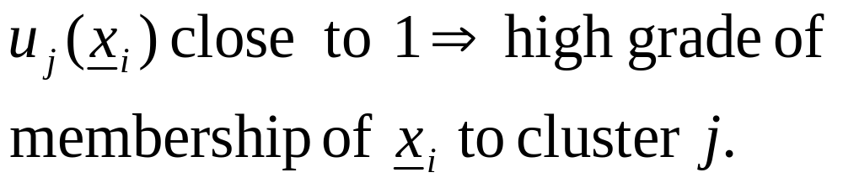
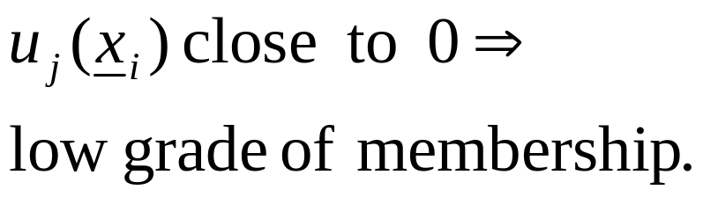
Clustering Definitions
  These are known as membership functions.
  Thus, each x_{i} belongs to any cluster “up to
  some degree”, depending on the value of

Slide 11
What Is Good Clustering?
A good clustering method will produce high quality clusters with
  high intra-class similarity
  low inter-class similarity
The quality of a clustering result depends on both the similarity measure used by the method and its implementation.
The quality of a clustering method is also measured by its ability to discover some or all of the hidden patterns.

Slide 12


Types of data
Data matrix
Dissimilarity matrix

Slide 13
Types of Clusters
Well-separated clusters
Center-based clusters
Contiguous clusters
Density-based clusters
Property or Conceptual
Described by an Objective Function

Slide 14
Types of Clusters: Well-Separated
Well-Separated Clusters:
  A cluster is a set of points such that any point in a cluster is closer (or more similar) to every other point in the cluster than to any point not in the cluster.
3 well-separated clusters

Slide 15
Types of Clusters: Center-Based
Center-based
  A cluster is a set of objects such that an object in a cluster is closer (more similar) to the “center” of a cluster, than to the center of any other cluster
  The center of a cluster is often a centroid, the average of all the points in the cluster, or a medoid, the most “representative” point of a cluster
4 center-based clusters

Slide 16
Types of Clusters: Contiguity-Based
Contiguous Cluster (Nearest neighbor or Transitive)
  A cluster is a set of points such that a point in a cluster is closer (or more similar) to one or more other points in the cluster than to any point not in the cluster.
8 contiguous clusters

Slide 17
Types of Clusters: Density-Based
Density-based
  A cluster is a dense region of points, which is separated by low-density regions, from other regions of high density.
  Used when the clusters are irregular or intertwined, and when noise and outliers are present.
6 density-based clusters

Slide 18
Types of Clusters: Objective Function
Clusters Defined by an Objective Function
  Finds clusters that minimize or maximize an objective function.
  Enumerate all possible ways of dividing the points into clusters and evaluate the `goodness' of each potential set of clusters by using the given objective function. (NP Hard)
  Can have global or local objectives.
    Hierarchical clustering algorithms typically have local objectives
    Partitional algorithms typically have global objectives

Slide 19
Major Clustering Approaches
Partitioning algorithms: Construct various partitions and then evaluate them by some criterion
Hierarchy algorithms: Create a hierarchical decomposition of the set of data (or objects) using some criterion
Density-based: based on connectivity and density functions

Slide 20
Partitioning Algorithms: Basic Concept
Partitioning method: Construct a partition of a database D of n objects into a set of k clusters
Given a k, find a partition of k clusters that optimizes the chosen partitioning criterion
  Global optimal: exhaustively enumerate all partitions
  Heuristic methods: k-means and k-medoids algorithms
  k-means (MacQueen’67): Each cluster is represented by the center of the cluster
  k-medoids or PAM (Partition around medoids) (Kaufman & Rousseeuw’87): Each cluster is represented by one of the objects in the cluster

Slide 21
The K-Means Clustering Method
Given k, the k-means algorithm is implemented in 4 steps:
  Partition objects into k nonempty subsets
  Compute seed points as the centroids of the clusters of the current partition. The centroid is the center (mean point) of the cluster.
  Assign each object to the cluster with the nearest seed point.
  Go back to Step 2, stop when no more new assignment.

Slide 22

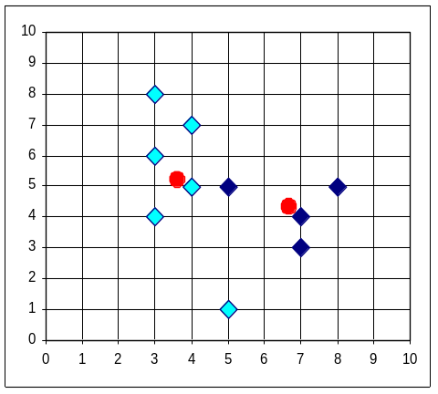


The K-Means Clustering Method
Example

Slide 23
Comments on the K-Means Method
Strength
  Relatively efficient: O(tkn), where n is # objects, k is # clusters, and t is # iterations. Normally, k, t << n.
  Very easy to implement. (Especially with standard libraries available nowadays)

Slide 24
Comments on the K-Means Method
Weakness
  Non-deterministic
  Often terminates at a local optimum.
  Applicable only when mean is defined, then what about categorical data?
  Need to specify k, the number of clusters, in advance
  Unable to handle noisy data and outliers
  Not suitable to discover clusters with non-convex shapes

Slide 25
K-means and outliers, an example:

Slide 26
K-means and outliers, an example:

Slide 27
K-means and non-convex shapes

Slide 28
K-means and non-convex shapes

Slide 29



Two different K-means Clusterings
Original Points
Optimal Clustering
Sub-optimal Clustering

Slide 30






Importance of Choosing Initial Centroids

Slide 31
Importance of Choosing Initial Centroids

Slide 32
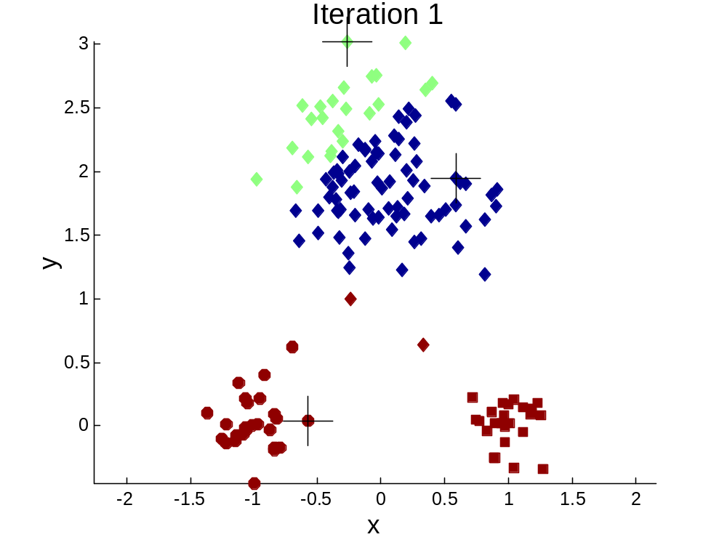


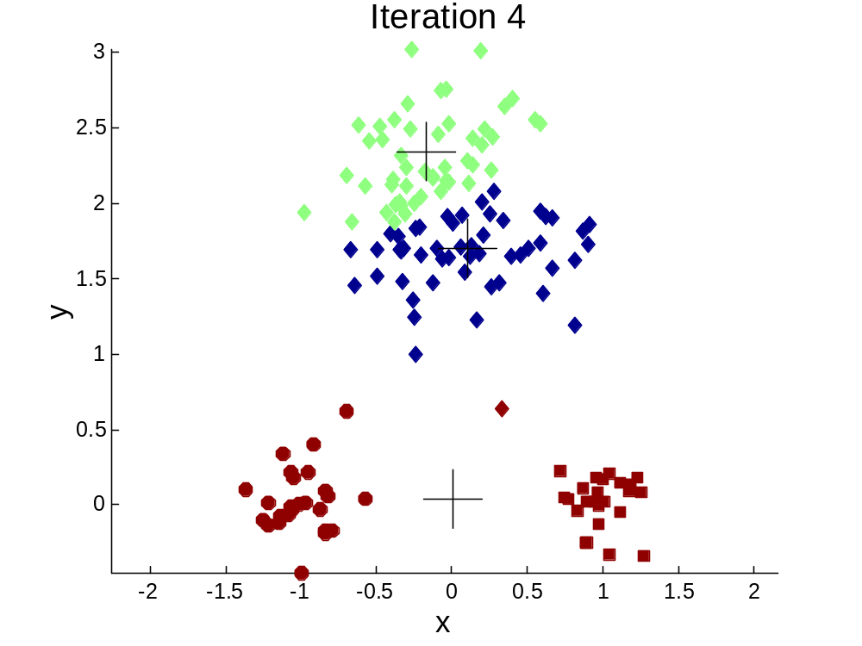
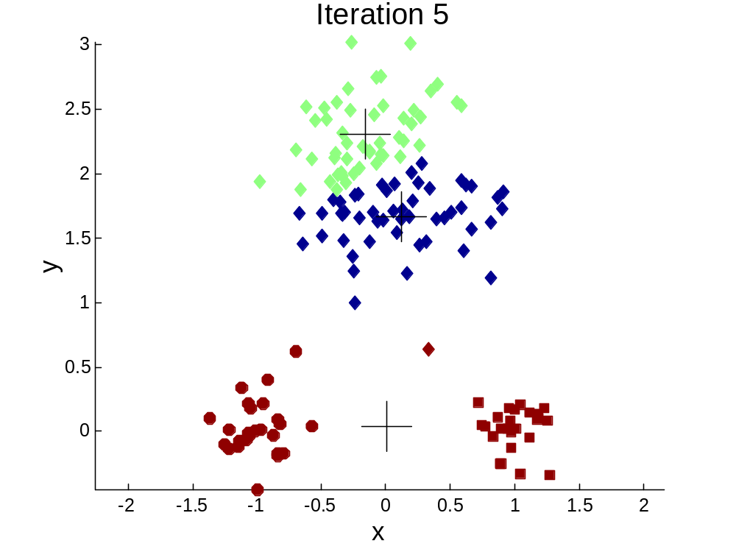
Importance of Choosing Initial Centroids …

Slide 33
Importance of Choosing Initial Centroids …

Slide 34
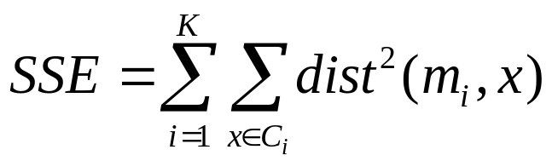
Evaluating K-means Clusters
Most common measure is Sum of Squared Error (SSE)
  For each point, the error is the distance to the nearest cluster
  To get SSE, we square these errors and sum them.
    x is a data point in cluster C_{i} and m_{i} is the representative point for cluster C_{i}
    can show that m_{i} corresponds to the center (mean) of the cluster
  Given two clusters, we can choose the one with the smallest error
  One easy way to reduce SSE is to increase K, the number of clusters
    A good clustering with smaller K can have a higher SSE than a poor clustering with higher K

Slide 35

Bisecting K-means
Bisecting K-means algorithm
  Variant of K-means that can produce a partitional or a hierarchical clustering

Slide 36
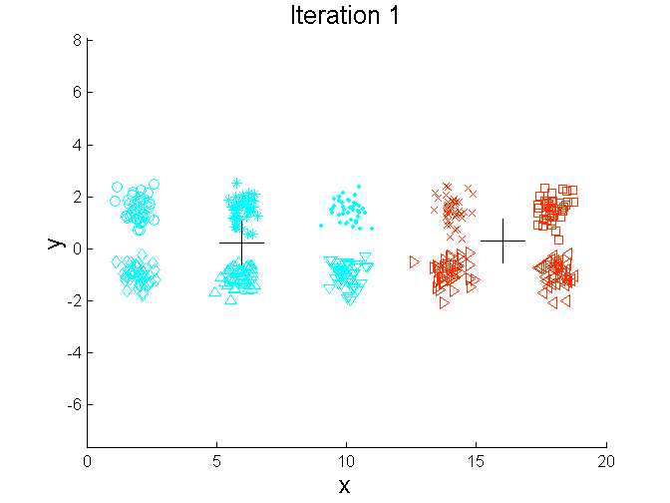
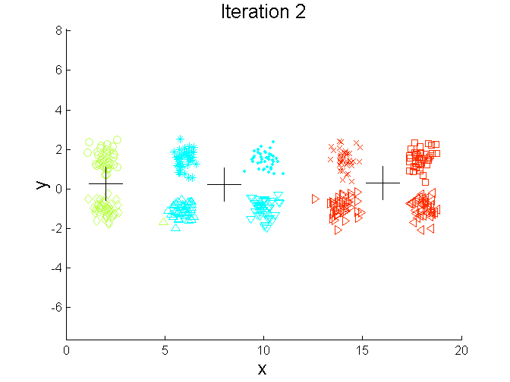
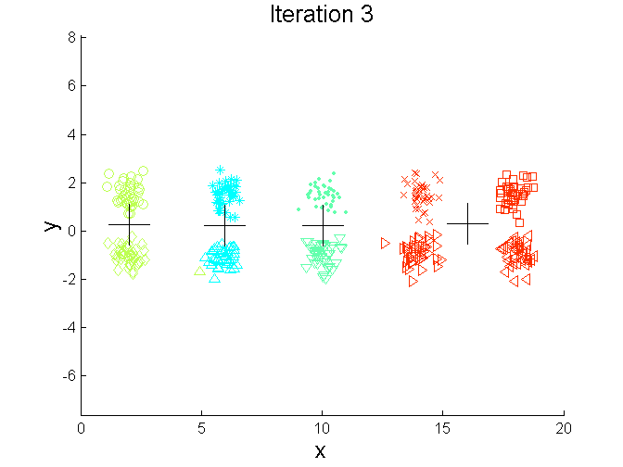
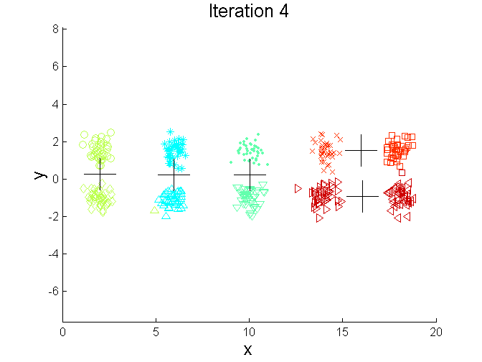
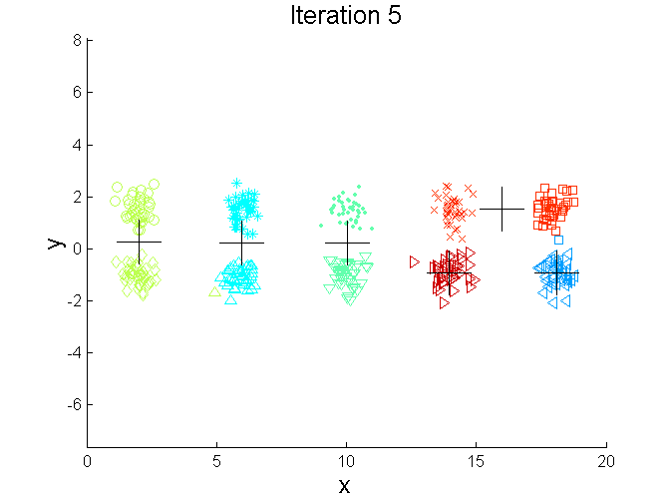
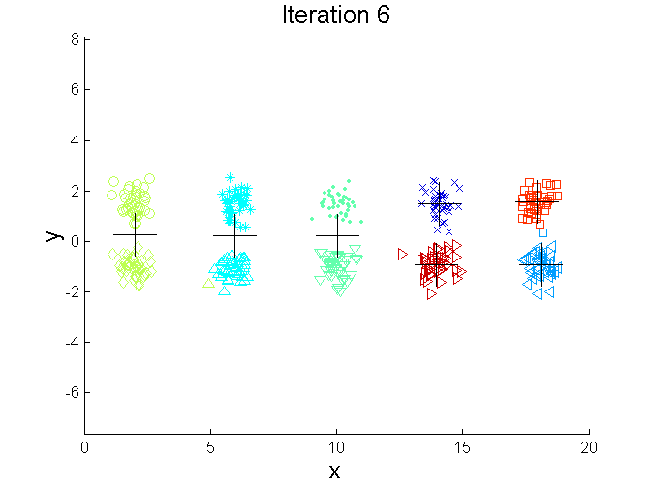
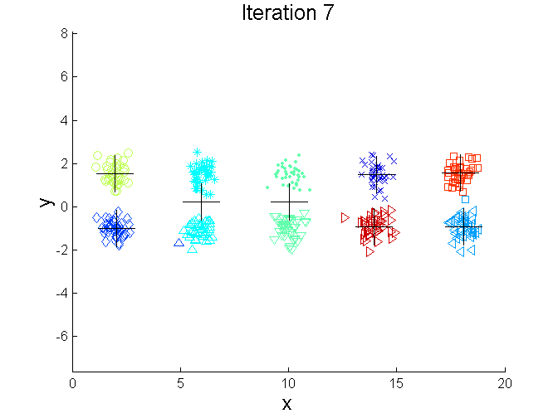
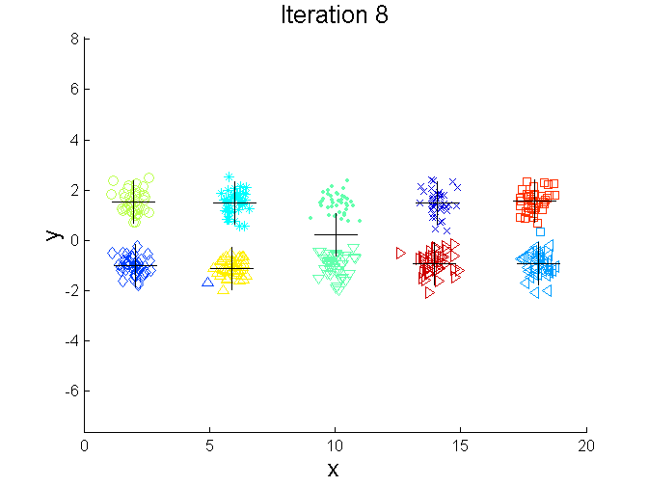
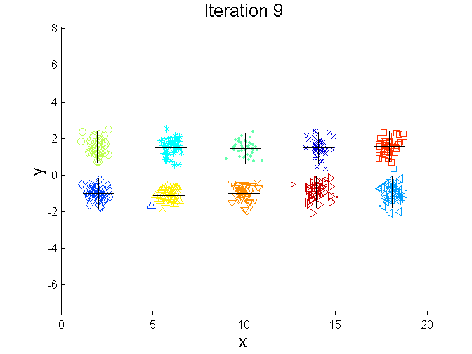
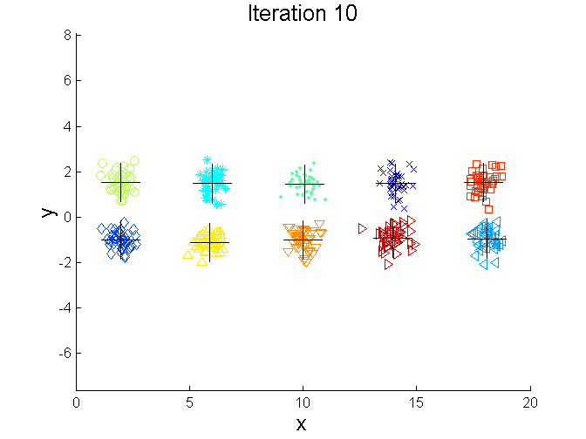
Bisecting K-means Example

Slide 37
Variations of the K-Means Method
A few variants of the k-means which differ in
  Selection of the initial k means
    With some extra effort to locate “good” starting points
  Dissimilarity calculations
    Use more information than distance to cluster means
  Strategies to calculate cluster means
    Introduce fuzziness

Slide 38
Variation of the K-means method
Generalizing K-means
  Partition objects into k nonempty subsets
  Compute seed points as the centroids of the clusters of the current partition. The centroid is the center (mean point) of the cluster.
  (what if we cannot calculate the centroid?)
  Assign each object to the cluster with the nearest seed point. (How do we measrue nearest?)
  Go back to Step 2, stop when no more new assignment.

Slide 39
Variations of the K-Means Method
What if categorical data? (No means)
Handling categorical data: k-modes (Huang’98)
  Replacing means of clusters with modes
  Using new dissimilarity measures to deal with categorical objects
  Using a frequency-based method to update modes of clusters
  A mixture of categorical and numerical data: k-prototype method

Slide 40
The K-Medoids Clustering Method
How about only dissimilarity matrix given?
Recall the SSE function:
The only value needed is the distance between objects
  No mentioning of coordinates, points in Euclidean space, etc.
So as long as adapt K-means to satisfy this condition, we are fine.

Slide 41
The K-Medoids Clustering Method
Problem 1: Computing centroids
  Solution: Use one of the data points itself as the centroid!
  This objects are known as medoids
Problem 1a: Updating centroids
  Substitute a medoid with another from the same cluster
Problem 2: Assigning clusters
  Solution: Use the distance between the object and the centroid itself. (This is provided, right?)

Slide 42
PAM (Partitioning Around Medoids) (1987)
PAM (Kaufman and Rousseeuw, 1987), built in S-plus
Use real object to represent the cluster
  Select k representative objects arbitrarily
  For each pair of non-selected object h and selected object i, calculate the total swapping cost TC_{ih}
  For each pair of i and h,
    If TC_{ih} < 0, i is replaced by h
    Then assign each non-selected object to the most similar representative object
  repeat steps 2-3 until there is no change

Slide 43

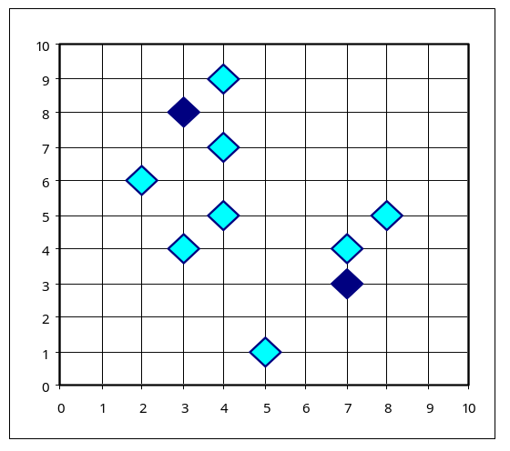
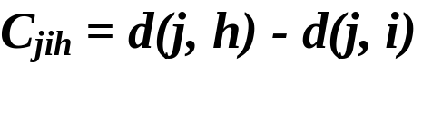

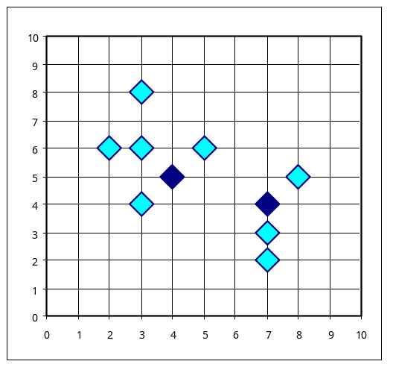
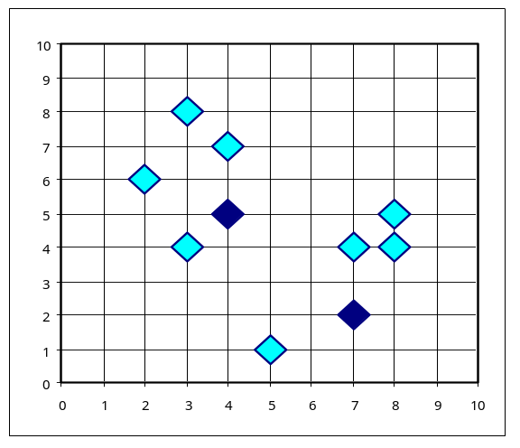


PAM Clustering: Total swapping cost TC_{ih}=∑_{j}C_{jih}
t
j
t
j
i
h
h
i
h
j
i
i
t
h
j
t

