Slide 1
Enhancements to the Ontology-driven Orrery Web App
Addition of Color Indicators and Eros Orbit Representation

Slide 2
Introduction
Overview of recent enhancements made to the orrery web application.
1. Added a color column to the data table for easier identification of celestial objects.
2. Introduced Eros Orbit representation in the simulation.

Slide 3
Adding the 'Color' Column
Problem: Previously, it was difficult to match colored spheres in the 3D simulation to table data.
Solution: Introduced a 'Color' column in the table to visually identify objects.
Benefit: Enhanced user experience by providing a clear visual reference.

Slide 4
Technical Implementation - Color Column
• Modified the table structure to include a new 'Color' column.
• Updated the 'populate_table' function to display the color using inline styles.
• Benefits: Provides an intuitive link between 3D objects and table data.

Slide 5
Introducing Eros Orbit
Objective: To represent a Near-Earth Object (NEO) in the simulation.
Eros was chosen due to its significance as a known asteroid with close encounters to Earth.

Slide 6
Technical Implementation - Eros Orbit
• Added 'Eros_Orbit' to the JSON-LD block with its orbital parameters:
- Semi-Major Axis, Eccentricity, Inclination, etc.
• Visual Representation: Assigned green color (#00FF00) for easy identification.

Slide 7
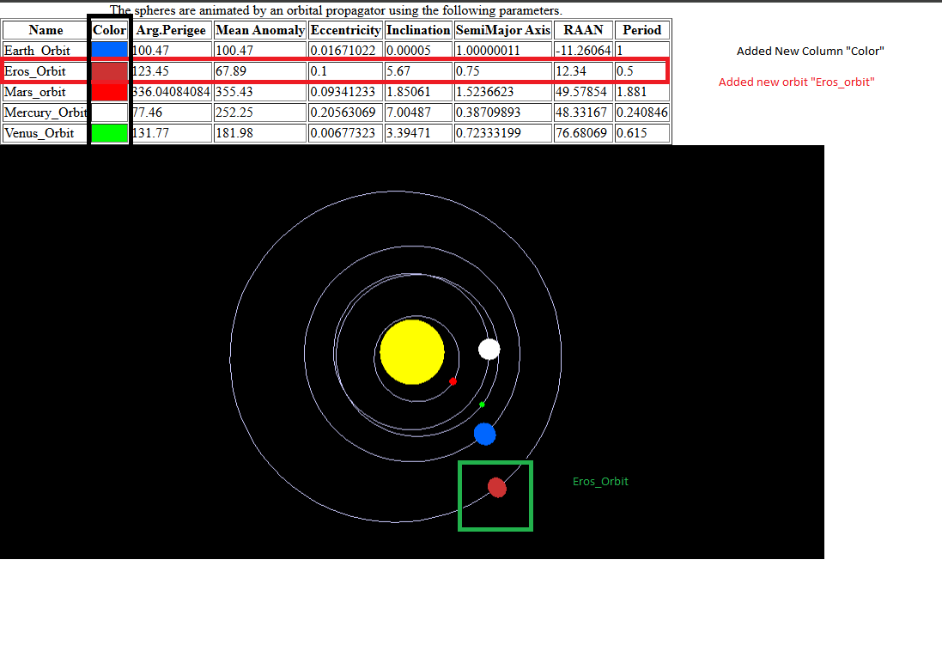
Demonstration

Slide 8
Benefits of These Enhancements
• Enhanced Visualization: Color column provides an immediate visual reference.
• Expanded Representation: Includes Near-Earth Objects like Eros.
• User-Friendly: Engaging and informative educational tool.

Slide 9
Conclusion
• Successfully integrated color indicators and Eros orbit.
• Future Scope: Potential to add more NEOs and refine interactivity.

Slide 10
Questions & Feedback
Open to any questions or feedback regarding the project.

