Slide 1

Color is the place where our brain and universe meet.
By: Paul Klee

Slide 2
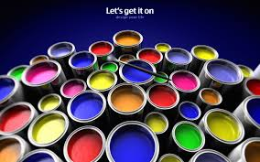
Pre-Color Visualizer For Smartphone

Slide 3
Co-Member’s Naveed Farhan-ul-Haq Supervisor: Dr. Aarij Mahmood Hussaan

Slide 4
Abstract Of Project
Every so often people are profound to know how their rooms will look like after applying a certain color.
we aspire to design a mobile application that can provide people the opportunity to preview their rooms/walls/ceilings, etc , with a certain color before applying in reality.

Slide 5
Introduction
Scope:
Objectives & Goals:
Features:
Over View Of The Model:

Slide 6
Project Description
ENLIGHTENMENT OF THE MODEL
FUNCTIONS PERFORMED
TECHNOLOGY USED
USER INTERFACE DESIGN

Slide 7
Implementations
DELIVERABLE ITEMS
MILESTONES

Slide 8
Vital Equipment

Slide 9
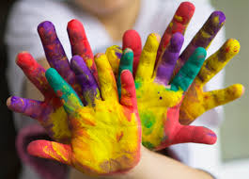
Conclusion
Pre-visualization of your painted walls, ceils etc.
This tool will be helpful for pre planning of a room and Pre-visualization of your painted walls, ceils etc

Slide 10


Slide 11



