Slide 1
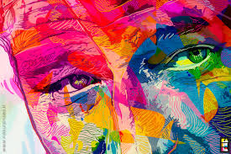
Color is the place where our brain and universe meet.
By: Paul Klee

Slide 2
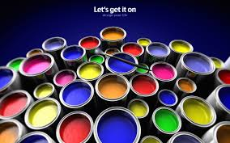
Pre-Color Visualizer For Smartphone

Slide 3
Co-Member’s Naveed Farhan-ul-Haq Supervisor: Dr. Aarij Mahmood Hussaan

Slide 4
Abstract Of Project
Every so often people are profound to know how their rooms will look like after applying a certain color.
we aspire to design a mobile application that can provide people the opportunity to preview their rooms/walls/ceilings, etc , with a certain color before applying in reality.

Slide 5
Introduction
Scope:
Objectives & Goals:
Features:
Over View Of The Model:

Slide 6
Project Description
ENLIGHTENMENT OF THE MODEL
FUNCTIONS PERFORMED
TECHNOLOGY USED
USER INTERFACE DESIGN

Slide 7
Implementations
DELIVERABLE ITEMS
MILESTONES

Slide 8
Scope
This App can be used by Home owners, Color shops, under construction buildings because of time-saving and productivity benefits. This apps work on android platform and you can run it on any android device.
It is also very effective for Paint industry for showing the customers the effects of their paint on the houses in real-time. This application can also be used as color visualizer.

Slide 9
Objectives & Goals
To allow homeowners to pre-visualize the effects of applying different colors on their walls, doors, ceilings, etc.
To achieve the aforementioned goal using a mobile application objectives.
To be able to identify different objects automatically using static images.
To be able to change colors of the identified objects.
To change colors keeping into account the light variations.

Slide 10
Features
Some of the features of this application are for user interface and easy to handle the application.
Detection of different objects (walls, doors, ceilings, etc.) in an automatic manner.
Ability to choose colors from a variety of different option and apply them to the detected objects.
Ability to apply colors according to the light intensity for more realistic visualization.

Slide 11
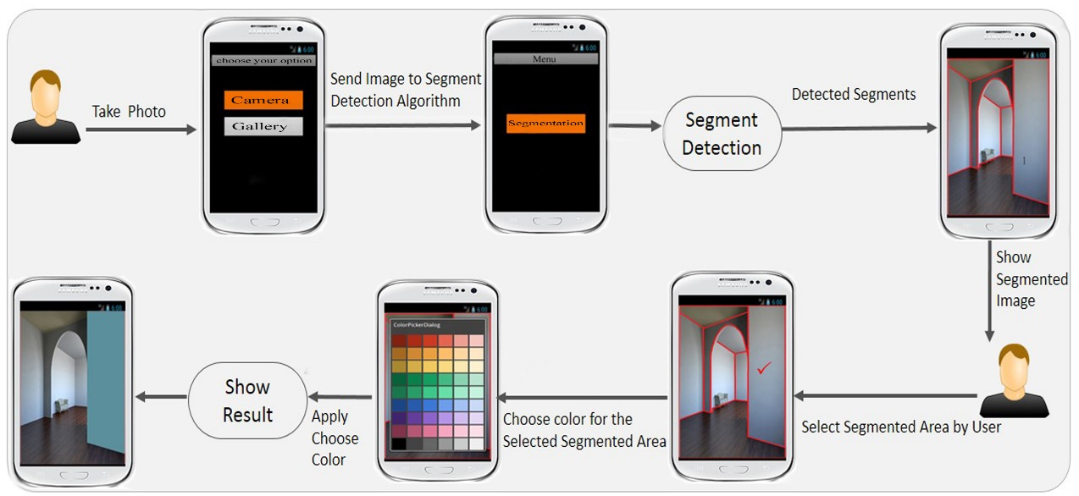
Overview of the Model

Slide 12
Implementation
The app is written in java and xml for design on tools Eclipse 4.2 Kepler.
The core library were use in project was Open CV library for android version 2.4.8.
Another library used was AmbilWarnaColorPicker
The OS on these tools used were Windows 8.1.

Slide 13
Canny Edge Detection
The main algorithm we used from OpenCV library for edge detection is Canny.

Slide 14
Vital Equipment

Slide 15
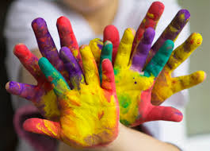
Conclusion
Pre-visualization of your painted walls, ceils etc.
This tool will be helpful for pre planning of a room and Pre-visualization of your painted walls, ceils etc

Slide 16


Slide 17



