Slide 1

20
CONFERENCE VIDEO PRESENTATION
Predicting Maternal and Child health outcomes
Bangladesh DHS data to predict maternal and child health risks and
carefully tests whether the predictions are reliable, fair, and useful in practice.
MD Farhan SM Sakib
22301430 22301431
Section: 2 Group: 13
BRAC University, Dhaka
Notes:
Bangladesh has cut maternal and child mortality sharply over three decades, but the burden that remains is neither small nor evenly shared. Four percent of live births still end in neonatal death, more than a quarter of young children are stunted, severly stunned and underweight. To answer how far can that information alone carry an early risk-screening system, we pooled the Bangladesh DHS rounds of 2017-18 and 2022 and predicted five outcomes: facility delivery, neonatal death, stunting, severe stunting and underweight.

Slide 2
PROJECT CONTRIBUTION
02
The project chain
Each stage answers a different question before the final risk score is allowed to speak.
1
Define the right population
Shorten seven raw universes to four defensible cohorts.
2
Protect the label
Remove post-outcome, definitional, arithmetic and missingness leakage.
3
Measure the population
Use survey weights, clusters, strata, EDA and data-quality checks.
4
Benchmark and stress-test
Compare models, thresholds, calibration, transport and equity.
5
Turn scores into action
Use uncertainty, anomalies and a phased maternal-child cascade.
Farhan | 1:06
Source: notebook cells 11-16, 129-242
BDHS 2017-18 + 2022
Notes:
Farhan: Our main contribution is the full evidence chain, not a single accuracy number.
Most published DHS studies stop at one outcome, one survey round and one accuracy figure, and some report near-perfect discrimination. One recent Bangladesh study reports ninety-nine point eight percent AUROC for under-five mortality. A meta-analysis of eleven DHS studies puts realistic pooled accuracy for stunting at about sixty-nine percent. That gap is what shaped our design.
So, first we define the population correctly. Second, we protect the outcome from leakage. Third, we describe the population using survey design and exploratory analysis. Fourth, we benchmark the models and stress-test them with thresholds, calibration, temporal validation and subgroup analysis. Finally, we convert the separate predictions into a phased cascade.

Slide 3
COHORT CONSTRUCTION
03
Why we shortened the cohorts before modelling
The complete notebook began with seven possible universes. We retained only the four needed by the final target registry.
Retained cohort | Purpose | Rows
Pregnancy / birth | Neonatal death | 112,546
Recent birth | Facility delivery | 10,773
Measured child | Stunting outcomes | 11,954
Mother | Equity, geography, mother-level features | 45,458
Removed from the final panel
Pregnancy-only cohort: no final pregnancy target.
Child-illness cohort: illness targets were not retained.
Immunization cohort: no final immunization target.
Shortening was a scientific decision: every cohort must have a target, a valid denominator and a defensible information time.
Farhan | 1:56
Source: notebook cells 11, 23, 27, 29, 32
BDHS 2017-18 + 2022
Notes:
Farhan: We did not keep every raw cohort simply to make the project look larger. The final registry uses four cohorts. The birth cohort supports neonatal death, recent births support facility delivery, measured children support the three anthropometry outcomes, and the mother cohort supports one-row-per-woman equity and geography analysis. Pregnancy, illness and immunization cohorts were removed because their corresponding targets were no longer part of the final panel. This keeps the denominator, feature groups and evaluation aligned.
Source: notebook cells 11, 23, 27, 29 and 32.

Slide 4
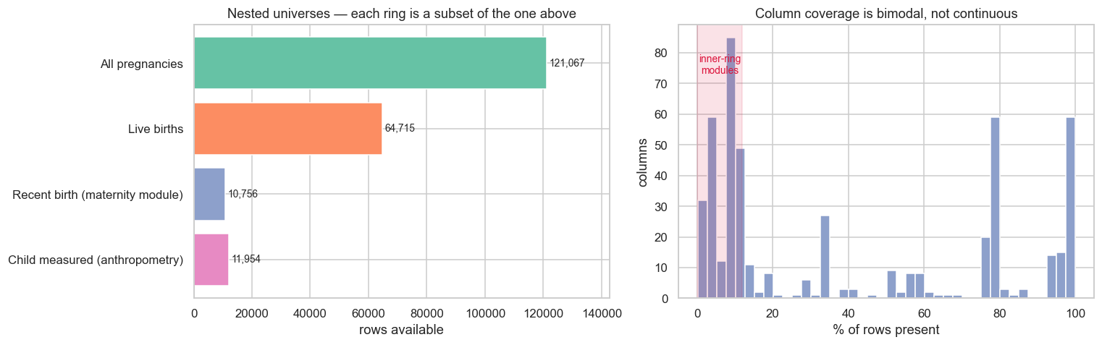
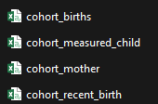
COHORT CONSTRUCTION
04
The cohorts are nested, not interchangeable
Notebook universes
121,067
all pregnancies
112,546
live births in the valid universe
10,773
recent maternity module
11,954
measured children
Farhan | 2:32
Source: notebook cells 12-16
BDHS 2017-18 + 2022
Notes:
Farhan: This figure makes the denominator problem visible. The notebook shows all pooled records, then the birth cohort, then the recent maternity module, and finally measured children.
These universes are nested, but they are not the same, and the drop is steep. A child who was never measured cannot be treated as a non-stunted child. We therefore construct each cohort using valid universe membership, and use the correct denominator for prevalence, for modelling and for evaluation.
Source: notebook cells 12-16.

Slide 5
PRE-PROCESSING
05
One target, one feature matrix, and two preprocessing paths
The pipeline respects the difference between a model that can learn missingness and a model that cannot.
TARGET-SPECIFIC DATA PREPARATION
universe_mask = valid_universe[target]
X = df.loc[universe_mask, feature_groups[target]]
y = df.loc[universe_mask, target]
train, test = grouped_split(X, y, groups=mother_id)
Dense path
Native-NaN path
Impute + missing indicators
Robust scale numeric values
Ordinal and one-hot encode categoricals
Keep numeric NaN values
XGBoost and LightGBM learn split directions for missingness
Grouped splitting: a mother never appears in both train and test.
This prevents the model from recognising families instead of learning transferable risk.
Farhan | 3:03
Source: notebook cells 134-138
BDHS 2017-18 + 2022
Notes:
Farhan: Preprocessing is target-specific. We first select the correct universe, features and label. Then we use two paths. The dense path imputes missing values, adds missingness indicators, scales long-tailed variables and encodes categorical variables. The native path keeps numeric missingness for XGBoost and LightGBM, because those models can learn where missing values should go. The split is grouped by mother ID, so one mother never appears in both training and testing.
Source: notebook cells 134-138.

Slide 6
LEAKAGE AUDIT
06
A near-perfect score can be a warning sign
We audited five ways that a survey variable can reveal the outcome instead of predicting it early.
Post-outcome
Same-moment
Definitional
breastfeeding or postnatal fields
fever, diarrhoea, ARI
stunted = HAZ below -2
Arithmetic identity
Missingness-as-outcome
children ever born - living children
b8 present for survivors only
Audited XGBoost
Arithmetic identity retained
Survivor-only age retained
ROC-AUC 0.742
ROC-AUC 0.967
ROC-AUC 0.987 = label proxy
Farhan | 3:33
Source: notebook cells 25, 34, 134, 137
BDHS 2017-18 + 2022
Notes:
Farhan: Leakage auditing is one of the most important parts of the project. We blocked post-outcome variables, same-moment symptoms, definitional variables, arithmetic identities, and missingness patterns that only occur after the outcome.
The effect is dramatic. For neonatal death, keeping the fertility identity produced an AUC of 0.967. Keeping a survivor-only age field produced 0.987. The audited model was 0.742 in this check, and our final notebook reports 0.773 for the best leakage-audited result.
That large drop is not a failure. It is the difference between a real early-risk estimate and a label proxy, and it is the most likely explanation for the ninety-nine percent figures we mentioned earlier.
Source: notebook cells 25, 34, 134 and 137.

Slide 7
SURVEY DESIGN AND EDA
07
The population view comes before the prediction view
We use survey weights for prevalence and variance, then inspect imbalance and social gradients before fitting models.
Survey estimator
Weighted proportion = sum(weight x outcome) / sum(weight)
Variance uses Taylor linearization between clusters within strata. The mean design effect was about 2.2, so naive intervals were roughly 1.5 times too narrow.
Survey weighting describes the country; grouped ML evaluates a deployable ranking.
Farhan | 4:18
Source: notebook cells 64, 67, 72, 76, 93
BDHS 2017-18 + 2022
Notes:
Farhan: Before modelling, we describe the population with the survey design. The weighted prevalence is 57.2 percent for facility delivery, 4 percent for neonatal death, 28.7 percent for stunting, 7.9 percent for severe stunting and 22.4 percent for underweight. The estimator uses sampling weights and Taylor linearization across clusters within strata. The mean design effect is about 2.2, which means naive confidence intervals would be too narrow. This separates two roles: survey weighting describes Bangladesh, while grouped machine learning evaluates a deployable ranking.
Source: notebook cells 64, 67, 72, 76 and 93.

Slide 8
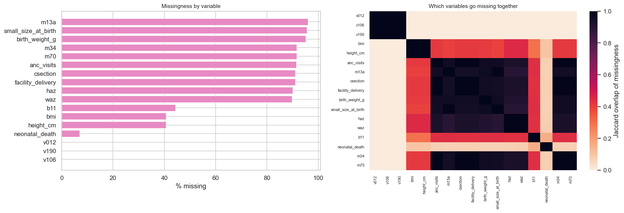
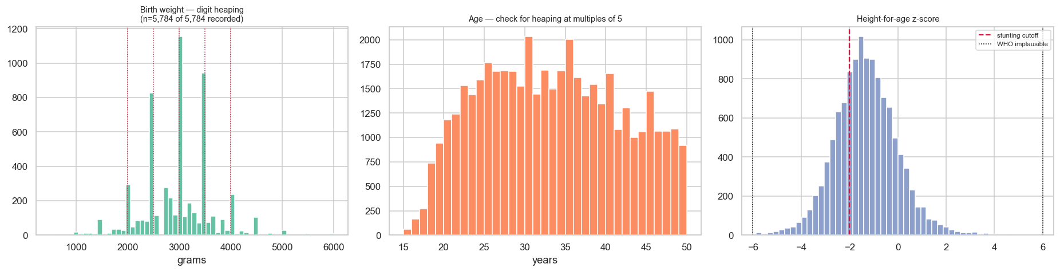
EDA AND DATA QUALITY
08
Missingness, heaping and correlation are part of the evidence
Structural missingness: DHS modules are asked only for eligible respondents.
Data quality: birth-weight digit heaping and plausible WHO z-score ranges were checked.
Feature structure: correlations and VIF checks identify redundancy before modelling.
The goal is not to erase the survey’s structure; it is to encode it without inventing information.
Farhan | 4:52
Source: notebook cells 86, 110-121
BDHS 2017-18 + 2022
Notes:
Farhan: The EDA also checked data quality. Missingness is not random because many DHS modules are structurally absent for ineligible respondents. We keep that distinction and use missing indicators where appropriate. We checked birth-weight digit heaping, age heaping, height-for-age cutoffs and implausible values. Finally, correlation matrices and VIF checks helped us see redundancy among features. These checks reduce the risk that the model learns a coding artifact or a duplicated measurement.
Source: notebook cells 86, 110 to 121.

Slide 9
MODEL CHOICES
09
Why we selected these model families
The panel spans interpretable baselines, bagging, boosting and modern deep tabular models.
Linear baseline
Bagged trees
Logistic regression
Random Forest
Readable coefficients; common DHS reference
Variance reduction for diffuse signal
Boosted trees
Deep tabular
XGBoost • LightGBM • CatBoost
RealMLP • TabM
Strong tabular learners; native missingness or ordered boosting
Published tuned defaults; independent inductive bias
TabPFN-3 was tested separately under the same grouped split and 10,000-row cap. It stayed within 0.007 PR-AUC of the incumbent on four of the five targets, so it did not change the conclusion.
Farhan | 5:21
Source: notebook cells 129, 141-166
BDHS 2017-18 + 2022
Notes:
Farhan: We chose models to span different strengths. Logistic regression gives an interpretable reference. Random Forest represents bagging. XGBoost, LightGBM and CatBoost represent the main tabular boosting families. RealMLP and TabM provide modern deep tabular baselines.
TabPFN-3, a transformer pretrained on synthetic tabular tasks, was measured separately with the same grouped split and a ten-thousand-row cap. It stayed within seven thousandths of the incumbent on four of the five targets. So a model family with a completely different inductive bias reproduces the same performance envelope, which suggests the information in the survey, rather than the architecture, sets the ceiling.
Source: notebook cells 129 and 141 to 166.

Slide 10
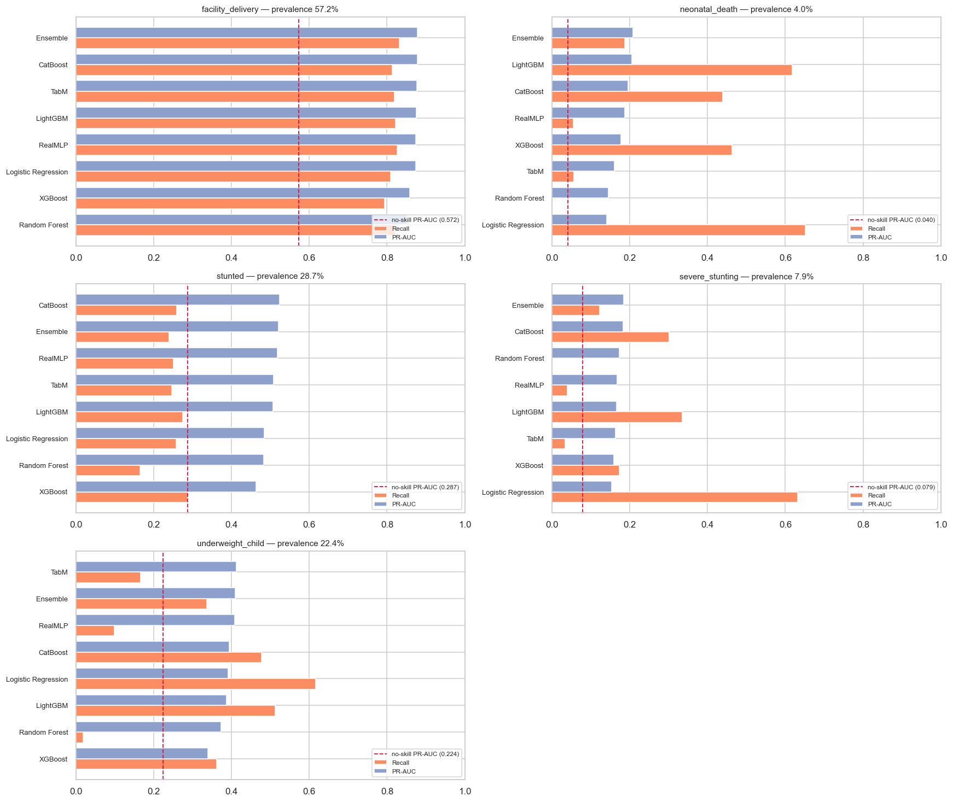
MODEL COMPARISON
10
The winning model depends on the outcome
The results are moderate and outcome-specific; there is no universal winner.
Outcome | Winner | ROC-AUC | PR-AUC
Facility delivery | Ensemble | 0.845 | 0.878
Neonatal death | Ensemble | 0.773 | 0.209
Stunted | CatBoost | 0.707 | 0.526
Severe stunting | Ensemble | 0.700 | 0.192
Underweight | TabM | 0.688 | 0.415
Read PR-AUC against prevalence for rare outcomes; ROC-AUC alone can look optimistic when negatives dominate.
Farhan | 6:02
Source: notebook cells 170-181
BDHS 2017-18 + 2022
Notes:
Farhan: The winning model depends on the outcome. Facility delivery reaches ROC-AUC 0.845 and PR-AUC 0.878. Neonatal death reaches ROC-AUC 0.773 but PR-AUC only 0.209, because the outcome is rare. CatBoost wins stunting at about 0.707, the ensemble wins severe stunting at 0.700, and TabM wins underweight at about 0.688.
We avoid a single leaderboard, because the gaps are small and the outcome prevalences are very different.
It is worth saying plainly what these numbers mean. Our stunting result sits almost exactly on the pooled envelope that the DHS meta-analysis reports. We are not claiming to beat the literature. We are showing what the literature actually supports, once leakage is removed and the split is grouped by mother.
Source: notebook cells 170 to 181. Values follow the notebook conclusion and outcome-specific results.

Slide 11
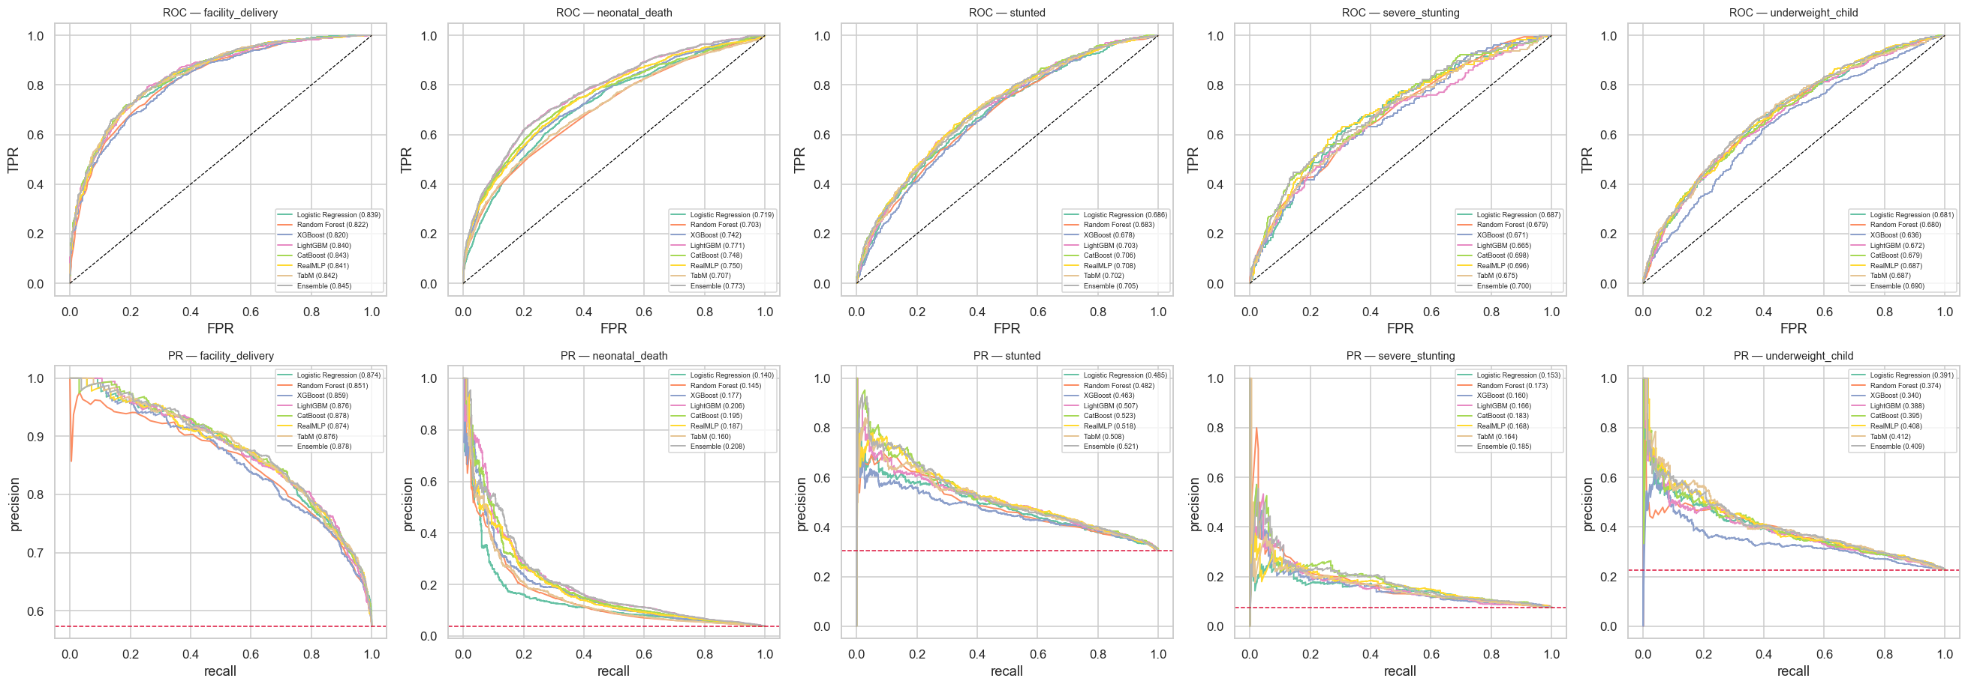
EVALUATION DESIGN
11
Curves explain the result; the ensemble tests diversity
Post-hoc ensemble
Greedy forward selection with replacement
Weights are selected on a nested validation split, not on the test set.
Every blend uses three to five different model families.
Gains are small: roughly +0.002 on three targets and slightly negative on two.
The benefit is stability across refits, not a dramatic accuracy jump.
ROC-AUC = ranking | PR-AUC = rare-event ranking above prevalence | Recall = missed cases | Precision = false-alarm burden | Brier/calibration = probability quality | Net benefit = usefulness at a threshold
Farhan | 6:51
Source: notebook cells 167-174, 182-184
BDHS 2017-18 + 2022
Notes:
Farhan: The two curve families answer different questions. ROC-AUC measures ranking, but it can look respectable for a rare outcome because there are so many true negatives. Precision-recall curves compare performance against the outcome prevalence, so they are more honest for neonatal death and severe stunting.
We also tried post-hoc ensembling. Models were blended by greedy forward selection on a nested validation split, never on the test set. The gains were small, about two thousandths on three targets, and slightly negative on two. We keep the ensemble because it improves stability across refits, not because it creates a new performance level.
I will now hand over to Sakib for the operating thresholds and the rest of the validation.
Source: notebook cells 167 to 174 and 182 to 184.

Slide 12
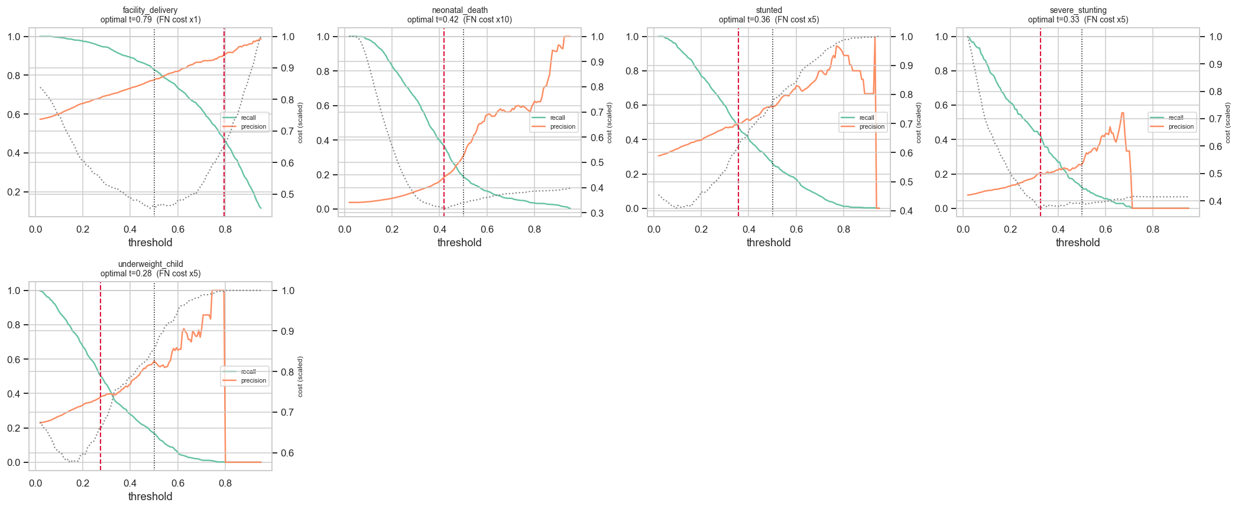
OPERATIONAL EVALUATION
12
Thresholds turn a probability ranking into a referral rule
Outcome | Cost | Cut-off | Flag rate
Facility delivery | 1x | 0.794 | 29.8%
Neonatal death | 10x | 0.419 | 7.6%
Stunted | 5x | 0.357 | 29.1%
Severe stunting | 5x | 0.326 | 15.4%
Underweight | 5x | 0.276 | 29.8%
Why the metric changes
Ranking: ROC-AUC / PR-AUC
Screening: recall + precision
Probability: Brier + calibration
The 0.5 cut-off is only a convention. The notebook chooses the cut-off by explicit false-negative cost and a maximum 30% flag-rate capacity.
Sakib | 7:40
Source: notebook cells 185-190
BDHS 2017-18 + 2022
Notes:
Sakib: The next step is to turn ranking into action. A probability of 0.5 is not automatically the correct cut-off. We define the cost of a missed case and the cost of a false alarm. Missing neonatal death is weighted ten times more heavily, while the other adverse outcomes use five times. Facility delivery uses a symmetric cost because a flag means counselling, not harm. We also cap the flag rate at thirty percent so the rule remains operational. This gives the thresholds shown here. For model reporting, we use ROC-AUC and PR-AUC for ranking, recall and precision for screening, and calibration measures for probability quality.
Source: notebook cells 185 to 190.

Slide 13
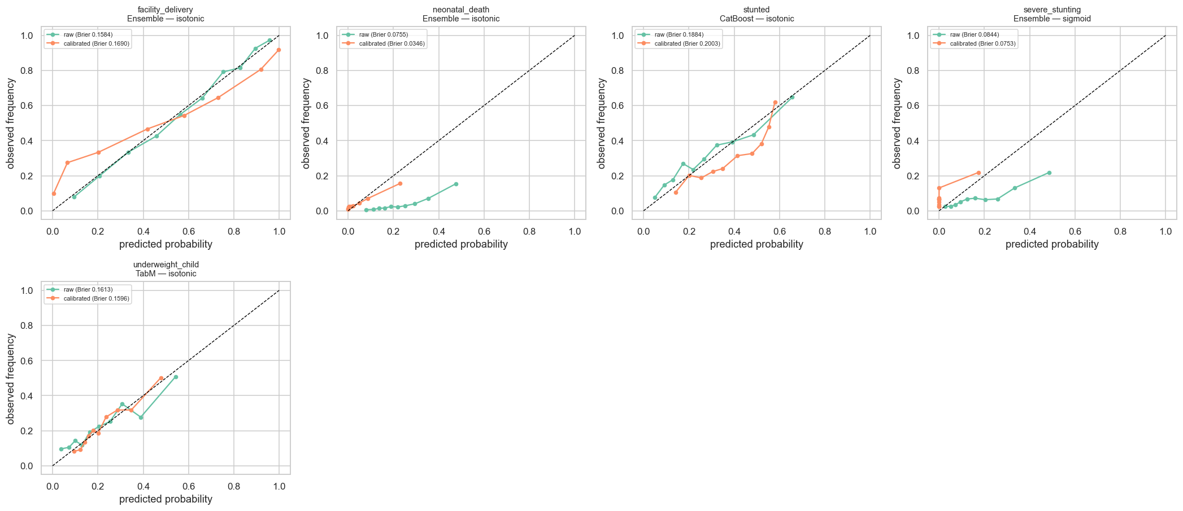
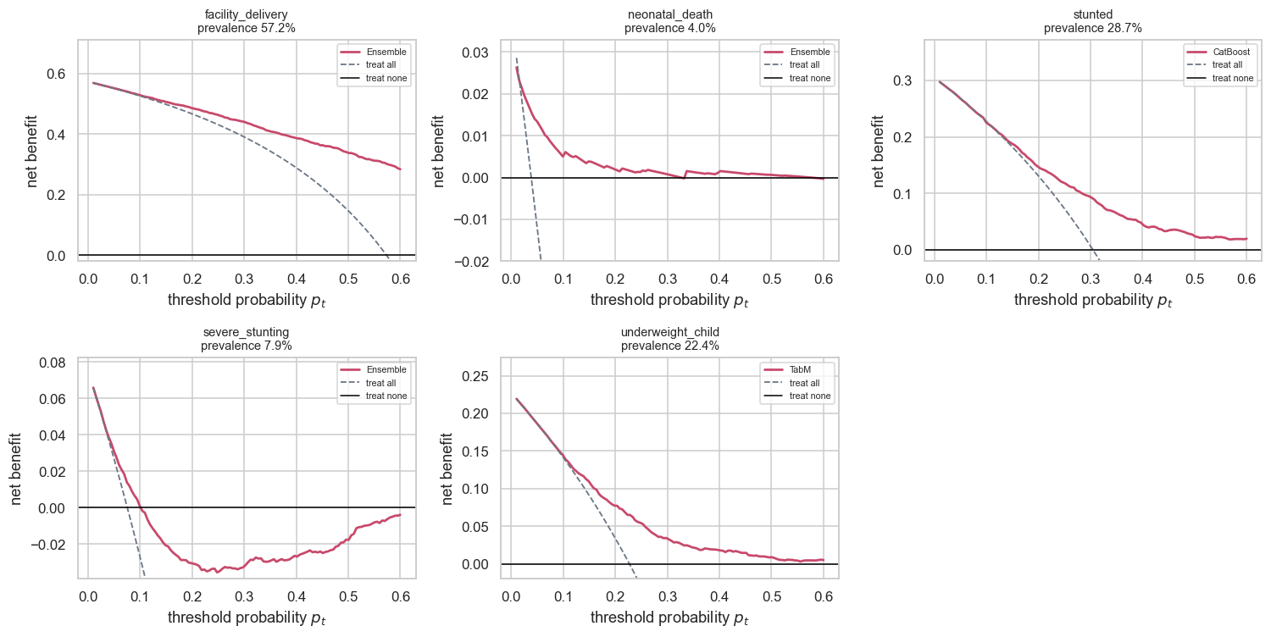
RELIABILITY
13
Calibration and decision curves ask whether the score is safe to use
Calibration guard
Decision-curve finding
Keep a calibrator only when it improves both Brier score and calibration-in-the-large. Three of five were refused; raw scores were used downstream.
Four outcomes beat treat-all and treat-none across useful ranges. Severe stunting had negative net benefit at its cost-optimal threshold, so it should not be a standalone screen.
Sakib | 8:24
Source: notebook cells 191-203
BDHS 2017-18 + 2022
Notes:
Sakib: Calibration checks whether a predicted probability behaves like a probability. We tried isotonic regression or Platt scaling depending on the number of positive cases, and we kept a calibrator only if both the Brier score and calibration-in-the-large improved. Three of five calibrators were rejected, so the raw scores remain downstream for those outcomes. Decision curves ask a different question: is the model better than treating everyone or treating no one at the thresholds that matter? Four outcomes showed useful ranges. Severe stunting had negative net benefit at its selected threshold, so it should not be used as a standalone screen.
Source: notebook cells 191 to 203.

Slide 14
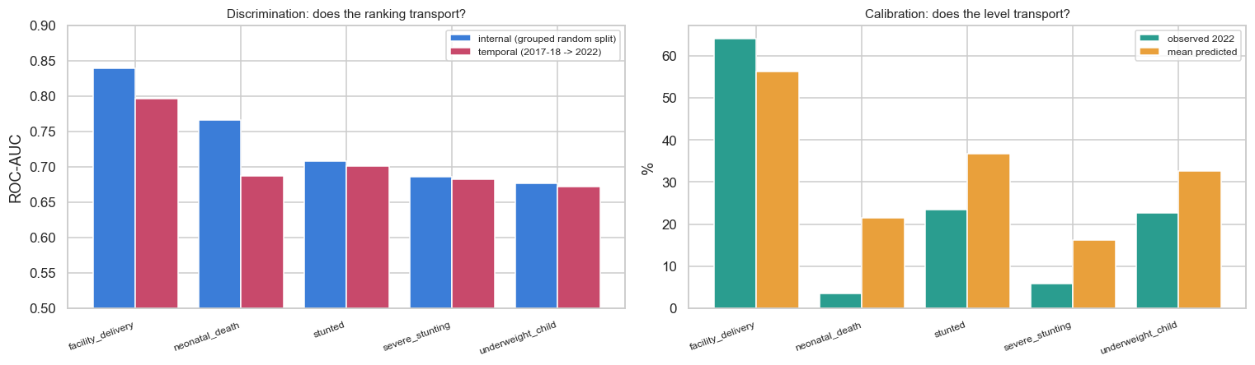
UNCERTAINTY AND TRANSPORT
14
Point estimates need error bars, and internal validation is not enough
Outcome | Test positives | ROC-AUC 95% CI | PR-AUC 95% CI
Facility delivery | 1,240 | 0.828-0.859 | 0.860-0.894
Neonatal death | 865 | 0.756-0.789 | 0.183-0.237
Stunted | 724 | 0.687-0.730 | 0.489-0.561
Severe stunting | 179 | 0.660-0.738 | 0.144-0.246
Underweight | 540 | 0.661-0.712 | 0.374-0.456
400 bootstrap resamples show wider intervals for rare outcomes. Training on 2017-18 and testing on 2022 kept nutrition ranking relatively stable, but calibration drifted: neonatal predicted-to-observed ratio was 5.90x.
Sakib | 9:06
Source: notebook cells 204-209
BDHS 2017-18 + 2022
Notes:
Sakib: We used four hundred bootstrap resamples to show uncertainty around the headline numbers. Severe stunting has only 179 test positives, so its interval is much wider than the interval for facility delivery. This makes small leaderboard differences difficult to interpret. We also performed temporal validation by training on BDHS 2017–18 and testing on BDHS 2022. The nutrition rankings lost only a few thousandths of AUC, but the absolute probabilities drifted. For neonatal death, the predicted-to-observed ratio was 5.90. So transport may be reasonable for ranking, but recalibration is required before using probabilities or thresholds in a new round.
Source: notebook cells 204 to 209.

Slide 15
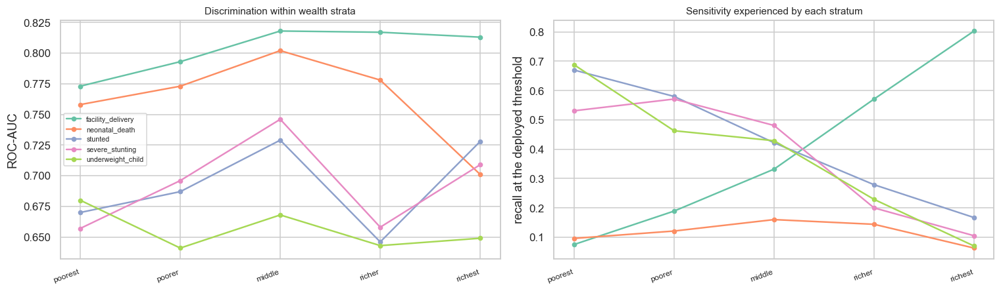
SUBGROUP PERFORMANCE AND EQUITY
15
A global threshold does not affect every group equally
The important distinction
Discrimination
Within-group ROC-AUC was comparatively stable.
Sensitivity
At one global cut-off, recall could range from 0.685 to 0.121 for stunting across the poorest to richest group.
Report subgroup recall, consider stratified thresholds, and state whether prioritising poorer households is an intended policy.
Sakib | 9:47
Source: notebook cells 210-212
BDHS 2017-18 + 2022
Notes:
Sakib: The equity analysis separates two ideas. The model can rank people within each wealth group with fairly stable discrimination. But recall at one global threshold can be very different. For stunting, the recall ranges from 0.685 in the poorest group to 0.121 in the richest. For facility delivery the direction reverses, because a high facility-delivery probability is a favourable sign. These gaps are created by the outcome gradient and the global cut-off. A responsible deployment should report subgroup recall, consider stratified thresholds, and clearly state the policy goal.
Source: notebook cells 210 to 212.

Slide 16
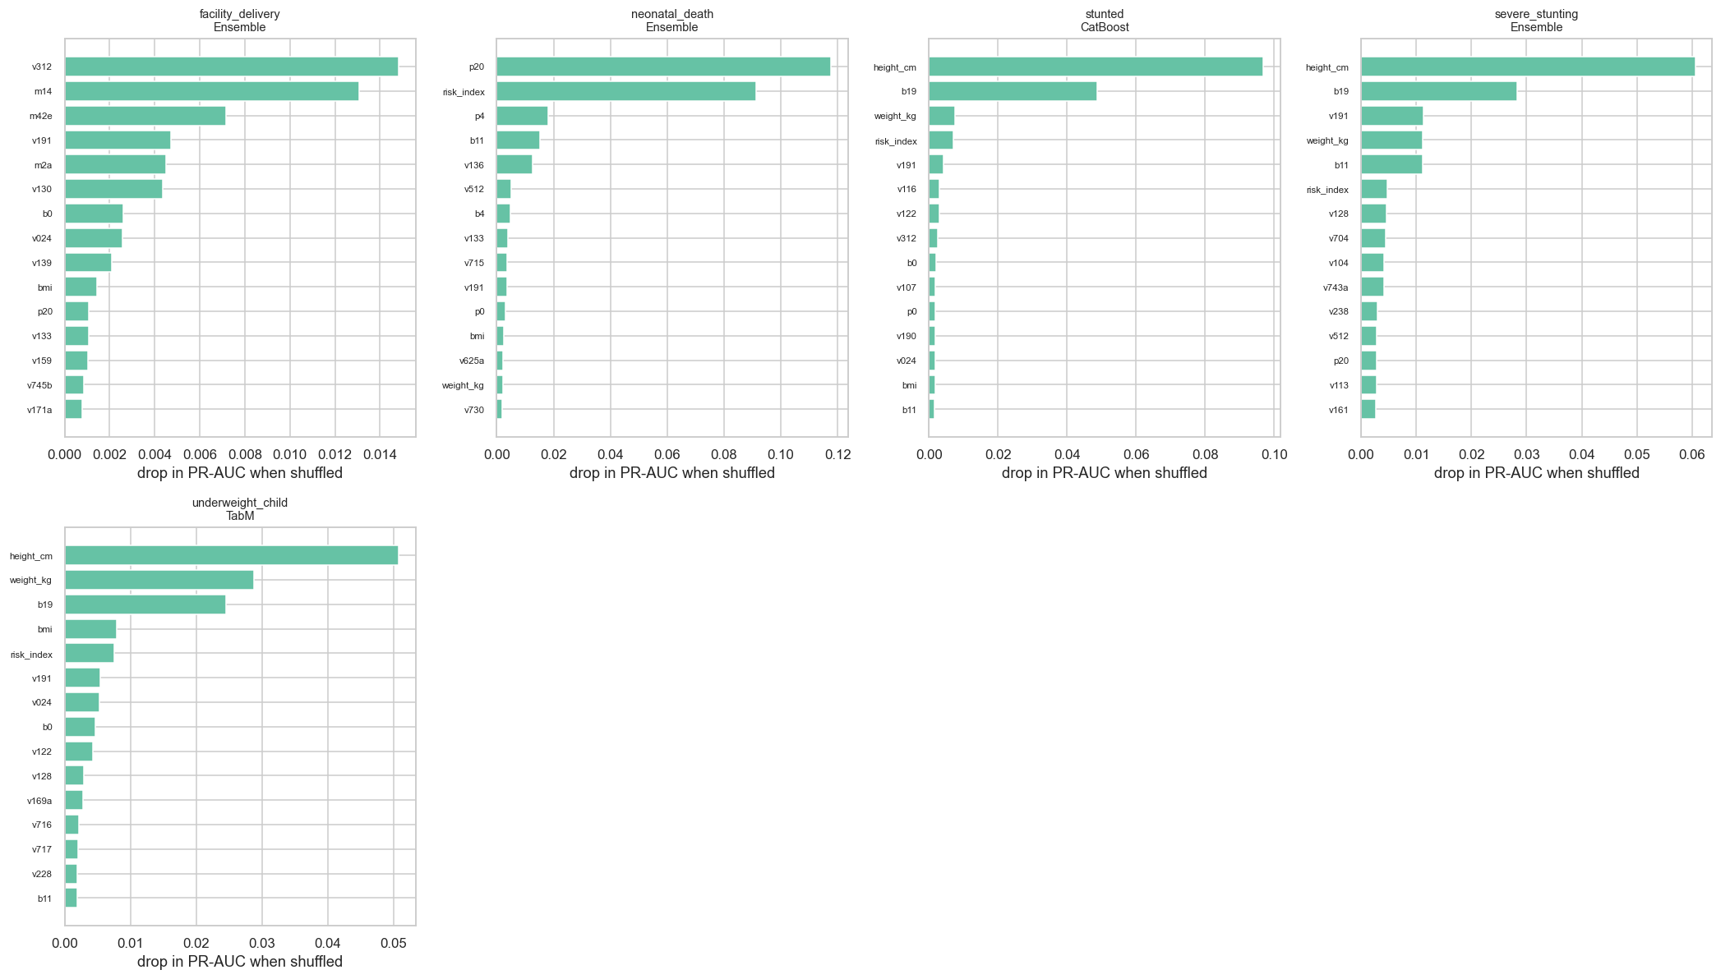
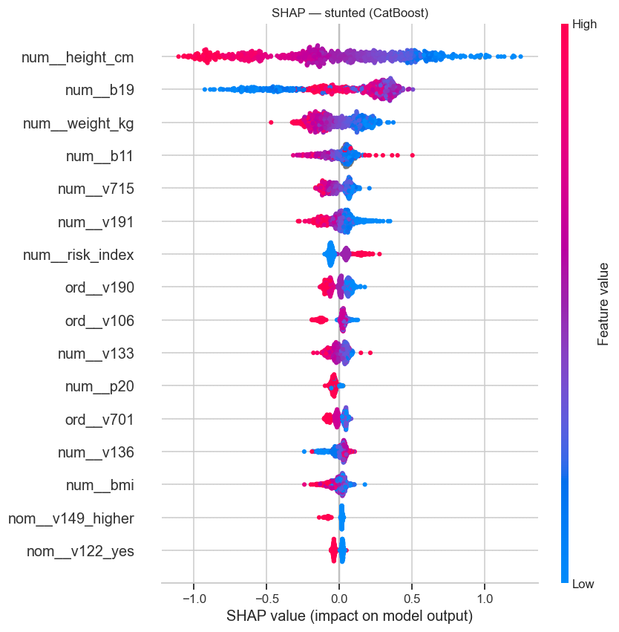
EXPLAINABILITY
16
Permutation importance shows reliance; SHAP shows direction
Permutation importance is measured on held-out data, so it reflects what generalises rather than what was memorised.
SHAP dots show whether a high or low feature value pushes a record toward higher predicted risk.
For the neonatal outcome, the fertility-accounting family was checked explicitly and should not return near the top.
Examples from the notebook: height and weight features dominate nutrition outcomes; social and maternity variables matter for facility delivery.
Sakib | 10:24
Source: notebook cells 213-218
BDHS 2017-18 + 2022
Notes:
Sakib: We used two explainability views. Permutation importance shuffles a raw feature on the held-out set and measures how much PR-AUC falls. This tells us what the model relies on to generalise. SHAP adds direction: a point to the right pushes predicted risk up, and a point to the left pushes it down. Height and weight features are prominent for nutrition outcomes, while social and maternity variables matter for facility delivery. We also use the leakage audit as a safety check: blocked fertility-accounting variables should not reappear as top neonatal predictors.
Source: notebook cells 213 to 218.

Slide 17
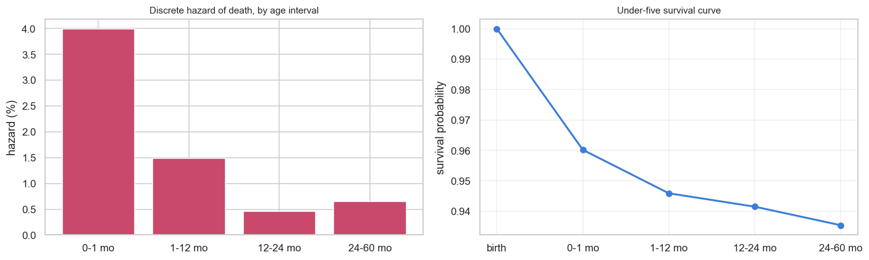
ADDITIONAL LEARNING VIEWS
17
The notebook also models time and shared child outcomes
Time-to-event view
A person-period model expands 104,025 births to 388,016 interval rows and handles right censoring correctly.
Hazard is front-loaded:
3.99% in month 0-1
1.49% in months 1-12
0.46% in months 12-24
Multi-task learning shared a trunk across stunting, severe stunting and underweight. Pairwise outcome association was moderate, but the shared model improved only about 0.010 over its ablation and remained below the best single-task model.
Sakib | 11:01
Source: notebook cells 219-224
BDHS 2017-18 + 2022
Notes:
Sakib: We also tested two broader learning views. The survival model expands births into time intervals and handles censoring, so a child observed alive at thirty months is not incorrectly treated as a five-year survivor. The hazard is highest in the first month, then falls. We also trained a multi-task model for stunting, severe stunting and underweight. The shared model gained about 0.010 over its no-sharing ablation, but it was still below the best single-task model. This tells us that shared biology exists, but a shared representation does not automatically outperform specialised models.
Source: notebook cells 219 to 224.

Slide 18
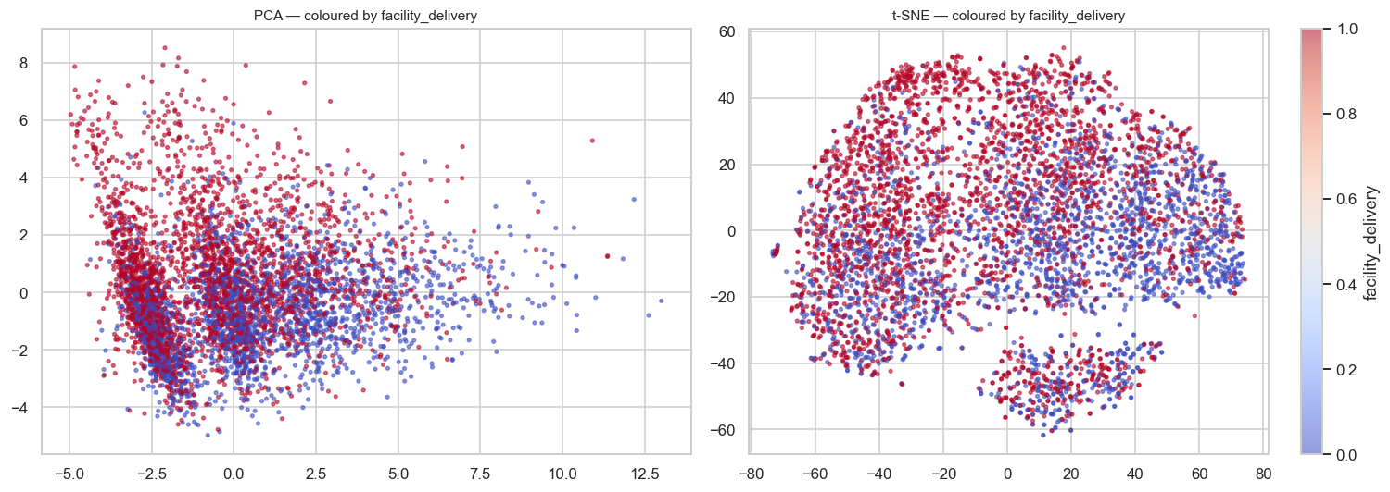
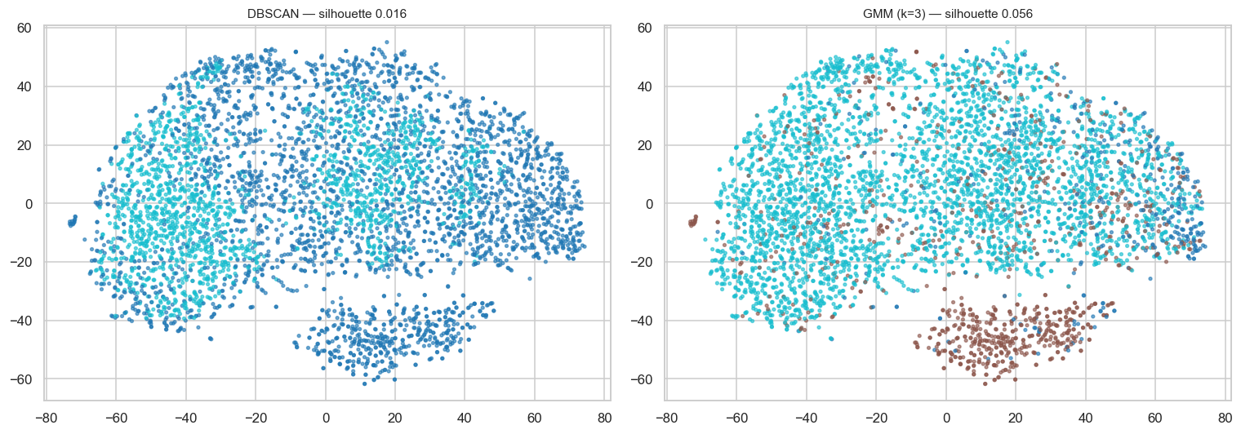
UNSUPERVISED LEARNING
18
The population is a diffuse cloud, not a set of natural risk classes
PCA
36.6% of variance in two components
DBSCAN
84.3% of points marked noise; only 2 clusters
KMeans
k=2 wins with silhouette 0.183, a weak split
Anomaly detectors
5% flagged across several algorithms
KMeans recovered a socioeconomic axis, but the soft boundary is not a clinical class. Unsupervised outputs are cross-checks and anomaly flags, not replacement targets.
Sakib | 11:40
Source: notebook cells 225-241
BDHS 2017-18 + 2022
Notes:
Sakib: The unsupervised section asks whether the labels are hiding natural groups. We use five thousand rows and thirty-two numeric features without outcome labels. PCA explains only 36.6 percent of the variance in two components. DBSCAN marks 84.3 percent as noise, and KMeans selects k equals two with a weak silhouette of 0.183. The clusters mainly recover a socioeconomic axis: one group is younger, better educated and wealthier. This confirms the EDA gradient, but the boundary is soft. We therefore use unsupervised methods for pattern discovery and anomaly flags, not as a replacement for supervised targets.
Source: notebook cells 225 to 241.

Slide 19
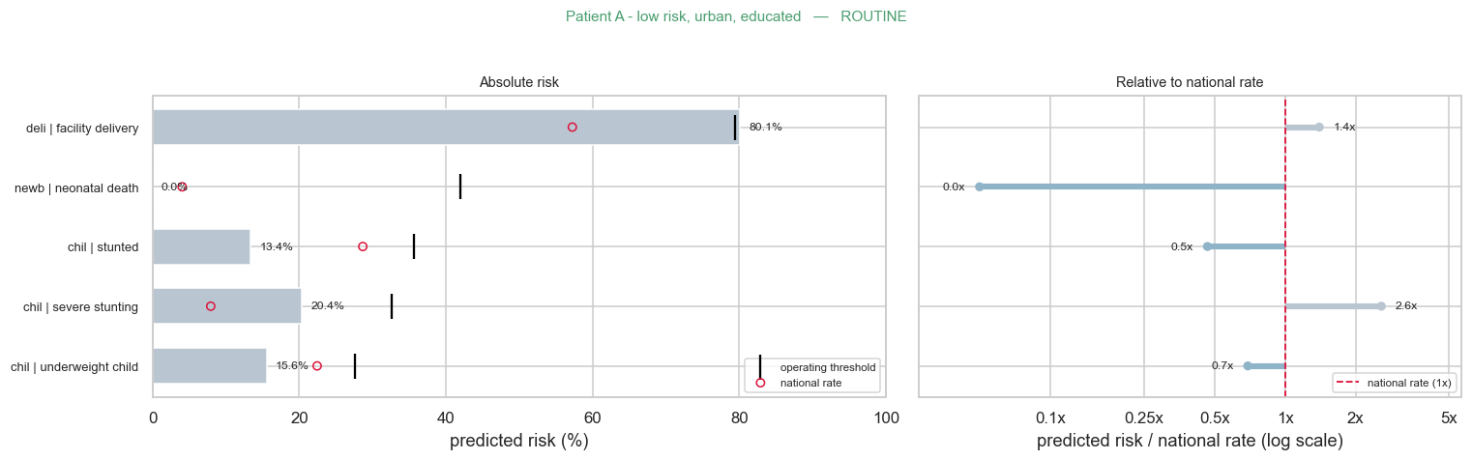
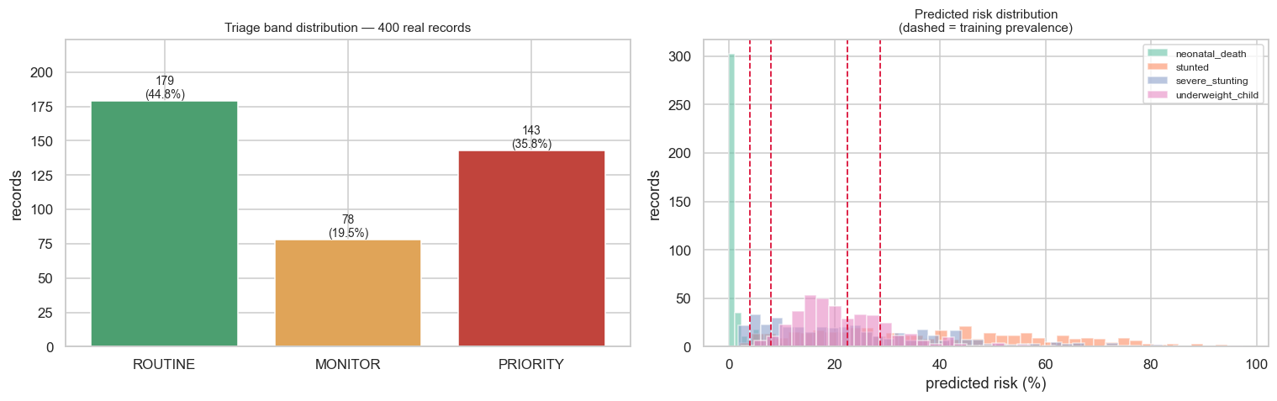
RISK CASCADE
19
Five predictions become one phased assessment
CLINICAL PHASES
DELIVERY
NEWBORN
CHILD 0-59 MONTHS
facility delivery
neonatal death
stunted • severe stunting • underweight
calibrated probabilities + cost-optimal thresholds
+ composite risk index + anomaly check
triage band + drivers
Sakib | 12:19
Source: notebook cells 242-248, 253-284
BDHS 2017-18 + 2022
Notes:
Sakib: The final architecture combines the models in clinical phase order. Delivery uses facility delivery, the newborn phase uses neonatal death, and the child phase uses the three nutrition outcomes. The cascade uses calibrated probabilities where calibration passed its guard, cost-optimal thresholds, a composite risk index and an anomaly check. Facility delivery is not treated as an adverse escalation signal because a high probability is favourable. We tested the assessment panel on synthetic profiles created within the observed feature range, and we also ran a sanity check on real records. The output is a triage band and the factors that drove it, not an automated diagnosis.
Source: notebook cells 242 to 248 and 253 to 284.

Slide 20
20
CONCLUSION
What the full project shows
1
The denominator is a result.
Four shortened cohorts made each target, feature set and evaluation universe defensible.
2
The ceiling is informational.
Seven model families converged on moderate performance; architecture did not erase weak signal.
3
Reliability changes deployment.
Thresholds, calibration, bootstrap intervals, temporal drift and decision curves matter as much as AUC.
4
Equity is operational.
A single global threshold can create large subgroup recall gaps, so reporting must be stratified.
5
The cascade is a cautious interface.
It exposes uncertainty, anomaly flags and drivers for human review rather than pretending to diagnose.
Thank you
Questions?
Farhan + Sakib
Notes:
Sakib: To conclude, this project shows that a trustworthy health-prediction study needs more than a model. The denominator must be correct, leakage must be removed, and the survey design must be respected.
The models provide moderate risk ranking, but uncertainty and temporal drift limit how the probabilities should be used, and subgroup threshold gaps make equity reporting essential. Our cascade therefore acts as a cautious triage interface. It reports calibrated or raw risk according to the validation guard, checks anomalies, and shows the drivers for human review.
Farhan: And briefly, what we would do next. The clearest gaps are recalibration on a current survey round, facility-level supply variables the survey does not capture, and a prospective test of whether risk-ranked triage actually changes outcomes.
Thank you for listening. We are happy to take your questions.
Source: notebook cells 248, 251, 253 and 284; Conference_paper.tex.

