Slide 1
CSE 299 • SECTION 3 • GROUP 1 • FACULTY: DR. M. SHIFAT-E-RABBI (MSRB)
AI-Powered E-Commerce Platform
with Intelligent Business Insights
Project Update 4 Presentation
UPDATE FOCUS
Latest Frontend + Backend Review
Customer AI Chatbot Integration
Admin AI Chatbot Integration
Branch Update & Demonstration Readiness
Group 1 • Nuhash Bin Hassan • Abu Md. Ashraful Rahat • Md. Shakib Rafid Shakib • Muhammad Farhan Rafid
1

Slide 2




PROJECT UPDATE 7 • CSE 299
Update Objective & Scope
Frontend Review First
Backend Review Second
Shakib's latest React frontend was checked against the previous frontend archive to verify API usage, authentication flow and page updates.
Rahat's latest Django backend was compared with the previous backend to identify added files, changed settings and missing chatbot endpoints.
Dual Chatbot Integration
Demo-Ready Setup
A separate DRF chatbot app was added for customer and admin AI assistants using the same local Ollama model.
Customer chat, admin chat, JWT login and one-click startup were tested together for the update demonstration.
Group 1 • Nuhash Bin Hassan • Abu Md. Ashraful Rahat • Md. Shakib Rafid Shakib • Muhammad Farhan Rafid
2

Slide 3



SHAKIB UPDATE • FRONTEND
React Frontend Became API-Driven
Core Progress
JWT login and logout handled in React
The latest frontend moved away from temporary local cart and order state. Multiple pages now communicate with backend REST APIs for products, categories, cart, checkout and order data.
The frontend also kept the customer chatbot request path required by our AI integration, so the missing part was the backend endpoint.
Products, categories and cart call backend APIs
Checkout and orders request backend data
Customer chat still calls /api/ai/chat/
Group 1 • Nuhash Bin Hassan • Abu Md. Ashraful Rahat • Md. Shakib Rafid Shakib • Muhammad Farhan Rafid
3

Slide 4

SHAKIB UPDATE • FRONTEND DETAILS
Pages Updated in the Latest Frontend
Shopping Interface
User & Support Flow
▸ Products page loads backend product data
▸ Login stores access and refresh tokens
▸ Category pages request backend category data
▸ Navbar shows logout based on token state
▸ Cart page loads and removes backend cart items
▸ Register submits account data to backend
▸ Checkout sends order creation request
▸ Chat page design improved with Tailwind UI
▸ Order pages load order history and details
▸ NotFound page redesigned with clear CTA
Group 1 • Nuhash Bin Hassan • Abu Md. Ashraful Rahat • Md. Shakib Rafid Shakib • Muhammad Farhan Rafid
4

Slide 5
RAHAT UPDATE • BACKEND REVIEW
Latest Django Backend Baseline
What Was Already Present
What Was Missing
Rahat’s backend already used Django REST Framework viewsets for normal database CRUD areas: users, store, cart, orders, chat records and core settings.
The latest backend did not include the working Ollama chatbot endpoint required by Shakib’s frontend.
Main Useful Changes:
Backend Finding:
Username field migration updated maximum length from 120 to 150 characters. STATIC_ROOT was added for collected static files. Sample monitor category and Dell product existed in SQLite.
• DRF CRUD views were already present
• /api/ai/chat/ was not present
• No admin chatbot existed yet
Group 1 • Nuhash Bin Hassan • Abu Md. Ashraful Rahat • Md. Shakib Rafid Shakib • Muhammad Farhan Rafid
5

Slide 6


RAHAT UPDATE • FILE CHANGES
Added, Modified and Removed Files
Rahat’s latest backend was almost the same as the previous backend archive, but these changes were recorded before integration:
Added Files
New username migration plus local PyCharm project files were added.
Modified Files
backend/settings.py added STATIC_ROOT; accounts/views.py received comments; db.sqlite3 received sample product data.
Removed Files
No application source file was removed from Rahat’s latest backend.
Important Gap
The backend still needed a real AI endpoint to answer the frontend chatbot request.
Baseline Decision
Rahat’s latest backend was kept as the base, then extended without overwriting his existing chat app.
Group 1 • Nuhash Bin Hassan • Abu Md. Ashraful Rahat • Md. Shakib Rafid Shakib • Muhammad Farhan Rafid
6

Slide 7

FARHAN UPDATE • CUSTOMER AI
Customer Shopping Assistant Added
New DRF Endpoint
Product-Aware Replies
POST /api/ai/chat/ receives customer messages from React, validates input and returns an AI reply using Django REST Framework Response.
Before answering, Django reads active products from SQLite and sends product name, category, price, stock and description to the model.
Safe Customer Scope
Frontend Improvement
The customer chatbot can answer product and shopping questions, but it cannot access customer accounts, payments or private order data.
Chat.jsx now shows loading state, disables repeated sends, handles failed responses and displays multi-line AI replies cleanly.
Group 1 • Nuhash Bin Hassan • Abu Md. Ashraful Rahat • Md. Shakib Rafid Shakib • Muhammad Farhan Rafid
7

Slide 8

FARHAN UPDATE • ADMIN AI
Protected Admin Business Assistant Added
Admin Endpoint
Access Control
POST /api/ai/admin-chat/ was added inside the same chatbot app, using the same phi3:mini model with a different admin instruction prompt.
The endpoint requires a valid JWT token and Django staff/superuser permission. Normal customer accounts are denied access.
Database Insight
Frontend Page
The admin bot receives a read-only snapshot of products, categories, stock, users, orders, order status counts, latest orders and top sellers.
AdminChat.jsx and /admin-chat route were added with quick question buttons and clear login or access-denied messages.
Group 1 • Nuhash Bin Hassan • Abu Md. Ashraful Rahat • Md. Shakib Rafid Shakib • Muhammad Farhan Rafid
8

Slide 9
FINAL INTEGRATION • TESTING
Working System Flow & Demo Status
The final update connects Shakib’s React frontend, Rahat’s Django backend and local Ollama model through two separate DRF chatbot endpoints. Both chatbots were tested from the browser and backend API level.
1. Customer chatbot works from /chat with live product data
2. Admin chatbot works from /admin-chat after admin login
3. Non-admin access to admin chatbot is blocked
4. Start-BestCommerce.bat launches backend and frontend together
5. FarhanRafid branch updated with latest frontend, backend and documentation
Group 1 • Nuhash Bin Hassan • Abu Md. Ashraful Rahat • Md. Shakib Rafid Shakib • Muhammad Farhan Rafid
9

Slide 10
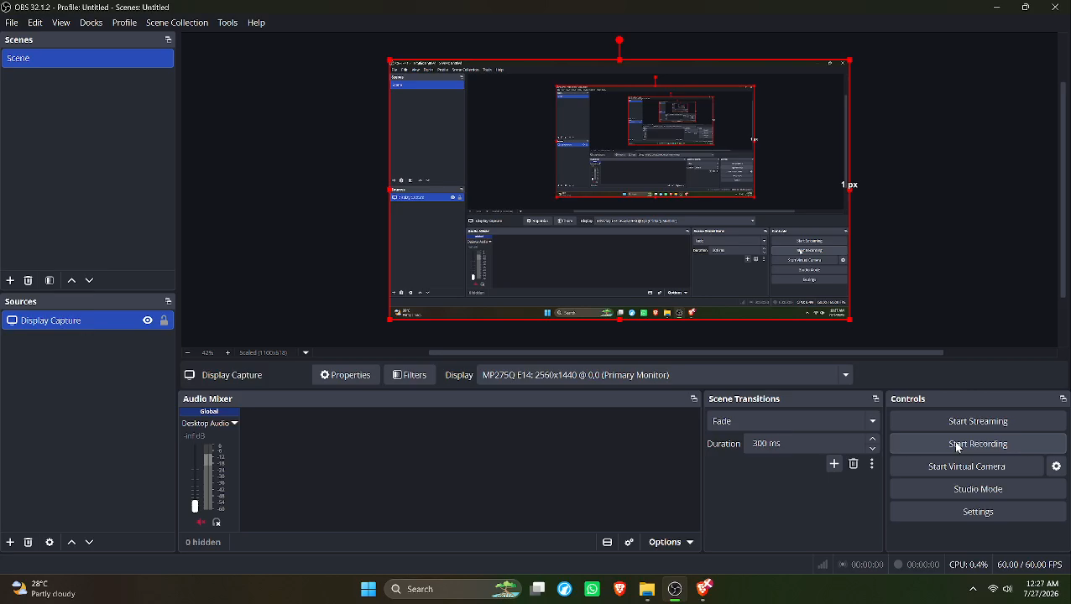
Group 1 • CSE 299 • North South University
Group 1 • Nuhash Bin Hassan • Abu Md. Ashraful Rahat • Md. Shakib Rafid Shakib • Muhammad Farhan Rafid
10

Slide 11
Thank You
Ready to demonstrate the customer AI chatbot and protected admin AI chatbot using the latest integrated frontend and backend.
Group 1 • CSE 299 • North South University
Group 1 • Nuhash Bin Hassan • Abu Md. Ashraful Rahat • Md. Shakib Rafid Shakib • Muhammad Farhan Rafid
10

