Slide 1
CSE299 – Junior Project Design
AI-Powered
E-Commerce Platform
Project Update Presentation
Section 3 | Group 1
July 2026 | Group 1 - CSE299

Slide 2
Project Information
AI-Powered E-Commerce Platform with Intelligent Business Insights
Group Members
2111540642
Nuhash Bin Hassan
2232755642
Abu Md. Ashraful Rahat
2311086642
Md. Shakib Rafid Shakib
2321534042
Muhammad Farhan Rafid
Faculty: Dr. M. Shifat-E-Rabbi (MSRB)

Slide 3
Frontend Update (Shakib)
Work Completed
React + Vite based frontend
Responsive customer interface
Separate pages for shopping, checkout and chatbot
Clean navigation using React Router
Communicates with Django backend via APIs
Key Features
Designed the React-based frontend architecture.
Improved overall UI responsiveness and page navigation.
Built customer interfaces including Home, Products, Cart, Checkout and Chat pages.
Developed reusable UI components such as the navigation bar.
Implemented multiple pages using React Router.
Frontend: React + Vite | Designed for seamless Django API integration.

Slide 4
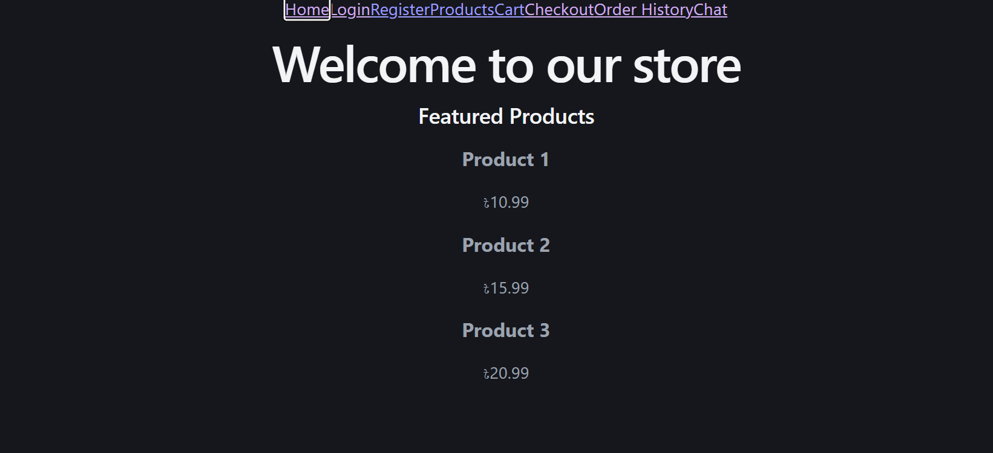
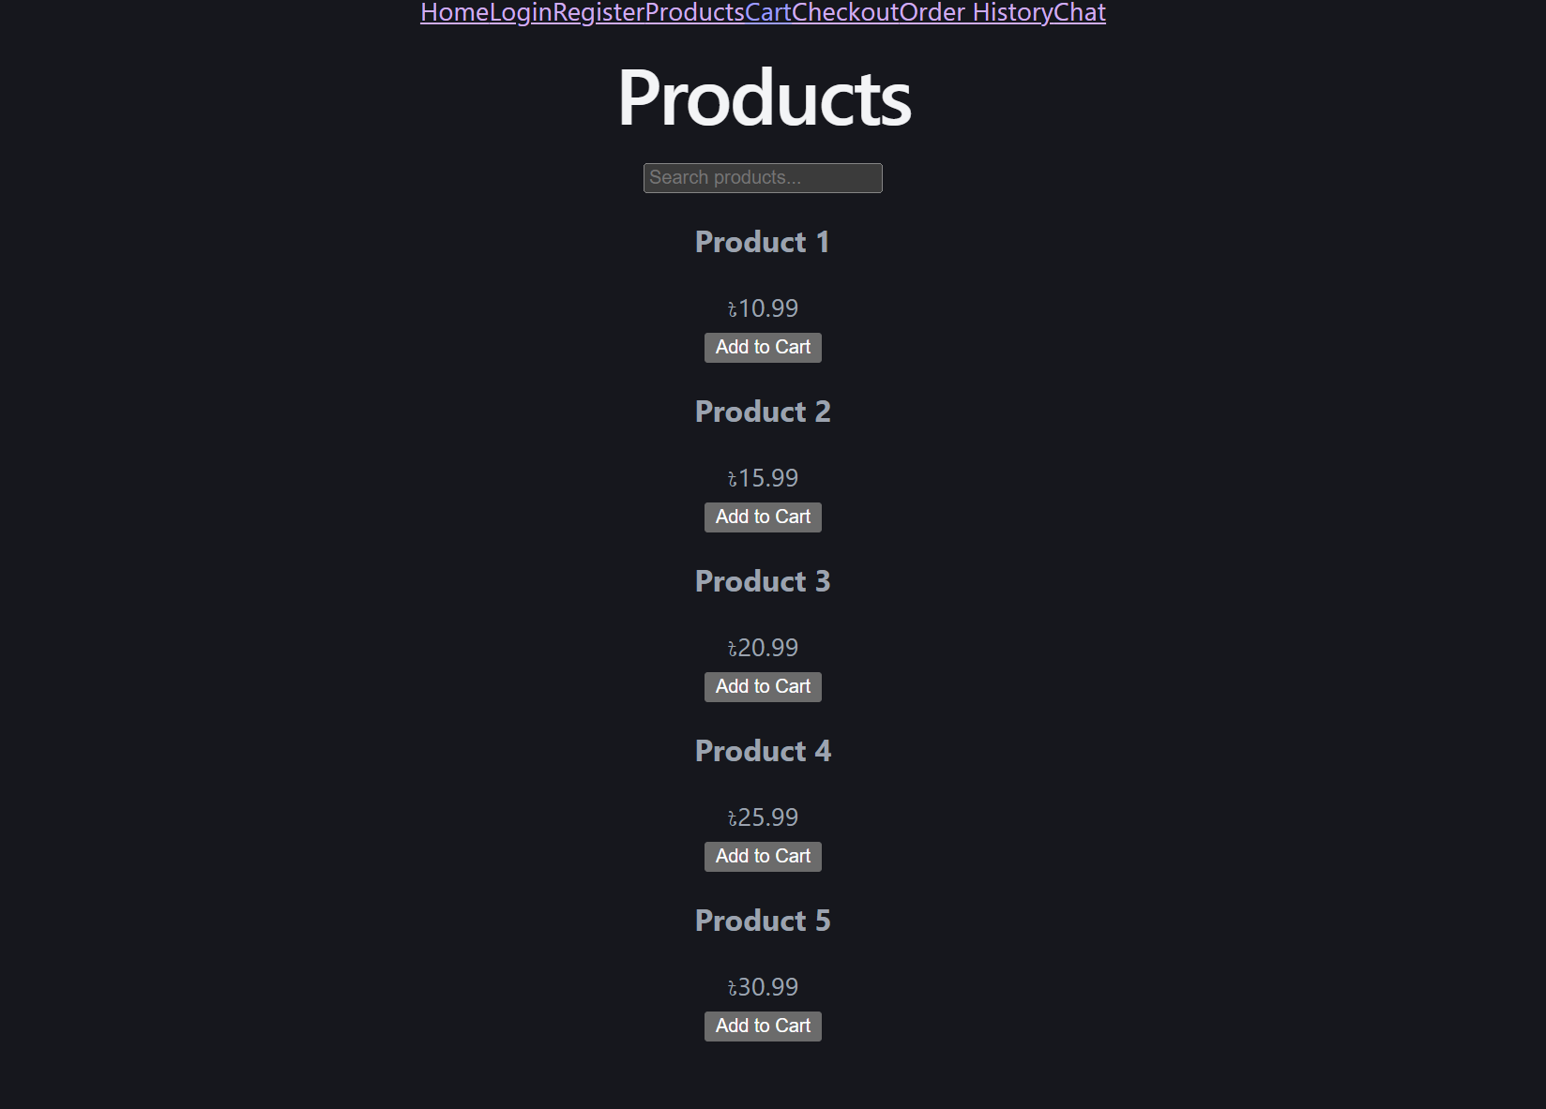
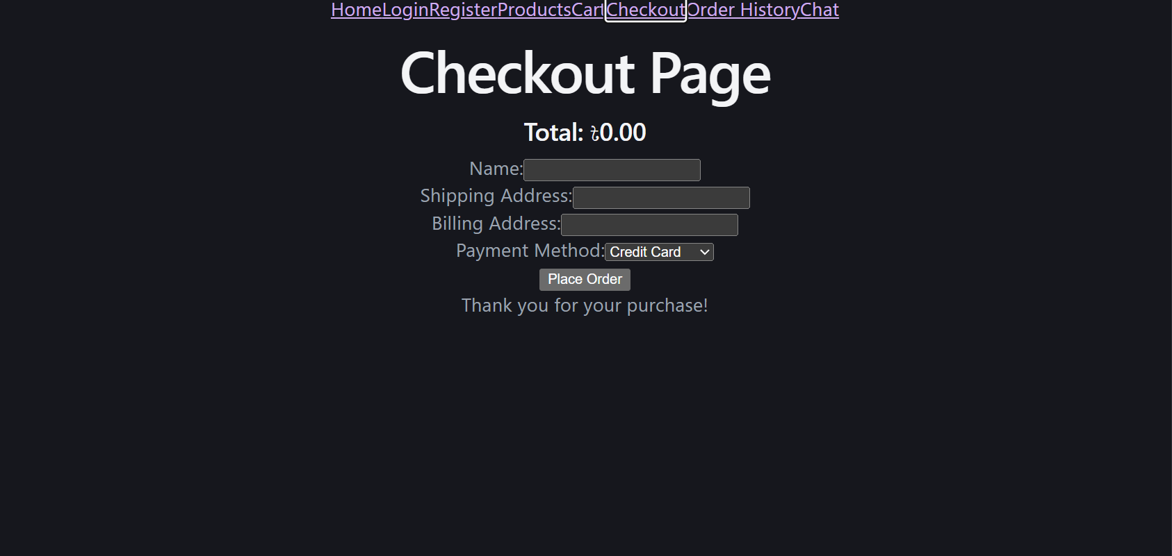
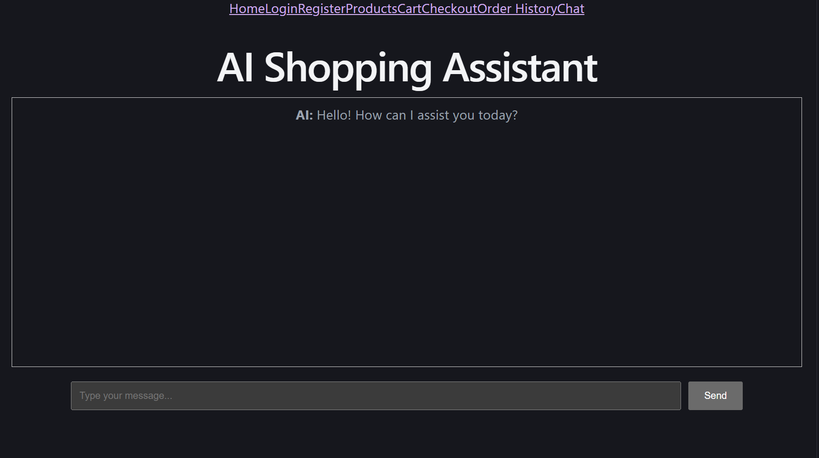
Frontend Demonstration
Demonstration Highlights
React + Vite based frontend.
Responsive customer interface
Separate pages for shopping, checkout and chatbot.
Clean navigation using React Router.
Designed to communicate with the Django backend through API requests.
Insert screenshot or demo image of the customer interfaces.

Slide 5
Backend Update (Rahat)
Work Completed
• Developed the Django backend project structure.
• Configured database models and migrations.
Backend Highlights
• Django application server
• REST APIs for frontend communication
• PostgreSQL / SQLite database
• Business logic & authentication
• Ready for AI chatbot integration
• Implemented REST API endpoints.
• Developed authentication functionality.
• Implemented product management APIs.
• Developed cart management logic.
• Implemented order processing functionality.
• Connected backend services with the database.
• Tested backend APIs using development tools.
• Prepared backend for AI chatbot integration.
Django REST Framework | Tested with Postman / Insomnia

Slide 6
Backend Architecture
Django serves as the primary application server.
REST APIs handle communication between frontend and backend.
Database stores users, products, carts and orders.
Business logic processed on backend.
API endpoints for AI chatbot.
Core Components
Django Backend Architecture
Frontend (React) ↔ REST APIs ↔ Django Server ↔ Database
Product, Cart, Order Models
Authentication & Business Logic
AI Chatbot Endpoints
Built with Django REST Framework for scalable e-commerce operations.

Slide 7
AI Chatbot Integration
Work Completed
• Integrated the AI chatbot with the Django backend.
• Connected the React frontend to the local Ollama LLM.
• Implemented end-to-end prompt and response flow.
• Configured API-based Large Language Model (OpenRouter) for chatbot responses.
• Successfully verified chatbot communication between frontend, backend and AI model.
Ollama + OpenRouter integration for intelligent business insights.

Slide 8
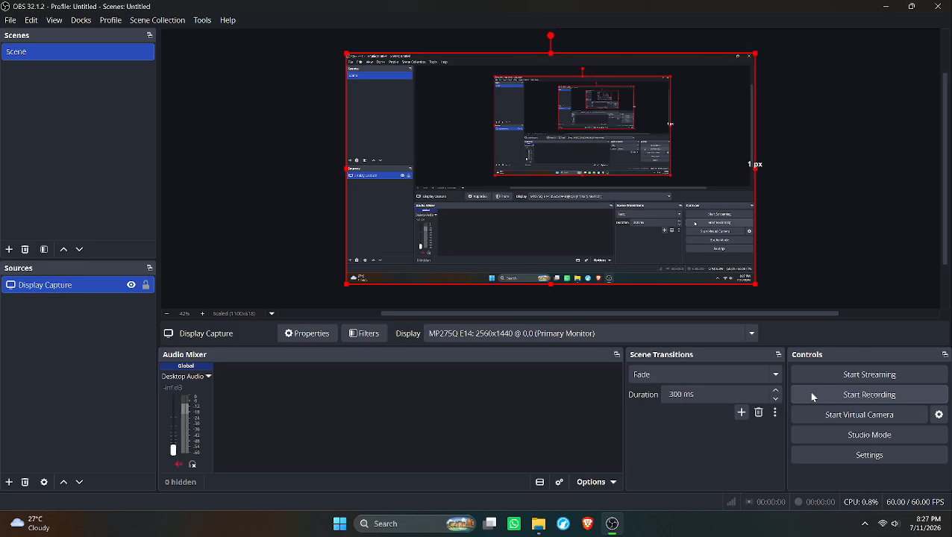
AI Chatbot Demonstration
1 minute OBS
Screen
Recording
Demonstrates end-to-end integration:Django + React + LLM.
Live Demo: Starting servers, chatbot interaction, AI responses

Slide 9
Questions?
CSE299 – Junior Project Design
Group 1

Slide 10
Thank You!

