Slide 1
Project:
Cinema Booking System
CSE311, Section-8, Fall-2025
SL-26: Muhammad Farhan Rafid, ID-2321534042
https://github.com/FarhanRafid382/CinemaBookingSystemFinal

Slide 2
Project Overview
Cinema Booking System manages movie scheduling and seat reservations through a structured database.
It ensures consistent data, clear relationships, and efficient queries for real-time booking operations.
Stores movies, halls, shows, users, and bookings in normalized tables
Tracks showtimes with linked hall and movie data
Maps seats per hall and identifies available seats per show
Supports real-time ticket booking and conflict prevention
Provides admin functions for adding movies, creating showtimes, and managing halls
Allows users to view movies, browse shows, and reserve seats
Ensures data integrity through foreign keys and normalization
Enables analytics such as bookings per show or per movie

Slide 3
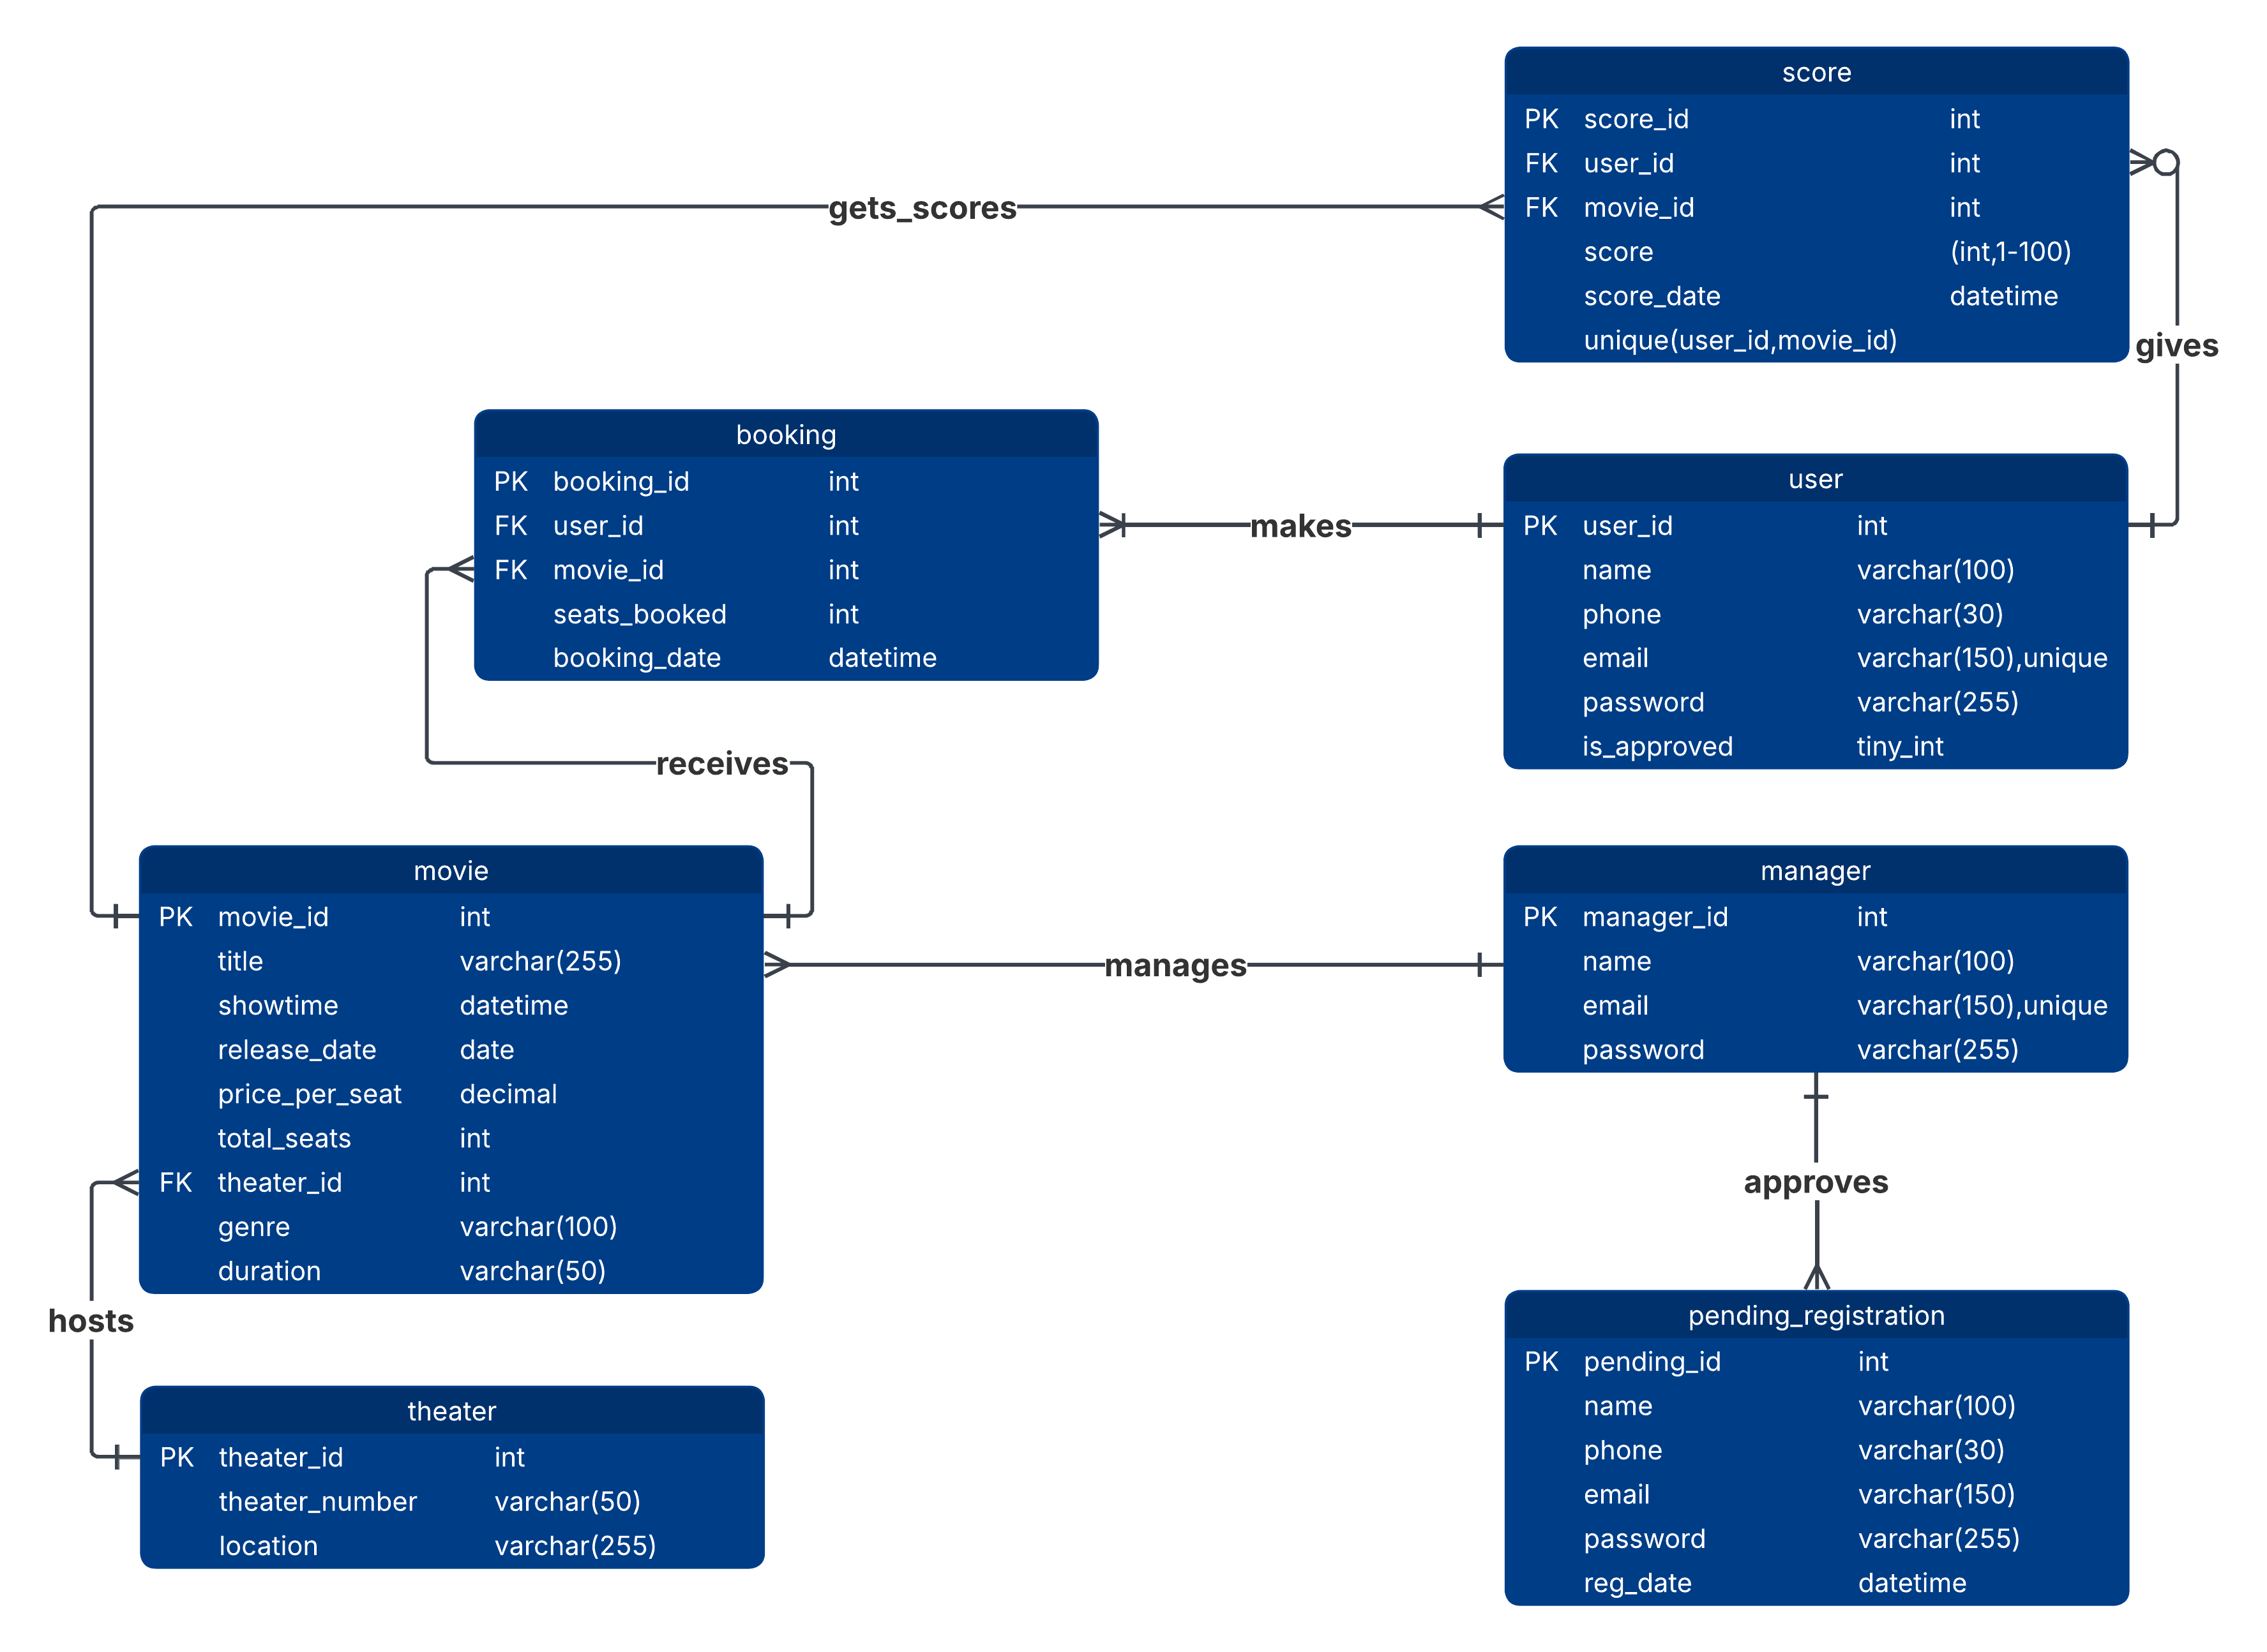
Entity-Relationship Diagram

Slide 4
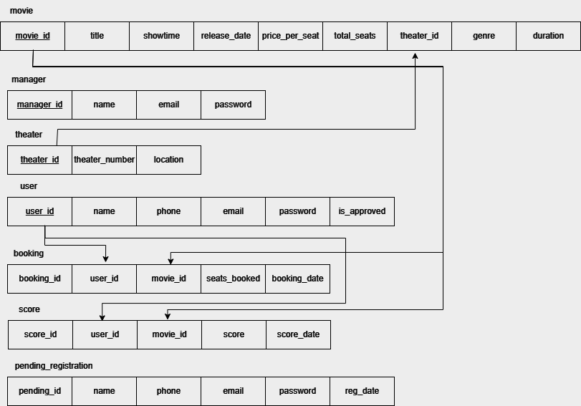
Relational Schema

Slide 5
Relational Schema
user(user_id INT, name VARCHAR(100), phone VARCHAR(30), email VARCHAR(150), password VARCHAR(255), is_approved TINYINT, PK(user_id), Unique(email))
manager(manager_id INT, name VARCHAR(100), email VARCHAR(150), password VARCHAR(255), PK(manager_id), Unique(email))
theater(theater_id INT, theater_number VARCHAR(50), location VARCHAR(255), PK(theater_id))
movie(movie_id INT, title VARCHAR(255), showtime DATETIME, release_date DATE, price_per_seat DECIMAL(8,2), total_seats INT, theater_id INT, genre VARCHAR(100), duration VARCHAR(50), PK(movie_id), FK(theater_id) → Theater(theater_id))
booking(booking_id INT, user_id INT, movie_id INT, seats_booked INT, booking_date DATETIME, PK(booking_id), FK(user_id) → User(user_id), FK(movie_id) → Movie(movie_id))
score(score_id INT, user_id INT, movie_id INT, score INT, score_date DATETIME, PK(score_id), FK(user_id) → User(user_id), FK(movie_id) → Movie(movie_id), Unique(user_id, movie_id))
pending_registration(pending_id INT, name VARCHAR(100), phone VARCHAR(30), email VARCHAR(150), password VARCHAR(255), reg_date DATETIME, PK(pending_id))

Slide 6
Normalization(From 1NF to BCNF)
1NF
Ensure atomic fields: movie_id, title, showtime, release_date, price_per_seat, total_seats, theater_id, genre, duration and remove any repeating groups(none here).
2NF
Primary key is movie_id. So no partial dependencies because the key is not composite. All attributes depend fully on movie_id.
3NF
Identify transitive dependency: theater_id → theater_number, location. These theater attributes do not belong in movies.
Fix: Move theater details into separate “theaters” table and reference it by theater_id.
BCNF
All determinants must be candidate keys.
movie_id determines all movie attributes.
theater_id determines theater attributes in its own table, not inside movies.
After separating tables, no non-key attribute determines another non-key attribute.
Final Schema after Normalization
movies(movie_id, title, showtime, release_date, price_per_seat, total_seats, theater_id, genre, duration)
theaters(theater_id, theater_number, location)

Slide 7
Sample Queries
Movies running today
SELECT m.title, s.show_date, s.show_time
FROM Show s JOIN Movie m ON s.movie_id = m.movie_id
WHERE s.show_date = CURDATE();
Available seats for a show
SELECT seat_no
FROM Seat WHERE hall_id = (SELECT hall_id FROM Show WHERE show_id = 5)
AND seat_no NOT IN ( SELECT seat_no FROM Booking WHERE show_id = 5 );
Total bookings per movie
SELECT m.title, COUNT(b.booking_id) AS total_bookings
FROM Booking b JOIN Show s ON b.show_id = s.show_id JOIN Movie m ON s.movie_id = m.movie_id GROUP BY m.movie_id, m.title;

Slide 8
SQL
-- init.sql
CREATE DATABASE IF NOT EXISTS cinemalast;
USE cinemalast;
-- 1) users
CREATE TABLE users (
user_id INT AUTO_INCREMENT PRIMARY KEY,
name VARCHAR(100) NOT NULL,
phone VARCHAR(30),
email VARCHAR(150) NOT NULL UNIQUE,
password VARCHAR(255) NOT NULL,
is_approved TINYINT(1) NOT NULL DEFAULT 0
);
-- 2) manager (single account)
CREATE TABLE manager (
manager_id INT AUTO_INCREMENT PRIMARY KEY,
name VARCHAR(100) NOT NULL,
email VARCHAR(150) NOT NULL UNIQUE,
password VARCHAR(255) NOT NULL
);
-- 3) theaters
CREATE TABLE theaters (
theater_id INT AUTO_INCREMENT PRIMARY KEY,
theater_number VARCHAR(50) NOT NULL,
location VARCHAR(255) NOT NULL
);
-- 4) movies
CREATE TABLE movies (
movie_id INT AUTO_INCREMENT PRIMARY KEY,
title VARCHAR(255) NOT NULL,
showtime DATETIME NOT NULL,
release_date DATE,
price_per_seat DECIMAL(8,2) NOT NULL DEFAULT 0.00,
total_seats INT NOT NULL DEFAULT 0,
theater_id INT NOT NULL,
genre VARCHAR(100),
duration VARCHAR(50),
FOREIGN KEY (theater_id) REFERENCES theaters(theater_id) ON DELETE CASCADE
);
-- 5) bookings
CREATE TABLE bookings (
booking_id INT AUTO_INCREMENT PRIMARY KEY,
user_id INT NOT NULL,
movie_id INT NOT NULL,
seats_booked INT NOT NULL,
booking_date DATETIME NOT NULL DEFAULT CURRENT_TIMESTAMP,
FOREIGN KEY (user_id) REFERENCES users(user_id) ON DELETE CASCADE,
FOREIGN KEY (movie_id) REFERENCES movies(movie_id) ON DELETE CASCADE
);
-- 6) pending_registrations
-- created to satisfy the 7-table requirement. Not used by default implementation.
CREATE TABLE pending_registrations (
pending_id INT AUTO_INCREMENT PRIMARY KEY,
name VARCHAR(100) NOT NULL,
phone VARCHAR(30),
email VARCHAR(150) NOT NULL,
password VARCHAR(255) NOT NULL,
reg_date DATETIME NOT NULL DEFAULT CURRENT_TIMESTAMP
);
-- 7) scores
CREATE TABLE scores (
score_id INT AUTO_INCREMENT PRIMARY KEY,
user_id INT NOT NULL,
movie_id INT NOT NULL,
score INT NOT NULL,
score_date DATETIME NOT NULL DEFAULT CURRENT_TIMESTAMP,
FOREIGN KEY (user_id) REFERENCES users(user_id) ON DELETE CASCADE,
FOREIGN KEY (movie_id) REFERENCES movies(movie_id) ON DELETE CASCADE,
UNIQUE KEY uq_user_movie (user_id, movie_id)
);

Slide 9
FEATURES

Slide 10
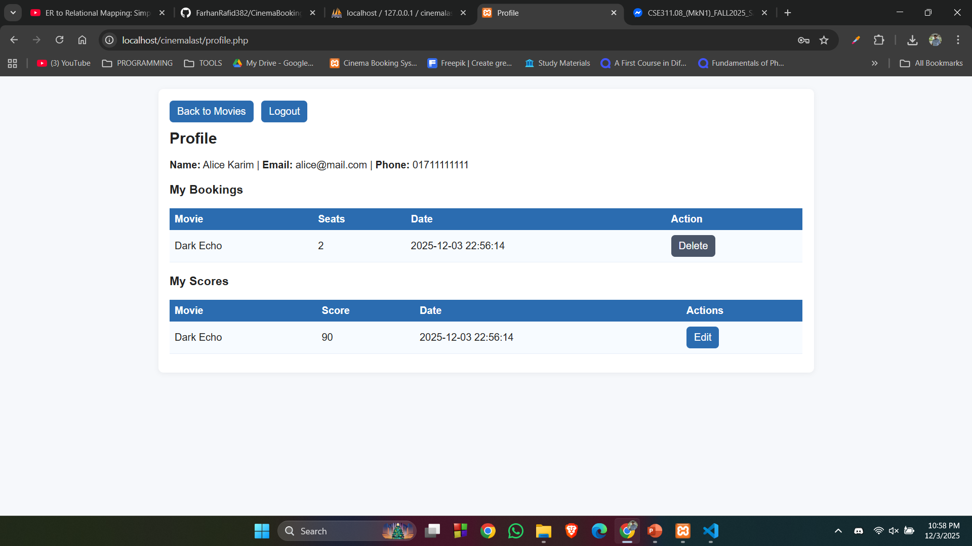
Booking Seats
Booking seats
Only one request can modify the seat count for a movie at a time.
Mechanics:
Start a transaction.
Lock the movie row with SELECT total_seats FROM movies WHERE movie_id = ? FOR UPDATE.
Re-read available seats while the row is locked.
Reject if seats are insufficient.
Insert booking.
Decrement seats.
Commit.
Effect:
Two users pressing “Book” at the same moment cannot both get the same seats because the first transaction locks the row. The second waits until the lock is released. After the lock is released, the second sees updated seat count and will fail if capacity is gone.

Slide 11
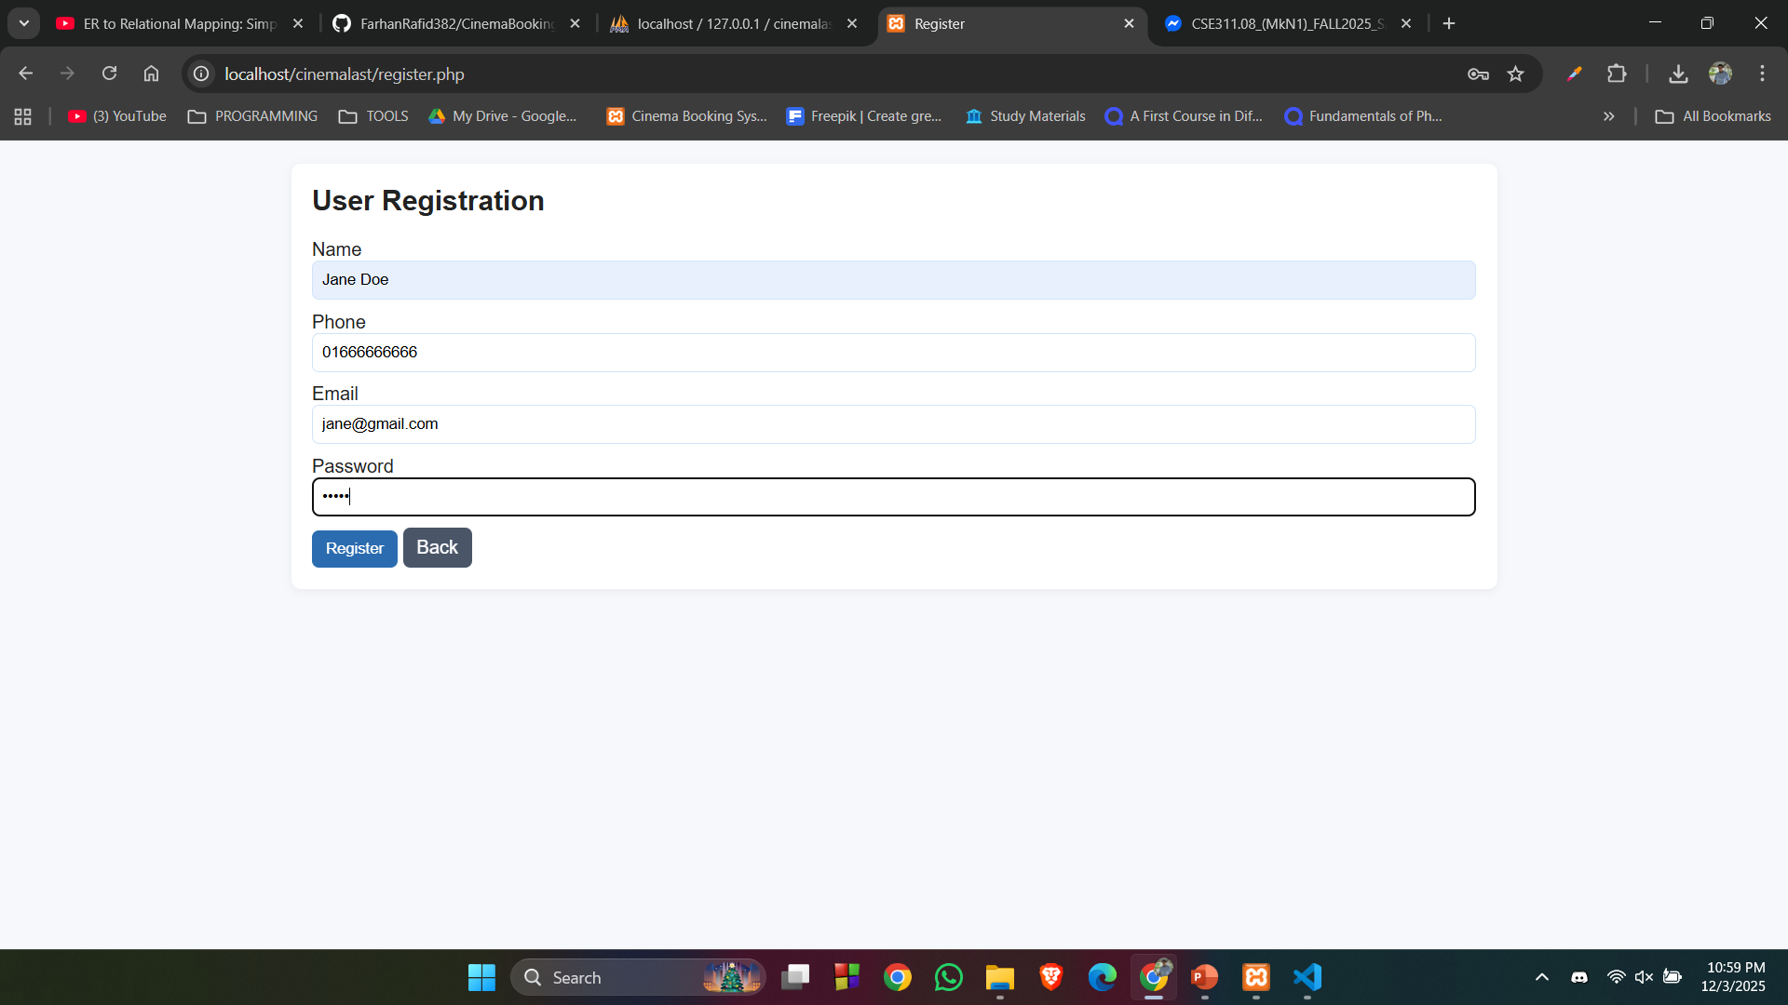
Prepared Statement
Prepared statements separate code from data. This removes the ability for user input to change the query structure.
1.Write a fixed SQL template with placeholders.
2.Bind user input as typed parameters.
3.Database executes the statement with the parameters treated as literal values.
$stmt = $mysqli->prepare(
"SELECT user_id, name, password, is_approved
FROM users
WHERE email = ?"
);
$stmt->bind_param('s', $email);
$stmt->execute();
This prevents injection, protects logins, bookings, scoring, and all CRUD actions.

Slide 12
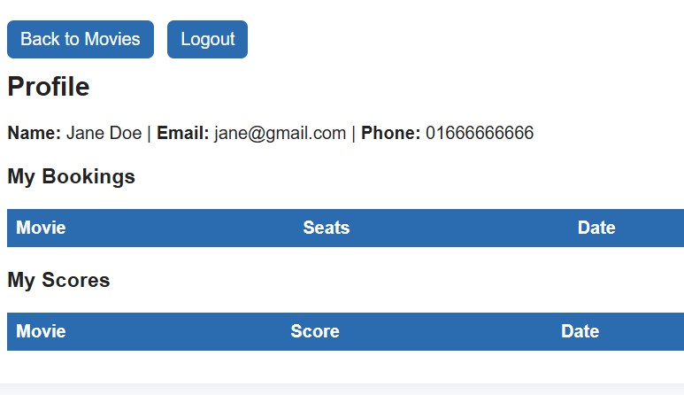
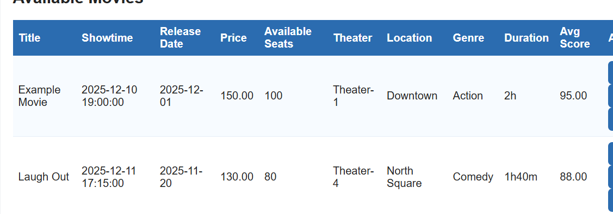
Seat Booking and Restoration
Seat handling works in two phases: decrement on booking and restoration on deletion.
Seat Decrement After Booking
When a user books seats, the system runs a transaction. After confirming that enough seats are available, it inserts the booking and then runs:
UPDATE movies SET total_seats = total_seats - ? WHERE movie_id = ?
This reduces the available seats and happens inside a transaction with a row lock, two users cannot decrement at the same time incorrectly.
// insert booking
$stmt = $mysqli->prepare("INSERT INTO bookings (user_id, movie_id, seats_booked) VALUES (?, ?, ?)");
$stmt->bind_param('iii', $uid, $movie_id, $seats);
$stmt->execute();
$stmt->close();
// decrement seats
$stmt = $mysqli->prepare("UPDATE movies SET total_seats = total_seats - ? WHERE movie_id = ?");
$stmt->bind_param('ii', $seats, $movie_id);
$stmt->execute();
$stmt->close();

Slide 13
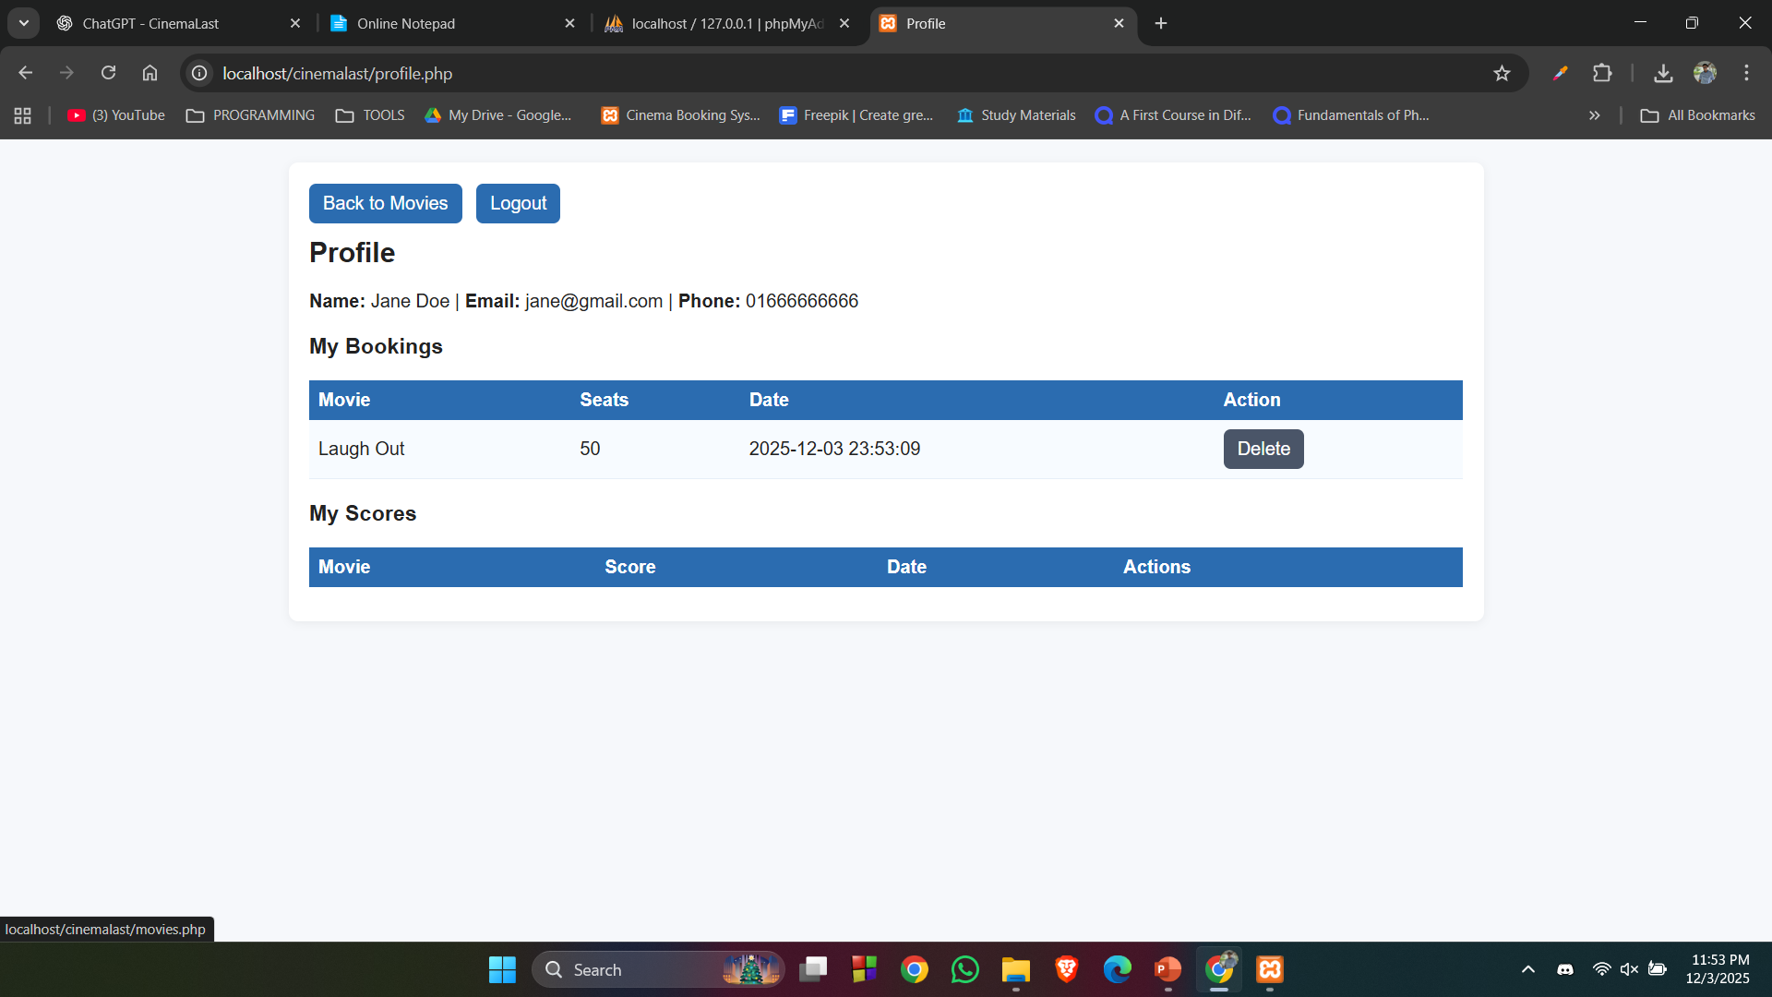

Seat Booking and Restoration
Seat Restoration After Deletion
When a user deletes a booking, the system again uses a transaction. It first removes the booking, then restores the exact number of seats the user had booked:
UPDATE movies SET total_seats = total_seats + ? WHERE movie_id = ?
This ensures no seats are permanently lost when a user cancels. The rollback mechanism also protects against partial updates.
// delete booking
$stmt = $mysqli->prepare("DELETE FROM bookings WHERE booking_id = ?");
$stmt->bind_param('i', $booking_id);
$stmt->execute();
$stmt->close();
// restore seats
$stmt = $mysqli->prepare("UPDATE movies SET total_seats = total_seats + ? WHERE movie_id = ?");
$stmt->bind_param('ii', $seats, $movie_id);
$stmt->execute();
$stmt->close();

Slide 14
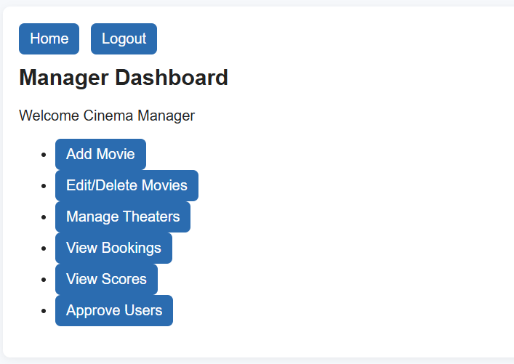
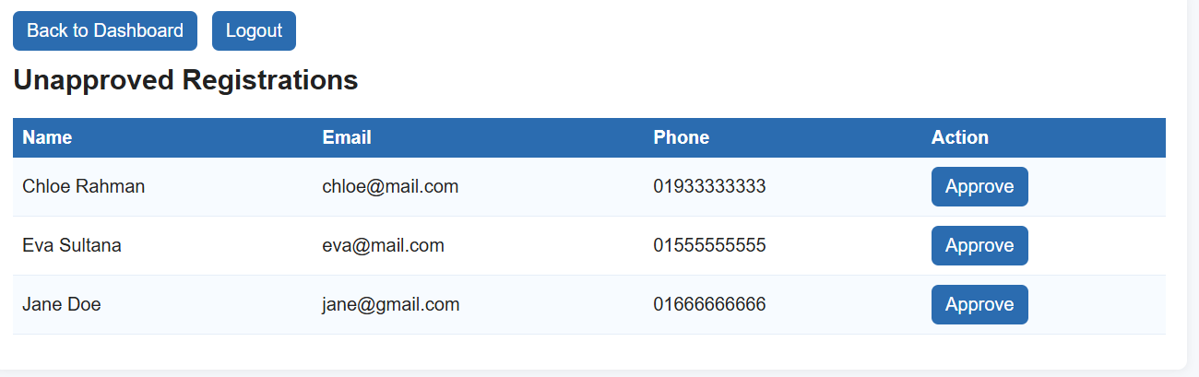
Manager
Manager handles all administrative control. Main tasks:
Approve new user registrations.
Add new movies with showtime, pricing, seats, and theater.
Edit or delete existing movies.
Manage theater information.
View all bookings made by users.
View all submitted movie scores.
This gives the manager full control over the cinema system’s operations.
if (isset($_GET['approve'])) {
$uid = (int)$_GET['approve'];
$stmt = $mysqli->prepare("UPDATE users SET is_approved = 1 WHERE user_id = ?");
$stmt->bind_param('i', $uid);
$stmt->execute();
$stmt->close();
}//approving new users
$stmt = $mysqli->prepare(
"INSERT INTO movies (title, showtime, release_date, price_per_seat, total_seats, theater_id, genre, duration)
VALUES (?,?,?,?,?,?,?,?)"
);
$stmt->bind_param('ssdiisss', $title, $showtime, $release_date, $price, $seats, $theater_id, $genre, $duration);
$stmt->execute();
$stmt->close();//adding new movies

Slide 15
CONCLUSION
Conclusion
The system maintains secure, reliable cinema operations.
Users can register, book seats, and score movies smoothly.
Managers retain full control over movies, theaters, bookings, and approvals.
Transactions and prepared statements ensure data accuracy and safety.

Slide 16
THANK YOU
Any questions?

