Slide 1

KIDO
A Safe, Agentic AI Learning Ecosystem for Children
Technical & Business Writing — Final Presentation
CSC-4101 Artificial Intelligence · BSCS-6D · SZABIST University, Karachi Team: Farhan (Lead) · Zubair Khan · Syed Muhammad Asghar · Chaudhary Saboor Munir
Live: kido-orcin.vercel.app
Notes:
Welcome. We are Team KIDO. KIDO is a safe, AI-powered learning ecosystem for children under 15 — and it is already live and deployed. Today we'll cover the problem, our solution, the agentic AI that powers it, safety, and a live demo.

Slide 2
02
The Problem — Pakistan's Learning Gap
One-size-fits-all curriculum ignores each child's pace & strengths
Low engagement → boredom, short attention, high dropout
No real-time feedback — students wait days for correction
Safety risks — inappropriate content, cyberbullying, unmonitored social
No unified progress view for parents and teachers
73%
No digital tools
58%
Low engagement
45%
Dropout factor
80%
No real-time feedback
KIDO · CSC-4101 Artificial Intelligence · SZABIST University
2
Notes:
Pakistan's education system struggles with personalization, engagement, feedback speed, and child safety online. Existing apps are foreign-made and not parent-centric. These five gaps are exactly what KIDO targets.

Slide 3
03
Our Solution — KIDO
One safe platform combining adaptive learning, gamification, parental oversight, teacher tools, and autonomous AI agents.
🎯
🏆
🛡️
👩‍🏫
🤖
Adaptive AI
Gamification
Parent Control
Teacher Tools
Agentic AI
ML tunes difficulty & content in real time
XP, levels, badges, streaks & leaderboards
Consent, screen-time & content oversight
Classrooms, lessons & progress tracking
Autonomous agents: observe → act → learn
KIDO · CSC-4101 Artificial Intelligence · SZABIST University
3
Notes:
KIDO is multi-layered. Five pillars: adaptive AI, gamification, parent control, teacher tools, and our agentic AI. Each directly answers a problem from the previous slide.

Slide 4
04
Core Features
📚 Adaptive Quizzes
AI-generated; difficulty scales with score
💬 AI Tutor
Multi-session, step-by-step, age-tuned
🎮 AI Games
Word, story & math challenges
▶️ Safe Video Library
Age-gated, searchable, parent-safe
👥 Approved Friends
Social only after parent consent
📊 Progress Dashboards
Real-time for kids, parents & teachers
KIDO · CSC-4101 Artificial Intelligence · SZABIST University
4
Notes:
Six core features cover learning, tutoring, play, video, safe social, and analytics — a complete ecosystem, not a single tool.

Slide 5
05
Agentic AI System (Multi-Agent Workflow)
Unlike rule-based engines, KIDO's agents run a true reasoning loop:
OBSERVE
→
ANALYZE
→
DECIDE
→
ACT
→
LEARN
Learning Agent
Tracks mastery, builds learning paths
Engagement Agent
Detects boredom, switches format
Safety Agent
Screens messages & social patterns
Behavior Analyst
Detects burnout & mood trends
Parent Assistant
Weekly insights & smart alerts
Content Moderation
Scans content before it reaches a child
KIDO · CSC-4101 Artificial Intelligence · SZABIST University
5
Notes:
This is our most distinguishing feature. Agents observe the child's state, analyze, decide, act, and learn from outcomes — and we have specialized agents for learning, engagement, safety, behavior, parent insights, and moderation.

Slide 6
06
System Architecture
Presentation
Mobile App · Child · Parent · Teacher portals
API Gateway
REST APIs · JWT Auth · Rate Limiting · WebSocket
Business Logic
Quiz · Streak · Social · Content services
AI Engine
Personalization · Behavior · Safety · Reports
Data Layer
PostgreSQL · Redis Cache · File Storage · Event Log
KIDO · CSC-4101 Artificial Intelligence · SZABIST University
6
Notes:
A clean layered architecture: presentation, API gateway, business logic, AI engine, and data. Each layer is independently scalable and feeds the continuous learning loop.

Slide 7
07
Technology Stack
Layer | Technology | Purpose
Frontend | Flutter / Web (Next.js) | Cross-platform app + responsive web/PWA
Backend | REST API | Async APIs, auth, business logic
Database | PostgreSQL + Redis | Relational data + real-time caching
Auth | JWT + Bcrypt | Role-based: parent/child/teacher/admin
AI / ML | LLM + Scikit-learn | Tutor, quizzes, agents, personalization
Deployment | Docker · Vercel / Render | Containerized CI/CD + installable APK
KIDO · CSC-4101 Artificial Intelligence · SZABIST University
7
Notes:
Industry-standard stack: cross-platform frontend, REST backend, PostgreSQL plus Redis, JWT auth, and an LLM-plus-ML AI layer — all containerized and deployed with CI/CD.

Slide 8
08
Safety, Privacy & Compliance
🔒 Parental Consent
Friends & classrooms activate only after a parent approves
🎚️ Age-Gated Content
Each child sees only age-appropriate material
🧹 Content Moderation
Messages & content screened for unsafe language
🗄️ Data Minimization
Only learning data stored · no ads · no trackers
🛡️ COPPA-Aligned
Privacy-by-design for under-15 users
🔑 Role-Based Access
Server-side guard blocks cross-account data
KIDO · CSC-4101 Artificial Intelligence · SZABIST University
8
Notes:
Safety is built-in, not bolted on. Verifiable parental consent, age-gating, content moderation, data minimization, COPPA alignment, and strict role-based access control.

Slide 9
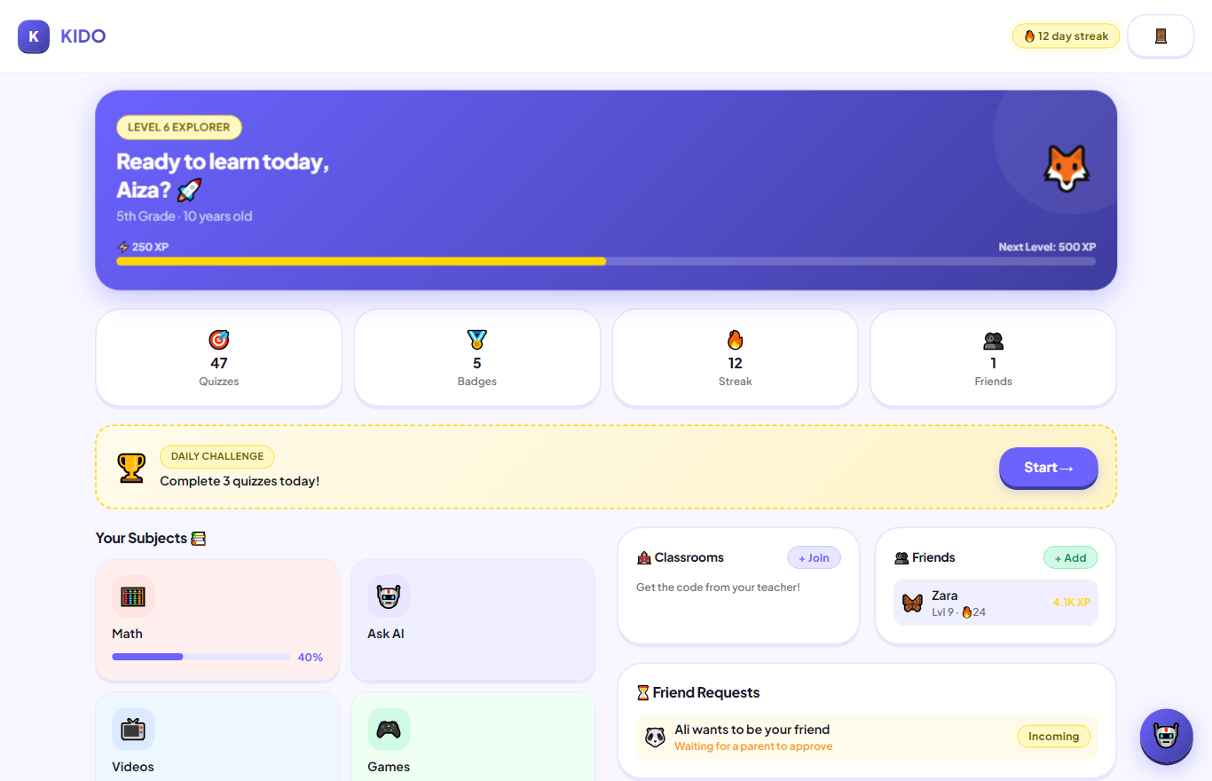
09
Live Product & Demo
Live at kido-orcin.vercel.app
Installable PWA + signed Android APK
Working AI tutor, quizzes, games & videos
Parent · teacher · child experiences
Child dashboard (live) — XP, subjects, and a parent-pending friend request
KIDO · CSC-4101 Artificial Intelligence · SZABIST University
9
Notes:
Crucially, KIDO is not a mockup — it is deployed and working. We will now switch to the live site and show the child dashboard, AI tutor, a quiz, the video library, and the parent approval flow.

Slide 10
10
Methodology & Timeline
Agile, iterative 8-week build with continuous deployment & atomic commits.
W1 Problem
PEAS · state/action/goal
W2 Research
Child-safety (COPPA) · context
W3 Architecture
Agentic workflow · data model
W4 Backend
Schema · APIs · auth guard
W5 AI Integration
Tutor · quizzes · agent pipeline
W6 Safety
Consent · age-gating · isolation
W7 Testing
Adversarial & access-control
W8 Submission
Deploy · PWA/APK · report
KIDO · CSC-4101 Artificial Intelligence · SZABIST University
10
Notes:
We followed an Agile 8-week cycle from problem formulation to deployment, with continuous integration and clear weekly milestones.

Slide 11
11
Team & Contributions
👑
Farhan
🎨
Zubair Khan
Team Lead
UI/UX & Frontend
AI architecture, agentic system, backend & system design
Design system, screens, animations, dashboards
📑
Syed Muhammad Asghar
🧪
Chaudhary Saboor Munir
Documentation
Testing & QA
Research, technical report & presentation
Unit/integration testing, QA, deployment
KIDO · CSC-4101 Artificial Intelligence · SZABIST University
11
Notes:
Four members. Farhan led AI and architecture; Zubair built the UI; Syed handled research and documentation; Saboor owned testing, QA and deployment.

Slide 12
12
Impact & Why It Matters
Closes the personalization gap with real-time adaptive learning
Boosts engagement via game mechanics → better retention
Keeps children safe with parent-gated social & moderation
Empowers parents & teachers with actionable AI insights
A scalable EdTech startup concept for Pakistan & South Asia
KIDO · CSC-4101 Artificial Intelligence · SZABIST University
12
Notes:
KIDO's impact: personalized, engaging, safe learning with real oversight — and a genuine startup opportunity in the regional EdTech market.

Slide 13
13
Conclusion
KIDO unifies adaptive learning, gamification, parental safety, and autonomous AI into one deployed product. It directly answers Pakistan's personalization, engagement, feedback, and safety gaps — and proves an agentic AI system can be both powerful and provably safe for children.
✅ Personalized
🛡️ Safe by design
🤖 Truly Agentic
🚀 Live & deployed
"KIDO is not just a project — it is a deployable EdTech product built to make safe, intelligent learning accessible to every child."
KIDO · CSC-4101 Artificial Intelligence · SZABIST University
13
Notes:
To conclude: KIDO synthesizes everything into one safe, intelligent, deployed product. Our closing message: it is not just a project — it is a deployable EdTech product for every child. Thank you — we'll take your questions.

Slide 14
Thank You
Questions & Discussion
kido-orcin.vercel.app · github.com/FarhanRajputFelix/KIDO
Notes:
Thank you. Open for questions.

