Slide 1
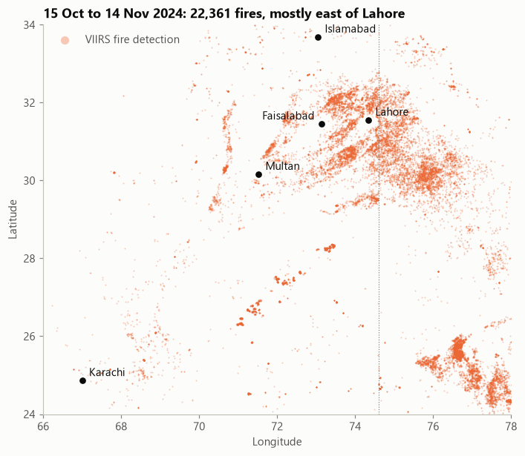
SAANS
AI smog forecasting and source attribution for five Pakistani cities
Saans means breath in Urdu
Farhan Bashir (2312407) · Data Science
Submitted to Sir Ahsan Nisar · SZABIST University Karachi · October 2026
Satellite fire detections, 15 Oct to 14 Nov 2024
Notes:
SAANS forecasts smog one to two days ahead for Lahore, Faisalabad, Multan, Islamabad and Karachi, and explains what is driving it. The map shows one month of crop fires in autumn 2024; most burn east of Lahore. Everything I show is computed from free data, and the code and notebooks are on GitHub.

Slide 2
Smog policy reacts after the air is already hazardous
1,165
18
Now only
AQI reported in Lahore, November 2024
districts closed schools and colleges
public AQI tools report the current hour, not tomorrow
1
No forecast
2
No explanation
3
No accessible advice
Nobody sees what tomorrow will bring, so schools close after the air turns bad.
Is it crop burning upwind, stagnant weather or local traffic? Nobody quantifies it.
Numbers on an app, not clear guidance in Urdu and English.
Source: Dawn, 7 November 2024 (schools closed across 18 districts as smog reigned in Punjab).
Notes:
In November 2024 Lahore's AQI was reported at 1,165 and schools closed across 18 districts. Every measure came after the air was already hazardous, because public tools only show the current hour. SAANS targets three gaps: no forecast, no explanation of the causes, and no clear advice in Urdu and English.

Slide 3
SAANS forecasts tomorrow's smog, explains it, and advises
1
Forecast
2
Explain
3
Advise
Mean PM2.5 for the next 24 hours and the 24 hours after, with an 80% range
A warning when the next 24 hours will exceed AQI 300
SHAP splits every forecast into four drivers: recent pollution, weather, upwind crop fires, calendar
What-if: fewer crop fires
Gemini writes a three-line advisory in English and Urdu
Only the model's numbers, checked automatically
4 free data streams
›
9-step cleaning
›
Features
›
LightGBM + SHAP
›
LLM advisories
›
Dashboard
Notes:
SAANS does three things. It forecasts the mean PM2.5 for the next 24 and 48 hours and warns when the air will cross AQI 300. It explains each forecast with SHAP, and it turns the numbers into a short English and Urdu advisory. The pipeline underneath runs from four free data streams to a public dashboard.

Slide 4
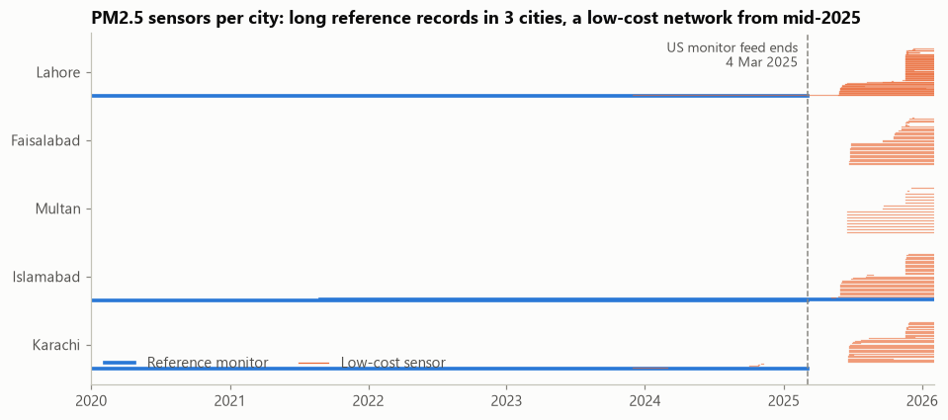
Two million raw records from four free sources
Source | Records
Open-Meteo ERA5 weather | 266,760
OpenAQ PM2.5, 200 sensors | 587,969
NASA FIRMS fires | 1,184,817
GDELT news headlines | 2,255
Total | 2,041,801
1 Jan 2020 to 31 Jan 2026, five cities. Every timestamp stored in UTC; every raw response kept untouched.
Reference monitors exist only at the US posts in 3 cities, and that feed ended on 4 March 2025. Faisalabad and Multan only start in June 2025, so they became a test on cities the model has never seen.
Notes:
Four free sources give just over two million raw records from 2020 to January 2026. The coverage chart was my first risk check: long reference records exist only at the US posts in three cities, and that feed stopped in March 2025. Faisalabad and Multan have sensors only from June 2025, so I turned them into an unseen-city test.

Slide 5
Cleaning caught four errors that would have passed silently
25,555
"negative" values were really empty readings: the filter value >= 0 also drops nulls
15,542
good Clarity hours in Lahore a wrong metadata field would have deleted (it assumes 12 readings an hour; Clarity sends 3 to 4)
105 h
the US monitor in Lahore stuck at exactly 67.0 µg/m³ (29 May to 1 June 2024)
9.8 → 15.6
AirGradient error if the EPA humidity correction were applied: its data are already corrected
Nine logged steps feed an auto-generated Data Quality Report: 95.1% of PM2.5 sensor-hours kept; 1.18 million fire detections cleaned to 814,793 distinct fires; 21,840 missing boundary-layer values imputed (r = 0.91 on a hidden half-year).
Notes:
Cleaning is the core of the project, and every step logs before and after counts. Four findings changed the rules: empty readings mislabelled as negatives, a metadata field that would have deleted Lahore's best monitor, a monitor stuck at 67 for 105 hours, and a humidity correction that would have doubled the error of already-corrected sensors. All of it is in the Data Quality Report.

Slide 6
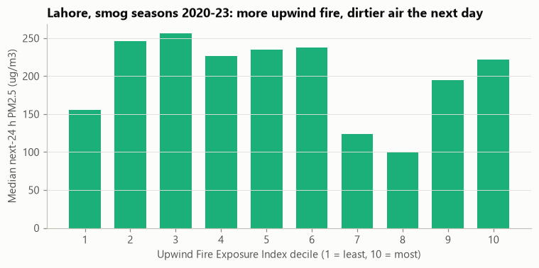
Wind direction matters: upwind fires predict tomorrow's smog
UFI(t) = Σ_{i} FRP_{i} · exp(−d_{i} / L) · max(0, cos θ_{i})
Fires seen 24 to 72 h earlier, weighted by power, distance and whether the wind blew from the fire to the city
0.295 → 0.383
Spearman correlation with next-day PM2.5 when only upwind fires count (best decay length L = 50 km)
Lahore, smog seasons 2020-23: median next-day PM2.5 by fire-index decile
Stagnation Index: low ventilation (lid height × wind) + high humidity + cold air, standardised on training data.
No peeking: every feature uses only what is known at forecast time.
Notes:
The Upwind Fire Exposure Index sums every fire seen one to three days earlier, weighted by its power, its distance and whether the wind was blowing from the fire to the city. Tuned on training data only, the wind term lifts the correlation with next-day PM2.5 from 0.30 to 0.38. That is the proposal's central physical claim, now measured.

Slide 7
Gemini read 2,255 headlines: 425 events, 65% fully correct
1
Dated headlines in batches of 60, temperature 0, strict JSON
2
Output validated like raw data: 428 events → 425
3
Hand-check of 20 random events: 13 fully correct
Why the 7 misses happened
Inverted meaning (2): "lift lockdown", "schools reopen"
Place inferred, not stated (2)
Not a smog event (3): toll tag, kiln upgrade, fuel lab
Notes:
The LLM works inside the data pipeline: Gemini reads 2,255 real headlines and returns structured events, and its output is validated like any raw data. I checked 20 random events strictly and 13 were fully correct, so I report 65%. The misses are instructive, for example reading 'lift lockdown' as a new lockdown, so the event calendar is treated as a noisy, minor feature.

Slide 8
Tested like a real forecast: split by time, against baselines
Test 1: record 2024-25 season
Training: Jan 2020 to Sep 2024 · Lahore, Islamabad, Karachi
2020
2021
2022
2023
2024
2025
2026
Validation: 2023-24 season
Test 2: 2025-26 season, plus unseen Faisalabad and Multan
Two baselines
No peeking
Predict the change
Persistence (next 24 h = last 24 h) and the seasonal average for that city, month and hour.
Only data known at forecast time; test seasons are never interpolated; the warning threshold is set on validation data.
6 Nov 2024, Lahore: a level model said 283, the change model 386; observed 510. Trees cannot extrapolate past record levels.
Notes:
I split by time, never at random, because overlapping 24-hour windows would leak tomorrow's air into training. The model trains up to September 2024 and is tested on the record 2024-25 season and on 2025-26, including two cities it never saw. One design change mattered most: predicting the change from the last 24 hours instead of the level, which lifted the record-day forecast from 283 to 386.

Slide 9
SAANS beats both baselines in both test seasons
+14.4%
lower 24-hour error than persistence in the record 2024-25 season (+13.8% at 48 h)
92% vs 76%
of hazardous periods (AQI > 300) warned: SAANS vs persistence, both seasons
0.774
F1 of the hazard warning in 2024-25 (persistence 0.755); 0.775 vs 0.764 in 2025-26
Notes:
In the record 2024-25 season SAANS cuts the 24-hour error of persistence by 14 percent, and by 14 percent at 48 hours too. In 2025-26 the margin is small, 2 to 4 percent, and I will explain why on the next slide. The hazard classifier catches 92 percent of hazardous periods against 76 percent for persistence, at the cost of more false alarms.

Slide 10
Works in unseen cities; fails where Lahore's sensors changed
+14%
+11%
2025-26, next 24 h | SAANS | Persistence | Skill
Faisalabad (unseen) | 33.3 | 38.7 | +14.0%
Multan (unseen) | 32.9 | 37.1 | +11.3%
Islamabad | 12.8 | 15.1 | +15.2%
Karachi | 16.7 | 16.0 | -4.4%
Lahore | 31.4 | 22.5 | -39.6%
Faisalabad: error 33.3 vs 38.7 for persistence
Multan: error 32.9 vs 37.1 for persistence
Neither city was in training: city identity is not a feature, so the model relies on weather, fires and recent pollution.
Why Lahore fails in 2025-26: after the US monitor stopped, Lahore's data come from low-cost networks that read differently (Clarity about 32% low). The model, trained on the reference monitor, runs about 26 µg/m³ high.
Notes:
The strongest result is generalisation: Faisalabad and Multan were never in training, yet SAANS beats persistence there by 14 and 11 percent. The honest weak spot is Lahore in 2025-26: when the US monitor stopped, the data switched to low-cost networks that read differently, and the model over-forecasts by about 26. Losing one reference monitor visibly degrades forecasts.

Slide 11
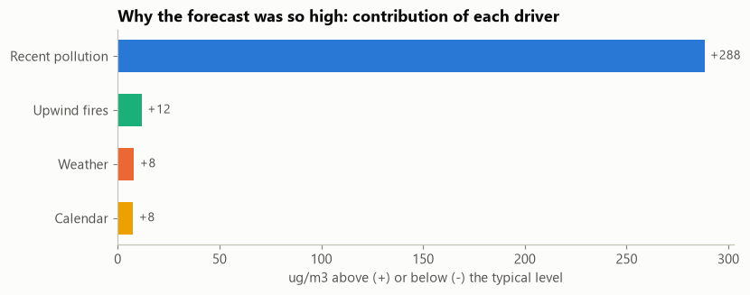
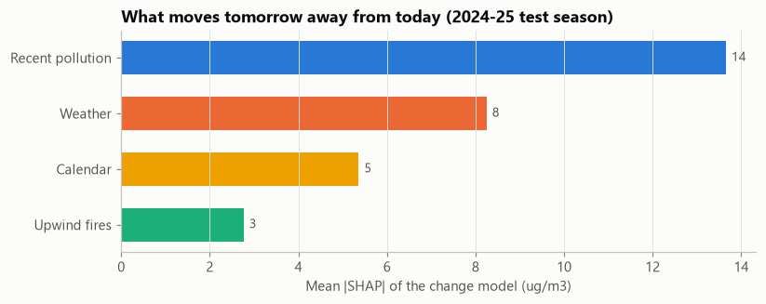
Every forecast comes with its reasons
Lahore, 08:00, 6 Nov 2024
Typical level
70
+ Recent pollution
+288
+ Upwind fires
+12
+ Weather
+8
+ Calendar
+8
= Forecast
386 µg/m³
Across the season, what moves tomorrow away from today: recent pollution, then weather, calendar and upwind fires.
Observed: 510. What-if: with no upwind fires the forecast drops to 340. SHAP is statistical attribution, not chemistry.
Notes:
SHAP splits each forecast into parts that add up exactly. On 6 November 2024 most of the 386 came from pollution already in the air, plus smaller pushes from fires, weather and calendar. The what-if tool shows that removing all upwind fires would lower this forecast to 340. This is the model's reasoning, not a chemical measurement.

Slide 12
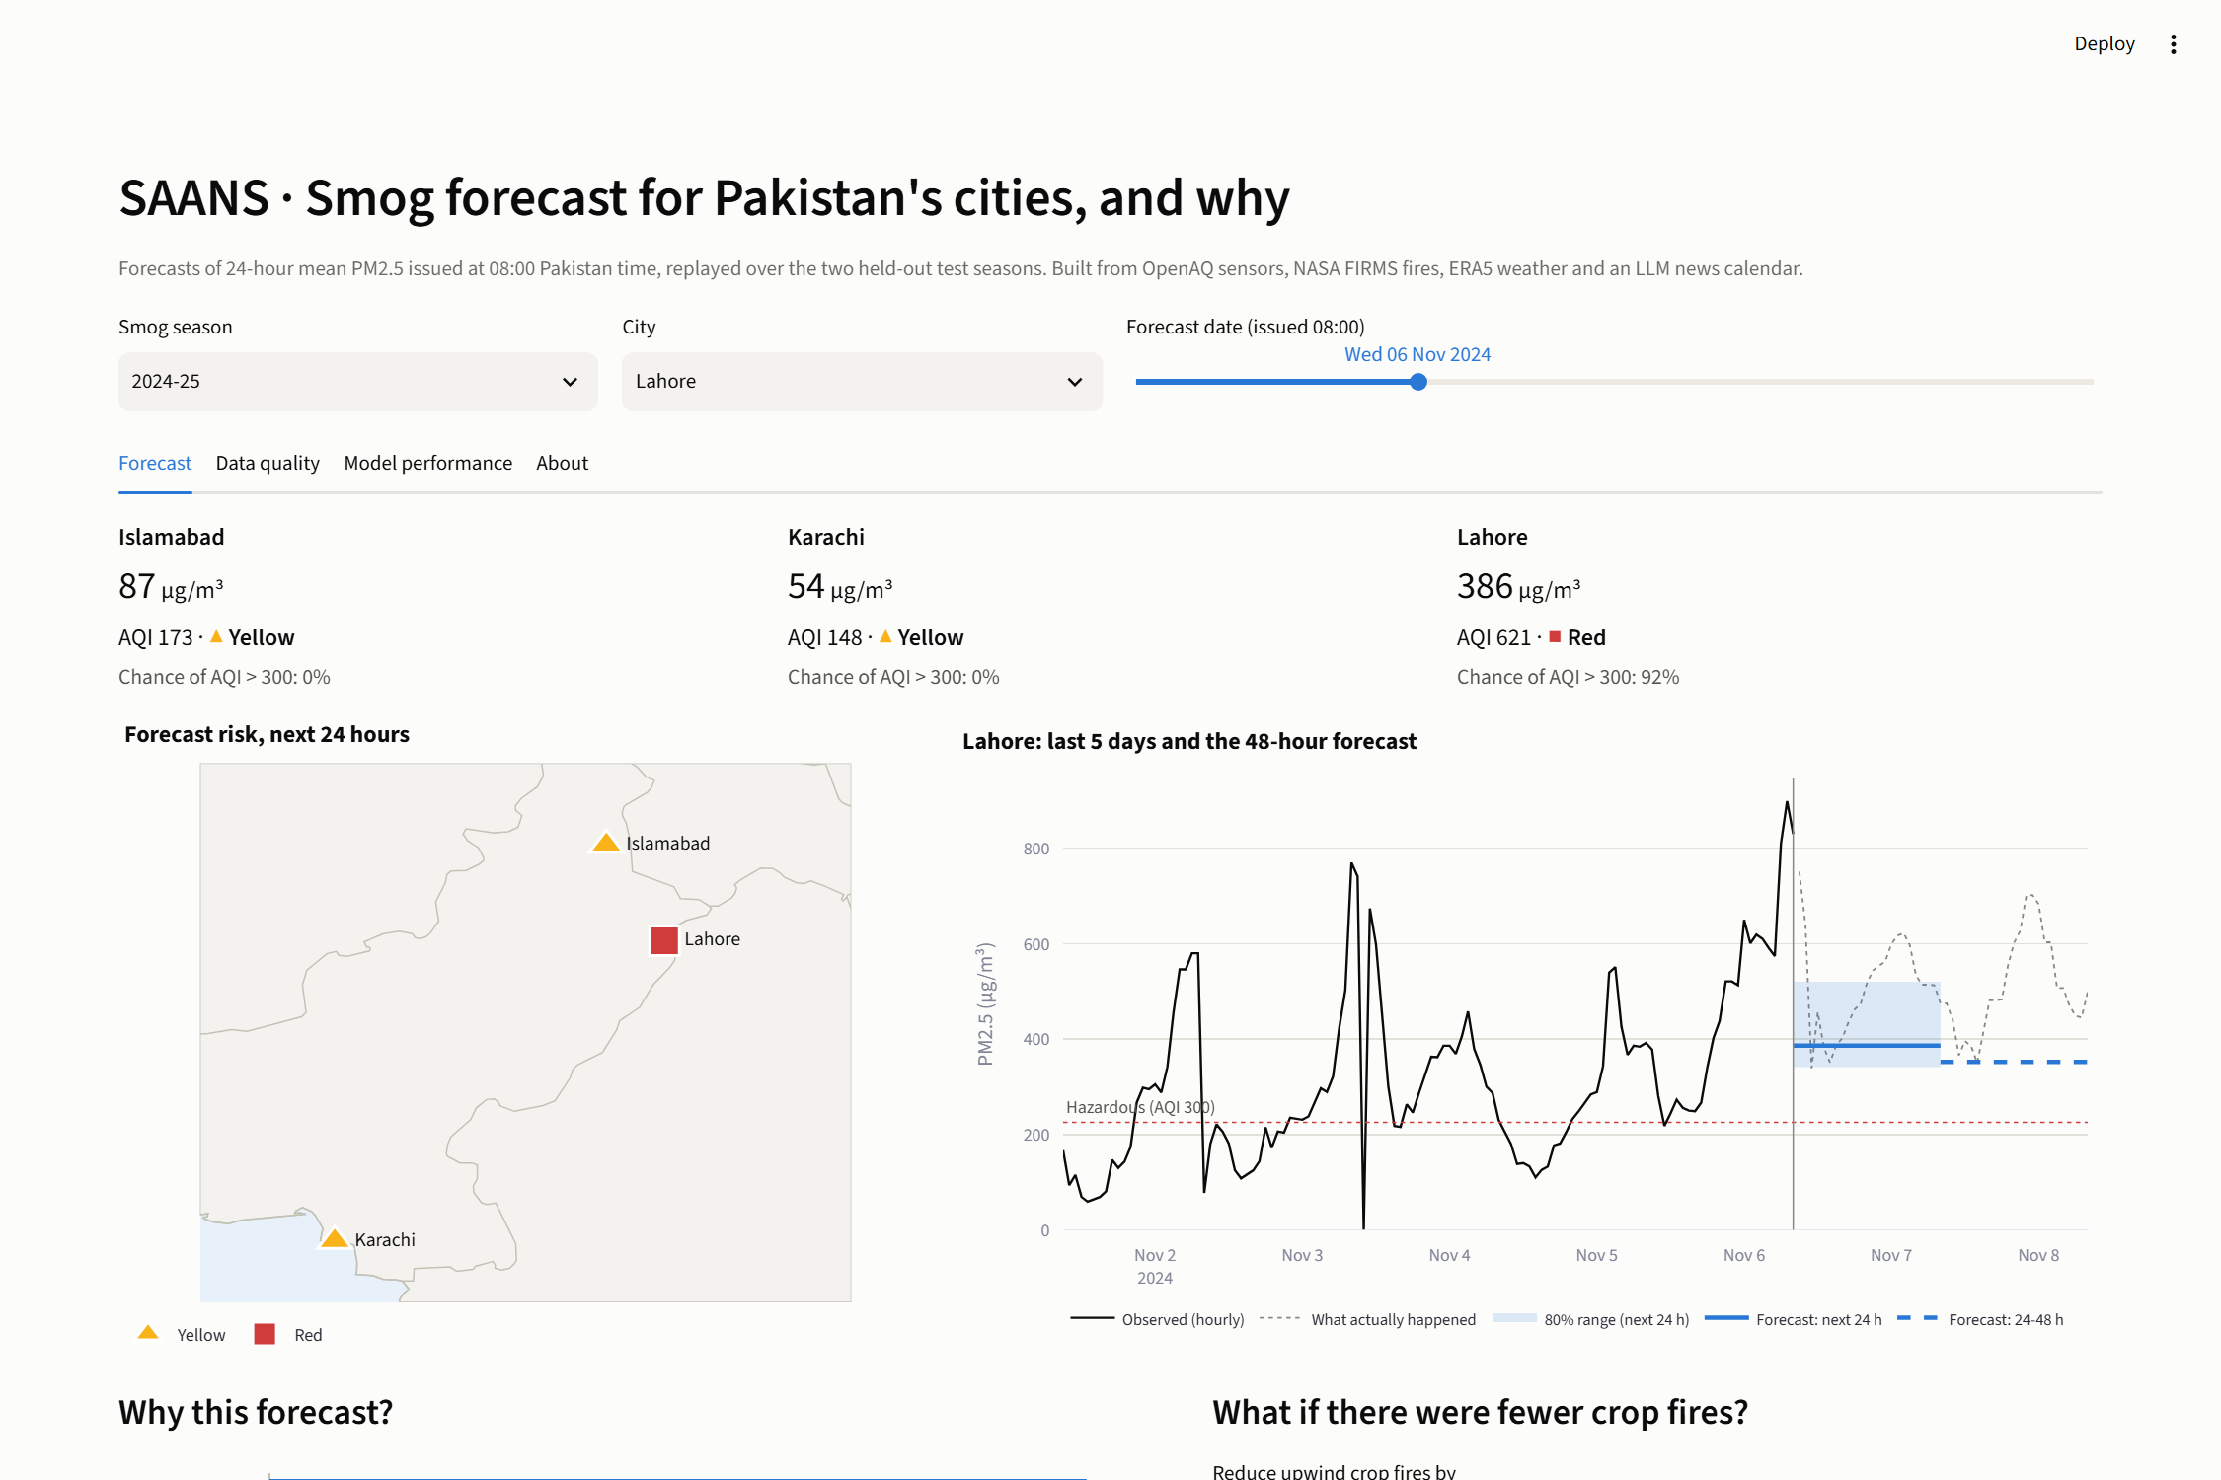
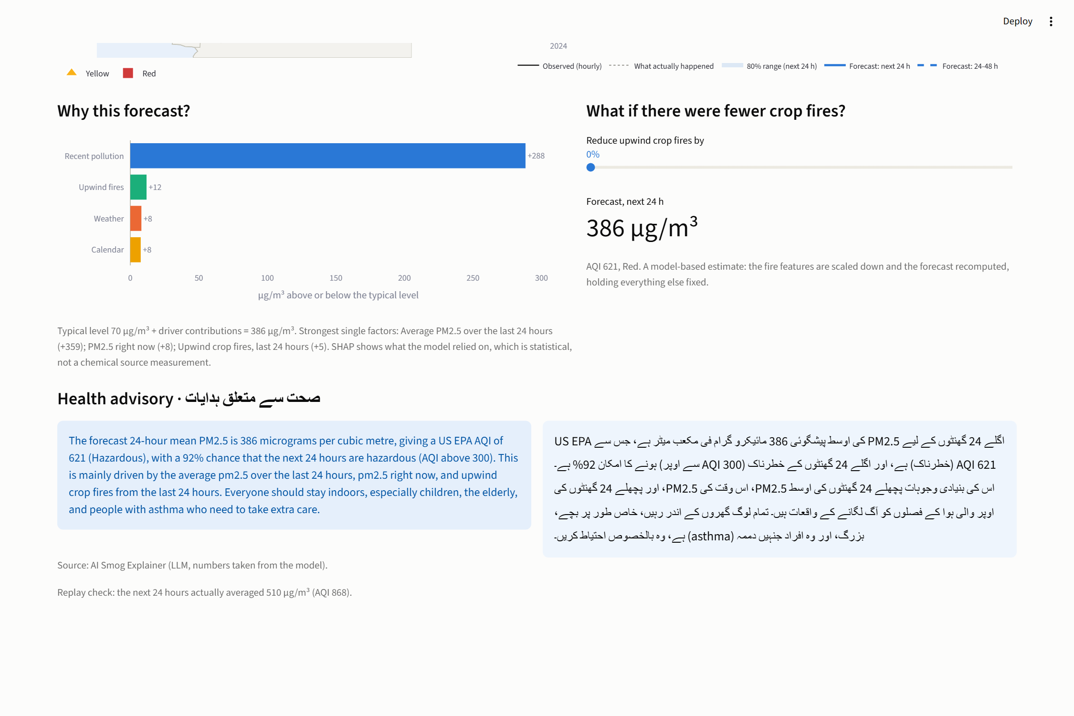
The dashboard: forecast, reasons and advice on one page
City tiles with AQI and hazard chance · risk map with shape-coded markers · 48-hour forecast with 80% band and what actually happened
Why-this-forecast drivers · what-if fire slider · English and Urdu advisory with its source labelled
Live dashboard URL (Streamlit Community Cloud): to be added after deployment · Code: github.com/FarhanRajputFelix/saans
Notes:
This is the Streamlit dashboard replaying the forecast for Lahore on 6 November 2024. The top shows each city's forecast, its risk on the map and the 48-hour chart with the 80 percent range; the bottom shows why, a what-if slider for crop fires, and the advisory in English and Urdu. It runs from precomputed files, so it needs no API key.

Slide 13
What SAANS cannot claim yet
1
Statistical, not chemical
2
Losing a reference monitor hurts
3
What-if is not monotonic
SHAP shows what the model relied on, not measured emission sources.
Lahore 2025-26 runs 26 µg/m³ high; Clarity reads about 32% low.
Multan 2025-26: removing all fires raised one forecast by 5 µg/m³. Fix: monotone constraints.
4
Thin data in two cities
5
Coarse weather, no forecast inputs
6
Noisy event calendar
Faisalabad and Multan: one season, low-cost sensors only, no reference.
ERA5 is a 25 km grid; BLH for Jan-Jun 2024 is imputed; no NWP inputs.
65% strict accuracy; misses on headlines that lift or end a measure.
Notes:
These are the limits I would state to a policymaker. Attribution is statistical; the Lahore network change shows how fragile public monitoring is; and the what-if is not guaranteed to move the right way, which monotone constraints would fix. The data are thin in two cities and the event calendar is noisy.

Slide 14
Conclusion and next steps
Free data can forecast city smog a day ahead: 14% better than persistence in the record season.
Warnings catch 92% of hazardous periods, and the model transfers to two unseen cities.
Careful cleaning changed the results: four silent errors caught, logged and fixed.
Next
Calibrate low-cost networks, Lahore first
Feed weather forecasts into the models
Monotone constraints on the fire features
Run live for the 2026-27 season
SMS alerts, Sentinel-5P, neighbourhood grid
github.com/FarhanRajputFelix/saans · Thank you
Notes:
To conclude: free, open data is enough to forecast smog a day ahead in Pakistan's cities, to warn of most hazardous periods, and to say why. The next steps are to calibrate the low-cost networks, add weather forecasts, constrain the fire response, and run SAANS live this season. Thank you; I am happy to take questions.

