Slide 1
Lab Test Problems

Slide 2
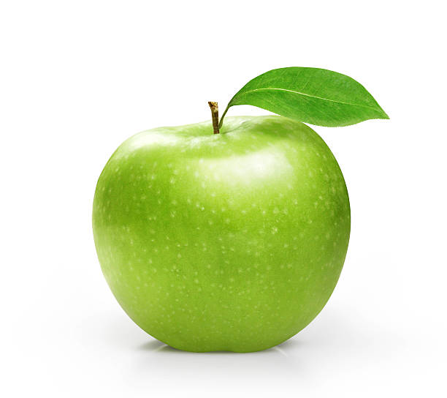
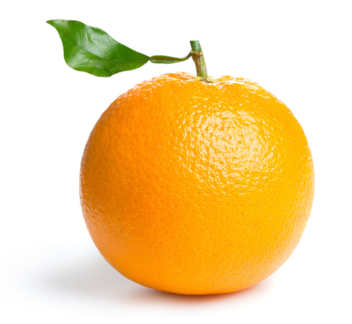
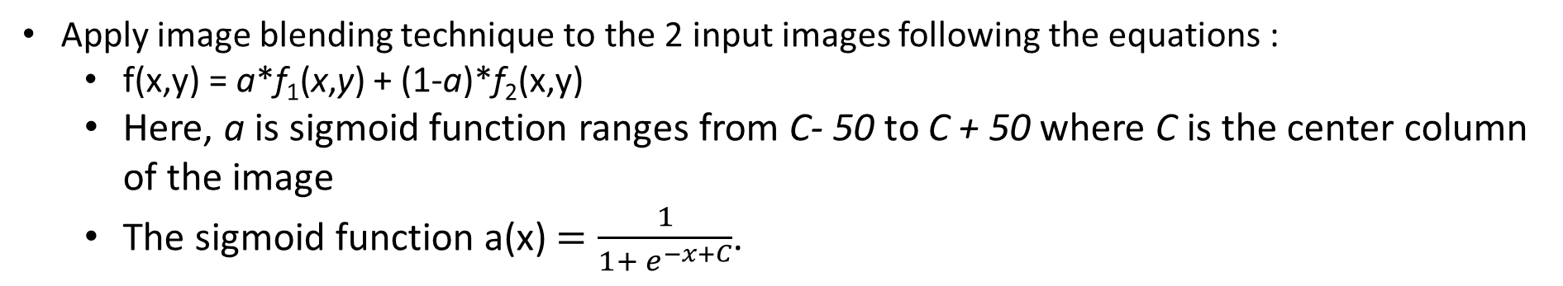
Problem 01
Apply image blending technique to the 2 input images following the equations :
f(x,y) = a*f₁(x,y) + (1-a)*f₂(x,y)
Here, a is sigmoid function ranges from C- 50 to C + 50 where C is the center column of the image
The sigmoid function a(x) $=\frac{1}{1+ e^{−x+C}}$.
apple.jpg
orange.jpg

Slide 3
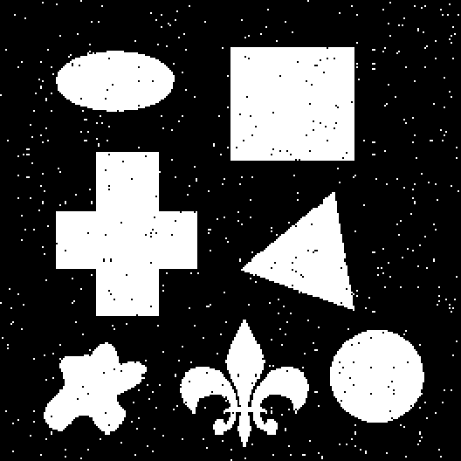
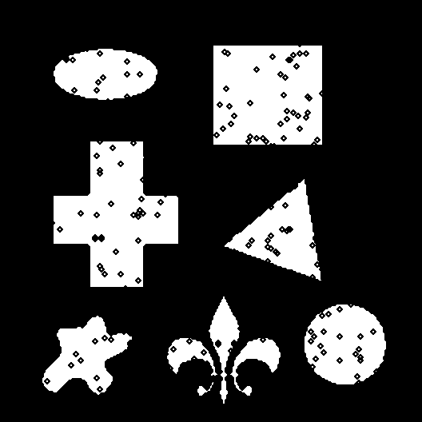
Problem 02
Apply appropriate morphological operation with the given structuring element of size 7×7 to the “Morphology 01.png” .
 |  |  | 1
 |  | 1 |  | 1
 | 1 |  |  |  | 1
1 |  |  | 0 |  |  | 1
 | 1 |  |  |  | 1
 |  | 1 |  | 1
 |  |  | 1
SE
Morphology 01.png
Output image

Slide 4
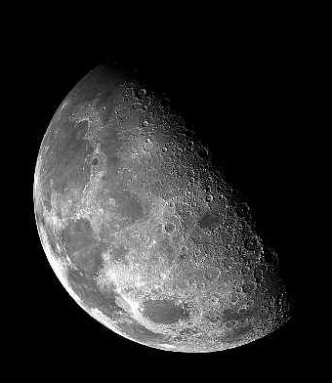
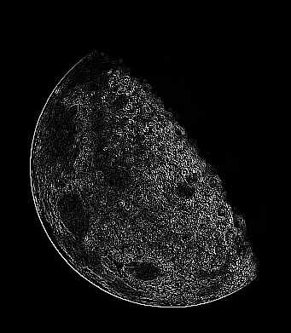
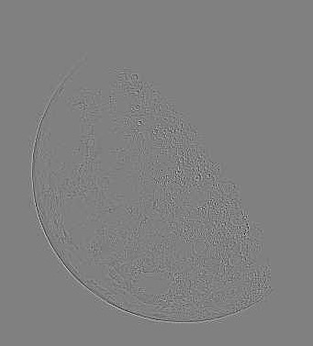
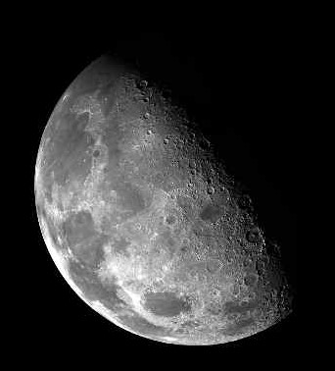
Problem 03
Apply Laplace operator to Sharpen the given ‘moon.jpg’ and Show following images as Output.
Use 3 x 3 kernel size
moon.jpg
After APPLYING LAPLACE
AFTER SCALING
Sharpen Output

