Slide 1

Employment Application Review System
PRESENTED BY
Name: Farhana Alam
ID: 151-35-1048
Notes:
NOTE:
To change the image on this slide, select the picture and delete it. Then click the Pictures icon in the placeholder to insert your own image.

Slide 2
INTRODUCTION
The name of my system is Employment Application Review System. Using this system applicants will apply for the job. Faculty members will give review the applications of applicants and list the applicant to find the best applicant for the job.

Slide 3
Objective
The main objective of the system to find the best applicant for a given job opening, by review the applications and list the applicant .

Slide 4
System Analysis
Actor and Goals
Actor | Goals
School Faculty | View applications Gives Feedback List best applicant
Applicants | Apply job
Admin | Upload jobs

Slide 5
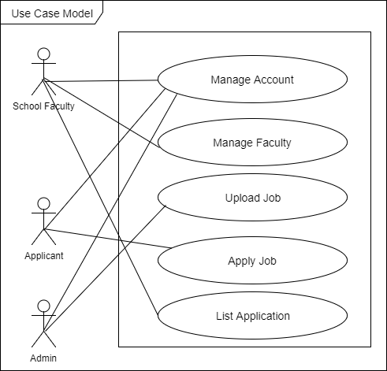
System Analysis
Use Case Modeling

Slide 6
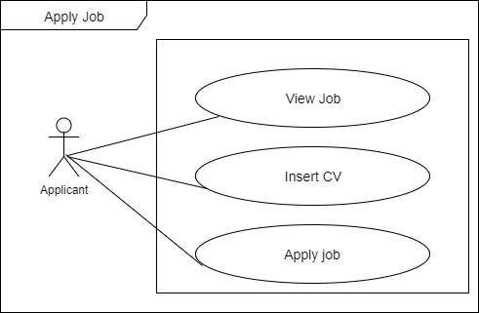
SYSTEM ANALYSIS
Apply job
Apply job
Use Case For ( Apply job)
Use case Description(Apply job)
Use Case Name: | Apply job
Scenario: (success Scenario) | Applicant can apply for the opening job
Brief Description: | Applicant can drop his/her cv and apply for the job
Actor: | Applicant
Preconditions: | Must have to have user account Must have to attached cv
Post conditions: | View job information
Flow of Events: | Actor | System
 | Applicant will Attached cv | System will give job information
Exception Conditions: | 1. Without attached applicant can not apply for any job

Slide 7
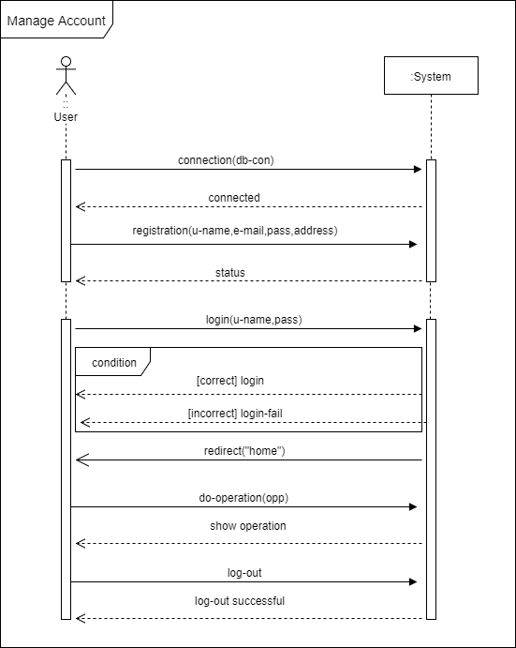

Slide 8
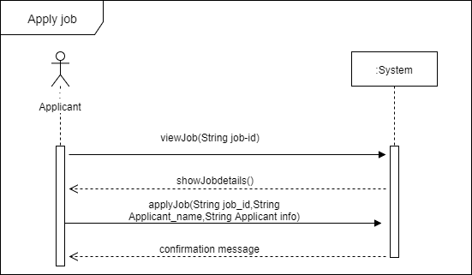
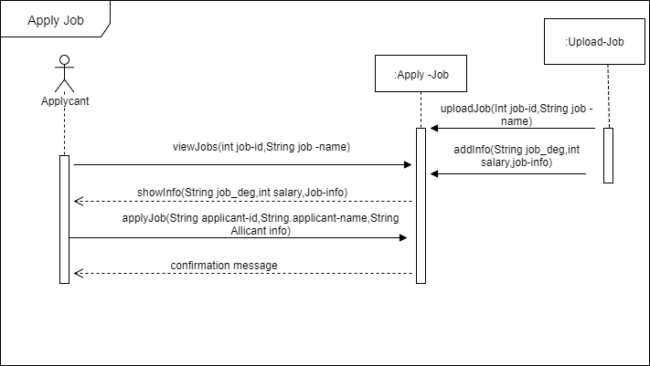
System Design
System Sequence Diagram
Sequence Diagram

Slide 9
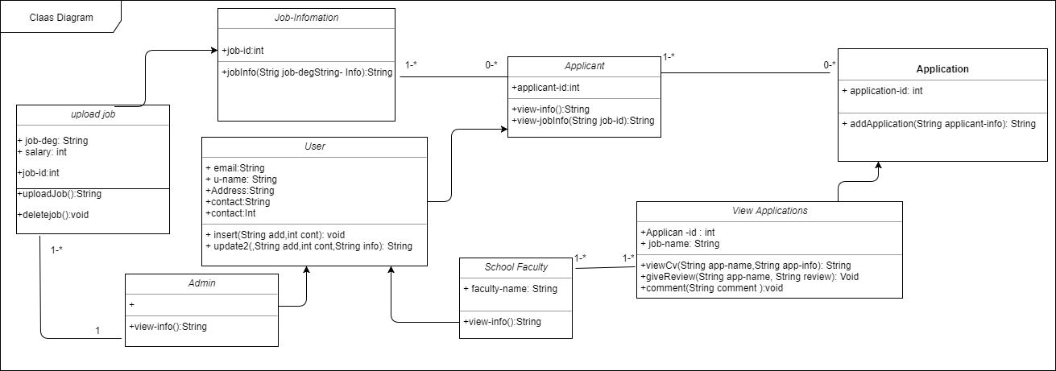

Slide 10
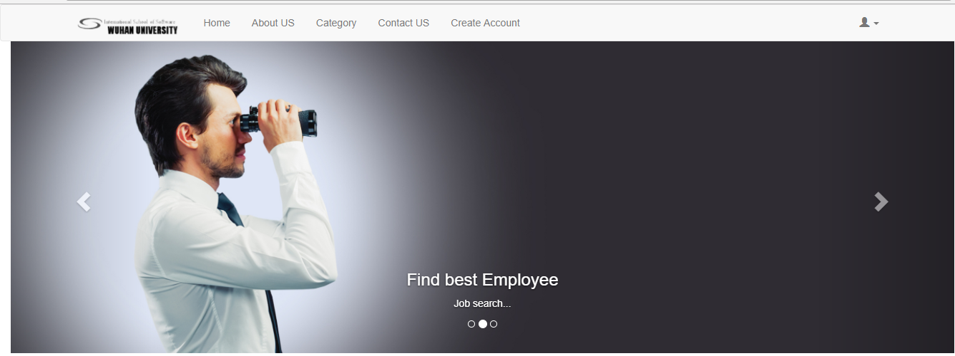
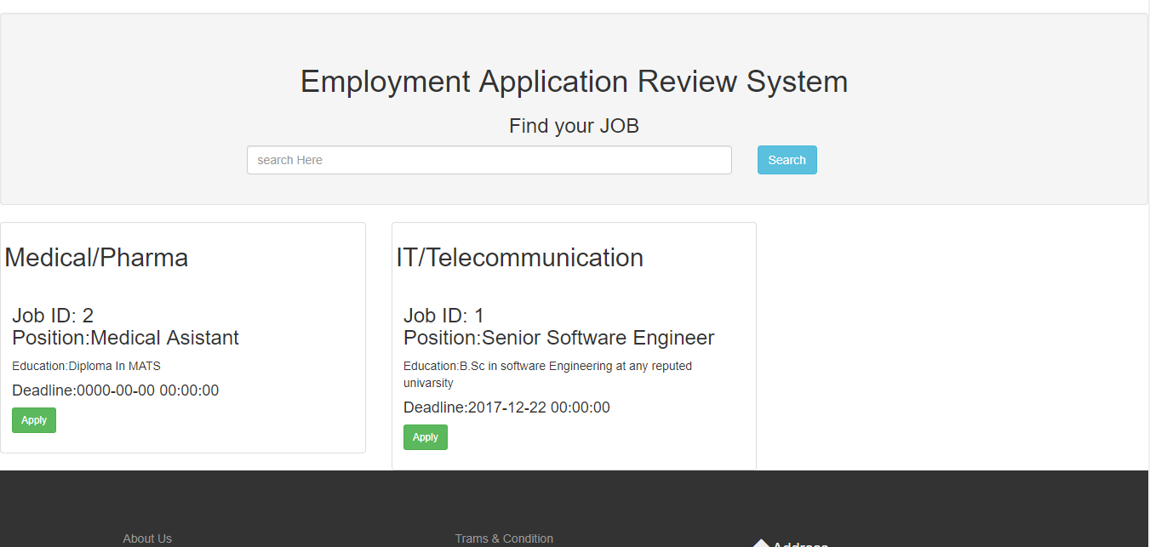

Slide 11
Apply
Apply

Slide 12
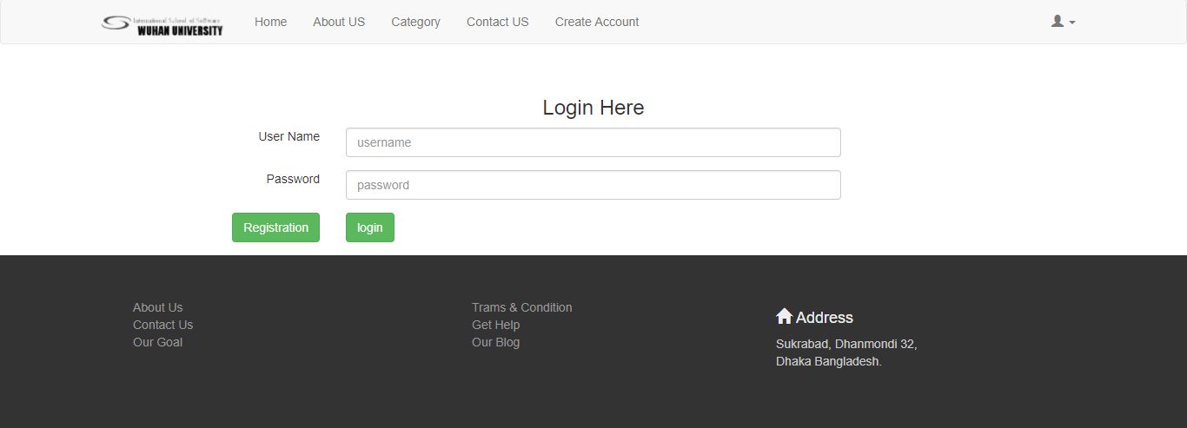
Registration
Log-in

Slide 13
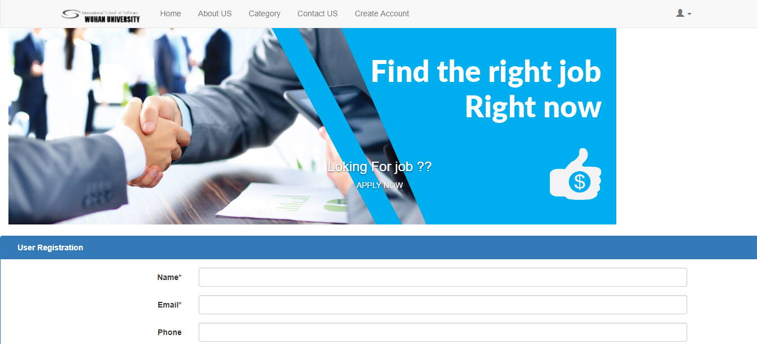
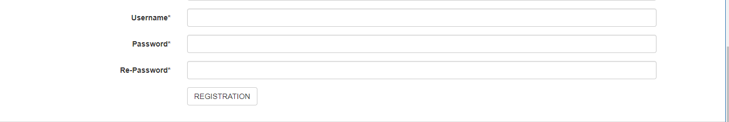
Registration

Slide 14
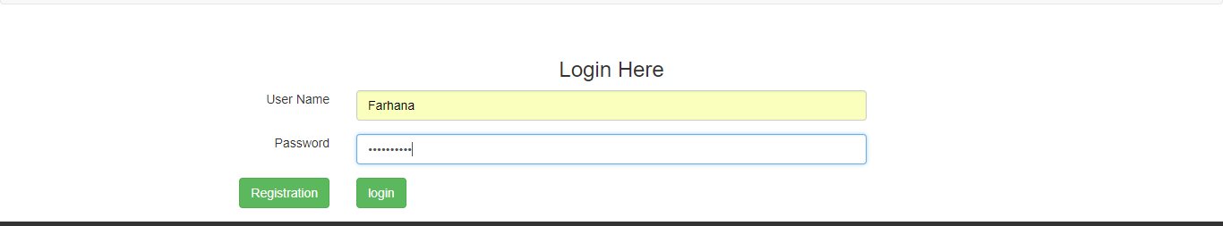
Registration
Log-in

Slide 15

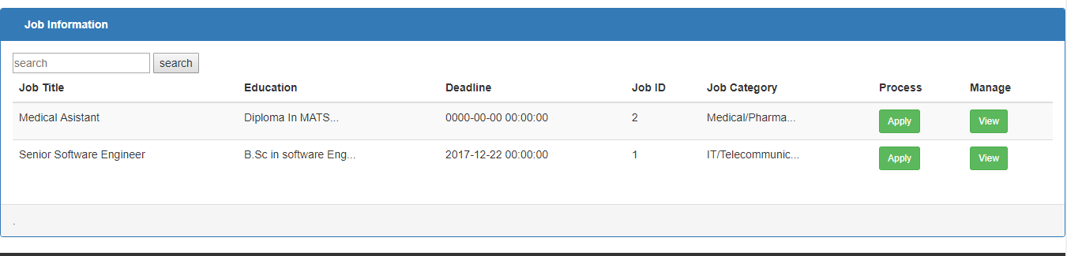
Apply
View
Apply
View

Slide 16
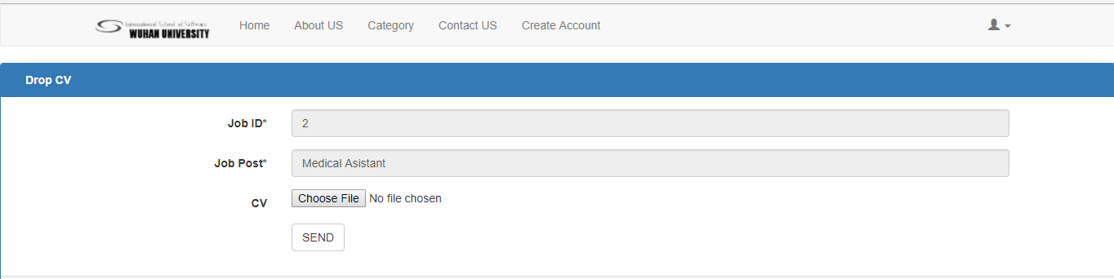
Send

Slide 17
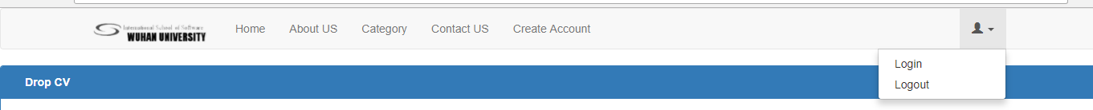
Log Out

Slide 18


