Slide 1
Digital Logic Design
Topic: 4-bit Parallel Adder-Subtractor
Farhana Akter Suci
Lecturer, Uttara University
1
Farhana Akter Suci, Lecturer, Uttara University

Slide 2
4-bit Parallel Adder
Consider a circuit to add two 4-bit numbers together and a carry-in, to produce a 5-bit result:
X₃
X₂
X₁
X₀
Y₃
Y₂
Y₁
Y₀
4-bit
Parallel Adder
C₄
C₀
Black-box view of 4-bit parallel adder
S₃
S₂
S₁
S₀
5-bit result is sufficient because the largest result is:
(1111)₂+(1111)₂+(1)₂ = (11111)₂
2
Farhana Akter Suci, Lecturer, Uttara University

Slide 3
4-bit Parallel Adder
SSI design technique should not be used.
Truth table for 9 inputs very big, i.e. 29=512 entries:
X₃X₂X₁X₀ | Y₃Y₂Y₁Y₀ | C₀ | C₄ | S₃S₂S₁S₀
0 0 0 0 | 0 0 0 0 | 0 | 0 | 0 0 0 0
0 0 0 0 | 0 0 0 0 | 1 | 0 | 0 0 0 1
0 0 0 0 | 0 0 0 1 | 0 | 0 | 0 0 0 1
… | … | … | … | …
0 1 0 1 | 1 1 0 1 | 1 | 1 | 0 0 1 1
… | … | … | … | …
1 1 1 1 | 1 1 1 1 | 1 | 1 | 1 1 1 1
Simplification very complicated as no. of input is 9 so 512(=2⁹) possible combination will be there in truth table!
3
Farhana Akter Suci, Lecturer, Uttara University

Slide 4
4-bit Parallel Adder
Alternative design possible.
Addition formula for each pair of bits (with carry in),
C_{i+1}S_{i} = X_{i} + Y_{i} + C_{i}
has the same function as a full adder.
C_{i+1} = X_{i} Y_{i} + (X_{i} ⊕ Y_{i} ) C_{i}
S_{i} = X_{i} ⊕ Y_{i} ⊕ C_{i}
NB: Similar to FA equation
C = XY + (X⊕Y)Z
S = (X⊕Y)⊕Z
In plain English
Each bit position just adds two input bits plus whatever carry rolled in from the position before it, producing one sum bit and one carry-out bit — that's exactly what a full adder does.
4
Farhana Akter Suci, Lecturer, Uttara University

Slide 5
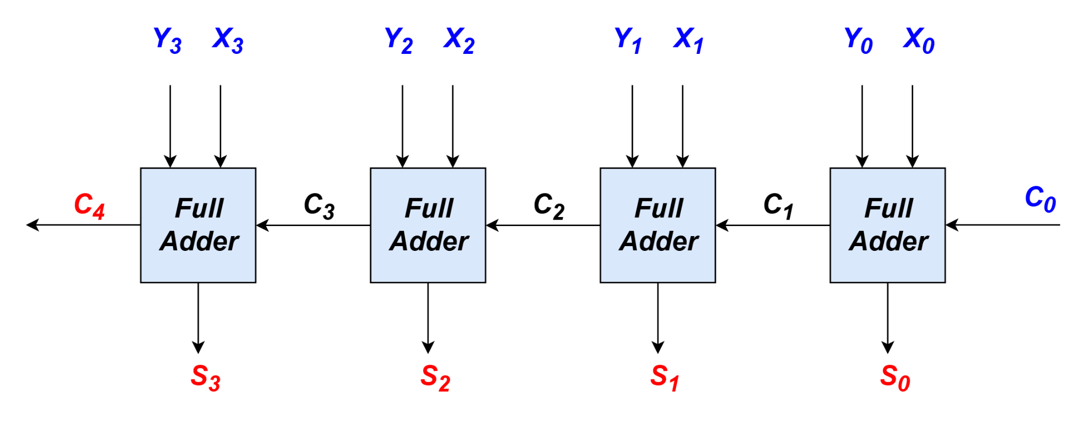
4-bit Parallel Adder
Cascading 4 full adders via their carries, we get:
Input
Output
n-bit parallel adder requires n full- adders
5
Farhana Akter Suci, Lecturer, Uttara University

Slide 6
Examples
Simple examples using 4-bit parallel adder as building blocks:
Adder cum Subtractor
16-Bit Parallel Adder
BCD to excess 3 code converter
6
Farhana Akter Suci, Lecturer, Uttara University

Slide 7
4-bit Parallel Adder-Subtractor
Subtraction can be performed through addition using 2s-complement numbers.
Hence, we can design a circuit which can perform both addition and subtraction, using a parallel adder.
X₃
X₂
X₁
X₀
Y₃
Y₂
Y₁
Y₀
4-bit
Parallel Adder
S: control signal for add/subtract
Result: either X+Y or X-Y
7
Farhana Akter Suci, Lecturer, Uttara University

Slide 8
4-bit Parallel Adder-Subtractor
Design requires:
(i) XOR gates:
Y
Y
Y
Y’
S = 0
S = 1
such that: output = Y when S=0
= Y' when S=1
(ii) S connected to carry-in.
S | Y | Output
0 | 0 | 0
0 | 1 | 1
1 | 0 | 1
1 | 1 | 0
8
Farhana Akter Suci, Lecturer, Uttara University

Slide 9
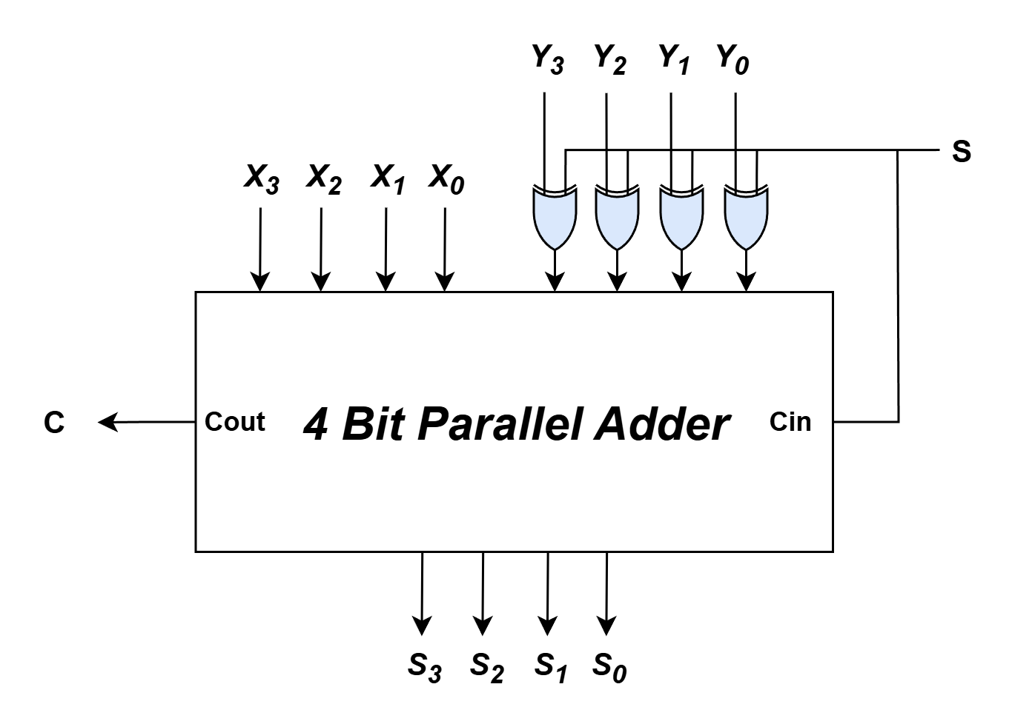
4-bit Parallel Adder-Subtractor
Adder cum subtractor circuit:
Analysis:
If S=1, then
X + (1's complement of Y) +1
appears as the result.
If S=0, then X+Y appears as
the result.
9
Farhana Akter Suci, Lecturer, Uttara University

Slide 10

Example
Applications: Condition Based Adder Subtractor
Design a circuit that takes two binary number A, B and performs A-B, if certain condition is met or else perform A+B
Two Methods
Brute Force Approach: Find the minterms and use the SOP(s) directly
Smart Approach: Find existing patterns within the SOP(s)
10
Farhana Akter Suci, Lecturer, Uttara University

Slide 11
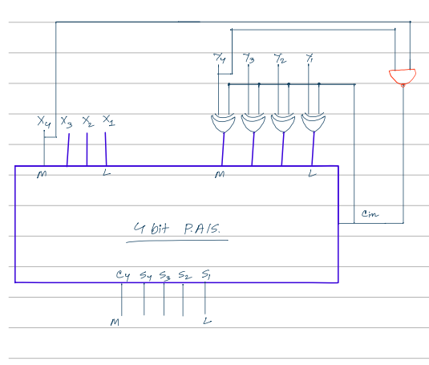
Example
Build a calculator that can add or subtract two 4-bit numbers: X and Y. Now, if both of the numbers are greater than or equal to 8, then the calculator will do the operation X+Y (addition). Otherwise, the calculator will do the operation X-Y(subtraction). Design the circuit using a 4-bit parallel adder-subtractor.
11
Farhana Akter Suci, Lecturer, Uttara University

Slide 12
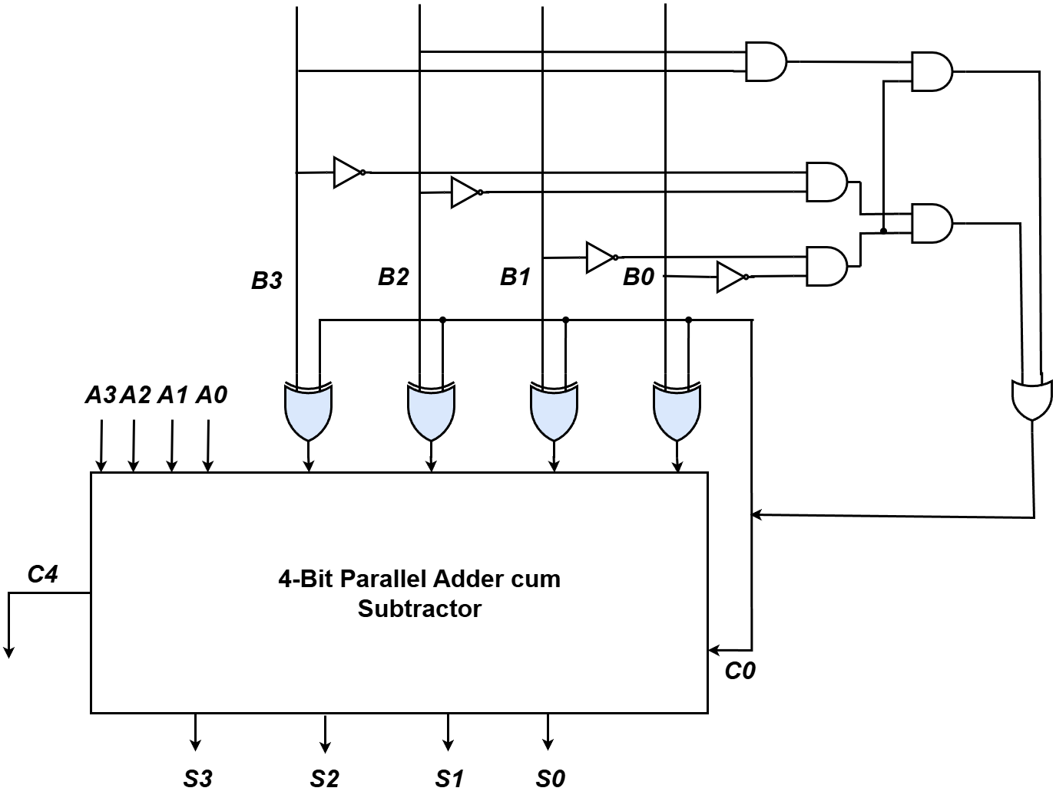
Example
Perform A-B, if B is Divisible by 12 using Brute Force Approach
Minterm | Product
0 | B₃’B₂’B₁’B₀’
12 | B₃B₂B₁’B₀’
Only the numbers 0 and 12 are divisible by 12 among all 4-bit numbers, So the following expression will solve the problem,
F(B₃,B₂,B₁,B₀) = B₃B₂B₁'B₀' + B₃'B₂'B₁'B₀'
If the number of minterm increases, you may use KMAP to simplify the circuit.
12
Farhana Akter Suci, Lecturer, Uttara University

Slide 13
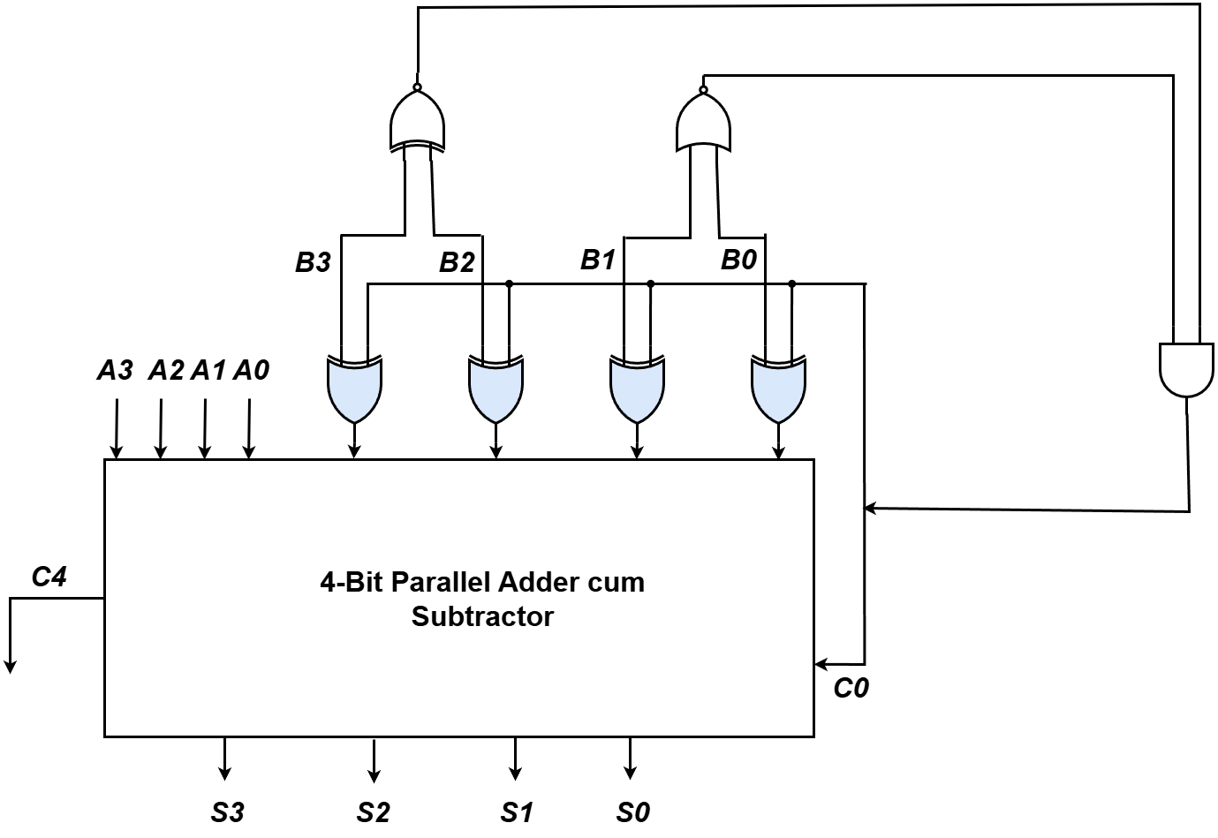
Example
Perform A-B, if B is Divisible by 12 using Patterns
Possible combinations among B₃ and B₂ are 00 and 11, hence XNOR gate was used to combine them as only XNOR gate will provide 1 for these two unique combinations. NOR gate was used for latter variables for the same reason.
Finally, combining them with AND gate ensures the output of the AND gate will only be 1 if the current combination is indeed divisible by 12. If C₀ receives 1 then it will perform A-B.
13
Farhana Akter Suci, Lecturer, Uttara University

Slide 14
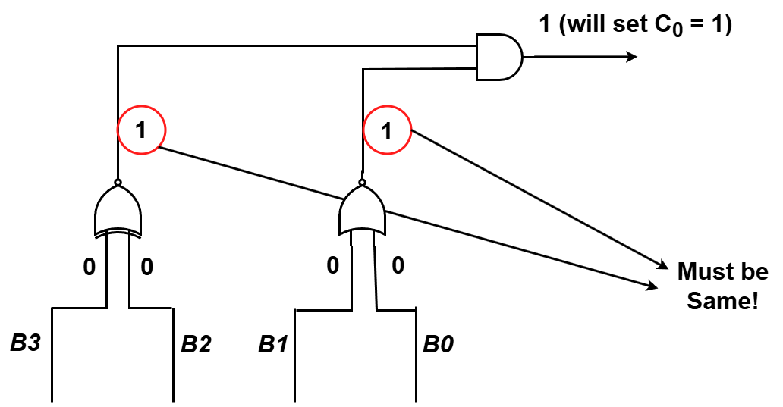
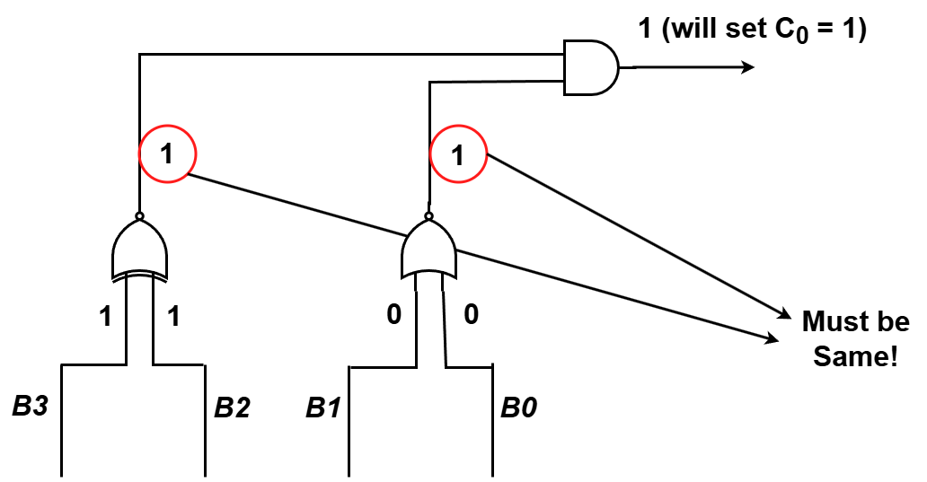
Example
Perform A-B, if B is Divisible by 12 using Patterns (Cont)
The solution is simulated for both valid combinations who are divisible by 12, 0000 and 1100. The red circled elements indicate that the output of the intermediary gates cannot mismatch, any mismatch in those circled outputs means that the current combination is not divisible by 12 and the final output will give 0 which will result in C₀ being 0 hence, performing A+B likewise
14
Farhana Akter Suci, Lecturer, Uttara University

Slide 15
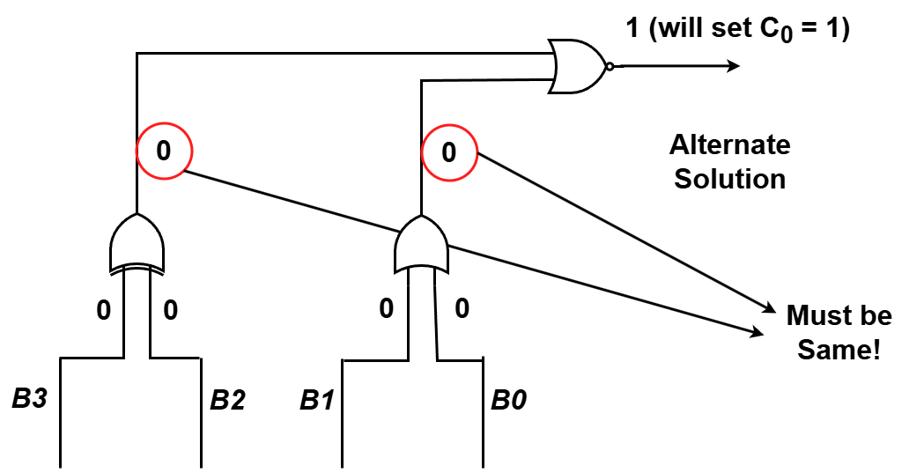
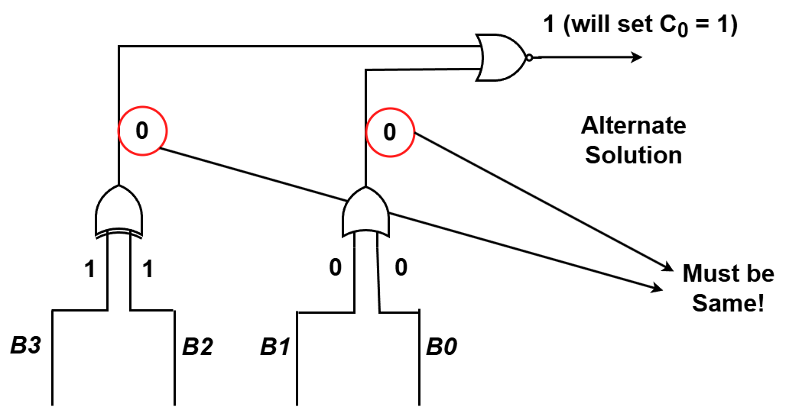
Example
Perform A-B, if B is Divisible by 12 using Patterns (Alternate Solution)
The alternate solution using different logic gates also fulfill the same logic
15
Farhana Akter Suci, Lecturer, Uttara University

Slide 16
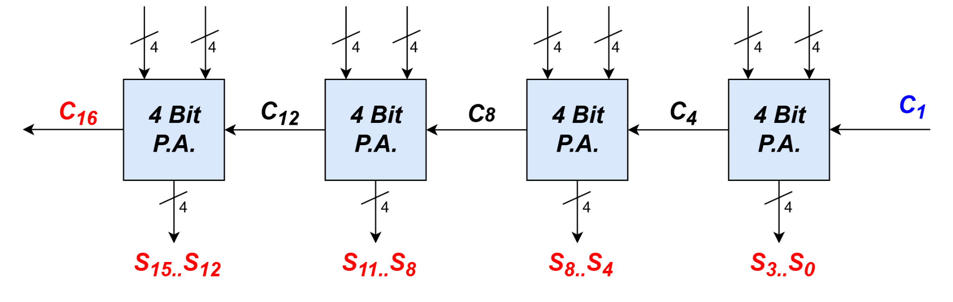
16-bit Parallel Adder
Larger parallel adders can be built from smaller ones.
Example: a 16-bit parallel adder can be constructed from four 4-bit parallel adders:
X₁₅…X₁₂
Y₁₅…Y₁₂
X₁₁…X₈
Y₁₁…Y₈
X₇…X₄
Y₇…Y₄
X₃…X₀
Y₃…Y₀
16
Farhana Akter Suci, Lecturer, Uttara University

Slide 17
16-bit Parallel Adder
Shortened notation for multiple lines.
16-bit parallel adder ripples carry from one 4-bit block to the next.
Such ripple-carry circuits are “slow” because of long delays needed to propagate the carries.
4
is a shortened notation for
S₃ .. S₀
S₃ S₂ S₁ S₀
17
Farhana Akter Suci, Lecturer, Uttara University

Slide 18
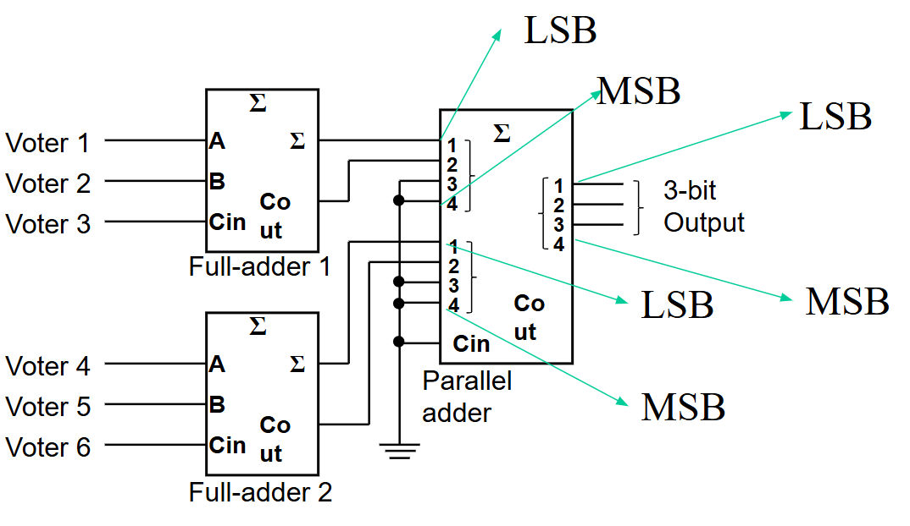
Arithmetic Circuits: Cascading Adders
Application: 6-person voting system.
Use FAs and a 4-bit binary parallel adder.
Each FA can sum up to 3 votes.
18
Farhana Akter Suci, Lecturer, Uttara University

Slide 19
Try it yourself
Example: Using Full adders and 4 Bit Parallel Adder,
Design a 12 person voting system
Design a 13 person voting system, your circuit must be efficient.
Design a 14 person voting system
Using Half Adder and 4 Bit Parallel Adder
Design 10 person voting system. Your circuit must be efficient
19
Farhana Akter Suci, Lecturer, Uttara University

Slide 20
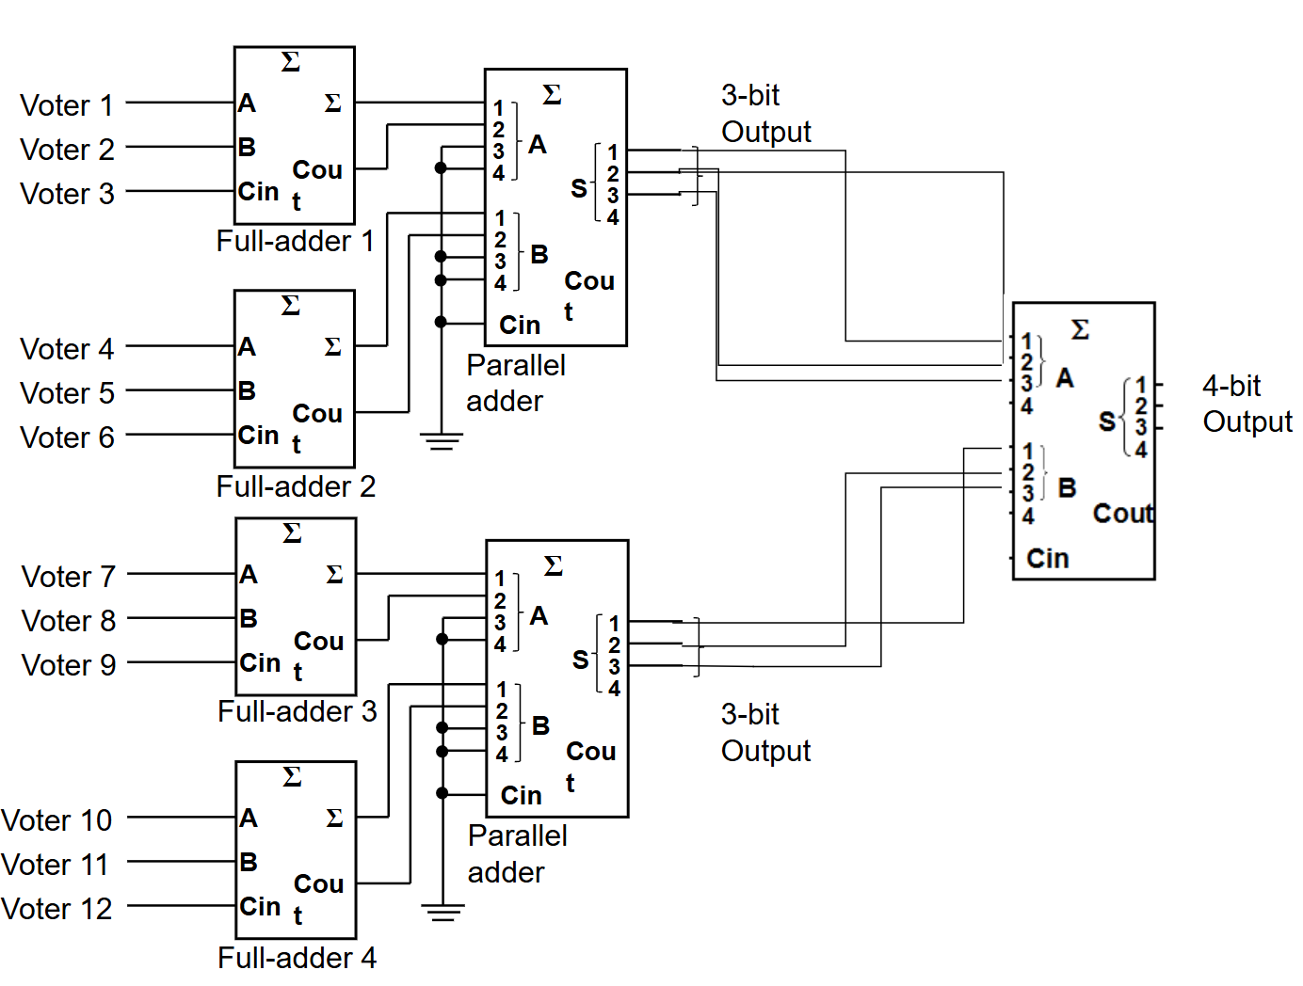
Solution of 1
Design a 12 person voting system
20
Farhana Akter Suci, Lecturer, Uttara University

Slide 21
BCD to excess 3 code converter
Think:
A code converter that will take 4 bit BCD code as input and generate the Excess 3 output using 4 bit parallel adder.
21
Farhana Akter Suci, Lecturer, Uttara University

Slide 22
BCD to excess 3 code converter
Solution:
Inspection of truth table of ‘excess 3 from BCD’ shows that we can get excess-3 code from BCD by adding ‘0011’ to each BCD number. This addition can be implemented by means of 4-bit full adder MSI circuit.
Let, ABCD as BCD input and WXYZ as Excess 3 output
22
Farhana Akter Suci, Lecturer, Uttara University

Slide 23
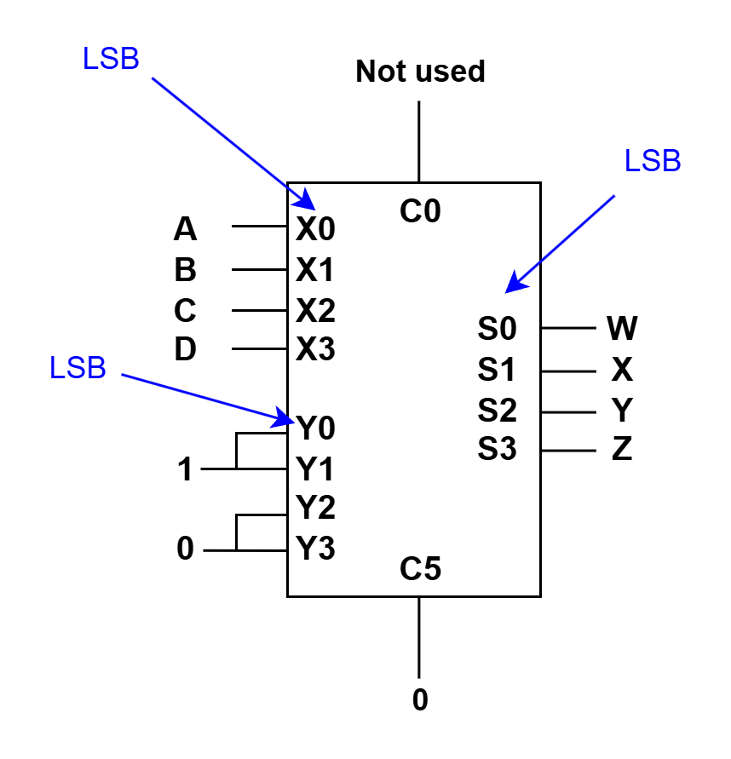
BCD to excess 3 code converter
Solution:
Let, ABCD as BCD input and WXYZ as Excess 3 output
23
Farhana Akter Suci, Lecturer, Uttara University

Slide 24
Code Converters
Code converters – take an input code, translate to its equivalent output code.
Input
code
Code
converter
Output
code
Example: BCD to Excess-3 Code Converter.
Input: BCD digit
Output: Excess-3 digit
24
Farhana Akter Suci, Lecturer, Uttara University

Slide 25
Overflow Detection [Self Study]
An overflow condition can be detected by observing the carry into the sign bit position (C3) and the carry out of the sign bit position (C4).
If these two carries are not equal, an overflow has occurred.
The two carries are applied to an exclusive-OR gate(XOR), an overflow is detected when the output(V) of the XOR gate is equal to 1.
Carry: 0 1
+7 0 111
+6 0 110
____ _____
+48 1 101
Carry: 1 0
-7 1 001
-6 1 010
____ _____
-13 0 011
Carry: 1 1
-3 1 101
-2 1 110
____ _____
-5 1 011
Carry: 0 0
+2 0 010
- 4 1 100
____ _____
-2 1 110
Overflow
Overflow
No Overflow
No Overflow
25
Farhana Akter Suci, Lecturer, Uttara University

Slide 26
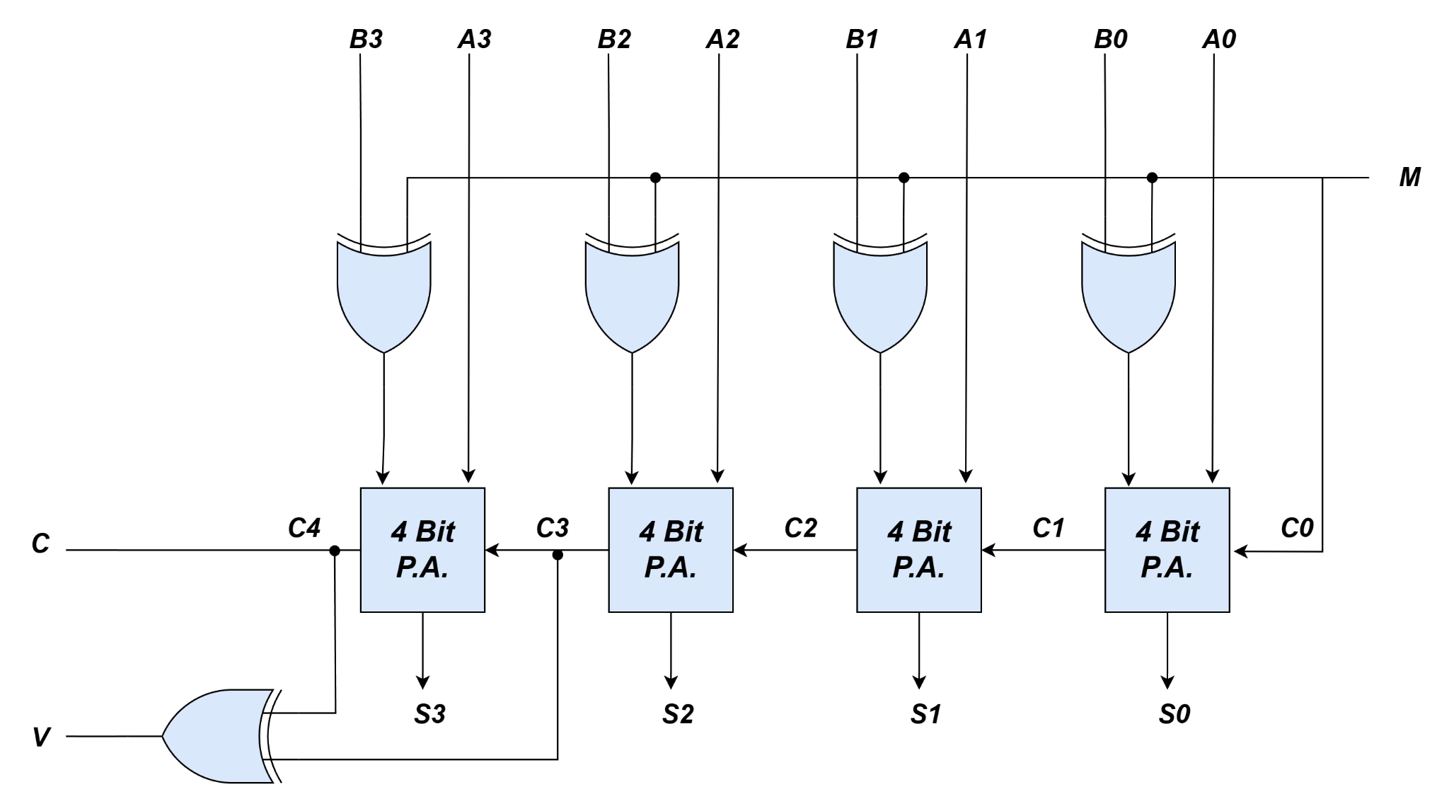
Overflow Detection [Self Study]
Full Adder
Full Adder
Full Adder
Full Adder
Figure: 4-bit Adder-Subtractor with Overflow Detection
26
Farhana Akter Suci, Lecturer, Uttara University

Slide 27
Summary & Key Takeaways
A 4-bit parallel adder chains four full adders through their carries, so an n-bit adder always needs n full adders.
Subtraction reuses the same adder: XOR gates controlled by signal S flip Y into its 1's complement, and S feeds the carry-in, so X + Y' + 1 gives X − Y (2's-complement trick).
Bigger adders scale up by cascading smaller blocks — four 4-bit adders form a 16-bit adder — but ripple-carry designs get slower as carries propagate down the chain.
Conditional add/subtract circuits (e.g. "subtract only if divisible by 12") are built by feeding a logic expression of the inputs into the carry-in/control line.
The same adder building block also powers code converters (e.g. BCD → Excess-3, adding 0011) and overflow detection (XOR of the last two carries, C3 ⊕ C4).
27
Farhana Akter Suci, Lecturer, Uttara University

