Slide 1
1
1
0
1
1
LECTURE SHEET · DIGITAL LOGIC DESIGN
Full Adder
Adding three bits at once — combining two half adders and an OR gate to absorb a carry-in.
Department of Computer Science and Engineering

Slide 2
01 · INTRODUCTION
What is a Full Adder?
A full adder is a combinational arithmetic circuit that adds three single binary digits — X, Y, and a Carry-in — and produces two outputs: Sum (S) — the result bit, and Carry-out (Cout), exactly as when adding a column of digits by hand with a carry from the column before it.
BLOCK DIAGRAM
X
FA
S
Y
C
Unlike a half adder, a full adder accepts a carry-in — which is exactly what lets many of them be chained together into a multi-bit adder.
Cin
X + Y + Cin → Cout Sum
Full Adder | Digital Logic Design
2

Slide 3
Why Not Just a Half Adder?
The half adder can't accept a carry from a previous stage
HALF ADDER
FULL ADDER
2 inputs → 2 outputs
3 inputs → 2 outputs
A
Sum
A
HALF ADDER
FULL ADDER
Sum
Carry
B
B
Cout
Cin
No Cin pin available — it can only add A and B in isolation.
Limitation: chaining half adders alone cannot correctly propagate a carry into the next bit position — the third input is missing.
Solution: the Cin pin absorbs the carry from the previous bit, so full adders chain cleanly into an n-bit adder.
FULL ADDER | DIGITAL LOGIC
3

Slide 4
02 · BEHAVIOR
Truth Table
Eight possible input combinations for three bits — the Sum is 1 when an odd number of inputs are 1; the Carry-out is 1 whenever two or more inputs are 1.
X | Y | Cin | Sum | Cout
0 | 0 | 0 | 0 | 0
0 | 0 | 1 | 1 | 0
0 | 1 | 0 | 1 | 0
0 | 1 | 1 | 0 | 1
1 | 0 | 0 | 1 | 0
1 | 0 | 1 | 0 | 1
1 | 1 | 0 | 0 | 1
1 | 1 | 1 | 1 | 1
Sum = X ⊕ Y ⊕ Cin
Cout = XY + Cin(X ⊕ Y)
Reading the pattern: Sum behaves like a parity-detector (1 when an odd count of bits are set); Carry-out behaves like a majority-detector (1 when two or three inputs are set).
Full Adder | Digital Logic Design
4

Slide 5
Truth Table
All eight combinations of A, B and Cin
A
B
Cin
Sum
Cout
Reading the table
0
0
0
0
0
Sum is 1 whenever an odd number of inputs are 1 (odd parity).
0
0
1
1
0
0
1
0
1
0
Cout is 1 whenever two or more inputs are 1 — a majority function.
0
1
1
0
1
All-1s row (1,1,1) produces Sum = 1 and Cout = 1: 1+1+1 = 11₂.
1
0
0
1
0
1
0
1
0
1
1
1
0
0
1
8 rows total = 2³ combinations for 3 binary inputs.
1
1
1
1
1
FULL ADDER | DIGITAL LOGIC
5

Slide 6
03 · DERIVATION
Boolean Expressions
From the truth table, the Sum-of-Products (SOP) expression is written from the rows where the output is 1, then simplified using the half-adder building blocks:
CARRY
SUM
Cout = XY + Cin(X ⊕ Y)
S = X ⊕ Y ⊕ Cin
Reuses the AND and XOR terms already used for Sum
Chained Exclusive-OR of all three inputs
Why this matters: because Sum reuses the half-adder XOR chain and Carry-out reuses its AND/OR terms, a full adder can be assembled directly from two half adders plus one OR gate — no new expression needs deriving from scratch.
Full Adder | Digital Logic Design
6

Slide 7
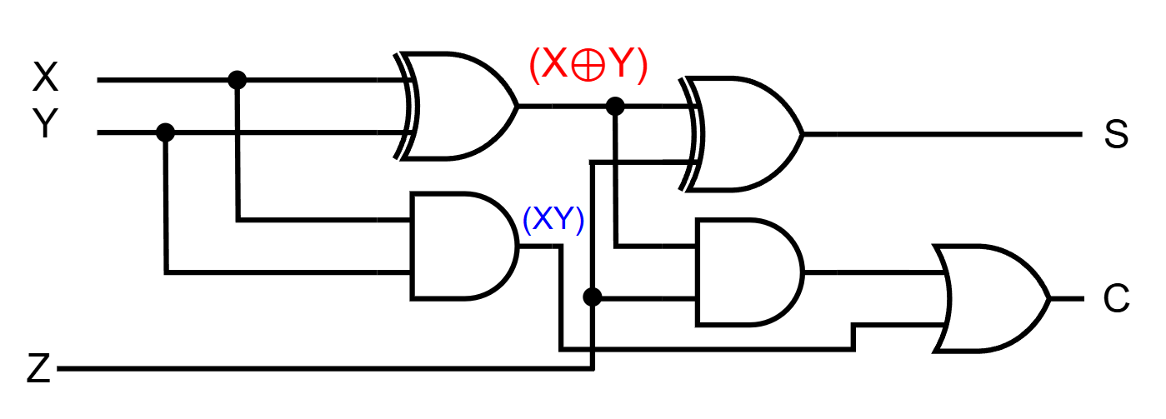
04 · CIRCUIT
Logic Diagram
The full adder is built from two half adders wired in series, plus one OR gate: the first half adder combines X and Y, the second combines that result with the carry-in.
X, Y → first half adder produces an intermediate sum and carry; that sum combines with Cin in the second half adder, while both carry outputs feed the final OR gate.
Full Adder | Digital Logic Design
7

Slide 8
Why It Is Called Full Adder?
Full Adder made from two Half-Adders (+ OR gate).
8
Department of Computer Science and Engineering

Slide 9
05 · EXAMPLE
Worked Example
Add the bits X = 1, Y = 1, and Cin = 1 using full-adder logic:
CARRY
SUM
Cout = 1·1 + 1·(1⊕1) = 1
S = 1 ⊕ 1 ⊕ 1 = 1
RESULT
Carry-out = 1, Sum = 1 — exactly matching ordinary binary addition of three bits (decimal 3).
1 + 1 + 1 = 11
Full Adder | Digital Logic Design
9

Slide 10
06 · IMPLEMENTATION
Alternate Gate Implementations
Real chips are often built from a single gate family, or from smaller pre-built blocks. A full adder can be composed several equivalent ways:
Implementation | Gates Used | Gate Count
Basic (XOR + AND + OR) | 2 XOR, 2 AND, 1 OR | 5 gates
Two half adders + OR | 2 HA, 1 OR | 5 gates
Using only NAND gates | 9 NAND gates | 9 gates
WHY IT MATTERS
Composing a full adder from two half-adder blocks keeps the design modular and easy to verify, while an all-NAND version suits fabs that standardize on one universal gate.
Full Adder | Digital Logic Design
10

Slide 11
08 · USES
Applications
1
2
3
Ripple-Carry Adders
ALUs
Binary Multipliers
Chaining full adders carry-to-carry builds a complete n-bit binary adder.
Forms the core addition stage inside a processor's Arithmetic Logic Unit.
Arrays of full adders sum the partial-product rows of a multiplication.
4
5
6
Subtractor Circuits
Counters & Accumulators
Teaching Foundation
With XOR-controlled inputs, the same adder performs two's-complement subtraction.
Incrementing and running totals reuse the same carry-chain logic.
The natural next step after the half adder for multi-bit arithmetic.
Full Adder | Digital Logic Design
11

Slide 12
SUMMARY
Key Takeaways
Full adder = 2 half adders + 1 OR gate (equivalently, 2 XOR + 2 AND + 1 OR gates directly).
Adds three bits — X, Y, and a Carry-in — and produces a Sum and a Carry-out.
S = X ⊕ Y ⊕ Cin, Cout = XY + Cin(X ⊕ Y)
Accepts a carry-in, so many full adders can be chained together, column by column.
Chaining full adders carry-to-carry forms a ripple-carry adder for multi-bit addition.
Department of Computer Science and Engineering

