Slide 1
1
0
1
1
0
LECTURE SHEET · DIGITAL LOGIC DESIGN
Half Adder
The simplest arithmetic circuit — adding two binary bits with just two logic gates.
Department of Computer Science and Engineering

Slide 2
01 · INTRODUCTION
What is a Half Adder?
A half adder is the simplest arithmetic combinational circuit. It adds two single binary digits, X and Y, and produces two outputs:
Sum (S) — the result bit, and Carry (C) — the overflow bit, exactly as when adding two digits by hand.
BLOCK DIAGRAM
HA
S
X
It's called a “half” adder because it cannot accept a carry-in from a previous addition — only the full adder can do that.
Y
C
X + Y → Carry Sum
Half Adder | Digital Logic Design
2

Slide 3
02 · BEHAVIOR
Truth Table
Four possible input combinations for two bits — the Sum is 1 only when exactly one input is 1; the Carry is 1 only when both inputs are 1.
X | Y | Sum (S) | Carry (C)
0 | 0 | 0 | 0
0 | 1 | 1 | 0
1 | 0 | 1 | 0
1 | 1 | 0 | 1
Sum = XOR(X, Y)
Carry = AND(X, Y)
Reading the pattern: Sum behaves like a difference-detector (1 when bits differ), Carry behaves like an overlap-detector (1 when both are set).
Half Adder | Digital Logic Design
3

Slide 4
03 · DERIVATION
Boolean Expressions
From the truth table, the Sum-of-Products (SOP) expression is written directly from the rows where the output is 1, then simplified:
CARRY
SUM
C = X · Y
S = X'Y + XY' = X ⊕ Y
AND of the two inputs
Simplifies to Exclusive-OR (XOR)
Why this matters: because both outputs reduce to a single 2-input gate each, a half adder needs only 2 gates total — one XOR for the Sum, one AND for the Carry.
Half Adder | Digital Logic Design
4

Slide 5
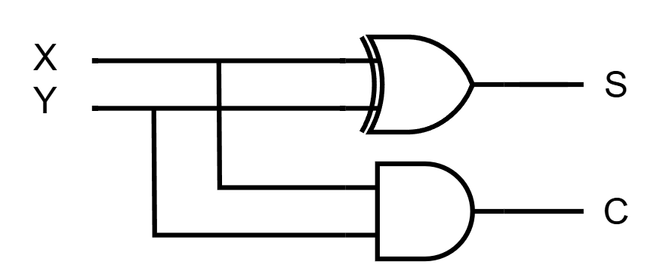
04 · CIRCUIT
Logic Diagram
The Boolean expressions translate directly into hardware: one XOR gate produces the Sum, and one AND gate — fed the same two inputs — produces the Carry.
X, Y → same two inputs feed both gates in parallel — Sum and Carry are computed independently, with no dependency between them.
Half Adder | Digital Logic Design
5

Slide 6
05 · EXAMPLE
Worked Example
Add the bits X = 1 and Y = 1 using half-adder logic:
CARRY
SUM
C = X · Y = 1 · 1 = 1
S = X ⊕ Y = 1 ⊕ 1 = 0
RESULT
Carry bit = 1, Sum bit = 0 — exactly matching ordinary binary addition.
1 + 1 = 10
Half Adder | Digital Logic Design
6

Slide 7
06 · IMPLEMENTATION
Alternate Gate Implementations
Real chips are often built from a single gate family to simplify manufacturing. A half adder can also be built entirely from NAND gates or entirely from NOR gates:
Implementation | Gates Used | Gate Count
Basic (XOR + AND) | 1 XOR, 1 AND | 2 gates
Using only NAND gates | 5 NAND gates | 5 gates
Using only NOR gates | 5 NOR gates | 5 gates
WHY IT MATTERS
Fabs often standardize on one gate type (e.g. NAND) since it's a universal gate — any Boolean function, including XOR and AND, can be built from NAND alone.
Half Adder | Digital Logic Design
7

Slide 8
07 · LIMITATION
Half Adder vs. Full Adder
A half adder can only combine two bits at a time — it has no third input for a carry produced by a previous column. This is exactly what the full adder solves.
Feature | Half Adder | Full Adder
Inputs | 2 (X, Y) | 3 (X, Y, Carry-in)
Outputs | 2 (Sum, Carry) | 2 (Sum, Carry-out)
Gates needed | 1 XOR + 1 AND | 2 XOR + 2 AND + 1 OR
Handles carry-in? | No | Yes
Use case | Least-significant bit pair | Higher-order bits in a multi-bit adder
Half Adder | Digital Logic Design
8

Slide 9
08 · USES
Applications
1
2
3
Full Adder Building Block
Multi-bit Adders
ALUs
Two half adders + one OR gate form a complete full adder.
Forms the least-significant-bit stage of ripple-carry and parallel adders.
Used inside processor Arithmetic Logic Units for bit-level addition.
4
5
6
Counters & Incrementers
Bit Comparison
Teaching Foundation
Applied in digital counter and increment circuits.
XOR output also flags whether two bits differ from each other.
The starting point for understanding all combinational arithmetic circuits.
Half Adder | Digital Logic Design
9

Slide 10
SUMMARY
Key Takeaways
Half adder = 1 XOR gate (Sum) + 1 AND gate (Carry).
Adds exactly two bits; produces a Sum and a Carry.
S = X ⊕ Y, C = X · Y
Cannot accept a carry-in — cannot be chained for multi-bit addition alone.
Two half adders + one OR gate combine to form a full adder.
Department of Computer Science and Engineering

