Slide 1

Lecture 10
CSE0613101: Structured Programming Language

Slide 2
Local Variables
A variable declared in the body of a function is said to be local to the function:
int sum_digits(int n)
{
int sum = 0; /* local variable */
while (n > 0) {
sum += n % 10;
n /= 10;
}
return sum;
}

Slide 3
Local Variables
Default properties of local variables:
Automatic storage duration. Storage is “automatically” allocated when the enclosing function is called and deallocated when the function returns.
Block scope. A local variable is visible from its point of declaration to the end of the enclosing function body.

Slide 4
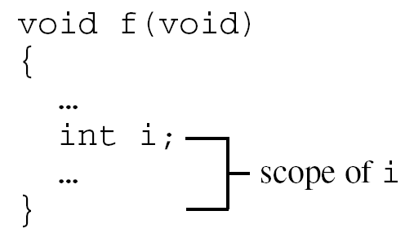
Local Variables
Since C99 doesn’t require variable declarations to come at the beginning of a function, it’s possible for a local variable to have a very small scope:

Slide 5
Parameters
Parameters have the same properties—automatic storage duration and block scope—as local variables.
Each parameter is initialized automatically when a function is called (by being assigned the value of the corresponding argument).

Slide 6
Global Variables
Passing arguments is one way to transmit information to a function.
Functions can also communicate through global variables—variables that are declared outside the body of any function.

Slide 7
Global Variables
Properties of global variables:
Static storage duration
File scope
Having file scope means that an global variable is visible from its point of declaration to the end of the enclosing file.

Slide 8
Pros and Cons of Global Variables
Global variables are convenient when many functions must share a variable or when a few functions share a large number of variables.
In most cases, it’s better for functions to communicate through parameters rather than by sharing variables:
If we change an global variable during program maintenance (by altering its type, say), we’ll need to check every function in the same file to see how the change affects it.
If an global variable is assigned an incorrect value, it may be difficult to identify the guilty function.
Functions that rely on global variables are hard to reuse in other programs.

Slide 9
Pros and Cons of global Variables
Don’t use the same global variable for different purposes in different functions.
Suppose that several functions need a variable named i to control a for statement.
Instead of declaring i in each function that uses it, some programmers declare it just once at the top of the program.
This practice is misleading; someone reading the program later may think that the uses of i are related, when in fact they’re not.

Slide 10
Pros and Cons of global Variables
Make sure that global variables have meaningful names.

Slide 11
Pros and Cons of global Variables
Making variables global when they should be local can lead to some rather frustrating bugs.
Code that is supposed to display a 10 × 10 arrangement of asterisks:
int i;
void print_one_row(void)
{
for (i = 1; i <= 10; i++)
printf("*");
}
void print_all_rows(void)
{
for (i = 1; i <= 10; i++) {
print_one_row();
printf("\n");
}
}
Instead of printing 10 rows, print_all_rows prints only one.

Slide 12
Blocks
Compound statements are of the form
{ statements }
C allows compound statements to contain declarations as well as statements:
{ declarations statements }
This kind of compound statement is also called a block.

Slide 13
Blocks
By default, the storage duration of a variable declared in a block is automatic: storage for the variable is allocated when the block is entered and deallocated when the block is exited.
The variable has block scope; it can’t be referenced outside the block.

Slide 14
Blocks
The body of a function is a block.
Blocks are also useful inside a function body when we need variables for temporary use.
C99 and C++ allows variables to be declared anywhere within a block.

Slide 15
Scope of a variable
Scope refers to the portion of the program in which
It is valid to reference the variable
The variable is visible or accessible

Slide 16
Scope
In a C program, the same identifier may have several different meanings.
C’s scope rules enable the programmer (and the compiler) to determine which meaning is relevant at a given point in the program.
The most important scope rule: When a declaration inside a block names an identifier that’s already visible, the new declaration temporarily “hides” the old one, and the identifier takes on a new meaning.
At the end of the block, the identifier regains its old meaning.

Slide 17
Scope
In the example on the next slide, the identifier i has four different meanings:
In Declaration 1, i is a variable with static storage duration and file scope.
In Declaration 2, i is a parameter with block scope.
In Declaration 3, i is an automatic variable with block scope.
In Declaration 4, i is also automatic and has block scope.
C’s scope rules allow us to determine the meaning of i each time it’s used (indicated by arrows).

Slide 18
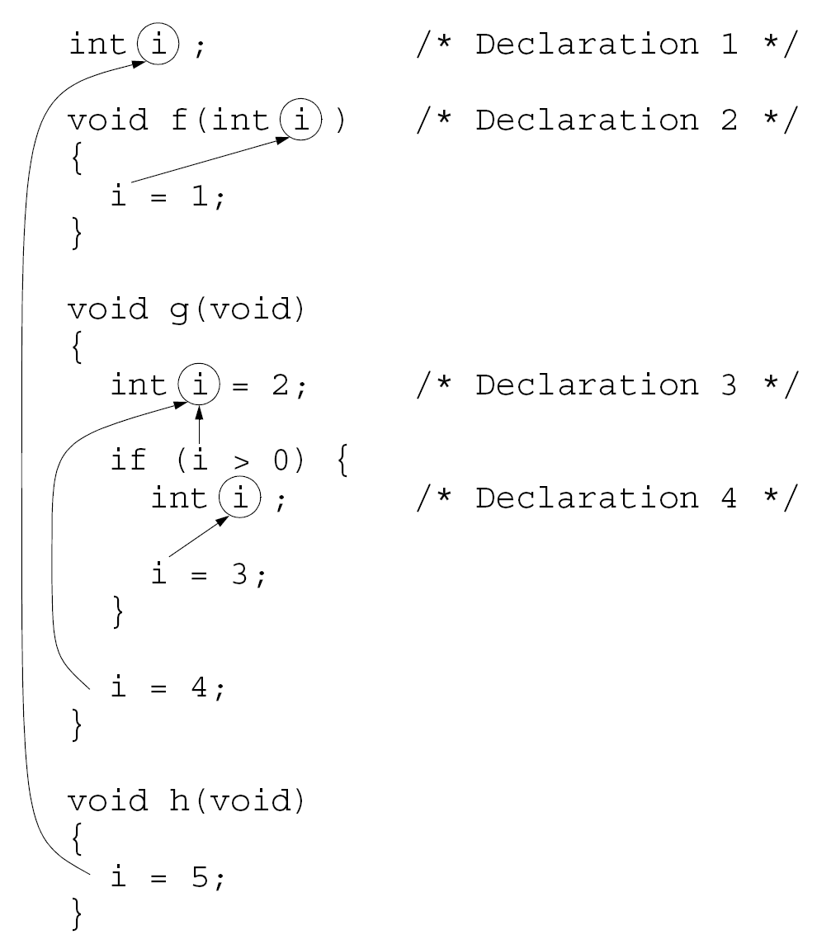

Slide 19
Scope
Local scope
a local variable is defined within a function or a block and can be accessed only within the function or block that defines it
Global scope
a global variable is defined outside the main function and can be accessed by any function within the program file.

Slide 20
Global vs Local Variable
#include <stdio.h>
int z = 2;
void function1()
{ int a = 4;
printf("Z = %d\n",z);
z = z+a;
}
int main()
{ int a = 3;
z = z + a;
function1();
printf("Z = %d\n",z);
z = z+a;
return 0;
}
z=2 5 9 12
a=4
a=3
Output
Z = 5
Z = 9

Slide 21
Scope rules
Identifiers (i.e. variables etc) are accessible only within the block in which they are declared. Example:
{
int a = 2; /* outer block a */
printf(“%d\n”, a); /* 2 is printed */
{
int a = 5; /* inner block a */
printf(“%d\n”, a); /* 5 is printed */
}
printf(“%d\n”, a); /* 2 is printed */
}
A variable that is declared in an outer block is available in the inner block unless it is redeclared, in which case the outer block declaration is temporarily “masked”.

Slide 22
Thank you

