Slide 1

Lecture 6
CSE0613101: Structured Programming Language

Slide 2
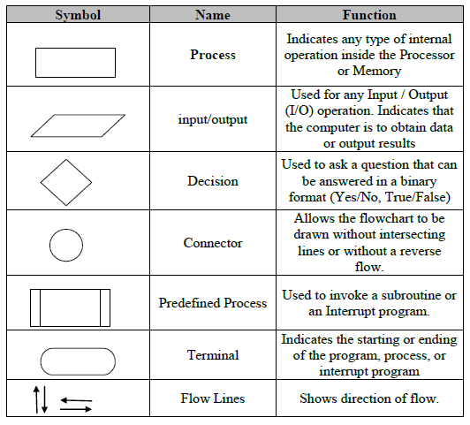
Pseudo-code Notation and Flowchart Symbols

Slide 3
Structured Programming
Use simple control structures to organize the solution to a problem
Sequence
Selection
Repetition
no
yes
no
yes

Slide 4
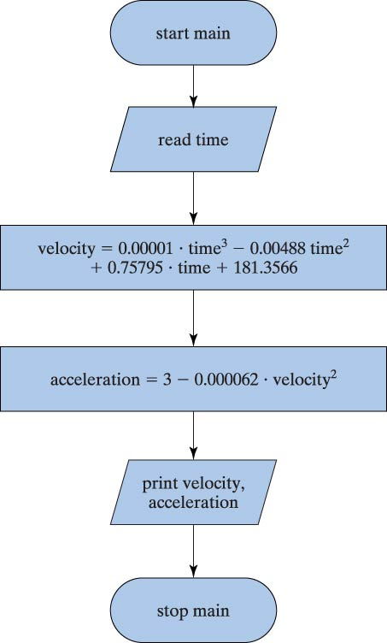
Sequence
Write a program that takes time “T” as input and calculate velocity
V=0.00001.T³-0.00488T²+ 0.75795.T + 181.3566
and acceleration
A =3-0.000062.V²

Slide 5
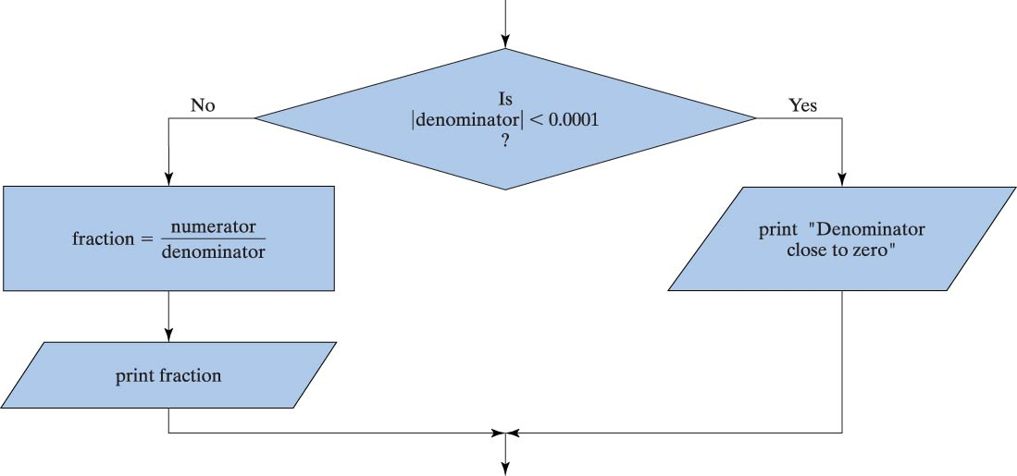
Selection

Slide 6
Conditional Statement
A condition is an expression that can be evaluated to be either
TRUE (any value other than 0) or
FALSE (value of 0)
Conditional Expression is composed of expressions combined with relational and/or logical operators
Conditional statements (selection statements) make decisions based upon the outcome of some condition

Slide 7
Relational Operators
== equality (x == 3)
!= non equality (y != 0)
< less than (x < y)
> greater than (y > 10)
<= less than equal to (x <= 0)
>= greater than equal to (x >= y)
!!! a==b vs. a=b !!!

Slide 8
Examples
A < B
D= b > c;
If (D)
A=b+c;
Mixing with arithmetic op
X+Y >= K/3
4
2
4
3
4
2
1
10
A
B
C
b
c
X
Y
K

Slide 9
Logical Operators
! not !(x==0)
&& and (x>=0) && (x<=10)
|| or (x>0) || (x<0)
A | B | A && B | A || B | !A | !B
False | False | False | False | True | True
False | True | False | True | True | False
True | False | False | True | False | True
True | True | True | True | False | False

Slide 10
Examples
A<B && C>=5
A+B * 2 < 5 && 4>=A/2 || T-2 < 10
A < B < C ????
A<B<C is not the same as
(A<B) && (B<C)

Slide 11
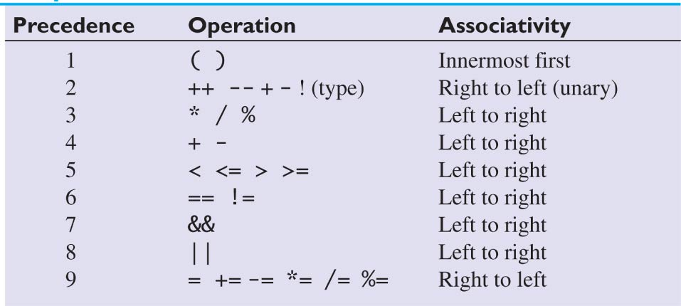
Precedence for Arithmetic, Relational, and Logical Operators

Slide 12
Exercise
Assume that following variables are declared
a = 5.5 b = 1.5 k = -3
Are the following true or false
a < 10.0 + k
a + b >= 6.5
k != a-b
!(a == 3*b)
a<10 && a>5

Slide 13
Selection Statements
if
if else
switch

Slide 14
if statement
The if statement allows the program to conditionally execute a program
General form:
if(Boolean expression)
statement; /* single statement */
if(Boolean expression) {
/* more than one statement */
statement1;
…
statement n;
}

Slide 15
if statement
The if statement allows the program to conditionally execute a program
The expression can be any valid C expression
If the expression is evaluated as true, the statements will be executed
Otherwise, the statement is bypassed, and the line of code following the if is executed.
An expression is true, if it is evaluated to non-zero value
If it evaluates to zero, it is false
Commonly, The expression inside the if compares one value with another using relational operator

Slide 16
The if Selection Flowchart
if statement is a single-entry/single-exit structure
A decision can be made on any expression.
zero - false
nonzero - true
Example:
3 - 4 is true
true
grade >= 60
print “Passed”
false

Slide 17
if statement
Example:
if(10>9)
printf(“true”);
if(5>9)
printf(“this will not print”);
if(1)
printf(“not zero!”);
What will be the output?

Slide 18
if else statement
Using the if else statement, if the expression is true, then the statements under if will execute, and the else portion will be skipped
If the statement is false, then the target of the if is bypassed and the target of the else is executed
Under no circumstance, both statements will execute

Slide 19
if else statement
General form:
if(Boolean expression)
statement;
else
statement;
if(Boolean expression) {
statement block
}
else {
statement block
}

Slide 20
The if…else Selection Statement
Flowchart of the if…else selection statement
false
true
grade >= 60
print “Failed”
print “Passed”

Slide 21
The if…else selection statement
Example:
if ( grade >= 60 )
printf( "Passed\n");
else
printf( "Failed\n");

Slide 22
if else statement
What does the following program do?
Assume that x, y, temp are declared.
int x=10, y=20, temp;
if (x > y)
temp = x;
else
temp = y;

Slide 23
Compound Statements
To make an if statement control two or more statements, use a compound statement ( statement block)
A compound statement has the form
{ statements }
Putting braces around a group of statements forces the compiler to treat it as a single statement.

Slide 24
Compound Statements
A compound statement is usually put on multiple lines, with one statement per line:
{
line_num = 0;
page_num++;
}
Each inner statement still ends with a semicolon, but the compound statement itself does not.

Slide 25
Example
if(value > 0)
{
result = 1.0 / value;
printf("Result = %f\n", result);
}
Will these two sections of code work differently?
if(value > 0)
result = 1.0 / value;
printf("Result = %f\n", result);

Slide 26
Example
Yes!
if(value > 0)
{
result = 1.0 / value;
printf("Result = %f\n", result);
}
Will always execute!
if(value > 0)
result = 1.0 / value;
printf("Result = %f\n", result);

Slide 27
Nested if statement
When an if statement is the target of another if or else, it is said to be nested within the outer if
Example:
if(count>max) /*outer if*/
if(error)printf(“error, try again.”);
/* nested if*/
Here, the printf() statement will execute only if count is greater than max and error is nonzero

Slide 28
Nested if statement
Another example:
if(p)
if(q)
printf(“a and b are true”);
else
Printf(“to which statement does this else apply?”);
An else always associates with the nearest if in the same block, which does not already have and else associated with it

Slide 29
Indentation
int a = 750;
if (a>0)
if (a >= 1000)
a = 0;
else
if (a <500)
a *= 2;
else
a *= 10;
else
a += 3;
int a = 750;
if (a>0)
if (a >= 1000)
a = 0;
else
if (a <500)
a *= 2;
else
a *= 10;
else
a += 3;
Good
Not good

Slide 30
If else if ladder
General form:
if(expression)
statement;
else if (expression)
statement;
else if (expression)
statement;
…
else
statement;

Slide 31
If else if ladder
The expressions are evaluated from the top downward
As soon as a true condition is found, the statement associated with it is executed, and the rest of the ladder is bypassed
If none of the expressions are true, the final else will be executed

Slide 32
Example
Write a program that takes a number as input, and prints whether the number is positive, negative or 0;
#include<stdio.h>
int main(){
int val;
scanf(“%d”,&val);
if(val < 0)
printf(“Negative value”);
else if(val == 0)
printf(“A value of zero”);
else
printf(“positive value”);
return 0;}

Slide 33
Switch statement
switch statement is the C’s multiple selection statement
It is used to select one of several alternative paths in program
A expression is matched against a list of constants
When a match is found, the statement associated with that match is executed

Slide 34
Switch statement
General form:
switch(int expression) {
case constant1 :
statement(s);
break;
case constant2 :
statement(s); break;
/* you can have any number of case statements */
default : /* Optional */
statement(s); }

Slide 35
Example
#include <stdio.h>
void main()
{
int gender;
printf("Enter your gender (male=1, female=2): ");
scanf("%d",&gender);
switch(gender) {
case 1:
printf("You are male\n");
break;
case 2:
printf("you are female\n");
break;
default:
printf(" invalid input\n");
break;}
}

Slide 36
Thank you

